Slide 1
Preventing Memory Leaks in Javascript
Peter Lukarov
Mitchell Aharon

Slide 2
Motivation: the Dangers of Javascript
Web Apps more complex (eg, AJAX)
Browser Windows Remain Open for Longer

Slide 3
Common Causes of MemLeaks
Closures
Circular References
Cross-Page Leaks
XmlHttpRequest()

Slide 4
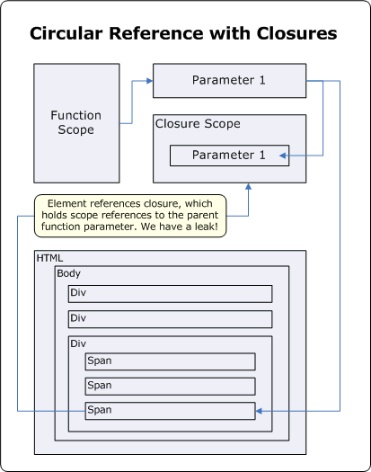
Closures
<head>
<script type="text/javascript">
function AttachEvents(element)
{
// This structure causes element to ref ClickEventHandler
element.attachEvent("onclick", ClickEventHandler);
function ClickEventHandler()
{
// This closure refs element
document.getElementById("LeakedDiv").innerHTML = “ ";
}
}
function SetupLeak()
{
// The leak happens all at once
AttachEvents(document.getElementById("leakedButton"));
}
</script>
</head>
<body onload="SetupLeak()">
<div>
<div id="buttonContainer">
<input id="leakedButton" type="button" value="Leak" />
</div>
</div>
</body>

Slide 5
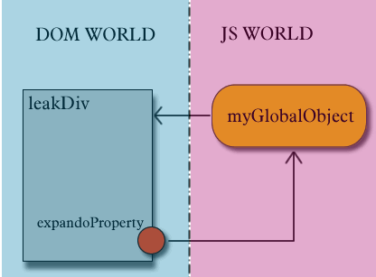
Circular Reference
<head>
<title></title>
<script type="text/javascript">
var myGlobalObject;
function SetupLeak()
{
// First set up the script scope to element reference
myGlobalObject = document.getElementById("LeakedDiv");
// Next set up the element to script scope reference
document.getElementById("LeakedDiv").expandoProperty =
myGlobalObject;
}
</script>
</head> <body onload="SetupLeak()">
<div>
<div id="LeakedDiv">
Leaked Div
</div>
</div> </ body>

Slide 6
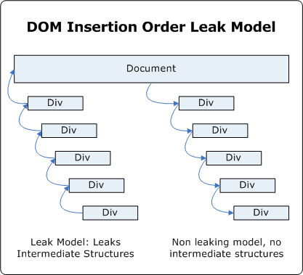
Cross-Page Leaks
<script type="text/javascript">
function LeakMemory()
{
var hostElement = document.getElementById("hostElement");
// Do it a lot, look at Task Manager for memory response
for (i = 0; i < 5000; i++)
{
var parentDiv =
document.createElement("<div onClick='foo()'>");
var childDiv =
document.createElement("<div onClick='foo()'>");
// This will leak a temporary object
parentDiv.appendChild(childDiv);
hostElement.appendChild(parentDiv);
hostElement.removeChild(parentDiv);
parentDiv.removeChild(childDiv);
parentDiv = null;
childDiv = null;
}
hostElement = null;
}
</script> <body>
<div id="buttonContainer">
<button onclick="LeakMemory()">
Memory Leaking Insert
</button>
</div>
</body>

Slide 7
Common Causes of MemLeaks
Closures
Circular References
Cross-Page Leaks
XmlHttpRequest()

Slide 8
Questions

