Slide 1

Beyond the Box: Distributed Computing with ZeroMQ
Paulmichael Blasucci
Senior Software Engineer at
Notes:
About the presenter:
Co-founder of the Nashville F# Meetup (NashF#)
Co-organizer of NYC F# Users Group
Discovered ZeroMQ in 2010
Creator of F# ZeroMQ binding (fszmq)

Slide 2

Collaboration
Some background on ZeroMQ
Notes:
About ZeroMQ:
ZeroMQ is NOT middleware (i.e. it's not a message queue)
ZeroMQ can be used anytime logic needs to be split (threads, processes, machines, networks)
"Sockets" aren't really like actual (network) sockets... even if they seem familiar
Build in layers
Wire protocol sits just above transport protocol (ZMTP)
Socket behavior sits just above wire protocol (libzmq)
App code sits just above socket behavior
Communication and community
FOSS
Designed and built by members of AMQP team
Well-defined protocols
Vibrant community (ZeroMQ GitHub org: 374 unique contributors - 12 Jun 2014)
Written in portable C/C++
Native "ports" to Java, C#, Erlang
45+ language bindings

Slide 3
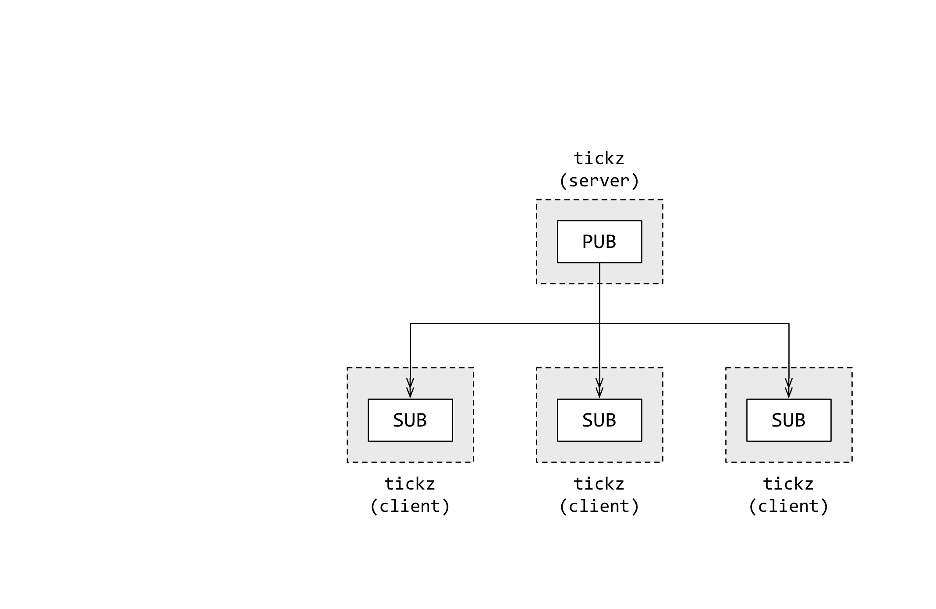
Composition
tickz: soft real-time stock ticker
C streamer w/ VB subscribers
Networks of Sockets
Well-defined message-exchange behavior
Passing Messages
One or more frames of zero or more bytes
Ignorant of transport
Notes:
Basic ZeroMQ Concepts:
Sockets passing (sending/receiving) messages
Sends or Receives messages according to socket type
Message transmission may be blocking or non-blocking
send/recv vs poll
Connects or Binds to an endpoint according to topology
No shared state
Binary data (0 or more bytes) — app provides meaning
Transport Unification
Change transport by changing address (string)
Popular transports include
TCP
IPC — doesn’t work on Windows!
InProc (actor-based multi-threading)
One node (i.e. process, context, et cetera) can have many sockets
Combining sockets helps separate concerns
Combining sockets improves overall flexibility

Slide 4
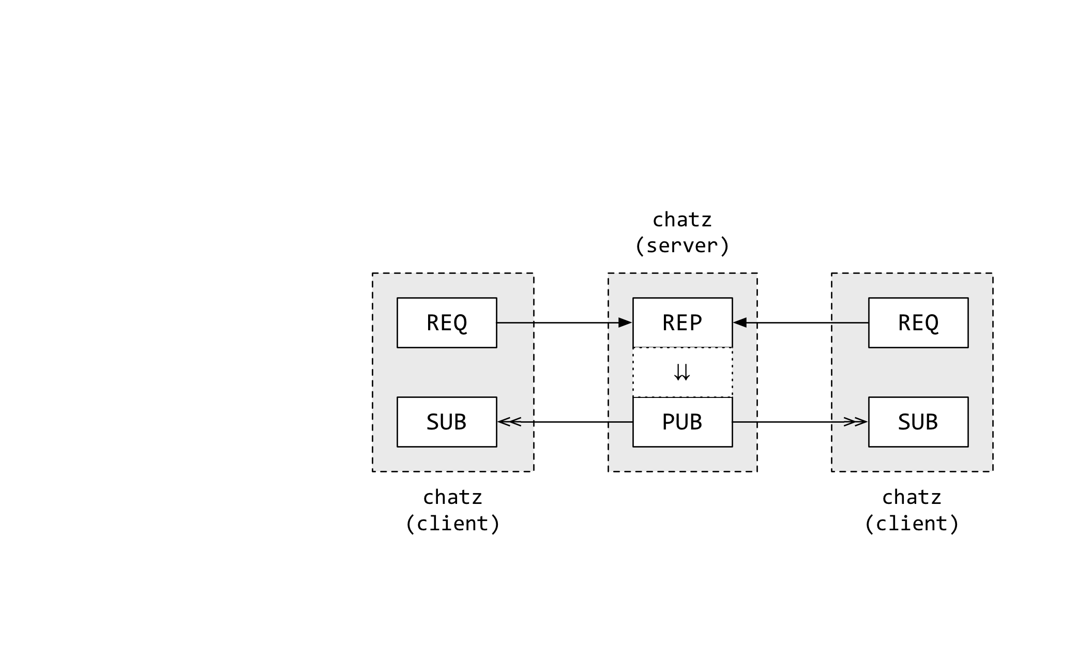
Communication
chatz: group-wide instant messaging
Rust server w/ C# clients
Socket roles
Transmission pattern
Routing strategy
Overflow behavior
Most common peers:
REP/REQ
PUB/SUB
PUSH/PULL
Notes:
ZeroMQ in detail:
Message-exchange patterns
Determined by connecting certain Socket "roles"
Client/Server
Remote procedure call
Workflow (parallel, repeat, et cetera)
Data distribution
Socket role
Determines message-exchange behavior
send/recv pattern
routing strategy
compatible peers
"mute state" action
Basic socket roles
REQ strictly synchronous send/recv, zmq handles tracking
REP strictly synchronous recv/send, zmq handles tracking
PUSH send messages downstream
PULL recv upstream messages
PUB send topical data
SUB recv topical data, filtered by topic

Slide 5
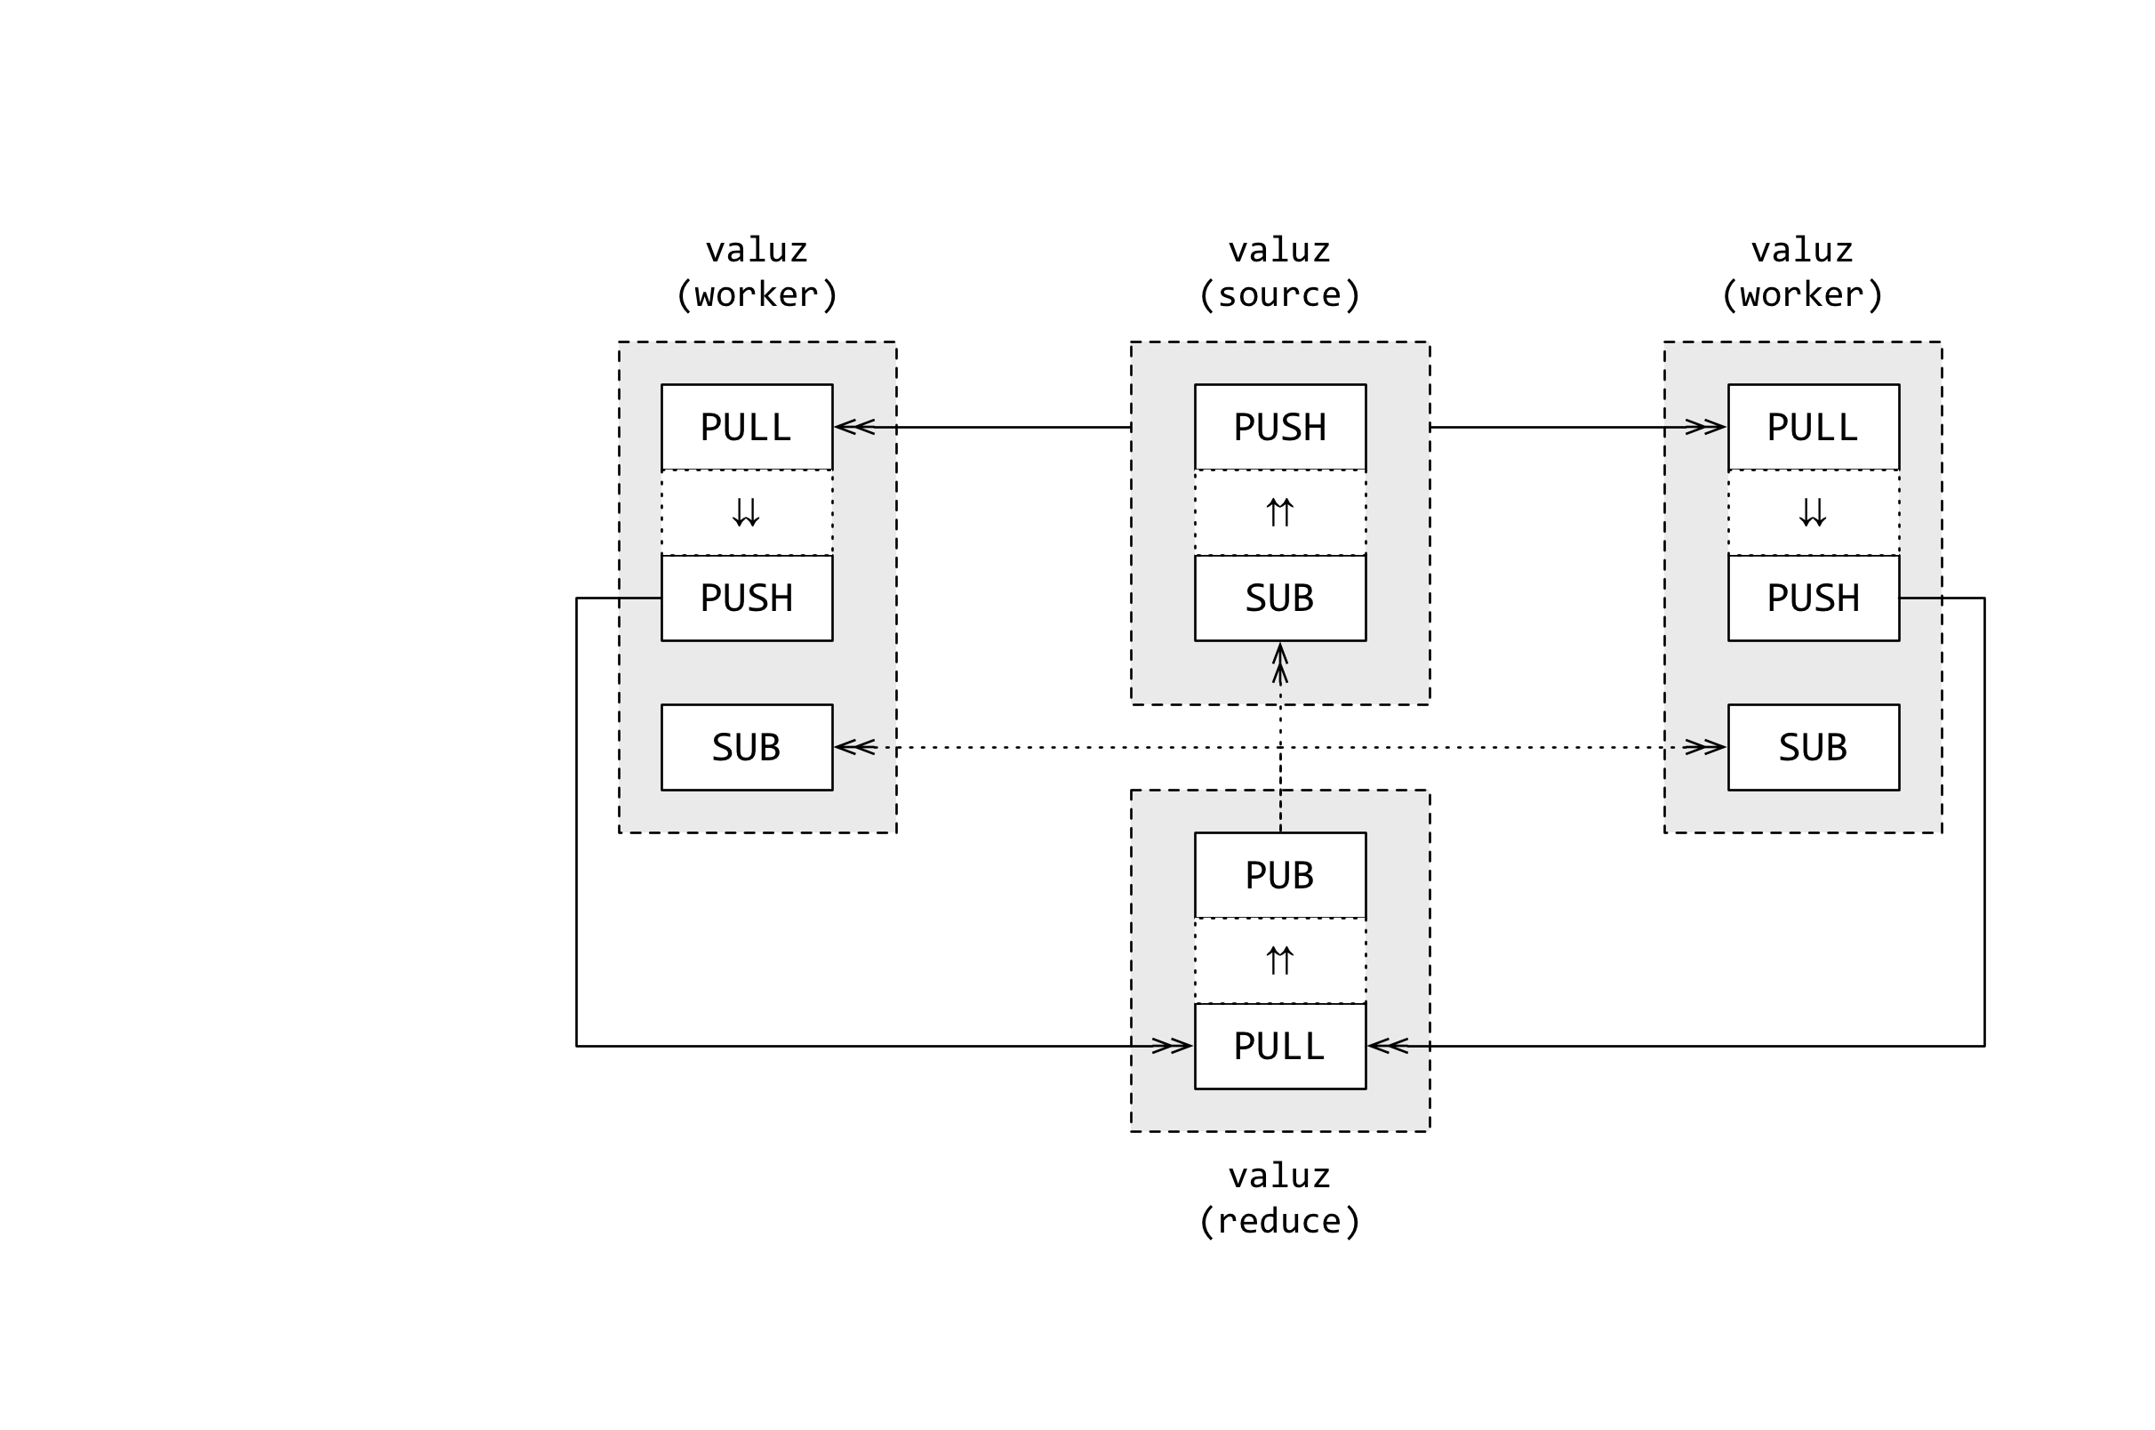
Coordination
valuz: “big data” computation
Haskell workers w/ Python mgmt
Context manages sockets
Thread-safe
Typically one per node
Guaranteed delivery of all Message frames (or none!)
Advanced peers:
DEALER/ROUTER
XPUB/XSUB
Notes:
More important concepts:
Context
Heavyweight (thread-safe)
Sockets are lightweight (NOT thread-safe)
"Owns" Sockets
IS TRANSPORT for INPROC channels
Multiple contexts in one process is like multiple processes
Multi-part messages
Framing for structure (1 or more frames)
Must fit in memory
Guaranteed to be delivered whole or not at all
Advanced socket roles
DEALER interleaved send/recv, app must do tracking
ROUTER interleaved recv/send, app must do tracking
XPUB like PUB, but subscription info is shared
XSUB like XSUB, but subscription info is shared

Slide 6
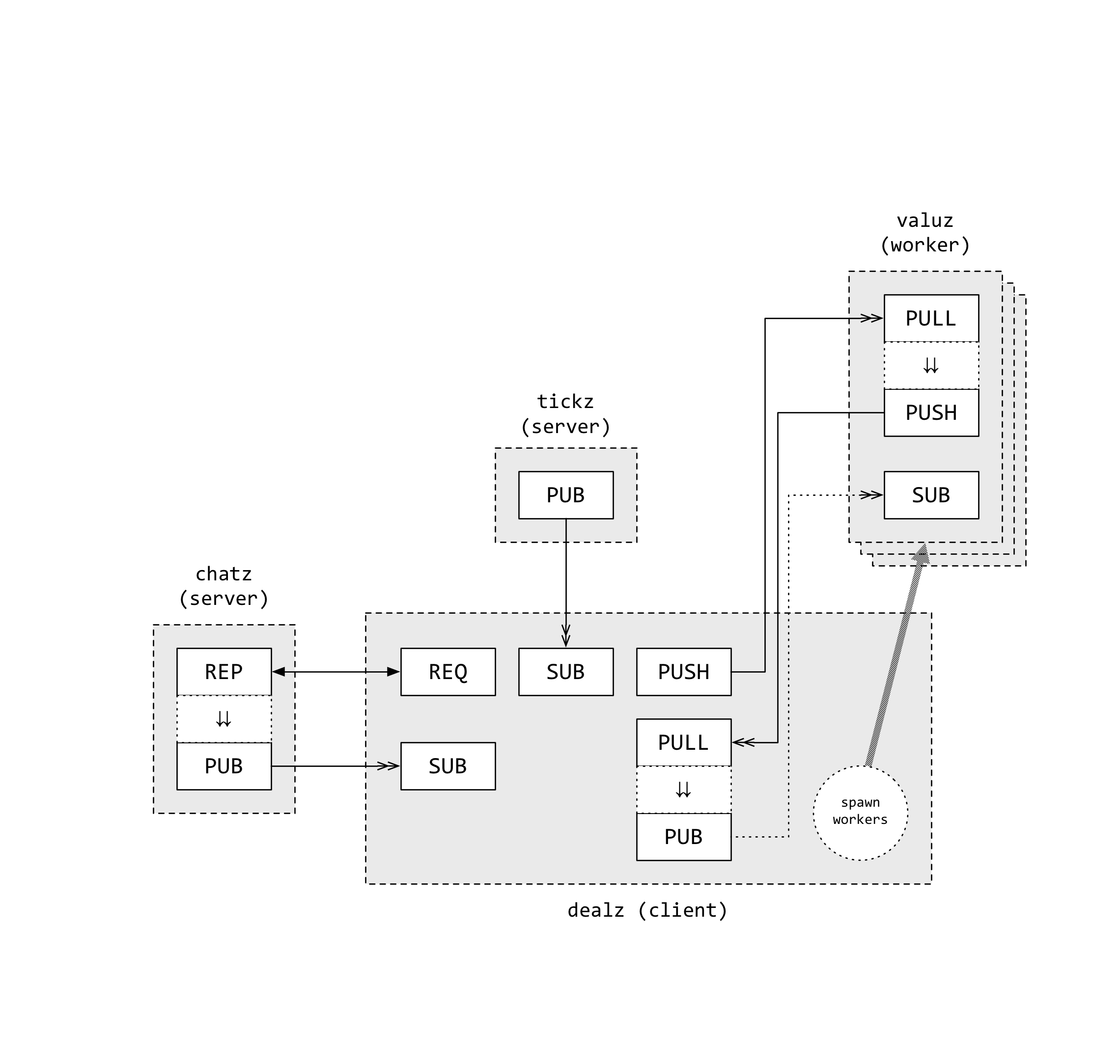
Complexity
dealz: putting it all together
F# client & mgmt w/ tickz, chatz, valuz
Proxy
See also: streamer, forwarder, et cetera
Monitor
Socket-level
Process-local
Notes:
Useful tooling
Proxy
In-the-box abstraction for shuttling messages between sockets
Also called: device, streamer, queue, forwarder
Not useful for custom routing logic
Diagnostics
Exposed at the Socket-level
Stream of events delivered via PAIR to a dedicated thread

Slide 7
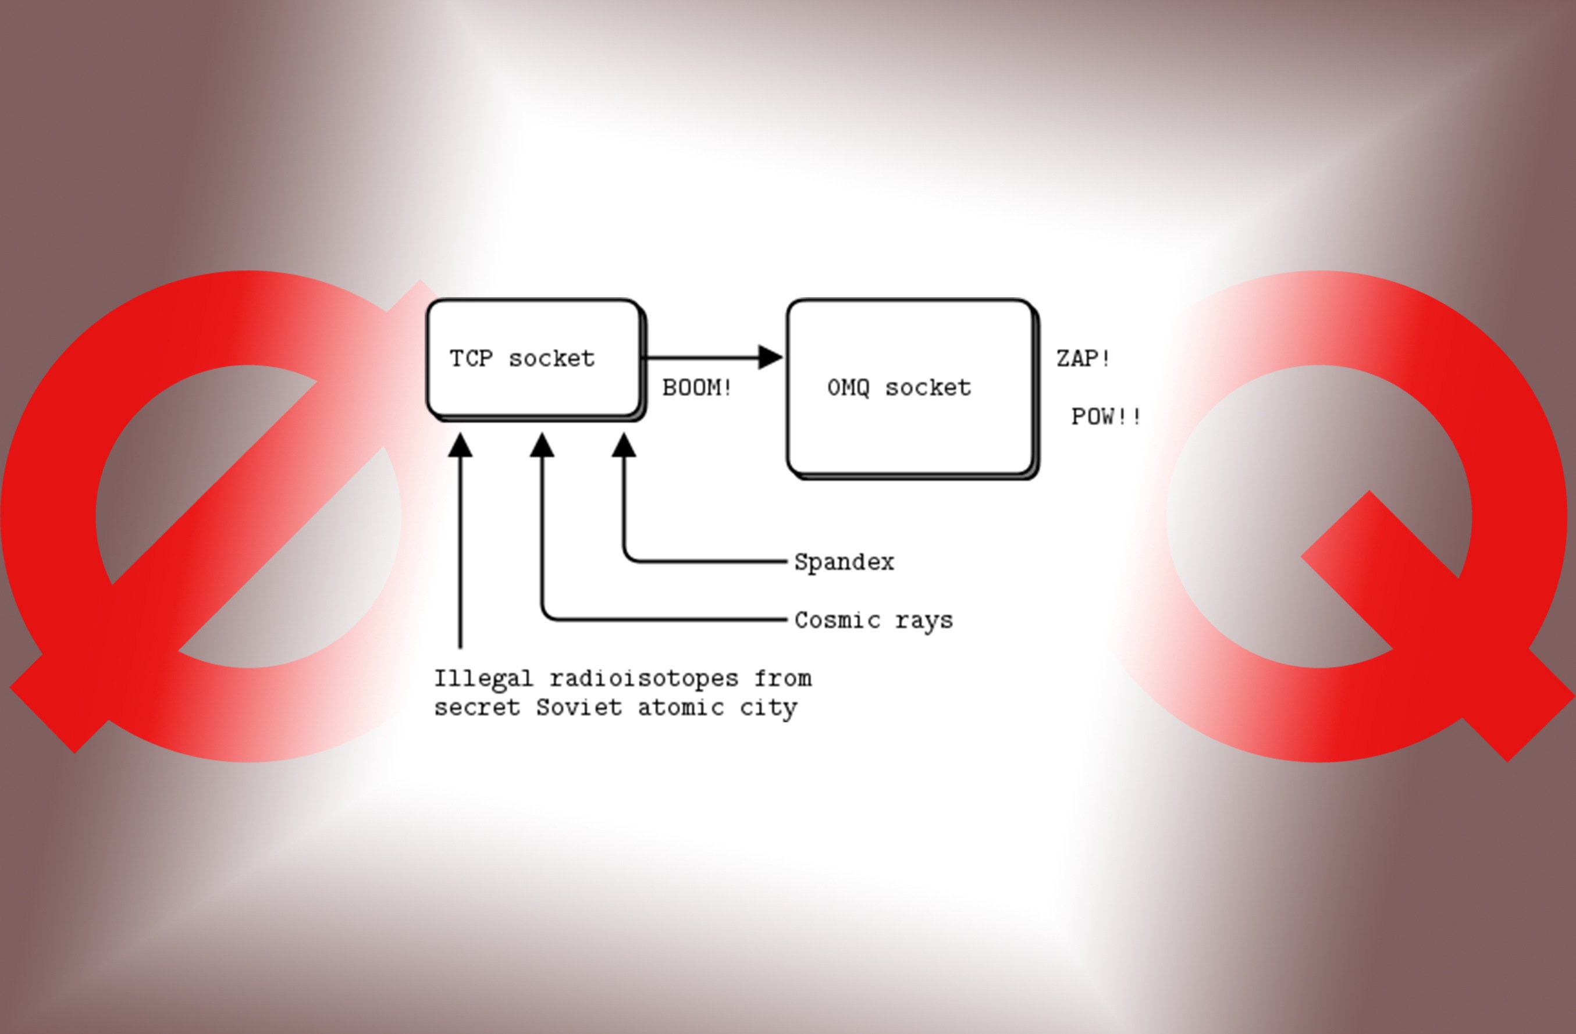
Continuation
For further details visit: http://zeromq.github.io/fszmq
Notes:
Things we didn't cover
Other protocols
PGM multicast
EPGM multicast
Other sockets
STREAM connect to non-ZeroMQ peers via TCP
Security framework
Available from ZMTP v3
SASL conformant
peers, arbitrarily, become "clients" or "servers"
Extensible mechanism with 3 defaults
NULL no security at all (same as older versions of ZMTP)
PLAIN username/password over plaintext, useful for internal networks or with transport-level encryption (e.g. VPN)
CURVE CurveCP handshake, adapted for TCP (elliptic curve crypto + perfect-forward secrecy)
Pluggable authenticators (INPROC nodes) via well-defined protocol

Slide 8
Paulmichael Blasucci
PaulBlasucci@QuickenLoans.com
Senior Software Engineer at
twitter.com/pblasucci
github.com/pblasucci
linkedin.com/in/pblasucci

