Slide 1

For All Code, There Exist Properties to be Checked (or, Random Testing with FsCheck)
Paulmichael Blasucci, Senior Software Engineer at
twitter.com/pblasucci github.com/pblasucci linkedin.com/in/pblasucci
Notes:
About the presenter
Has been building software professionally for over 17 years
Senior software engineer at Quicken Loans
Co-founder of the Nashville F# Meetup
Co-organizer of the NYC F# Users Group
2014 Microsoft .NET MVP

Slide 2
Random Testing
“Properties are described as … functions, and can be automatically tested on random input... [or] custom test data generators.”
from ICFP’00 – Claessen, Hughes
Notes:
About property-based testing
Originated with QuickCheck (in Haskell)
Since ported to many many languages
This session covers library for use with F#, C#, VB.NET, et cetera
Well-suited to functional programming, but useful with other paradigms
Especially with pure functions (also referentially transparent functions)
Allows very granular testing (and implicit guarantees via composition)

Slide 3
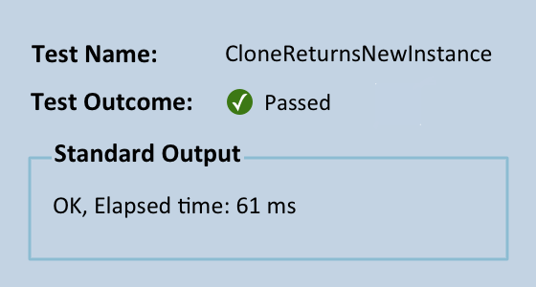
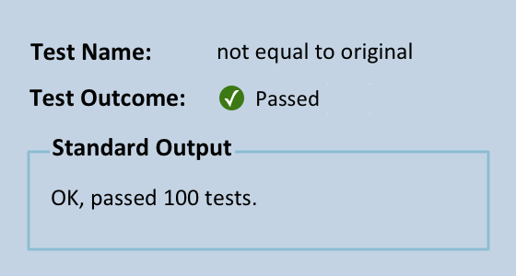
From Unit Testing…
To Property Testing!
[<Test>]
let CloneReturnsNewInstance ()
use msg1 = new Message("test"B)
use msg2 = Message.clone msg1
(msg2 <> msg1) |> Assert.True
[<Property>]
let ``not equal to original`` data
use msg1 = new Message(data)
use msg2 = Message.clone msg1
msg2 <> msg1
`
`
Notes:
Introducing FsCheck
Uses random data and logical propositions to prove or disprove behavior
Simple eDSL for logical propositions
API for steering data generation
API for observing distributions of generated data
With or without other testing tools
Failing tests can raise exceptions, providing compatibility with: xUnit, Nunit, et cetera
Does not obviate the need for other types of testing
TDD works with specific examples, while PBT works with universal properties

Slide 4
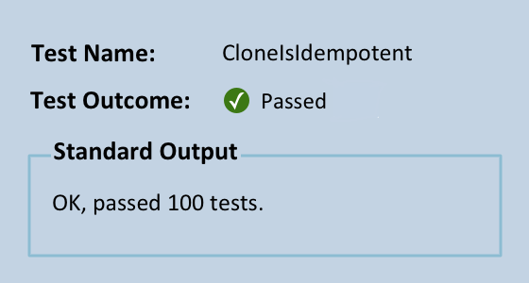
FsCheck: Properties
Function HasEqualContent (msg1 As Message,
msg2 As Message) As Boolean
Return msg1.Size() = msg2.Size() AndAlso
msg1.Data().SequenceEqual(msg2.Data())
End Function
<CheckProperty()>
Public Function CloneIsIdempotent (msg As Message) As Boolean
Using once As Message = msg.Clone(),
twice As Message = msg.Clone().Clone()
Return HasEqualContent(once, twice)
End Using
End Function
Notes:
Think of property-based testing not as a testing process, but as a design process -- a technique that helps you clarify what your system is really trying to do.
We can even test the properties of higher-order functions because FsCheck can GENERATE FIRST-CLASS FUNCTION VALUES AS INPUT DATA!!!!
Idempotence is essential for reliable systems and is a key aspect of service oriented and message-based architectures.
PRO TIP: Make sure your property checks are very fast. You will be running them a LOT!!!

Slide 5
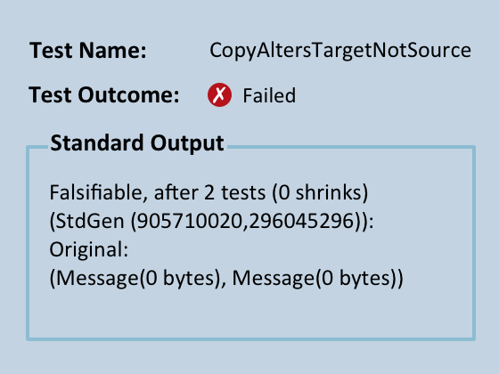
FsCheck: Properties
[CheckProperty]
public Boolean CopyAltersTargetNotSrc(Message msg1
,Message msg2) {
var source = msg1.Data();
var before = msg2.Data();
msg1.Copy(msg2);
var after = msg2.Data();
return after.SequenceEqual(source)
&& !after.SequenceEqual(before);
}
combining properties (naïvely)
Notes:
StdGen seeds can be used to demonstrably re-create (replay) a given run of FsCheck
Simple boolean operations (AND, OR) work… but don’t help us identify where failure occurred

Slide 6
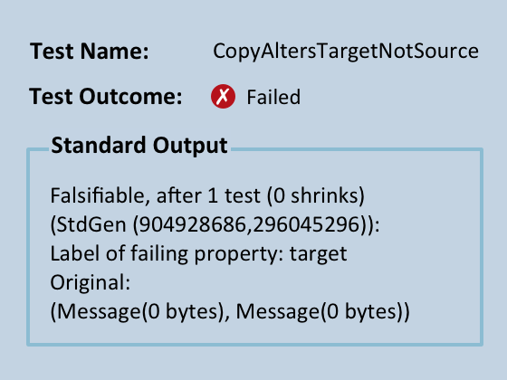
FsCheck: Properties
[CheckProperty]
public Boolean CopyAltersTargetNotSrc(Message msg1
,Message msg2) {
var source = msg1.Data();
var before = msg2.Data();
msg1.Copy(msg2);
var after = msg2.Data();
return after.SequenceEqual(source)
.Label("Source")
.And(!after.SequenceEqual(before))
.Label("Target");
}
combining and labeling properties
`
Notes:
FsCheck provides (AND,OR) for properties… many purpose is to use with LABELS, so properties don’t amalgamate into a useless bool
(.&.) boolean AND for properties
(.|.) boolean OR for properties
(@|) adds an arbitrary label, which is reported for falsifiable tests

Slide 7
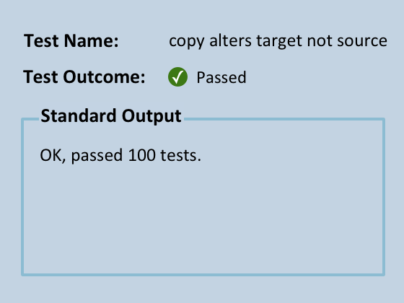
FsCheck: Properties
[<Property>]
let ``copy alters target not source`` msg1 msg2 =
// only work with dissimilar messages
(Message.data msg1 <> Message.data msg2)
==> ( let source,before = Message.data msg1,
Message.data msg2
Message.copy msg1 msg2
let after = Message.data msg2
(after = source |@ "source")
.&.
(after <> before |@ "target") )
conditional properties
Notes:
REMEMBER: “Property” = “boolean expression” (i.e. tests can be used as the pre-conditions to other tests)
Conditionals allow pre-execution filtering.
When a pre-condition isn’t met, the run is scraped and a new set of random inputs is generated (i.e. acts like a filter)
Useful for expressing SIMPLE invariants and SIMPLE business rules. In many scenarios, a custom data generator is more appropriate.

Slide 8
FsCheck: Generation
distribution of random data using a custom generator
Notes:
FsCheck provides many useful random generators out-of-the-box.
Often necessary to define our own
FsCheck has an API for generators and shrinkers
Use for custom data types
Use to formalize, encode business logic
Container types can be generated so long as FsCheck knows how to generate the contained types
!!! Complex conditional generator (i.e. co-recursive types) can be convoluted !!!

Slide 9
FsCheck: Generation
using GenVersion = FsCheck.Gen<fszmq.Version>;
// ...
public static Arbitrary<fszmq.Version> Version ()
{
var unknown = Gen.Constant(fszmq.Version.Unknown);
var random = from data in Arb.Generate<NonNegativeInt>().Three()
let major = data.Item1.Item
let minor = data.Item2.Item
let revision = data.Item3.Item
select fszmq.Version.NewVersion(major, minor, revision);
// Creates a random distribution weighted in favor of version with random values
var distribution = Gen.Frequency(
new WeightAndValue<GenVersion>(2, random )
, new WeightAndValue<GenVersion>(1, unknown)
);
return Arb.From(distribution);
}
Notes:
Size – numeric value interpreted differently by each generator/shrinker (some even ignore it!); used to create a sense of “bigger” (or “smaller”) between generated type instances
Generator – (optionally) interprets Size; provides actual generation logic; build from a mix of: Gen module functions, Gen computation expression, Arb module functions, and custom logic needed
Shrinker – optional function which takes a randomly generated input and returns a sequence of “smaller” instances
Arbitrary = Generator + Shrinker for a particular type (often built from Arb module functions); defined as an interface

Slide 10
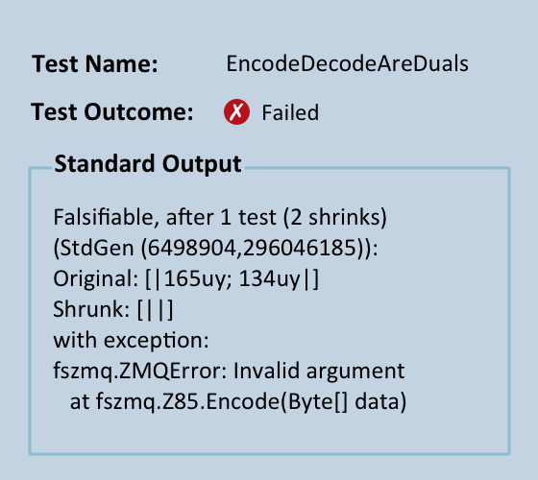
FsCheck: Generation
<CheckProperty()>
Public Function _
EncodeDecodeAreDuals (data() As Byte) As Boolean
Dim processed = Z85.Decode(Z85.Encode(data))
Return processed.SequenceEqual(data)
End Function
expressing implicit business rules
“Z85 … takes a binary frame and encodes it as a printable ASCII string, or takes an ASCII encoded string and decodes it into a binary frame.”
from Z85 RFC
Notes:
Random data generation often identifies previously unknown edge cases; also helpful in guiding exploration of an existing codebase

Slide 11
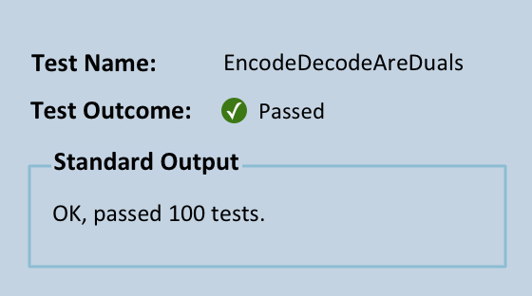
FsCheck: Generation
<CheckProperty()>
Public Function _
EncodeDecodeAreDuals (data() As Mod4Binary) As Boolean
Dim processed = Z85.Decode(Z85.Encode(data))
Return processed.SequenceEqual(data)
End Function
expressing implicit business rules
“Z85 … takes a binary frame and encodes it as a printable ASCII string, or takes an ASCII encoded string and decodes it into a binary frame.
The binary frame SHALL have a length that is divisible by 4 with no remainder. The string frame SHALL have a length that is divisible by 5 with no remainder.”
from Z85 RFC
Notes:
Could’ve used a conditional property, but custom arbitrary is more efficient and better captures (otherwise implicit) business constraint

Slide 12
FsCheck: Generation
/// A byte[] whose length is evenly divisible by 4
type Mod4Binary = Mod4Binary of data:byte[]
// ... elsewhere ...
static member Mod4Binary =
let isValid (data:byte[]) = data <> null &&
data.Length > 0 &&
data.Length % 4 = 0
Arb.fromGenShrink (
// generator
Arb.generate<byte[]>
|> Gen.suchThat isValid
|> Gen.map Mod4Binary
// shrinker
, fun (Mod4Binary data) -> data
|> Arb.shrink
|> Seq.filter isValid
|> Seq.map Mod4Binary )
expressing implicit business rules
“Z85 … takes a binary frame and encodes it as a printable ASCII string, or takes an ASCII encoded string and decodes it into a binary frame.
The binary frame SHALL have a length that is divisible by 4 with no remainder. The string frame SHALL have a length that is divisible by 5 with no remainder.”
from Z85 RFC
Notes:
Could’ve used a conditional property, but custom arbitrary is more efficient and better captures (otherwise implicit) business constraint

Slide 13
FsCheck: Observations
Tiny (0 .. 4 bytes)
Small (8 .. 20 bytes)
Medium (24 .. 60 bytes)
Large (64 .. ∞ bytes)
distribution of randomly generated inputs to a test run
Notes:
“meaningless to talk about random testing without discussing the distribution of test data. Random testing is most effective when the distribution of test data follows that of actual data… [when possible]”
PRO TIP: "Correctness confidence" very dependent on test distributions!!!
FsCheck does not measure coverage – dev MUST investigate distributions to ensure suitability

Slide 14
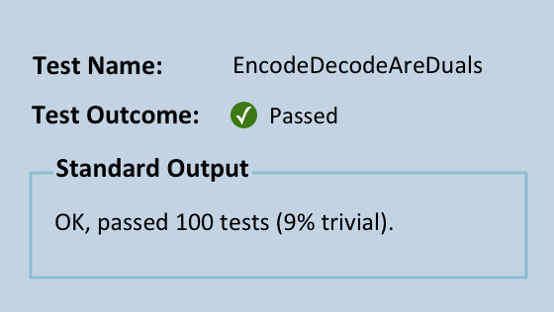
FsCheck: Observations
[CheckProperty]
public Property EncodeDecodeAreDuals (Mod4Binary input)
{
var processed = Z85.Decode(Z85.Encode(input.Data));
return processed.SequenceEqual(input.Data)
// identify a special case
.Trivial(input.Data.Any (b => b == 70));
}
Notes:
Prop.trivial – a simple boolean qualification observed against a whole distribution… puts ALL tests into one of 2 buckets
Prop.classify – arbitrary number of boolean qualifications observed (individually) against a whole distribution… puts SOME tests into one of N buckets

Slide 15
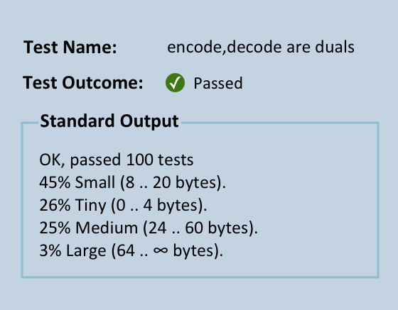
FsCheck: Observations
[<Property>]
let ``encode,decode are duals`` (Mod4Binary data) =
(data |> Z85.encode |> Z85.decode = data)
// bucket by common sizes
|> Prop.classify (large data)
"Large (64 .. ∞ bytes)"
|> Prop.classify (medium data)
"Medium (24 .. 60 bytes)"
|> Prop.classify (small data)
"Small (8 .. 20 bytes)"
|> Prop.classify (tiny data)
"Tiny (0 .. 4 bytes)”
Notes:
Prop.collect – compiles arbitrary value from each test; reported alongside percentage of overall distribution
Combining observations – no limit; be as complex as you want/need (but be mindful of performance!)

Slide 16
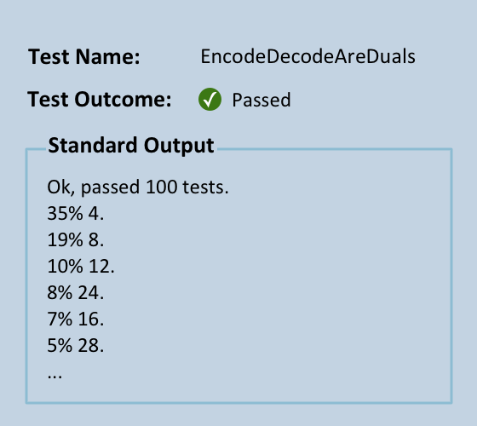
FsCheck: Observations
<CheckProperty()>
Public Function EncodeDecodeAreDuals (input As Mod4Binary) As [Property]
Dim processed = Z85.Decode(Z85.Encode(input.Data))
' gather individual sizes
Return processed.SequenceEqual(input.Data) _
.Collect(input.Data.Length)
End Function
Notes:
Prop.collect – compiles arbitrary value from each test; reported alongside percentage of overall distribution
Combining observations – no limit; be as complex as you want/need (but be mindful of performance!)

Slide 17
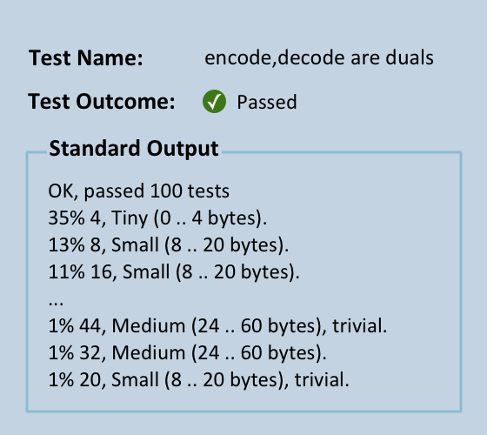
FsCheck: Observations
[<Property>]
let ``encode,decode are duals`` (Mod4Binary data) =
(data |> Z85.encode |> Z85.decode = data)
// identify a special case
|> Prop.trivial (data |> Array.exists ((=) 70uy))
// bucket by common sizes
|> Prop.classify (large data)
"Large (64 .. ∞ bytes)"
|> Prop.classify (medium data)
"Medium (24 .. 60 bytes)"
|> Prop.classify (small data)
"Small (8 .. 20 bytes)"
|> Prop.classify (tiny data)
"Tiny (0 .. 4 bytes)"
// gather individual sizes
|> Prop.collect (Array.length data)
Notes:
Prop.collect – compiles arbitrary value from each test; reported alongside percentage of overall distribution
Combining observations – no limit; be as complex as you want/need (but be mindful of performance!)

Slide 18
Random Testing
“One of the major advantages… is that it encourages us to formulate formal specifications, thus improving our understanding…”
from ICFP’00 – Claessen, Hughes
Notes:
Not covered:
Quantified properties
Expecting exceptions – INCLUDED IN SAMPLES (F# only!)
Time-dependent properties (F# only!)
Model-based testing
Seeding (for reproducibilty)
Fine-tuning output
Still more property patterns
Commutitivity
Structural induction
Easy to verify
Test oracle
FsCheck:
Uses random data and logical propositions to prove or disprove behavior
Simple eDSL for logical propositions
API for steering data generation
API for observing distributions of generated data
Limitations:
Not easy to define properties for certain domains
Complex conditional generator (for linked types) can be convoluted
Does NOT obviate need for other quality control mechanisms
"Correctness confidence" very dependent on test distributions

Slide 19
More Information
about F# and FsCheck
about Paulmichael Blasucci
fsharp.org
fscheck.github.io/FsCheck
fsharpforfunandprofit.com
tryfsharp.net
twitter.com/pblasucci
github.com/pblasucci
linkedin.com/in/pblasucci
pblasucci.wordpress.com

Slide 20
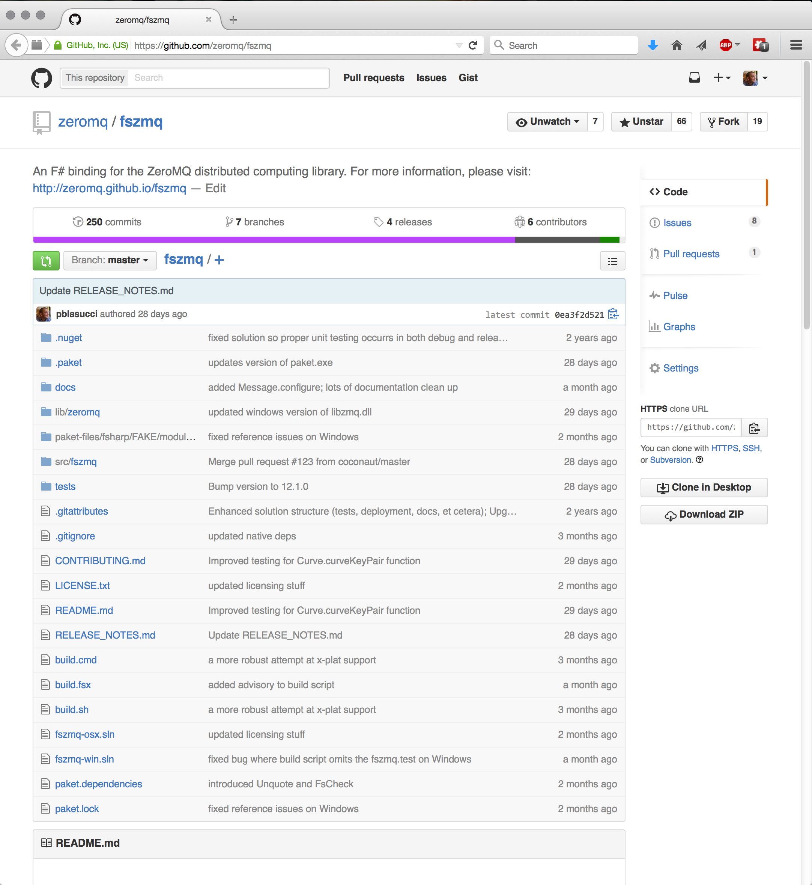
github.com/pblasucci/checkprops
More than 3,000
tests!
my code is your code!
Notes:
Download:
+ QuickCheck ICFP paper
+ This slide deck
+ All code samples featured in this talk
+ EACH SAMPLE IS IN AVAILABLE IN THREE (3) LANGUAGES
+ F#
+ C#
+ VB
+ Various bits and bobs

