Slide 1
Boston Crime analysis
Prepared for the head of Police department

Slide 2
Which neighborhoods should we focus on?
We want to try to understand what drives endemic crime in residential neighborhoods, not exogeneous crime committed by people from other areas
As such we disregard two neighborhoods:
Downtown Boston -> a lot of daytime office commuters from other neighborhoods, plus it is not a very residential neighborhood
South End -> a very trendy area that has a lot of culture (art galleries) and a vibrant nightlife (restaurants, bars). As such, it attracts a lot of people from outside the neighborhood

Slide 3
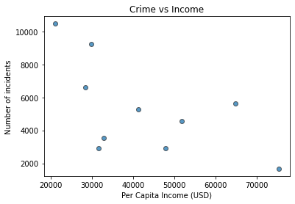
What is the relationship between crime and income per capita? There is a clearly negative relationship: the lesser the income, the higher the number of incidents
Excluding Downtown and South End

Slide 4
What does a regression tell us?
The negative relationship is statistically significant (absolute value of t-stat is > 2 and p-value = 6.6%)
The R-squared is not satisfactory yet so need to investigate other factors at play (R-squared = 36%)
No multicollinearity issues (only one variable…)
Need more data (from other US cities)

Slide 5
Conclusions
More analysis is needed
But so far it seems that economic conditions of inhabitants is an important driver of crime
While punishment is important when warranted, more effort should be put on education, economic development, etc…

