Slide 1



COMPLEXITY vs. INTERESTINGNESS
Notes:
This is where we left off last time. Complexity is well understood: we can measure it and the measures we have for it behave consistently and predictably.
The problem is that the extremes of complexity behave in a way that is counter to our intuition of information. A snowy television signal is maximally complex, it takes the maximum amount of information to describe. But it's not very interesting. Neither is the minimally complex blank screen.
The sweet spot of interestingness, a peak of useful information lies somewhere in the middle. Can we define a notion of interestingness that is as well-behaved and universal as our notions of complexity?

Slide 2

Computation
Interestingness
Complexity
Data
Notes:
There is a recurrent theme to this story. One of starting out with an intuitive concept and trying to bring it into mathematical terms without losing the intuitive power.

Slide 3
DATA
bit strings
numbers
Operations on data
=
functions on numbers
empty string
0
1
00
01
10
11
000
001
010
011
100
101
110
111
0000
0001
0010
0011
0100
0101
0110
0111
1000
1001
1010
1011
1100
1101
1110
1111
00000
00001
00010
00011
0
1
2
3
4
5
6
7
8
9
10
11
12
13
14
15
16
17
18
19
20
21
22
23
24
25
26
27
28
29
output
f(x)
input
Notes:
Anything that can be called data, can be represented as a bit string. Any bit string can be translated into natural numbers.
Examples: A DVD of a movie. A DVD of a movie that hasn't been made yet. A proof of a mathematical theorem. The Mona Lisa.
This means that we can think of operations on data as functions over (the natural) numbers.

Slide 4
COMPUTATION: EFFECTIVE PROCEDURES
Hilbert (1900): “Is there an effective procedure for finding the roots of any polynomial?”
Hilbert (1928): “Is there an effective procedure for proving any given theorem?”
Von Mises, Wald, Church (1919-1939): “A bitstring is random if there exists no effective procedure to select a substring with more 1's than 0's”
Computable numbers: Integers ⊂Rational numbers ⊂ Algebraic numbers ⊂ ... ⊂ Real numbers
Notes:
Around the start of the last century, people were starting to ask questions like these. What kind of mathematics are possible in general. There was an intuition that certain functions were fundamentally “possible”, or “real” and others weren't.
To compound the issue, Godel had shown that certain mathematical statements (ie. Numbers) could be true but not provable. That is, there were limits to mathematics.
To answer these questions, people needed a way to study the family of all effective procedures.

Slide 5
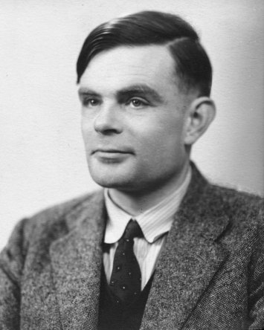
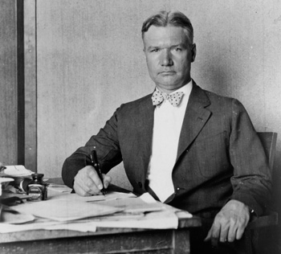
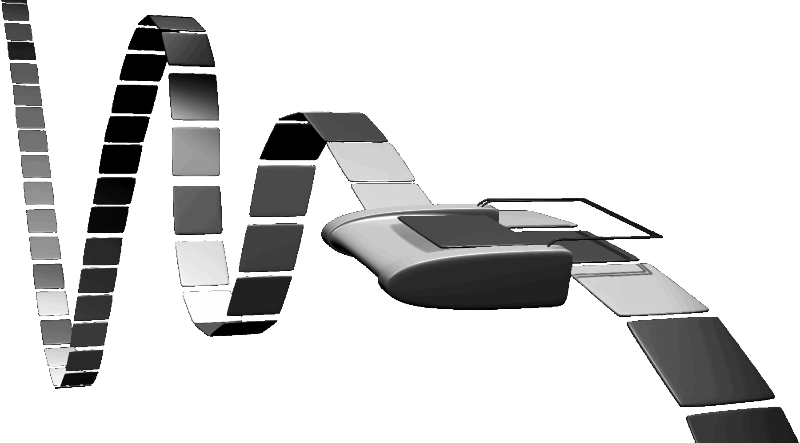
The TURING MACHINE
Alan Turing (1937): On computable numbers, with an application to the Entscheidungsproblem
Start T with x 1's on the tape and count the number of 1's after it finishes. In this way, T computes the function T(x) = y
Notes:
Turing's solution was to start with the only system we are sure can follow any effective procedure: a mathematician sitting at a desk, writing on paper.
He then simplified anything that would not reduce the basic expressive power of the mathematician. The paper became a 1-dimensional string of squares. Each of which could contain one of a finite set of symbols.
Internally the machine has a (finite) number of states. It reads its state and the number on the tape, and based on this information it moves either right left, erases the current square, or writes down a symbol.
If we start the machine with x 1's and run it until it halts, we can say that T computes the function T(x) = y, where y is the number of 1's on the tape after it halts, and y = inf if it doesn't halt.

Slide 6
The UNIVERSAL TURING MACHINE
A turing machine which can simulate any other Turing machine
  T: Some Turing machine: T(x) = y
  <T>: T encoded as a number/bitstring
  <<T>, x>: T and input x encoded as a number/bitstring
  U(<<T>, x>) = y for any T and x
The Church-Turing Thesis: “All effective procedures can be computed by a Turing machine.”
  Alternatively: You cannot build a machine that does something a Turing Machine cannot do.

Slide 7
The HALTING PROBLEM
inputs
1 2 3 4 5 6 7 8 9 10 11 12 13 14 15 ...
1 2 3 4 5 6 7 8 9 10 11 12 13 14 15 ...
T0
T1
T2
T3
T4
T5
T6
T7
T8
T9
T10
T11
T12
T13
T14
T15
T16
T17
...
1 2 3 4 5 6 7 8 9 0 1 2 3 4 5 ...
0 0 0 0 0 0 0 0 0 0 0 0 0 0 0
1 0 1 0 1 0 0 0 0 0 0 1 0 0 1
1 2 3 2 1 2 1 1 1 0 0 0 0 4 5
1 1 3 4 5 6 ∞ 8 9 ∞ 1 2 1 4 5
1 3 3 ∞ 5 ∞ 7 8 9 1 ∞ 2 3 4 1
1 1 3 ∞ 5 6 7 8 9 1 1 2 5 4 1
1 4 3 4 5 6 7 ∞ 9 ∞ ∞ 1 3 4 1
0 1 3 4 5 6 7 8 9 1 1 2 ∞ 56 1
∞ 9 3 14 5 6 7 8 9 1 1 1 3 4 1
1 2 3 4 5 6 7 8 9 0 ∞ 1 1 4 1
1 ∞ 3 ∞ 5 3 7 8 9 1 1 1 3 4 1
1 2 3 4 5 31 7 8 9 1 1 1 3 4 1
1 0 ∞ 4 5 4 7 8 9 1 1 1 3 4 1
∞ 0 3 4 5 6 7 8 9 0 ∞ 3 3 4 1
1 9 3 4 5 6 8 8 9 64 5 2 3 4 1
∞ ∞ ∞ ∞ ∞ ∞ ∞ ∞ ∞ ∞ ∞ ∞ ∞ ∞ ∞
1 1 2 5 8 13 1 1 9 1 1 2 3 4 1
Turing machines

Slide 8
The HALTING PROBLEM
T(x) = 2 1 2 3 6 0 8 0 10 2 0 3 4 5 2 ...
1 2 3 4 5 6 7 8 9 10 11 12 13 14 15 ...
1 2 3 4 5 6 7 8 9 10 11 12 13 14 15 ...
T0
T1
T2
T3
T4
T5
T6
T7
T8
T9
T10
T11
T12
T13
T14
T15
T16
T17
...
1 2 3 4 5 6 7 8 9 0 1 2 3 4 5 ...
0 0 0 0 0 0 0 0 0 0 0 0 0 0 0
1 0 1 0 1 0 0 0 0 0 0 1 0 0 1
1 2 3 2 1 2 1 1 1 0 0 0 0 4 5
1 1 3 4 5 6 ∞ 8 9 ∞ 1 2 1 4 5
1 3 3 ∞ 5 ∞ 7 8 9 1 ∞ 2 3 4 1
1 1 3 ∞ 5 6 7 8 9 1 1 2 5 4 1
1 4 3 4 5 6 7 ∞ 9 ∞ ∞ 1 3 4 1
0 1 3 4 5 6 7 8 9 1 1 2 ∞ 56 1
∞ 9 3 14 5 6 7 8 9 1 1 1 3 4 1
1 2 3 4 5 6 7 8 9 0 ∞ 1 1 4 1
1 ∞ 3 ∞ 5 3 7 8 9 1 1 1 3 4 1
1 2 3 4 5 31 7 8 9 1 1 1 3 4 1
1 0 ∞ 4 5 4 7 8 9 1 1 1 3 4 1
∞ 0 3 4 5 6 7 8 9 0 ∞ 3 3 4 1
1 9 3 4 5 6 8 8 9 64 5 2 3 4 1
∞ ∞ ∞ ∞ ∞ ∞ ∞ ∞ ∞ ∞ ∞ ∞ ∞ ∞ ∞
1 1 2 5 8 13 1 1 9 1 1 2 3 4 1

Slide 9
COMPLEXITY
The length of the shortest description: Kolmogorov Complexity
Other notions of Complexity:
  Shannon entropy
  Computational resources, logical depth

Slide 10
The BERRY PARADOX
Every number can be described in different ways:
  “The third prime”, “The age of queen Beatrix”, “The number of letter in the English languages”
  There are only so many descriptions of 140 characters of less
“The lowest natural number that cannot be described in under 140 characters.”

Slide 11
“The lowest natural number that cannot be described in under 140 characters.”
This is a description
in 75 characters!

Slide 12
KOLMOGOROV COMPLEXITY
The complexity of x
  Take some universal Turing Machine U
  Find the shortest input on U that produces x:
    CU(x) = min { p | U(p) = x }
If T is universal then:
    CU(x) < CT'(x) + c
Kolmogorov Complexity: The length of the shortest program that outputs x on a universal turing machine.
  There is no effective procedure for producing x in less than CU(x) + c
Notes:
Remember:
Spend plenty of time on invariance
End with practical examples (works of shakespeare etc)

Slide 13
BERRY Revisited
“The lowest natural number that cannot be described in under 140 characters.”
y = min { x | C(x) > n }
This is a description of y, but is it also a computer program for producing y?
  Only if C(x) is computable (it isn't)

Slide 14
So what's the point?
We can approximate C(X)
C(x) ≤ C(ZIP) + ZIP(x)
log(x) + c
C(x)

Slide 15
INFORMATION DISTANCE
Vitanyí & Cilibrasi 2006
C(x|y): Length of the shortest program that turns y into x
Make it a proper distance:
  NID(x, y) = max[C(x|y), C(y,|x)] / max[C(x), C(y)]
Replace C with a general purpose compressor (ZIP, TAR): Instant cross-domain distance measure
Replace C with a domain-specific compressor (JPEG, MPEG4): Instant domain-specific distance measure
Notes:
General conclusion: describe something as a function of C, then approximate.
General conclusion: learning is compression and compression is learning

Slide 16
Computation
Interestingness
Complexity
Data
Notes:
Now that we have conquered data, computation and complexity, we can have a look at interestingness.

Slide 17
INTERESTINGNESS
Amount of model information
  Amount of self-descriptive information
Self dissimilarity
Sophistication, Logical Depth
Parsing Automaton Size

Slide 18
LOGICAL DEPTH

Slide 19
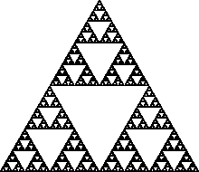
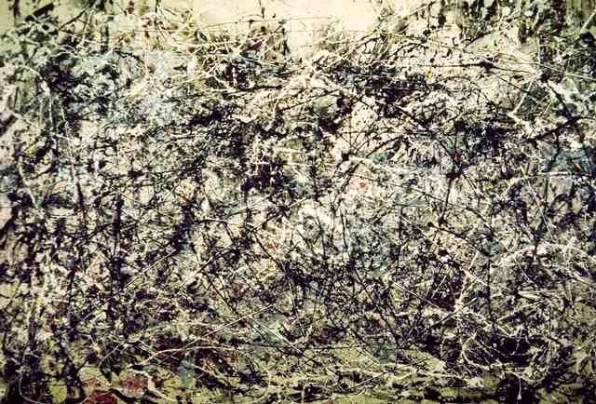
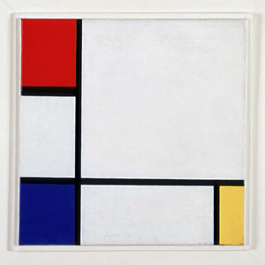
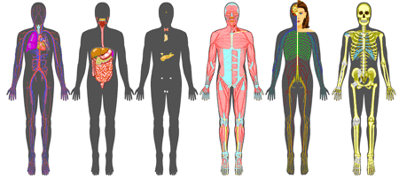
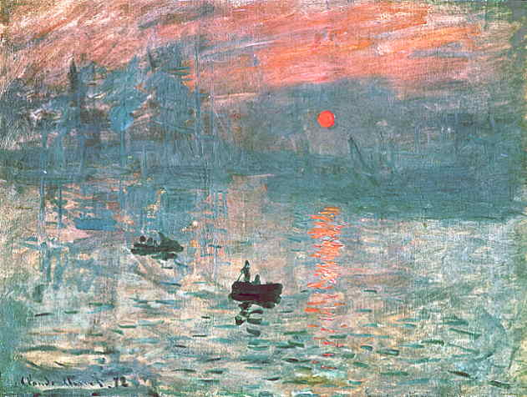
SELF DISSIMILARITY (Wolpert & McReady)
simple
interesting
Complex

Slide 20
SELF-DESCRIPTIVE INFORMATION: Two-Part Coding
01001010010011
01010001010011
01001000100101
10100110100100
10100100101010
10000100100001
11010110111010
11101011111011
11101110111011
10111110111111
10011111010101
01011011010111
00000001010100
11010010100101
10100100101010
10000100100001
11010110111010
11101011111011
11101110111011
10111110111111
10100100101010
10000100100001
11010110111010
11101011111011
11101110111011
10111110111111
10100100101010
10000100100001
11010110111010
11101011111011
11101110111011
10111110111111
S =
Si

Slide 21
SELF-DESCRIPTIVE INFORMATION: Two-Part Coding
01001010010011
01010001010011
01001000100101
10100110100100
10100100101010
10000100100001
11010110111010
11101011111011
11101110111011
10111110111111
10011111010101
01011011010111
00000001010100
11010010100101
10100100101010
10000100100001
11010110111010
11101011111011
11101110111011
10111110111111
10100100101010
10000100100001
11010110111010
11101011111011
11101110111011
10111110111111
10100100101010
10000100100001
11010110111010
11101011111011
11101110111011
10111110111111
S =
Si
C(Si) ≤ C(S) + C(i) + c
Notes:
Explain that S represents a Model.

Slide 22
SELF-DESCRIPTIVE INFORMATION: Two-Part Coding
Model information (S)
Model-to-data information (i)

Slide 23
SELF-DESCRIPTIVE INFORMATION: Two-Part Coding
Model information (S)
Model-to-data information (i)

