Slide 1
Implementation
AF optimization with evolutionary algorithm

Slide 2
Neural Network
Based on basics group’s Python version
Addition: self.activation_funs
Stores activation function vector per hidden layer
Last layer keeps sigmoid

Slide 3
Evolutionary Algorithm
Tournament selection (with replacement)
No elitism
All networks trained separately (on same batch)
Fitness: mean squared error on current batch (doesn’t modify weight)
Crossover or max() randomly
Mutation: 1% probability, 20% of functions

Slide 4
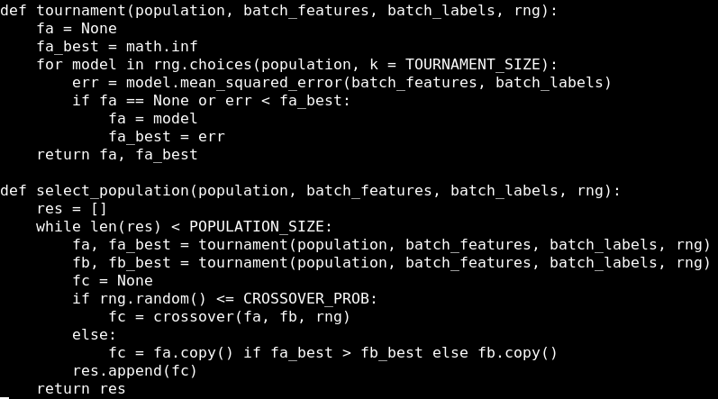

Slide 5
Open questions
Since we train networks separately, separate weights
What happens on crossover?
Too slow to support large population
Lots of slow copies, matrix multiplication in Python (use PyTorch)

Slide 6
Thank you for your attention

