Slide 1

Saving private Token

Slide 2

About Me
Paweł Bocheński
Senior mobile developer
Siili Solutions
pbochenski.pl
https://github.com/pbochenski

Slide 3
Problem
User logs in into some web service using login and password.
Web service returns token to authenticate further requests
How to securely store token on device, so user does not have to login next time?

Slide 4
Official statement
“By default, files that you create on internal storage are accessible only to your app. Android implements this protection, and it's sufficient for most applications.”
https://developer.android.com/training/articles/security-tips.html

Slide 5
Always encrypt data on local storage
OWASP recommendation
Always store sensitive data encrypted
Use strong approved Authenticated Encryption
Mobile Top 10 2016: M2 Insecure Data Storage
OWASP MSTG - data storage

Slide 6
MASVS
OWASP Mobile Application Security Verification Standard
„Definition of Sensitive Data
Sensitive data in the context of the MASVS pertains to both user credentials and any other data considered sensitive in the particular context, such as:
Personally identifiable information (PII) that can be abused for identity theft: Social security numbers, credit card numbers, bank account numbers, health information;
Highly sensitive data that would lead to reputational harm and/or financial costs if compromised: Contractual information, information covered by non-disclosure agreements, management information;
Any data that must be protected by law or for compliance reasons.„

Slide 7
Threats
Other apps on rooted phones can read internal storage
Malware can do a local privilege escalation attack
Allow backup = true
Security holes in certain phones
If someone steals your phone, than can also steal your car
tesla app hacked

Slide 8

Solution?
If it is not saved it can’t be hacked

Slide 9
Solution?
Encrypt data, store key in system keystore
Does it work on every android device?

Slide 10
Android 4.4
Api levels < 19
Keystore below android 4.4 is not secure

Slide 11
Below Android 6.0
Api levels 19 <= level <23
Mostly unusable:
Only saves asymmetric keys
Only has unsafe crypto primitives

Slide 12
Lookout for internet examples
why crypto is hard
if you type letters AES into your code you are doing it wrong

Slide 13
Android 6.0 and above
Api level >= 23
Use key store
Improved in Android 6.0
It can be backed by lock screen
Does encryption out of process on separate processor with separate OS
Keys never leave secure enclave
Unfortunately there is no library
Lock screen changes removes all keys!

Slide 14
Workaround
Ask user for pin
derive strong password from it
use library to encrypt / decrypt
Google keyczar
java-aes-crypto
Realm, sqlCipher

Slide 15
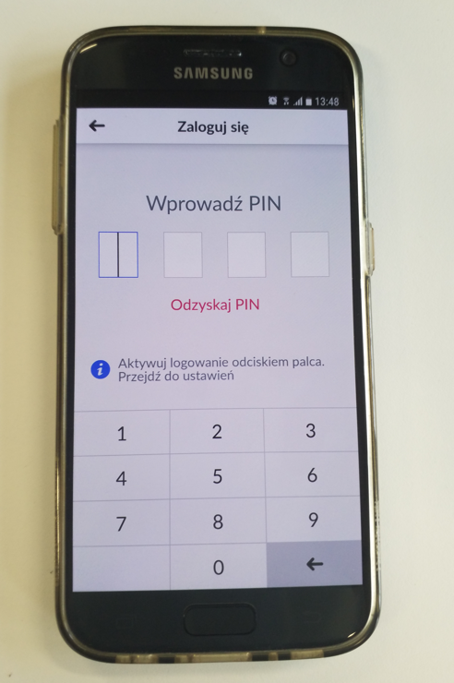
This solution is suggested by Google
Banks do this​
They also implement own keyboards to prevent keylogging​
Also block screen capture

Slide 16

Example 1
http://bit.ly/2xBZXRo

Slide 17
private void encrypt(String s, String pinFromEdit) {
byte[] salt = new byte[32];
random.nextBytes(salt);
try {
//generate keys
AesCbcWithIntegrity.SecretKeys keys
= AesCbcWithIntegrity.generateKeyFromPassword(pinFromEdit, salt);
//encrypt
AesCbcWithIntegrity.CipherTextIvMac ciphered = AesCbcWithIntegrity.encrypt(s, keys);
String saltString = new String(Base64.encode(salt, Base64.DEFAULT));
sharedPreferences.edit().putString("salt", saltString).apply();
sharedPreferences.edit().putString("ciphered", ciphered.toString()).apply();
Toast.makeText(this, "Encryption succeeded", Toast.LENGTH_SHORT).show();
} catch (GeneralSecurityException | UnsupportedEncodingException e) {
Toast.makeText(this, "Encryption failed", Toast.LENGTH_LONG).show();
}
}

Slide 18
private void decrypt(String pin) {
//read salt and ciphered text
String saltString = sharedPreferences.getString("salt", "");
String cipheredString = sharedPreferences.getString("ciphered", "");
AesCbcWithIntegrity.CipherTextIvMac ciphered
= new AesCbcWithIntegrity.CipherTextIvMac(cipheredString);
try {
//generate keys
byte[] salt = Base64.decode(saltString, Base64.DEFAULT)
AesCbcWithIntegrity.SecretKeys keys
= AesCbcWithIntegrity.generateKeyFromPassword(pin,salt);
byte[] decrypted = AesCbcWithIntegrity.decrypt(ciphered, keys);
String decryptedString = new String(decrypted);
Toast.makeText(this, decryptedString, Toast.LENGTH_LONG).show();
} catch (GeneralSecurityException e) {
Toast.makeText(this, "Decryption failed", Toast.LENGTH_LONG).show();
}
}

Slide 19

Example 2
http://bit.ly/2xLHzrB
Notes:
How to use key store.

Slide 20
private static SecretKey generateSecretKeyApi23(String alias) throws GeneralSecurityException {
KeyGenParameterSpec.Builder builder = new KeyGenParameterSpec.Builder(alias,
KeyProperties.PURPOSE_ENCRYPT | KeyProperties.PURPOSE_DECRYPT);
KeyGenParameterSpec keySpec = builder
.setKeySize(256)
.setBlockModes(KeyProperties.BLOCK_MODE_GCM)
.setEncryptionPaddings(KeyProperties.ENCRYPTION_PADDING_NONE)
.setRandomizedEncryptionRequired(true)
.setUserAuthenticationRequired(true)
.setUserAuthenticationValidityDurationSeconds(5)
.build();
KeyGenerator kg = KeyGenerator.getInstance("AES", ANDROID_KEY_STORE);
kg.init(keySpec);
return kg.generateKey();
}
Notes:
PADDING_NONE is wrong here. Please figure out and change here and in code.

Slide 21
private void getKey() {
try {
KeyStore keyStore = KeyStore.getInstance("AndroidKeyStore");
keyStore.load(null);
KeyStore.Entry entry = keyStore.getEntry("SOME_ALIAS", null);
SecretKey key = ((KeyStore.SecretKeyEntry) entry).getSecretKey();
Toast.makeText(this,
"encoded key = ["+ Arrays.toString(key.getEncoded()) +"]",
Toast.LENGTH_SHORT).show();
} catch (Exception e) {
e.printStackTrace();
}
}

Slide 22
Summary
Always encrypt credentials
Use libraries for encryption
Proper hardware backed secure store is implemented only in Android 6 and up

Slide 23
THANK YOU!
Paweł Bocheński

