Slide 1
A1: Needfinding
Sejal, Dhara, Peter, Will B.

Slide 2
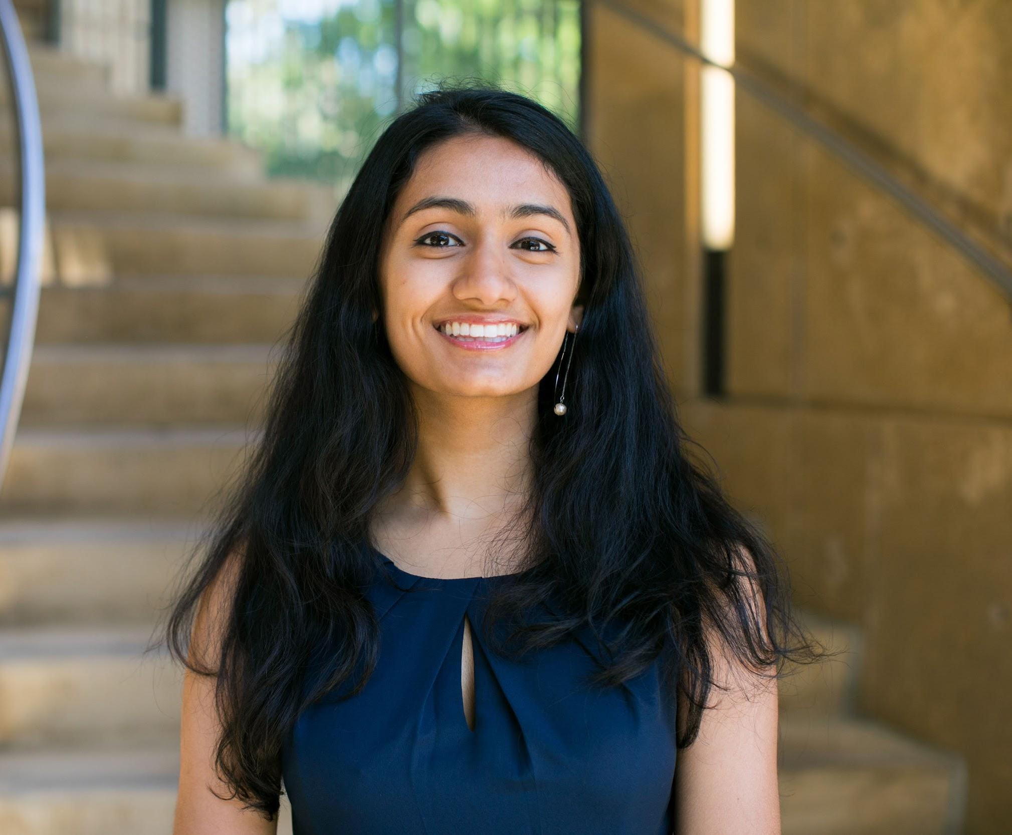
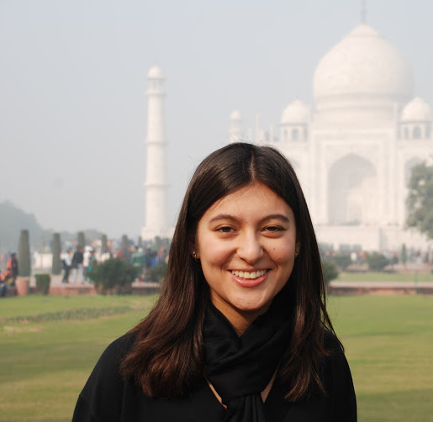
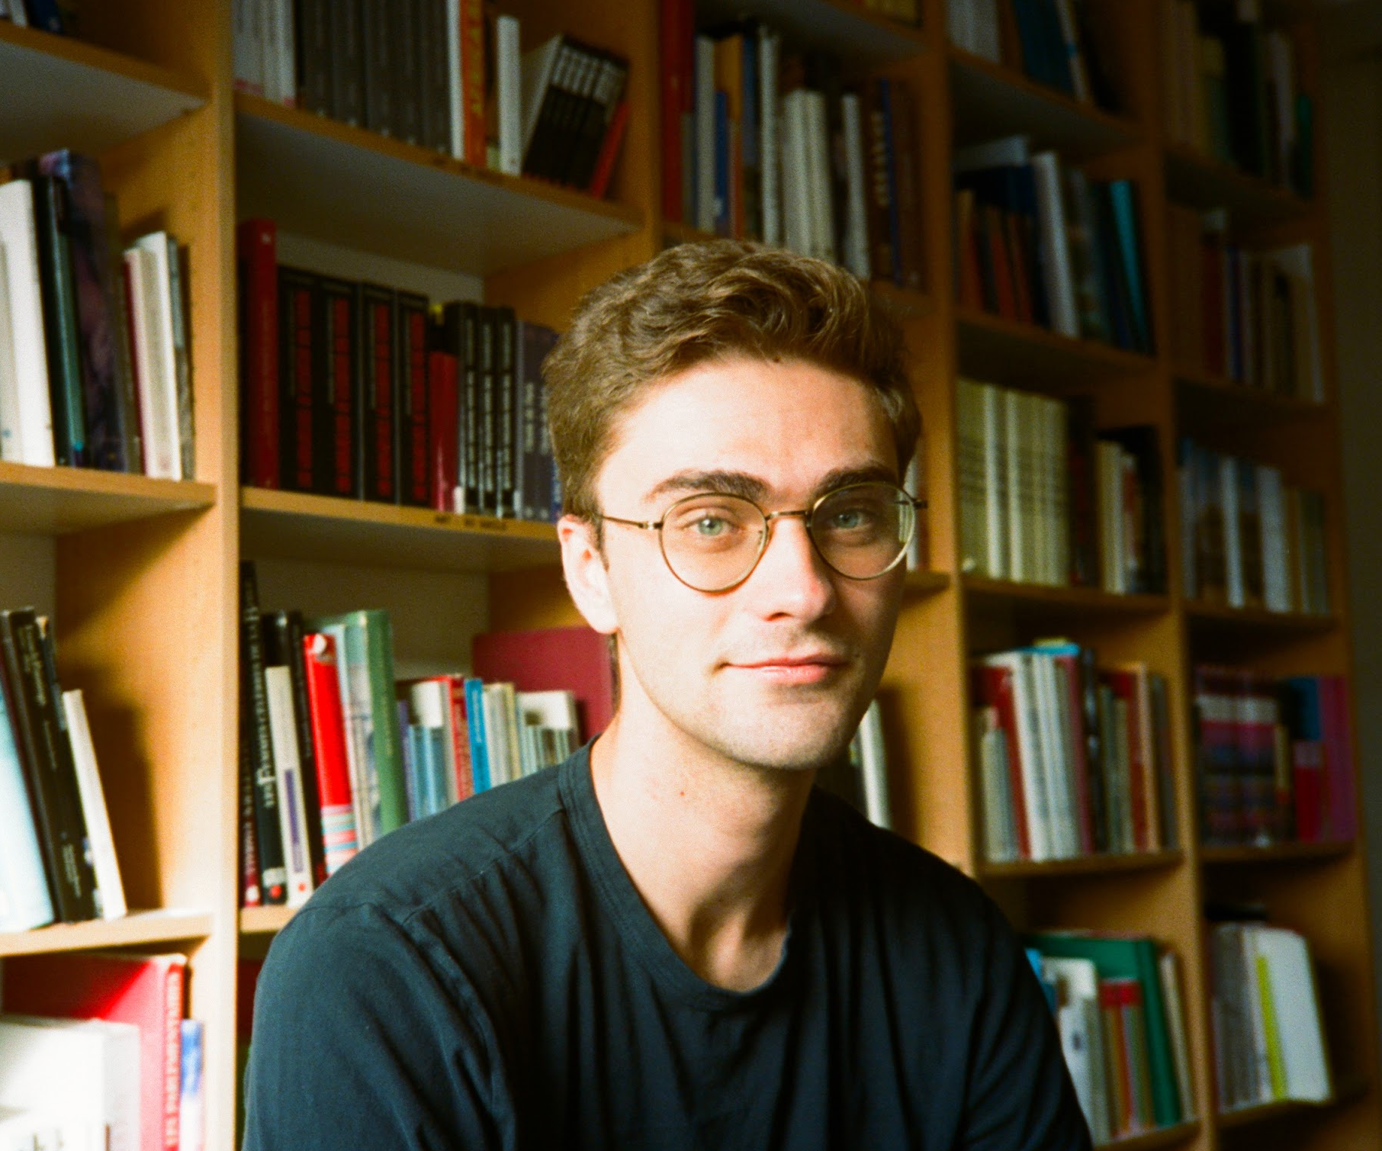
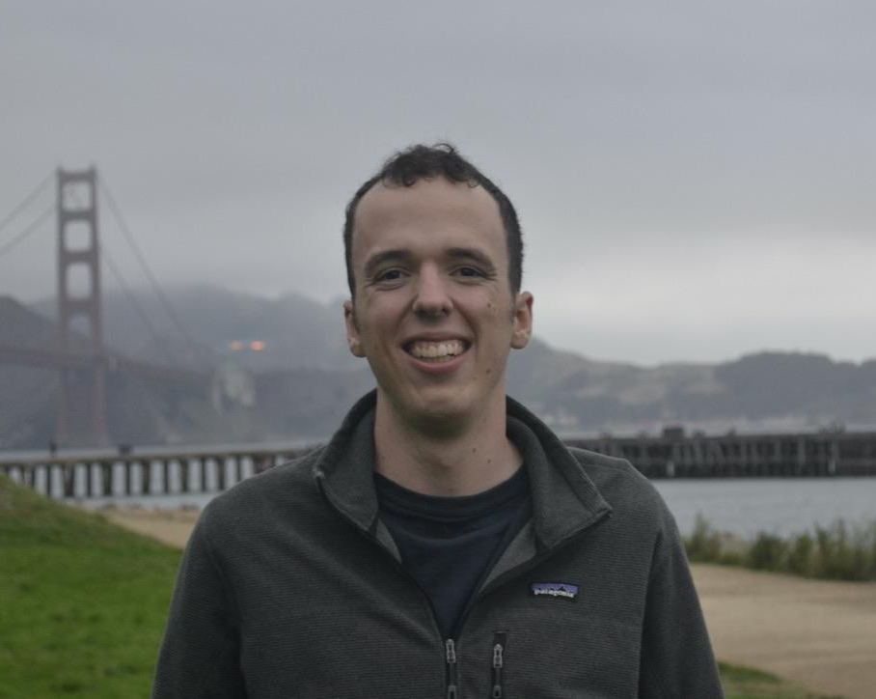
Domain:
Passion Project Creators
Our Team
Picture of team member
Sejal
Dhara
Picture of team member
How can digital experiences improve the wellbeing of passion-project creators?
Will
Peter

Slide 3
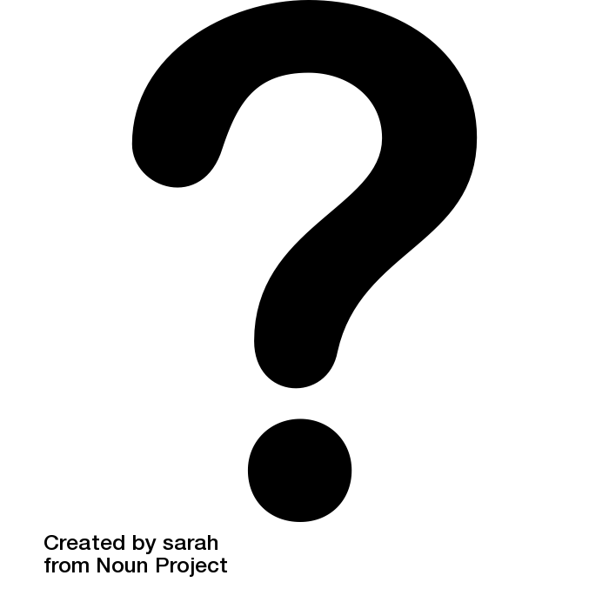

Questions asked
Tell me about your channel’s growth. Was there a specific moment it could be traced back to?
How did you interact with your fans?
What have been the downsides of being a content creator?
Has your creator career impacted or overlapped with your professional career? How do you balance them?
Tell me about the best moments in your YouTube career.
Why did you start creating your content? Who do you share it with?
Tell me about the community you’ve found through Minecraft. How do you communicate/connect with each other? What do you talk about?
What was your relationship with your content like?

Slide 4
Interviewees

Slide 5
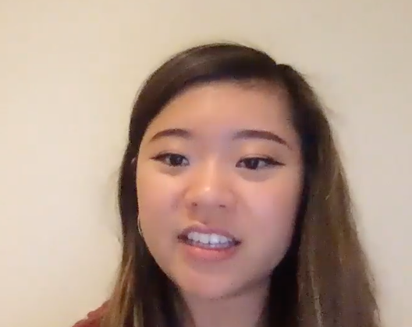
Rachel
@kawaiisweetworld
[image]
Stanford Student
Creator of popular YouTube baking channel with > 1.2M subscribers
Recently stopped producing videos
Notes:
3 of these slides

Slide 6
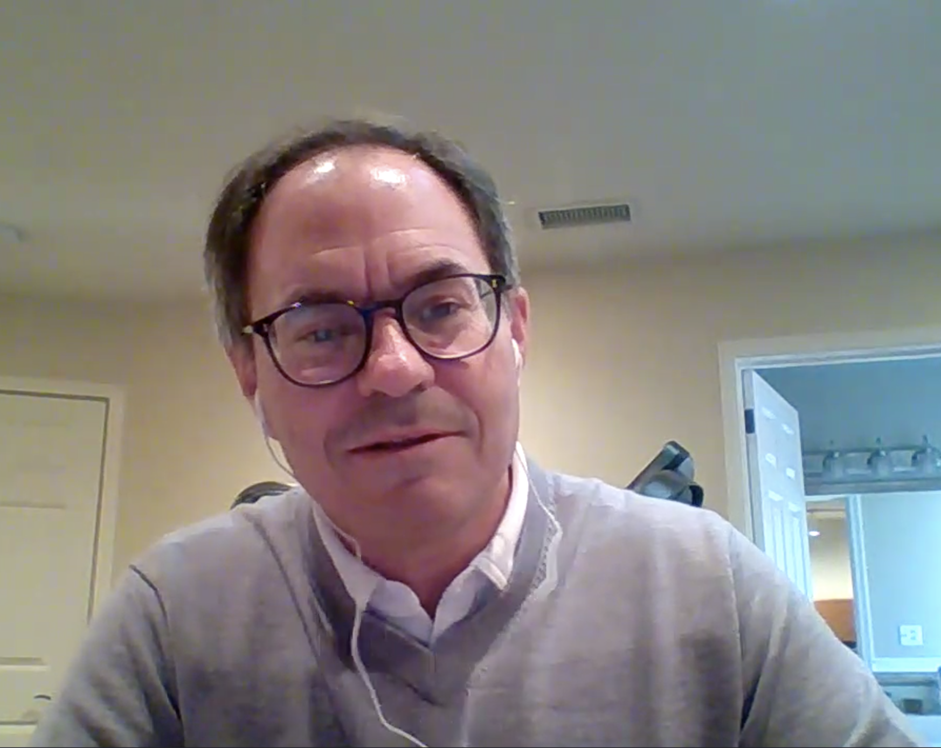
Jon
@camphedgefund
[image]
Middle-aged man with finance background (ex-hedge fund manager and CFA)
Rising TikTok finance creator with > 38K followers
Notes:
3 of these slides

Slide 7
Casey*
[Anonymous Child]
[Image redacted]
6th grader, creates Digital Art and collaborative Minecraft builds
Shares art with close friends during these activities via Messages app and Discord
Notes:
3 of these slides

Slide 8
Results

Slide 9
Rachel’s interview
Quotes
“I realized: Wow, people made the effort to drive out and see me. I’m not just making videos in my bedroom.”
“It’s hard to have my own separate identity from my work”
Notes:
Need
Improved methods of receiving and understanding fan love
Containment between personal life and creator life

Slide 10
Empathy Map highlights
Say
Do
Chooses not to read negative comments
Constantly looks at analytics
“Wow, people made the effort to drive out and see me”
“Hard to have my own separate identity”
Compares her self-image to competitors’
Do fans really care about me as a person or my content?
I want to grow my brand without losing myself
Anxious to please stakeholders and fans
What is my identity outside of YouTube?
How can I have authentic interactions with fans?
Think
Feel
Notes:
[rachel only]

Slide 11
Jon’s interview
Quotes
“The euphoria of views wears off quick”
“I started creating because it’s useful and fun… I help people who have limited knowledge of investing get started”
Notes:
Needs
Improved methods of receiving and understanding fan love
Non-political social media that focuses on connections

Slide 12
Casey’s interview
Quotes
“I’m not interested in meeting new people through Minecraft because I’m satisfied with my current friends”
“One of my friends moved across the country 2 years ago [i.e., in 4th grade], but she is still an integral part of my friend group because we play Minecraft together everyday”

Slide 13
Analysis

Slide 14
QUOTE
"I felt pressure as a YouTuber to look happy all the time, and I couldn’t be honest with my subscribers even though I was so stressed"
INSIGHT
Creators feel pressure to balance authenticity with their image.
NEED
A way to remain authentic in their fan interactions.
Notes:
RACHEL

Slide 15
QUOTE
“The euphoria of receiving views wears off quickly…. The feeling is similar to making a big trade and seeing the price go up... an emotional addiction”
INSIGHT
Creators do not fully realize how many or how much their fans love them.
NEED
A way to help creators healthily feel gratified by their fans.
Notes:
JON / RACHEL

Slide 16
QUOTE
“I can't process having 1 million fans, but at the convention I realized: Wow, people made the effort to drive out and see me. I’m not just making videos in my bedroom.”
INSIGHT
It’s difficult to sustain impersonal one-to-many relationships.
NEED
A way to recreate group-chat like environments for creators with thousands of followers.
Notes:
There do exist individuals who prioritize enhancing strong ties instead of expanding their network

Slide 17
Summary
Creators want to share their passion with the world, but often experience burnout from a sense of artificiality
Close relationships based on friendship can be fulfilling and long-lasting even in digital mediums
Goal: Focus on making the experience of creating for thousands more sustainable and gratifying

