Slide 1
POVs and Experience Prototyping

Slide 2
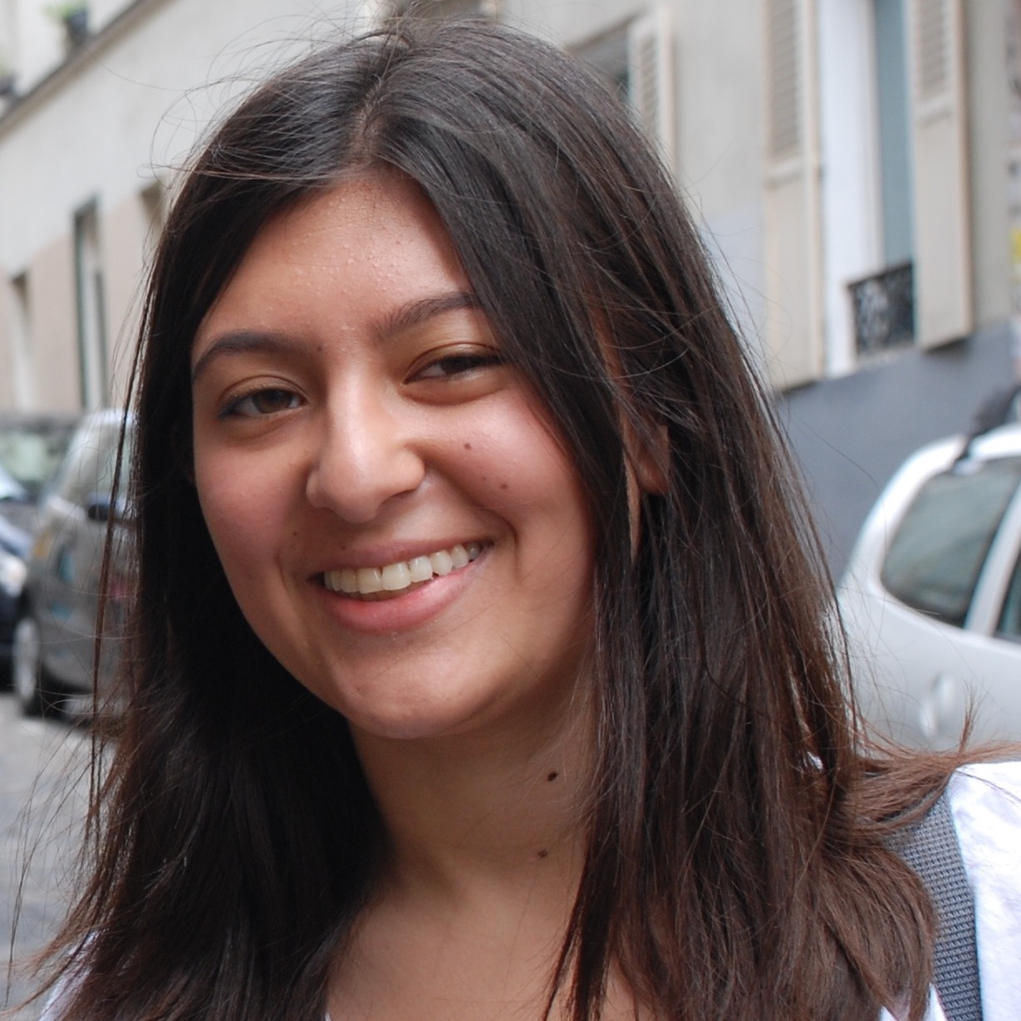
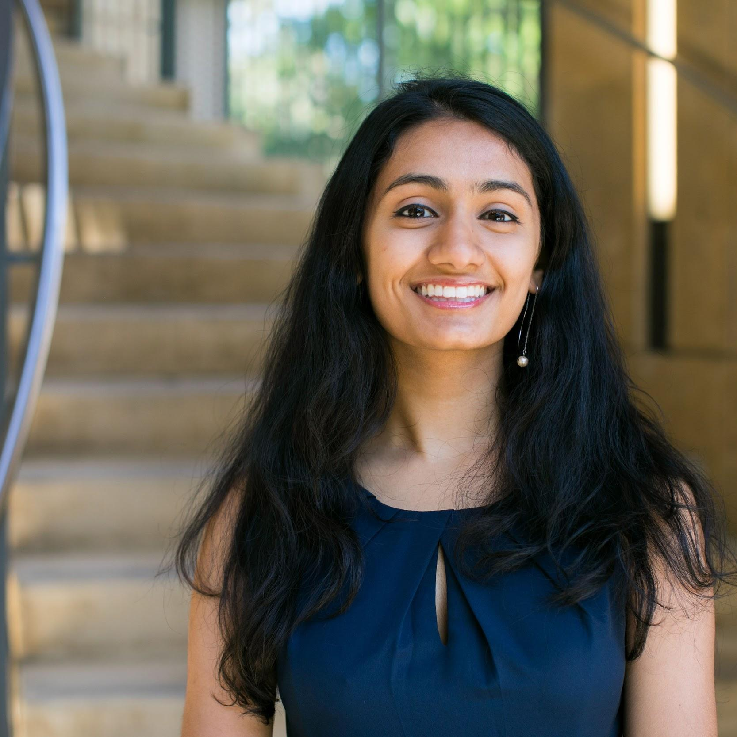
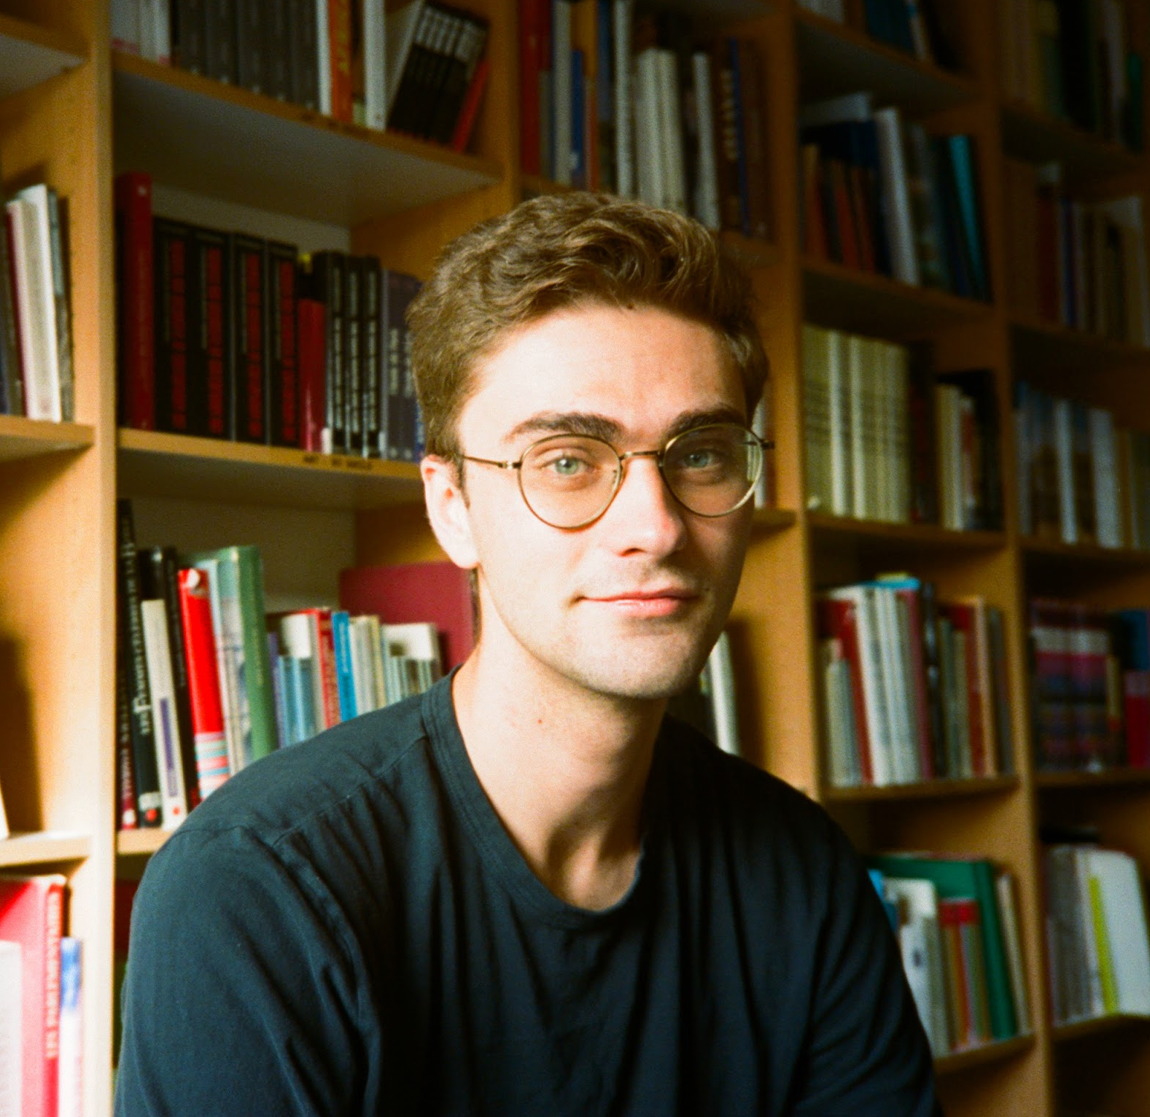
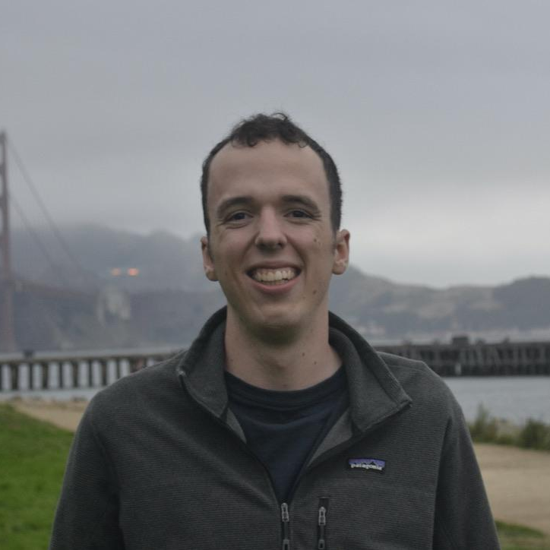
Our Team
Dhara Y.
B.S. Symbolic Systems, M.S. Computer Science
Sejal J.
B.S. Computer Science
Will B.
B.S Computer Science
Peter B.
B.S/M.S. Computer Science

Slide 3
Our Problem Space
Passion project creators
...and their fans
Smaller-scale “influencers” who have a unique talent and share it with a broader audience on social media
Notes:
We’re interested in building something for passion project creators, who we’ve defined as smaller-scale influencers who have a unique talent that they share on social media. We’ve now broadened our focus to include the perspective of their fans as well.

Slide 4
1.
Initial POVs

Slide 5
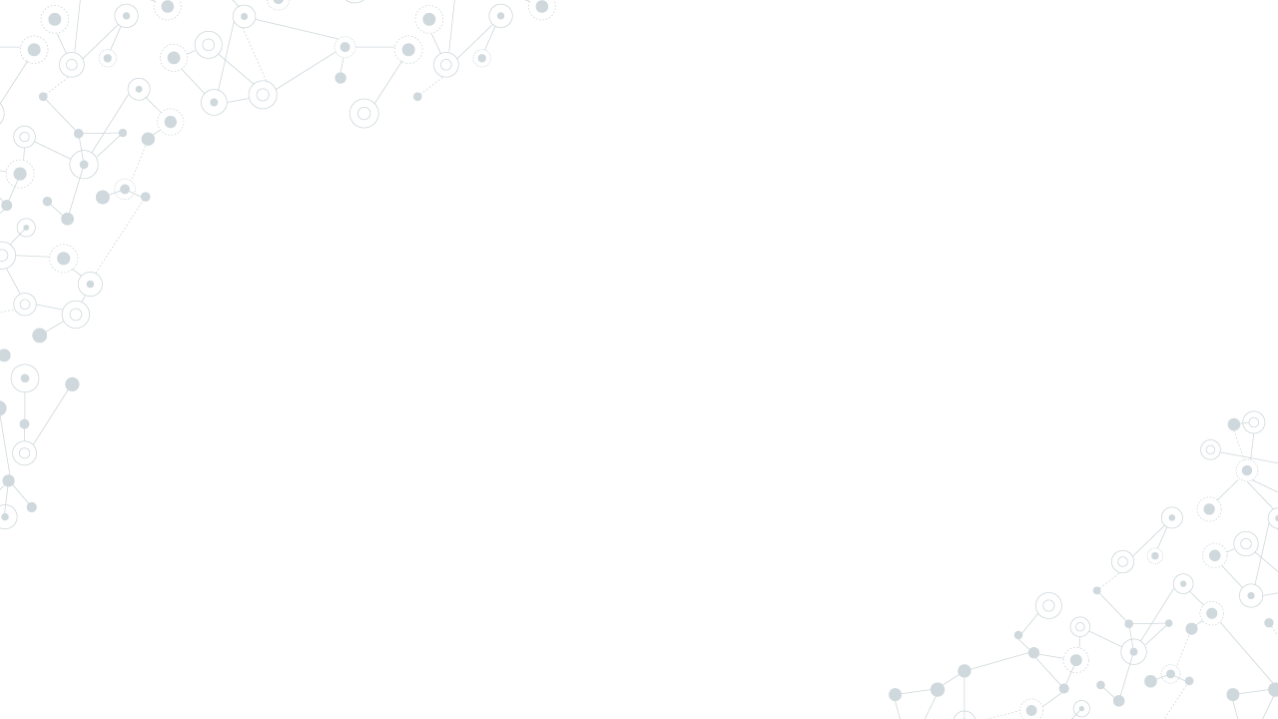
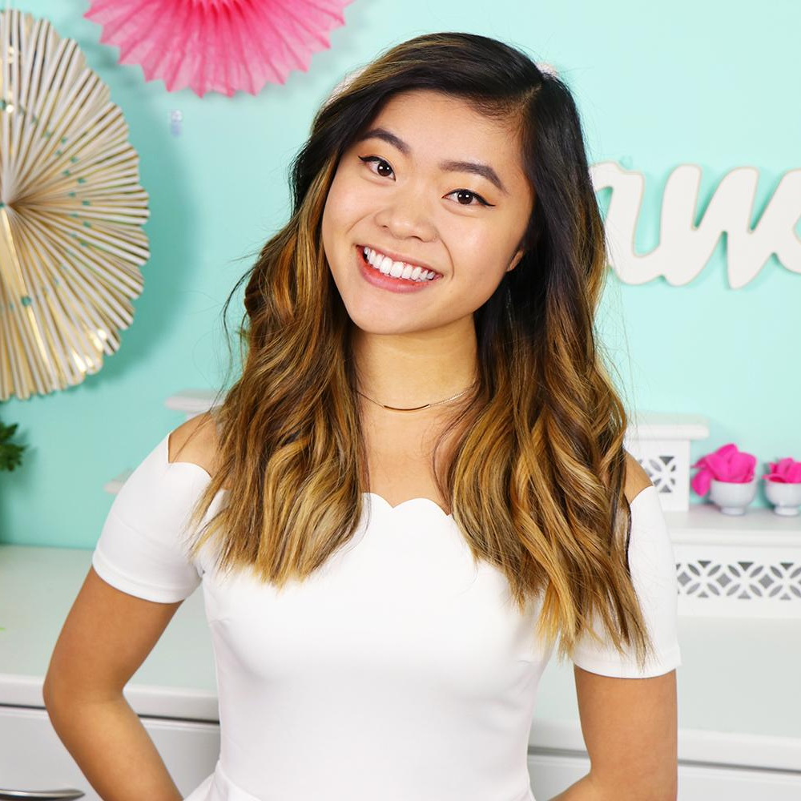
Rachel, a Youtube creator who produced popular baking videos.
She would only read/respond to comments within the first hour of her posting a video because she knew they came from committed fans.
Make the experience of engaging with her fan community regularly positive, constructive and personal.
We met...
We were amazed to find...
It would be game-changing to...

Slide 6

Casey*, an 11-year-old gamer and digital art creator.
Her use of social media reinforced strong connections with existing friends.
Allow other people to forge similarly strong relationships with friends through online mediums.
We met...
We were amazed to find...
It would be game-changing to...

Slide 7
2.
Additional Needfinding

Slide 8
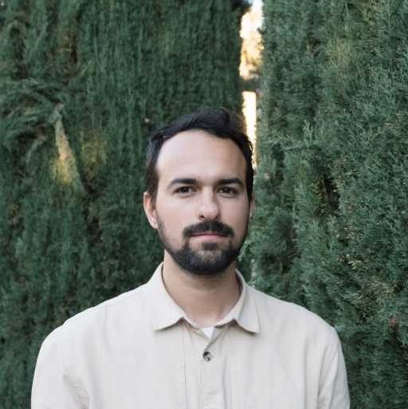
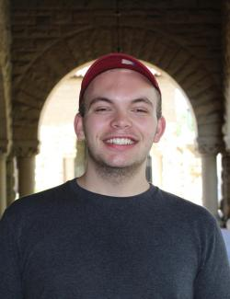
Needfinding Interviewees
Jack
Freelance journalist active in the Twitter journalism sphere
Nate
Stanford student and devoted follower of the travel blogger Ben Schlappig

Slide 9
Jack
Twitter is a key part of his job: both learning about the world and getting more visibility for his work
Social media reputation is important for journalists; editors give articles to names they recognize
Also uses Twitter personally; can justify wasting time on social media as “work”

Slide 10
Jack
“Early on, I had editors respond to my pitches because they knew me from Twitter.”
“The most unhealthy thing is just using it too much… it is work-related and it feels a lot like work.”
Notes:
This first quote captures the reality that for Jack, Twitter is extremely important for his job, to extend the reach of his content and also gain name-brand recognition
The second quote alludes to the dynamic that Jack uses Twitter both professionally and casually, and for him, the line between them has started to blur, resulting in fatigue

Slide 11
Insights
Jack views Twitter as empowering for his job and profession
A surprise: despite being a freelance writer, Jack views the rise of independent media celebrity with suspicion
A tension: posting non-journalist content might bring in more readers/assignments, but also might distract

Slide 12
Nate
Deep passion for the travel/airline industry
Has followed onemileatatime.com (travel blog of Ben Schlappig) since he was 14 years old
Reads blog daily, occasionally engages through comments

Slide 13
Nate
“A lot of people who work in the industry put on a fake, diplomatic front but he doesn’t do that… only through him I realized it’s OK to be an introvert.”
“My absolute dream would be… ‘hey, Lucky [Ben] can I take over your blog?’”
Notes:
This first quote is actually really poignant - it captures the extent to which Nate admires Ben the blogger for his authenticity, to the point where he actually gained self-confidence by reading his posts.
This second quote is in a similar vein - Nate revealed that his dream would be to take over Ben’s blog, so that really shows a sort of aspirational role-model relationship

Slide 14
Insights
Nate views Ben Schlappig as a role model, because of similar interests and Ben’s authentic persona
A surprise: Nate feels a personal connection despite never meeting Ben
A tension: Despite his relationship with Ben, Nate doesn’t feel a connection with the rest of Ben’s fans

Slide 15
3.
Revised POVs

Slide 16
Rachel, a Youtube creator who produced popular baking videos.
She would only read/respond to comments within the first hour of her posting a video because she knew they came from committed fans.
Make the experience of engaging with her fan community regularly positive, constructive and personal.
We met...
We were amazed to find...
It would be game-changing to...

Slide 17
Casey, an 11-year-old gamer and digital art creator.
Her use of social media reinforced strong connections with existing friends.
Allow other people to forge similarly strong relationships with friends through online mediums.
We met...
We were amazed to find...
It would be game-changing to...

Slide 18
Nate, a Stanford student who is obsessed with travel and the airline industry.
He’s followed the travel blog of Ben Schlappig religiously for 8 years, and views Ben as an aspirational role model.
Help foster the role model relationship between creators and superfans.
We met...
We were amazed to find...
It would be game-changing to...

Slide 19
4.
HMW Statements

Slide 20
Rachel’s POV (Make the experience of engaging with her fan community regularly positive, constructive and personal.)
HMW incentivize fans to engage constructively?
HMW we make the feeling of receiving views less like a sugar high and more like a meal?
HMW avoid the constant urge to refresh?
HMW leverage superfans’ help to help curate the community?
HMW spread the feeling of fulfillment over the entire creative process?
HMW make creators look forward to receiving feedback -- both positive and negative?

Slide 21
Casey’s POV (Allow other people to forge similarly strong relationships with friends through online mediums.)
HMW allow people to re-discover the physiological need to stop using screens?
HMW make digital interaction like going out to dinner with friends?
HMW make digital interactions naturally unwind just like in-person ones?
HMW make online relationships based on referrals/mutual friends?
HMW flip the narrative that online interactions are worse than in-person interactions?
HMW make social networks less individualistic and isolating?
HMW shame people from posting inauthentic content?
HMW root online relationships in a physical foundation?

Slide 22
Nate’s POV (Help foster the role model relationship between creators and superfans.)
HMW incentivize creators to be more authentic with fans?
HMW enable fans to contribute to their creators’ content (without infringing on the creator’s individuality)?
HMW enable creators to get more than fulfillment out of relationships?
HMW emphasize content by role model-worthy creators?
HMW scale deep mentor relationships?
HMW emulate the older sibling relationship between creators and fans?
HMW enable creators to separate mentorship relationships from their normal lives?

Slide 23
How might we...
Enable fans to contribute to creator content, without infringing on the creator’s individuality?
Spread the feeling of fulfillment over the entire creative process?
Make social networks less individualistic and isolating?
1
3
2
Creator-centric
Fan-centric

Slide 24
5.
Solutions &
Experience Prototypes

Slide 25
Solution 1
Assumptions
Create a daily digest for creators, with a more detailed but smaller sample of their stats (views, comments, etc.) to encourage less frequent, more thoughtful engagement
Creators desire more qualitative feedback to understand content performance
Creators are willing to break out of the constant-refresh mentality and engage in a slower, more periodic fashion

Slide 26
Solution 2
Assumptions
Match people based on shared fandoms in order to form friendships and plan physical meet-ups
Shared digital/media interests can help kickstart a friendship
People are willing to start a relationship online based solely on shared fandom

Slide 27
Solution 3
Assumptions
Create a digital space where creators can put their thoughts for their next work and involve fans in the entire creative process
Creators want fan suggestions/feedback over the entire development of an idea
Creators are willing to share behind-the-scenes and an unedited version of themselves
Fans want to contribute to their favorite creators’ content
Fans are interested to see the behind-the-scenes

Slide 28
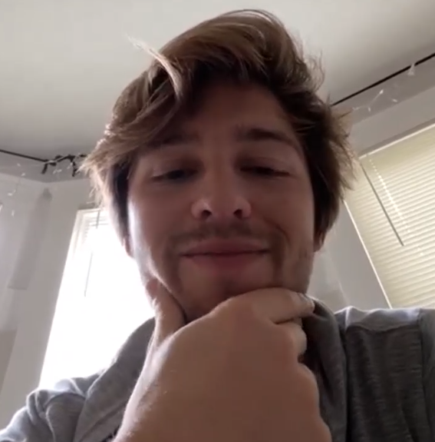
EP 1 Interviewee
Max
Stanford student who makes TikToks for his 30k followers

Slide 29
Experience Prototype (Daily Digest)
Prompt: Which of these two do you prefer?
Quantitative summary: Likes, views, engagement
Qualitative summary:
Grouped comments
A
B
Constantly monitoring stats isn’t rational
Prefers likes to any other metric
Negative comments worse than bad metrics
Weak correlation between video success and comment quality
Notes:
We did a simple A/B test to determine if Max preferred quantitative or qualitative info
Upshot: Max wants quantitative stats
Comments are not important
Quantitative algorithm -> quantitative

Slide 30
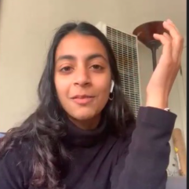
EP 2 Interviewee
Anmol
Boston student who watches the Bachelor and follows specific influencer contestants

Slide 31
Experience Prototype (Fan Matching)
Hypotheticals: Would you want to converse or meet up with another aspirational fan of Hannah G.’s travel lifestyle?
Imagine none of your existing friends wanted to travel with you to Joshua Tree. Would you be willing to meet with another fan and travel with them?
You’re a huge Pitbull fan, even more than Hannah G. Would you want to meet up with another Pitbull fan?
A
B
No, that seems weird. It’s not enough for me to meet up with someone just because of a shared social media interest. .
No, they would probably be really scary. On the other hand, I follow a wellness micro-influencer from LA. I would consider meeting with her fans since we probably have shared values.
Imagine you had no friends in a new city. Now would you do this?
C
Only if I knew them through a mutual friend, and could see them being an “in-person” “real” relationship.
Notes:
We asked Anmol several hypothetical questions about if she would be willing to meet strangers based on shared fandom
Anmol is viscerally opposed - she uses very negative language
Only conditions where she would be comfortable is if the meetup was mediated by a mutual friend

Slide 32
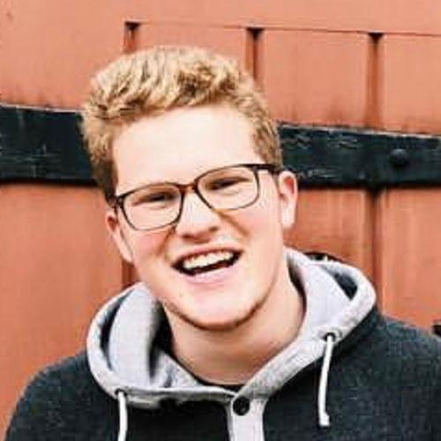
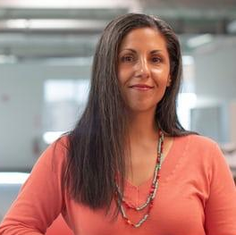
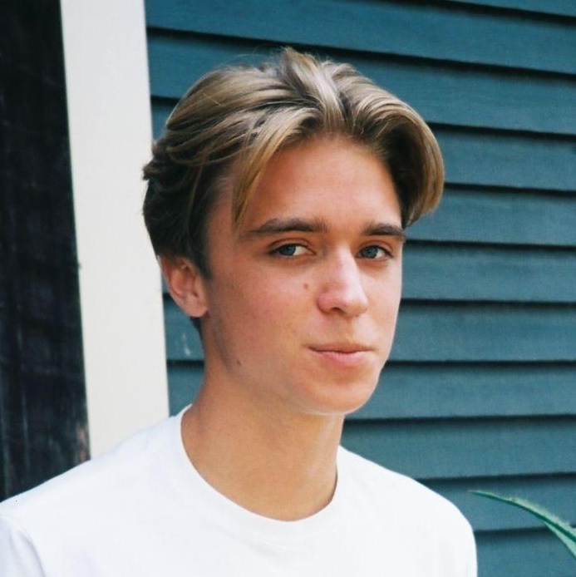
EP 3 Interviewees
Henry (Creator)
College student and Broadway-style singer who primarily shares content on TikTok
Bryan (Fan)
Film student who follows directors and other students on YouTube and Vimeo

Slide 33
Experience Prototype (Digital Workshop, Creator)
Prompt: How would you respond to the following fan comments?
-Less interested
-Requires vetting on his part; also less specific to him and his videos
-Not super specific, but feels validated by the comment
-Doesn’t feel a need to respond
Extremely detailed critique
1
3
Pure affirmation
2
4
-Favorite type of response
-Easy to reply and make a new video, and possibly give a shout-out
-Has the potential to be game-changing, but rare
-Also requires some degree of vetting
Notes:
We showed Henry 4 different comments from fans, ranging from simple affirmative things like “good job” to extremely detailed feedback, and gauged his response.
He gravitated toward medium detail, since he found that to be the most actionable

Slide 34
Experience Prototype (Digital Workshop, Fan)
Prompt: What kind of engagement with creators would you prefer?
-Not interested in leaving this feedback
- Too much effort while creating little value for creator
-Easy, great to give to friends/creators that you want to support
Extremely detailed critique
1
3
Pure affirmation
2
4
-At this level, critiques aren’t specific enough to be actionable
-Genuine, constructive critique is best
- Great to leave long form comments that you know the creator will read
Notes:
We did the same thing with Bryan, from the fan perspective, and he actually gravitated toward the extremes. But interestingly, it was for the same reason - Bryan said in his focus area, detailed critique is the most actionable form of feedback.

Slide 35
Recap of Assumptions Tested
Daily analytics digest
🤢 Creators desire more qualitative feedback to understand content performance
😐 Creators are willing to break out of the constant-refresh mentality
Matching fans with shared interests
😐 Shared digital/media interests can help kickstart a friendship
🤢 People are willing to start a relationship online based solely on shared fandom
Digital creator workshop
😍 Creators want fan suggestions throughout creative process
😐 Creators want to share an unedited version of themselves
😍 Fans want to contribute to their favorite creators’ content
😐 Fans are interested to see the behind-the-scenes

Slide 36
Summary
Shared social media tastes are not sufficient grounds for kickstarting a friendship
Some creators (perhaps content-specific) are more focused on aggregated stats to optimize growth
Other creators and fans crave affirmative content and constructive feedback at the beginning and end of the process (but not in the middle)

Slide 37
Thanks!
Any questions?

