Slide 1
Effects of the resolution and bias of the energy on the oscillation probability at T2K
M2 pre-thesis internship
Neutrino accélérateurs – Group Meeting – 18/06/2024

Slide 2
Neutrino oscillation in LBL experiments
How to measure neutrino oscillation probability in LBL ?
Assuming:
  α neutrinos detected at ND ;
  β neutrinos detected at FD ;
  a baseline L ;
  a neutrino true energy E ;
  a neutrino reconstructed energy E ;

Slide 3
Neutrino oscillation in LBL experiments

Slide 4
Neutrino oscillation in LBL experiments
Number of νβ events
Measured at FD

Slide 5
Neutrino oscillation in LBL experiments
Number of νβ events
Measured at FD
Flux of να
Measured at ND
Extrapolated at FD

Slide 6
Neutrino oscillation in LBL experiments
νβ interaction cross-section
Measured at ND
Extrapolated at FD
Number of νβ events
Measured at FD
Flux of να
Measured at ND
Extrapolated at FD

Slide 7
Neutrino oscillation in LBL experiments
νβ interaction cross-section
Measured at ND
Extrapolated at FD
Neutrino energy reconstruction
Number of νβ events
Measured at FD
Flux of να
Measured at ND
Extrapolated at FD
Detector efficiency

Slide 8
Neutrino oscillation in LBL experiments
νβ interaction cross-section
Measured at ND
Extrapolated at FD
Neutrino oscillation probability
What we want
Neutrino energy reconstruction
Number of νβ events
Measured at FD
Flux of να
Measured at ND
Extrapolated at FD
Detector efficiency

Slide 9
This model

Slide 10
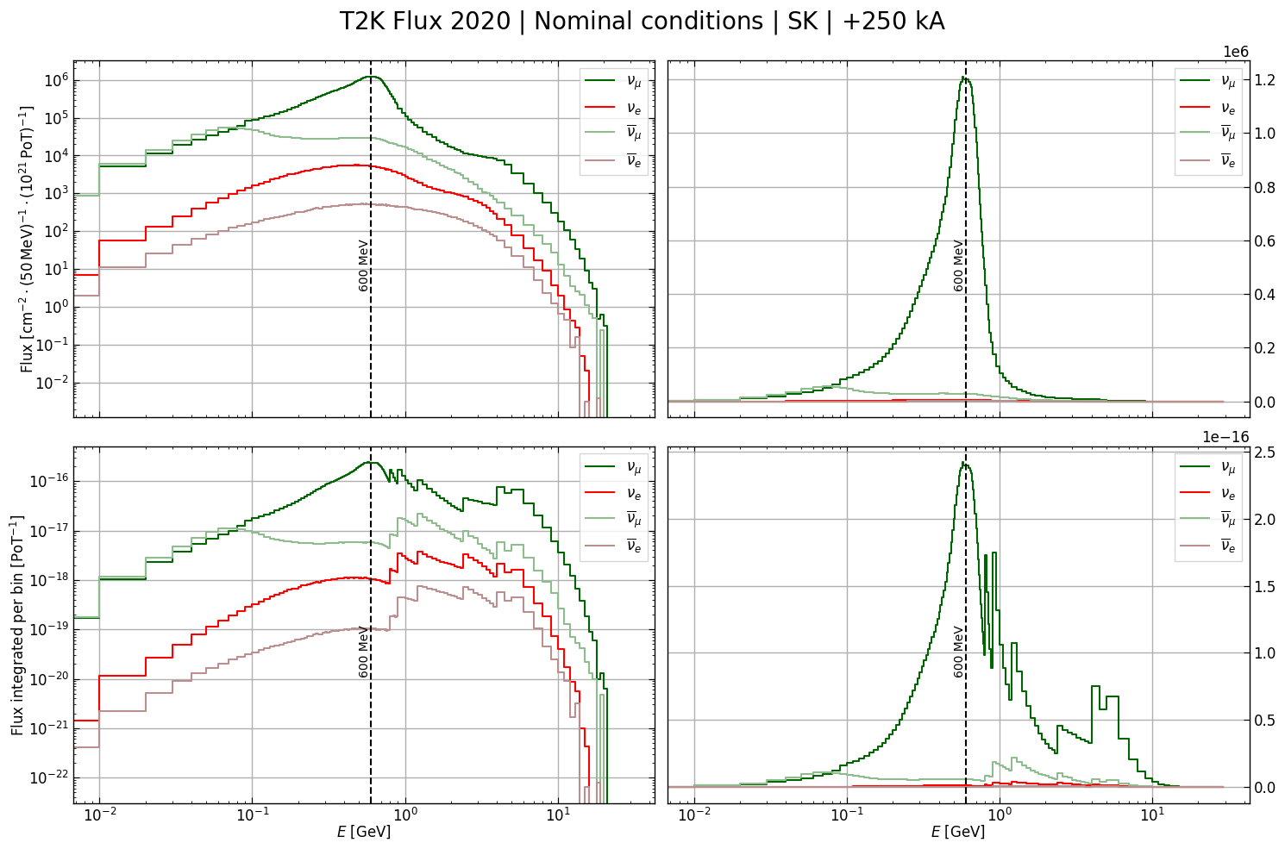
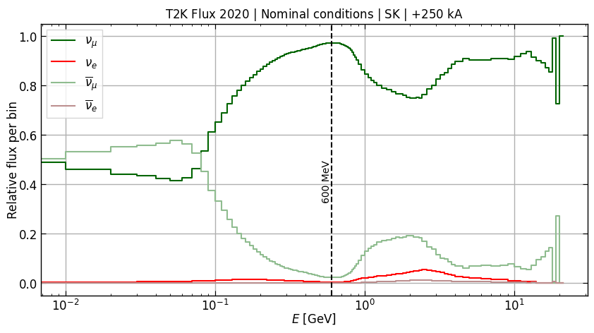
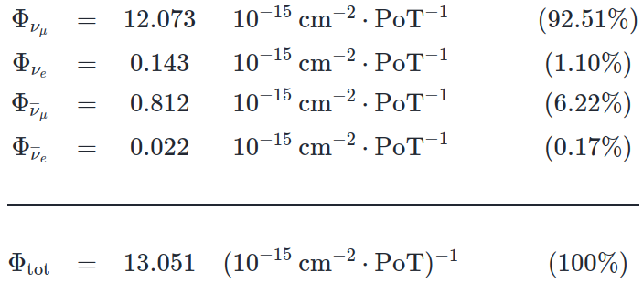
Neutrino flux at SK in FHC
Main background
‘wrong-sign’ (νμ in FHC) :
  ~1% in FHC / 10% in RHC ;
  enough stat. to constrain ;
  cannot distinguish in FD ;
νe :
  few stat. ;
  issue for νμ → νμ & νμ → νe ;

Slide 11
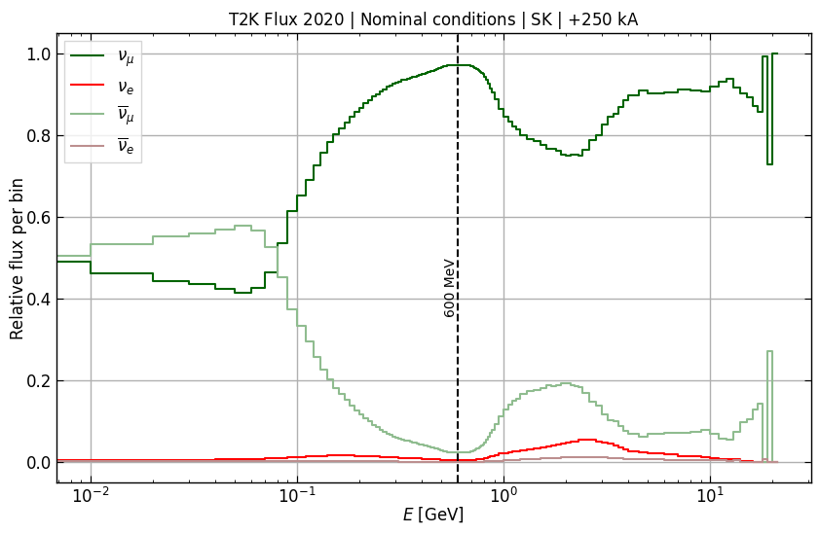
Neutrino flux at SK in FHC
Main background
‘wrong-sign’ (νμ in FHC):
  ~1% in FHC / 10% in RHC
  enough stat. to constrain
  cannot distinguish in FD
νe :
  few stat
  issue for νμ → νμ & νμ → νe
<numéro>

Slide 12
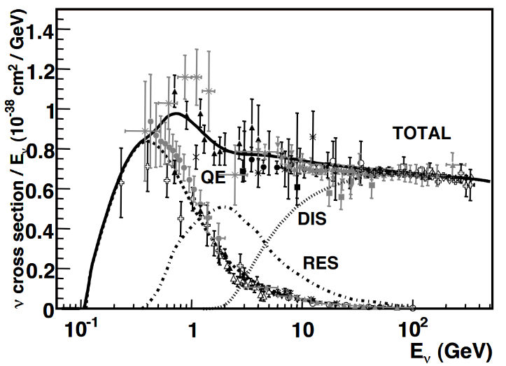
Neutrino interaction cross-section
Total neutrino per nucleon CC cross sections
J. A. Formaggio and G. P. Zeller
2012

Slide 13
Neutrino interaction cross-section
Total neutrino per nucleon CC cross sections
J. A. Formaggio and G. P. Zeller
2012
600 MeV

Slide 14
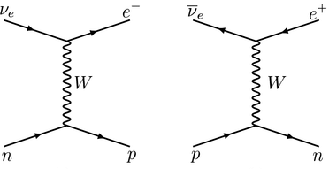
Neutrino interaction cross-section
Total neutrino per nucleon CC cross sections
J. A. Formaggio and G. P. Zeller
2012
CCQE
Charged-Current Quasi-Elastic scattering
600 MeV

Slide 15
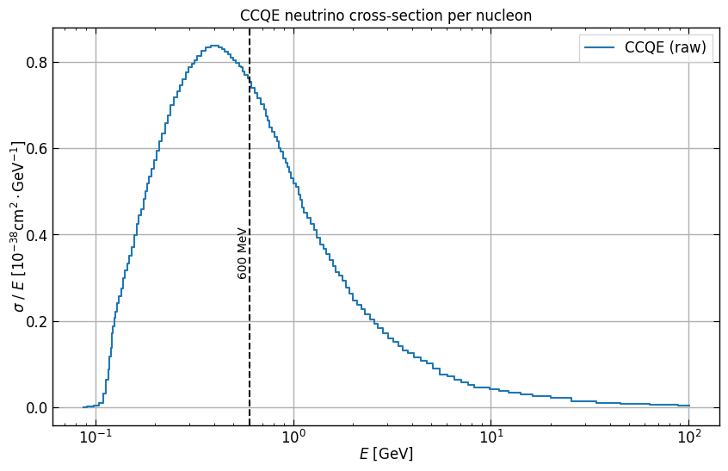
Neutrino interaction cross-section
J. A. Formaggio and G. P. Zeller
2012
digitization
<numéro>

Slide 16
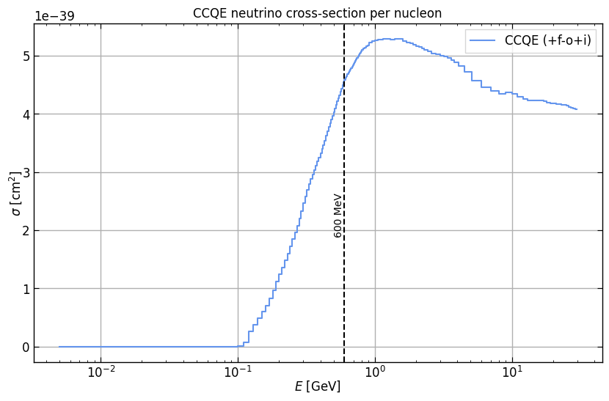
Neutrino interaction cross-section
J. A. Formaggio and G. P. Zeller
2012
numerical corrections (hidden in +f-o+i)
<numéro>

Slide 17

Neutrino number
If no oscillation and perfect energy reconstruction:

Slide 18
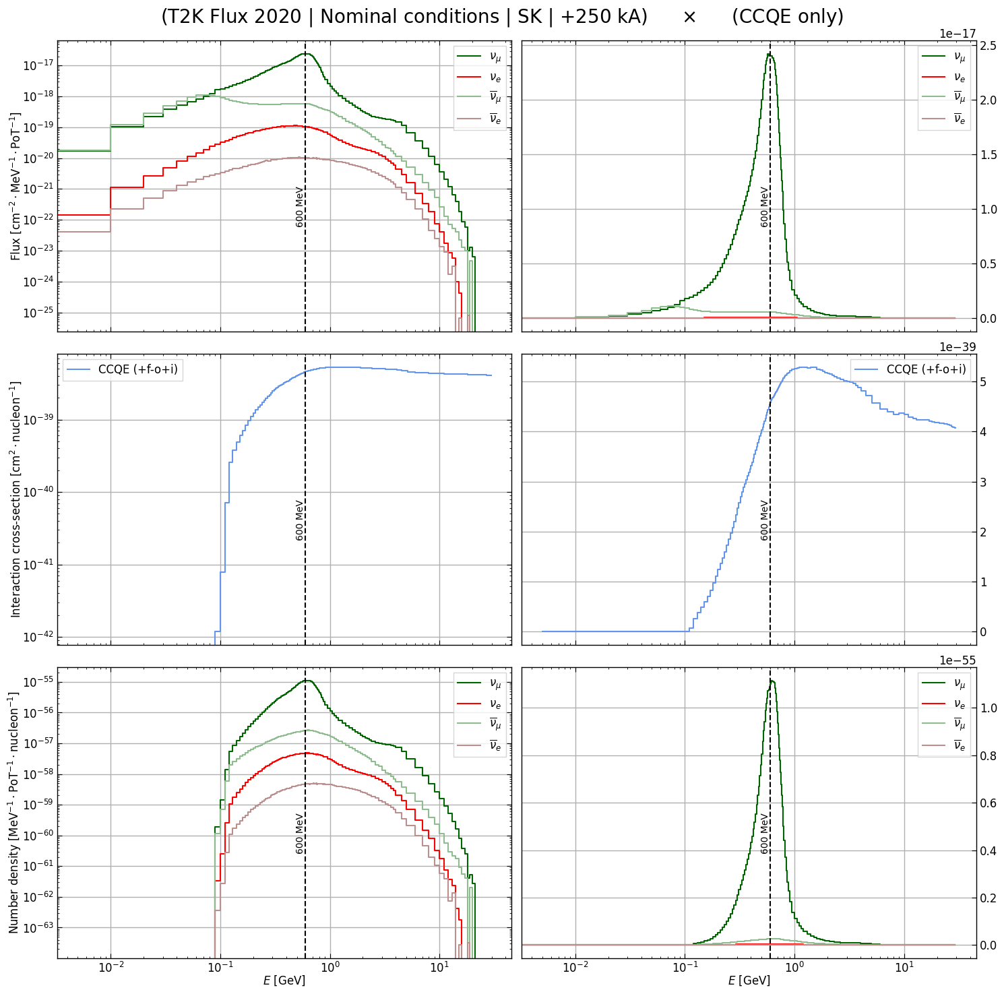
Neutrino number

Slide 19
Neutrino number
To note
Huge background at low energies suppressed
Model is customizable to:
  material (per nucleon)
  statistic (per PoT → SK to HK)

Slide 20
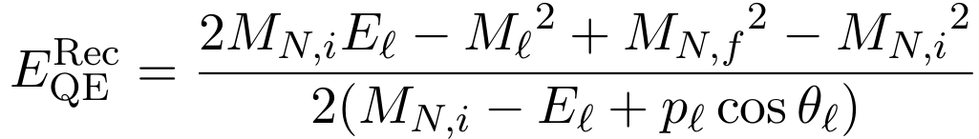
Neutrino energy reconstruction
Assuming:
  CCQE cross-section interaction only ;
  perfect detector efficiency ;
One can reconstruct the neutrino energy using final-state charged-lepton kinematics only :
with : the masses of initial, final nucleon and charged lepton ;
: the kinematics of the charged lepton.

Slide 21
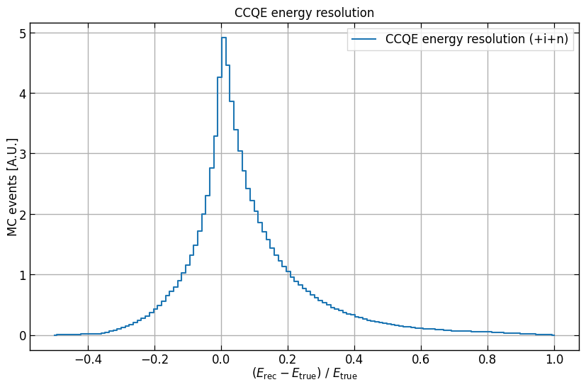
Neutrino energy reconstruction

Slide 22
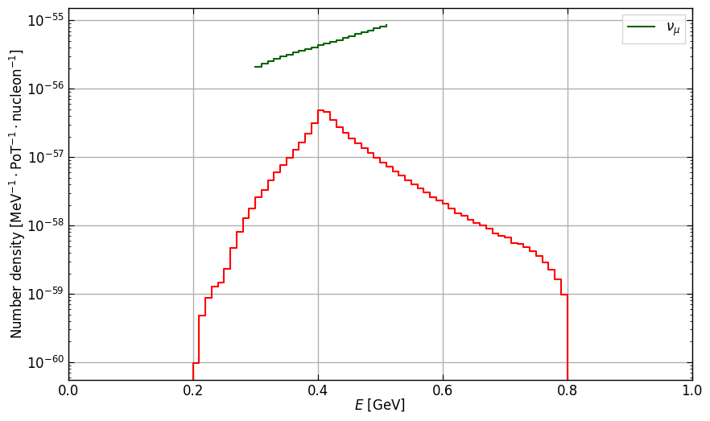
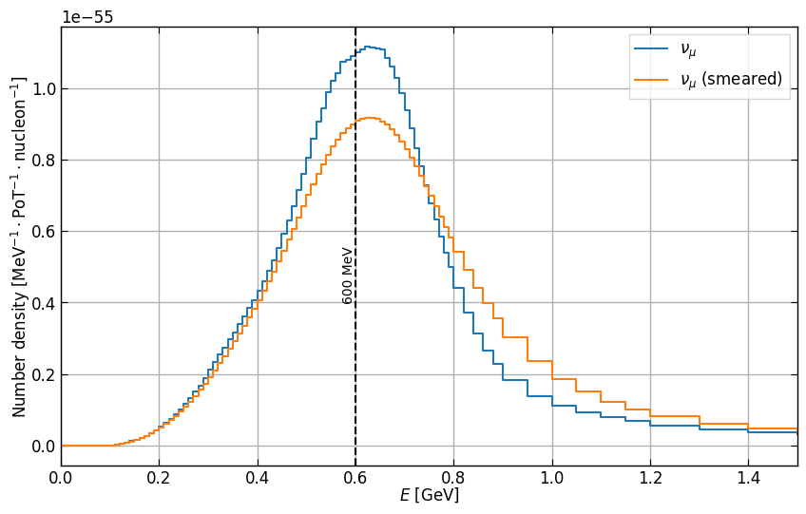
Neutrino energy reconstruction
Implementing a convolution « by hand » :
For each bin, convoluting with the CCQE energy resolution, then summing over all bins.
For 1 bin
For a curve

Slide 23
Neutrino flux at SK in FHC
Main background
‘wrong-sign’ (νμ in FHC):
  ~1% in FHC / 10% in RHC
  enough stat. to constrain
  cannot distinguish in FD
νe :
  few stat
  issue for νμ → νμ & νμ → νe
Variable bin effect
10 MeV → 1 GeV
<numéro>

Slide 24
Neutrino flux at SK in FHC
Main background
‘wrong-sign’ (νμ in FHC):
  ~1% in FHC / 10% in RHC
  enough stat. to constrain
  cannot distinguish in FD
νe :
  few stat
  issue for νμ → νμ & νμ → νe
Not very good at suppressing ‘wrong-sign’ at low energies
<numéro>

