Slide 1
AI Project2: Labelling
Authors: Piotr Mateusz Bonar – NIU: 1759684 Tom Kurowski– NIU:1761154 Marek Tutka– NIU: 1733158

Slide 2
Agenda
Problem Introduction
Modifications
Shape analysis
Color analysis
Shape and color

Slide 3
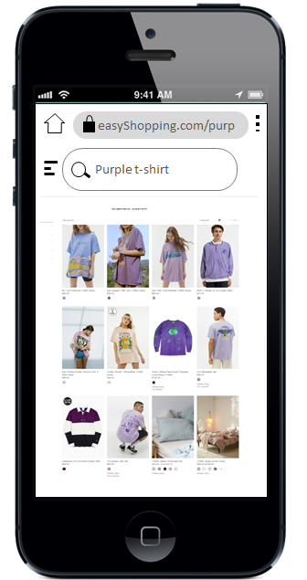
Problem Introduction

Slide 4
Modifications – KNN
Implemented Manhattan distance in additon to the Euclidean distance
Manhattan distance computes the absolute difference accross all dimensions and is knwon to be more robust to outliers in certain contexts
Evaluation of both metrics accross different values of k

Slide 5
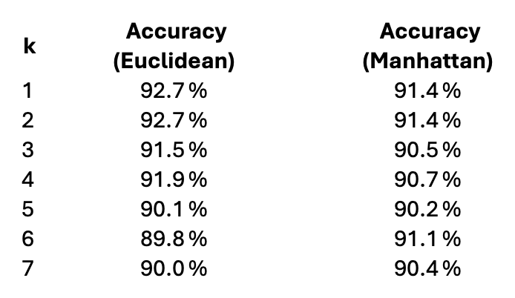
Modifications – KNN

Slide 6
Modifications – KNN
Manhattan performed slightly worse than Euclidean (especially k = 1-4)
Manhattan distances can become less informative because the differences across many dimensions accumulate evenly
Euclidean distance penalizes larger differences more strongly due to squaring, which may help emphasize meaningful pixel-level variations in grayscale images of clothing

Slide 7
Modifications – KMeans I
We implemented two additional heuristics to determine the optimal number of clusters (K)
Inter-Class Distance (ICD), which measures the average pairwise distance between all centroids
Fisher Criterion, which balances intra-cluster compactness with inter-cluster separation (ratio between WCD and ICD)

Slide 8
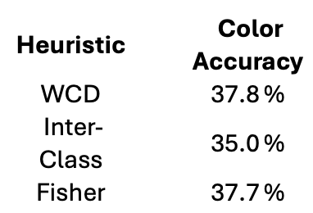
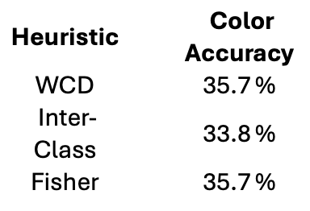
Modifications – KMeans I
km_init = "random"
km_init = "first"

Slide 9
Modifications – KMeans I
Choosing right km_init has a notable impact on color classification accuracy
WCD and Fisher achieved the highest accuracy
both compactness (WCD) and the balance between compactness and separation (Fisher) are effective criteria for selecting the number of clusters in this setting
Inter-Class Distance heuristic performed the worst across both initializations, indicating that maximizing centroid separation alone is not sufficient for good clustering performance in this task

Slide 10
Modifications – KMeans II
Refining the selection of the optimal number of clusters K
In Part 1 of the project, we used a fixed threshold of 20% improvement in within-class distance (WCD) to decide when to stop increasing K
In this part, we investigated whether varying this threshold could lead to better results

Slide 11
Modifications – KMeans II
 | thr=0% | thr=5% | thr=10% | thr=15% | thr=20% | thr=25% | thr=30% | thr=35% | thr=40% | thr=45% | thr=50%
K=2: | 39.0 | 39.3 | 39.8 | 39.2 | 39.0 | 40.8 | 41.1 | 40.8 | 37.0 | 36.0 | 36.3
K=3: | 30.0 | 32.6 | 37.9 | 37.2 | 36.8 | 36.1 | 34.4 | 31.9 | 30.6 | 30.5 | 30.6
K=4: | 29.5 | 34.8 | 39.1 | 38.1 | 35.7 | 34.9 | 33.5 | 31.2 | 30.5 | 30.3 | 30.3
K=5: | 28.4 | 38.7 | 41.3 | 39.7 | 36.2 | 33.9 | 33.9 | 32.9 | 33.0 | 33.0 | 33.0
K=6: | 28.6 | 43.9 | 48.4 | 43.6 | 40.8 | 39.3 | 38.8 | 38.0 | 38.0 | 38.0 | 38.0
K=7: | 27.4 | 43.2 | 44.2 | 41.6 | 39.3 | 38.8 | 38.6 | 38.3 | 38.3 | 38.3 | 38.3
K=8: | 27.9 | 45.0 | 43.9 | 41.5 | 40.6 | 40.0 | 40.0 | 39.7 | 39.7 | 39.7 | 39.7

Slide 12
Shape accuracy
Knn(K=6)
Knn(K=3)
 | Precision | Recall | F1-score
Dresses | 90.8% | 95.7% | 93.2%
Flip Flops | 73.2% | 84.5% | 78.5%
Handbags | 94.7% | 95.7% | 95.2%
Heels | 84.6% | 77.8% | 81.1%
Jeans | 95.7% | 94.6% | 95.1%
Sandals | 89.5% | 81.9% | 85.6%
Shirts | 98.9% | 95.9% | 97.4%
Shorts | 90.0% | 90.0% | 90.0%
Socks | 93.5% | 92.6% | 93.0%
 | Precision | Recall | F1-score
Dresses | 90.7% | 94.6% | 92.6%
Flip Flops | 75.7% | 89.7% | 82.1%
Handbags | 97.8% | 96.8% | 97.3%
Heels | 95.3% | 82.8% | 88.6%
Jeans | 92.8% | 96.8% | 94.7%
Sandals | 87.8% | 84.0% | 85.9%
Shirts | 97.9% | 96.9% | 97.4%
Shorts | 91.0% | 90.0% | 90.5%
Socks | 98.9% | 92.6% | 95.6%
accuracy: 89.8%
accuracy: 91.5%

Slide 13
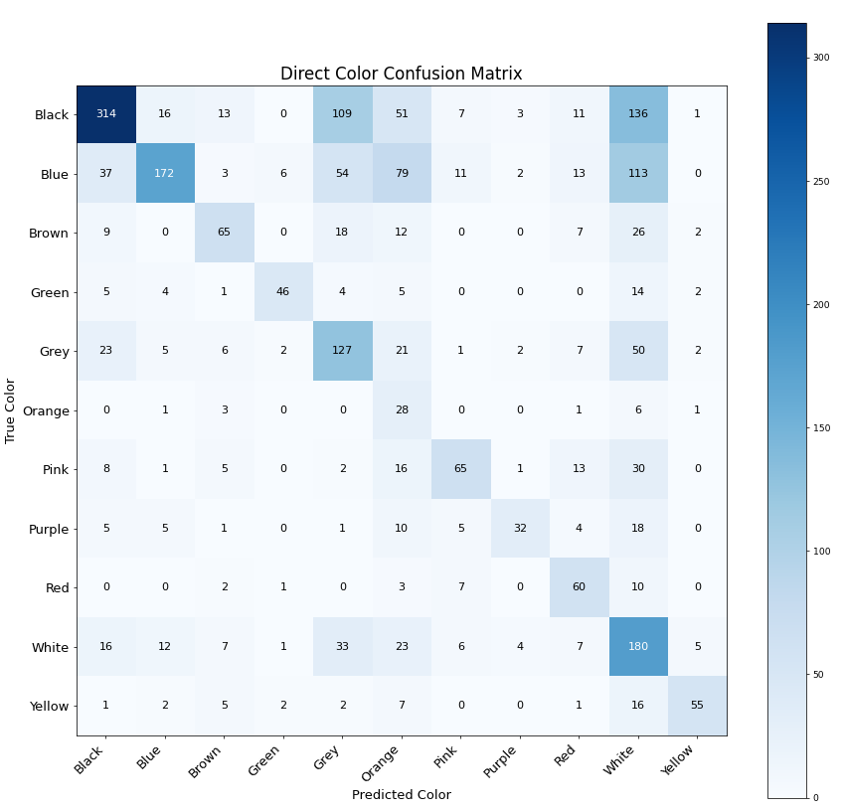
Color accuracy Kmeans(K=6,threshold=0.1,km_init="first") Overall accuracy: 48.4%
Overall accuracy: 37.8%
 | Precision | Recall | F1-score
Black | 0.81 | 0.64 | 0.71
Blue | 0.88 | 0.55 | 0.67
Brown | 0.56 | 0.31 | 0.40
Green | 0.80 | 0.31 | 0.44
Grey | 0.58 | 0.52 | 0.55
Orange | 0.08 | 0.12 | 0.10
Pink | 0.83 | 0.38 | 0.53
Purple | 0.40 | 0.25 | 0.31
Red | 0.40 | 0.40 | 0.40
White | 0.24 | 0.74 | 0.37
Yellow | 0.50 | 0.20 | 0.29

Slide 14
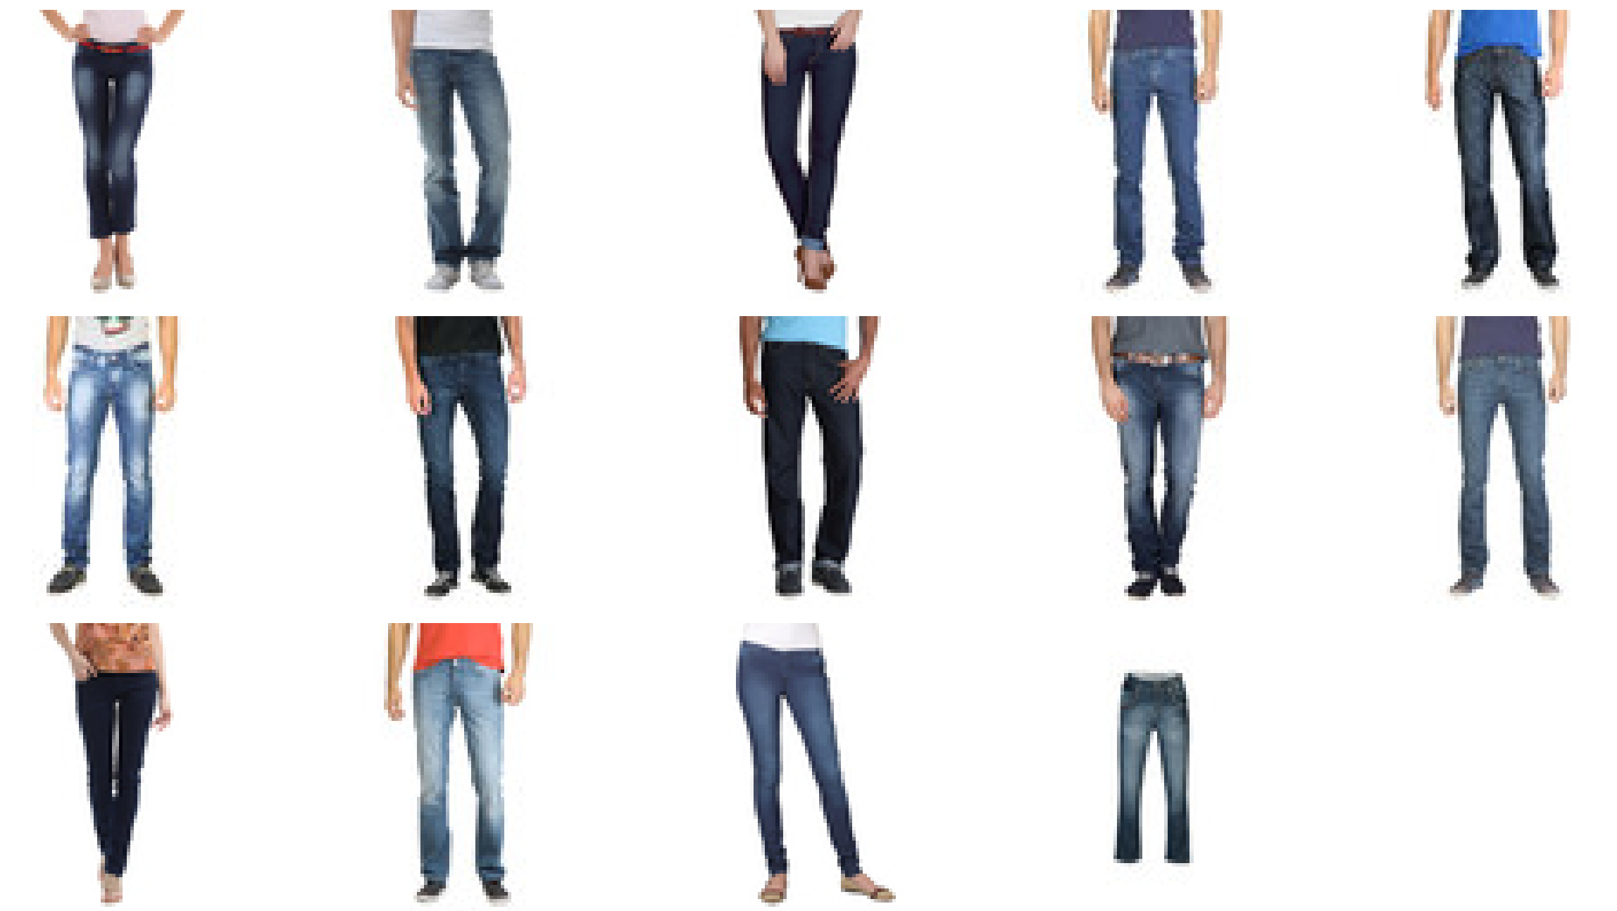
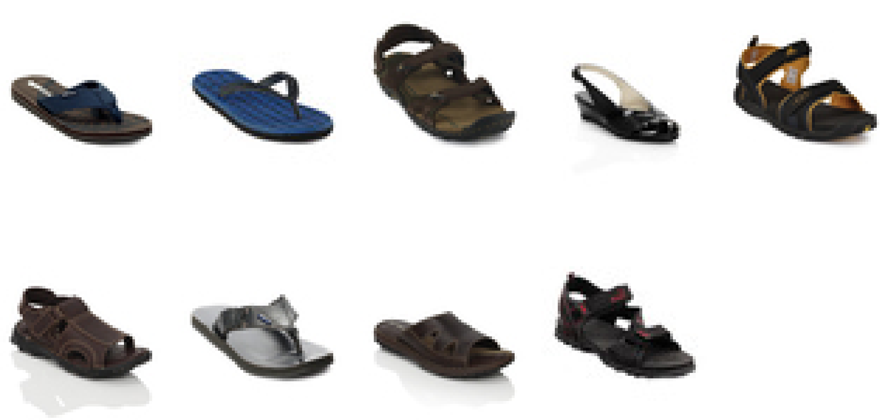
Color and shape retrieval Using: Knn(K=3), Kmeans(K=6,threshold=0.1,km_init="first")
Looking for Black Sandals
Looking for: Blue Jeans

Slide 15
Thank you!

