Slide 1

SCHOOL OF COMPUTER SCIENCE AND ENGINEERING
IILM University, Greater Noida, U.P.
Internship Report
Data Science Master
Virtual Internship
In partial fulfilment of the requirement for the degree of Bachelor of Technology in Computer Science and Engineering
Student Pallavi Bora
Roll Number 25SCS1003003067
Batch 2025-29
2026 – 27

Slide 2

FRONT MATTER
Candidate's Declaration
I, Pallavi Bora, do hereby declare that the internship report titled “Data Science Master Virtual Internship” has been completed by me to fulfil the requirement for the award of the degree of Bachelor of Technology in Computer Science and Engineering.
All the references have been duly quoted, and I have not made use of any material from any other source without acknowledgement. I affirm that this report is my own original work and has not been submitted to any other institute for any degree or diploma requirement. I shall be solely responsible for any kind of copyright violation in this regard.
Originality
Affirmed
This report represents independent work completed under the AICTE–EduSkills virtual internship framework.
Pallavi Bora
Roll No.: 25SCS1003003067
Data Science Master Virtual Internship | Pallavi Bora | IILM University
2

Slide 3

FRONT MATTER
Acknowledgement
I am using this opportunity to express my gratitude to everyone who supported me throughout the internship program. I am thankful for their aspiring guidance, invaluable constructive criticism, and friendly advice extended to me during this work.
I am sincerely grateful to them for sharing their truthful and illuminating views on a number of issues related to this work. I would also like to express my heartfelt gratitude to my parents for their blessings and continued support.
Pallavi Bora
Roll No.: 25SCS1003003067
Data Science Master Virtual Internship | Pallavi Bora | IILM University
3

Slide 4
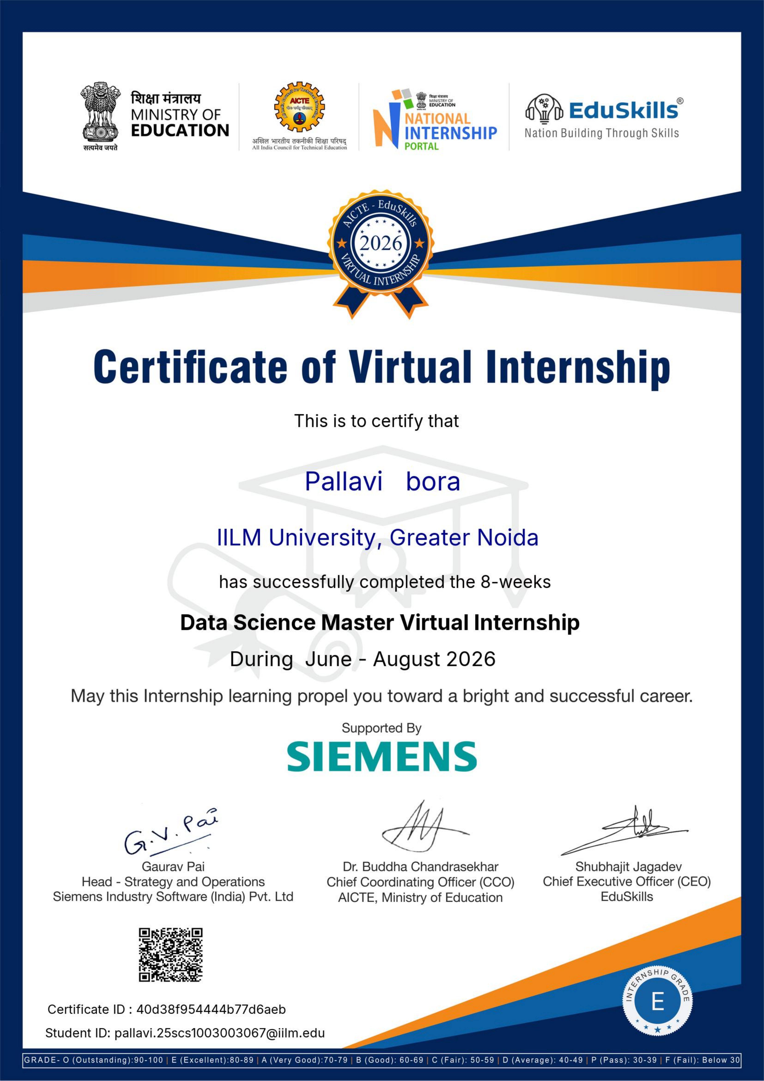
PROJECT DESCRIPTION · 4.10
Internship Completion Certificate
The internship completion certificate issued jointly by AICTE, EduSkills, and Siemens records successful completion of the Data Science Master Virtual Internship from June 2026 to August 2026, with an overall grade of E (Excellent).
Data Science Master Virtual Internship | Pallavi Bora | IILM University
4

Slide 5



4.1
Introduction
This report summarises the Data Science Master Virtual Internship, undertaken under the AICTE–EduSkills National Internship Portal initiative and supported by Siemens Industry Software (India) Pvt. Ltd. Completed over an 8-week duration (June–August 2026) alongside the B.Tech CSE programme at IILM University, the internship combined structured weekly modules, practical assessments, and a project-based approach to bridge the gap between academic learning and industry practice — using the RapidMiner AI Hub and associated Siemens data science tools.
Delivery mode
Fully virtual, self-paced
Duration
8 weeks, June – Aug 2026
Platform
RapidMiner AI Hub
Goal of the internship
Bridge academic learning with real-world data engineering, machine learning, and platform administration practice.
Data Science Master Virtual Internship | Pallavi Bora | IILM University
5

Slide 6


4.2
Organization Profile
Siemens Industry Software
EduSkills Foundation
AICTE National Internship Portal
Global leader in industrial software and digital transformation; provides the RapidMiner platform and domain expertise.
AICTE-recognised skilling partner; responsible for curriculum design, learner assessment, and credential issuance.
Ministry of Education initiative connecting students nationwide with structured virtual internship opportunities.
Data Science Master Virtual Internship | Pallavi Bora | IILM University
6

Slide 7

4.3
Problem Statement
Organisations today generate large volumes of data but often lack skilled professionals capable of transforming this data into actionable business insight using structured, repeatable machine learning workflows.
The internship addressed this gap by developing practical competencies to identify suitable business problems for AI/ML, access and prepare data, build and evaluate machine learning models, and deploy and administer these models on an enterprise-grade platform — skills directly transferable to real industry data science roles.
Core gap addressed
Data volume → skilled talent → actionable, repeatable ML workflows
Data Science Master Virtual Internship | Pallavi Bora | IILM University
7

Slide 8



4.4
Project Objectives
Frame business problems as data science and ML use cases.
Access, load, transform, and calculate data using industry tools.
Build foundational and advanced machine learning models.
Master advanced data preparation and automation techniques.
Deploy, monitor, and maintain ML models in production-like settings.
Configure and administer the RapidMiner AI Hub platform.
Data Science Master Virtual Internship | Pallavi Bora | IILM University
8

Slide 9
4.5
Scope of the Project
The scope of this internship was limited to the structured, week-wise virtual curriculum defined by Siemens and EduSkills under the “Data Science Master” track — covering the complete lifecycle of a data science project.
1
2
3
4
›
›
›
Problem
Identification
Data
Engineering
Model Building
& Evaluation
Deployment &
Administration
Note: the internship focused on guided modules, weekly assessments, and a final assessment test using simulated business scenarios — it did not involve deployment on a live external client project.
Data Science Master Virtual Internship | Pallavi Bora | IILM University
9

Slide 10
4.6
Technologies & Tools Used
RapidMiner Studio & AI Hub
Data Engineering Tools
Data preparation, model building, and platform administration.
Accessing, loading, and transforming structured and unstructured data.
Machine Learning Algorithms
AICTE EduSkills Portal
Classification, regression, and clustering across professional and master modules.
Weekly assessments, documentation submission, and credential evaluation.
Data Science Master Virtual Internship | Pallavi Bora | IILM University
10

Slide 11

4.7
System Architecture
The learning environment followed a typical enterprise data science pipeline across four architectural layers:
01
Data Access & Ingestion
Connecting to and loading raw data sources.
02
Data Preparation
Cleaning, transforming, and enriching data.
03
Modeling
Training, validating, and tuning ML algorithms.
04
Deployment & Administration
Publishing, monitoring, and managing models via RapidMiner AI Hub.
Data Science Master Virtual Internship | Pallavi Bora | IILM University
11

Slide 12
4.8
Methodology — Week-wise Structure
Week | Module | Focus
1 | Applications & Use Cases – Professional | Identifying business problems suitable for AI/ML
2 | Data Engineering – Professional | Accessing, loading, transforming, and calculating data
3 | Machine Learning – Professional | Building foundational machine learning skills
4 | Data Preparation – Master | Advanced data handling and automation
5 | Machine Learning – Master | Advanced machine learning techniques
6 | Applications & Use Cases – Master | Deploying and monitoring ML models
7 | Platform Administration – Master | Configuring and managing RapidMiner AI Hub
8 | Platform Administration – Master | Enterprise-level platform operations
Data Science Master Virtual Internship | Pallavi Bora | IILM University
12

Slide 13
4.9
Expected Outcomes
Developed a strong conceptual understanding of the end-to-end data science and machine learning workflow.
Gained practical, hands-on skills in data engineering, model building, and model deployment using RapidMiner.
Acquired platform administration skills necessary for managing enterprise AI/ML solutions.
Successfully completed all weekly assessments and the Final Assessment Test, earning the Virtual Internship Certificate.
Strengthened employability and confidence in applying data science concepts to real-world business problems.
Data Science Master Virtual Internship | Pallavi Bora | IILM University
13

Slide 14
CHAPTER 5
Bibliography / References
1
AICTE – EduSkills National Internship Portal, “Data Science Master Virtual Internship Programme,” Ministry of Education, Government of India, 2026.
2
Siemens Industry Software (India) Pvt. Ltd., RapidMiner AI Hub – Official Documentation, 2026.
3
EduSkills Foundation, Internship Offer Letter, Ref. No. C17Y2026M081503620, 2026.
4
EduSkills Foundation, Certificate of Virtual Internship, Certificate ID: 40d38f954444b77d6aeb, 2026.
5
IILM University, School of Computer Science and Engineering. (2026–27). Internship Report Format, updated 2026–27.
Data Science Master Virtual Internship | Pallavi Bora | IILM University
14

Slide 15
Thank You
Pallavi Bora • Roll No. 25SCS1003003067 • B.Tech CSE, 2025-29
School of Computer Science and Engineering | IILM University, Greater Noida, U.P.

