Slide 1
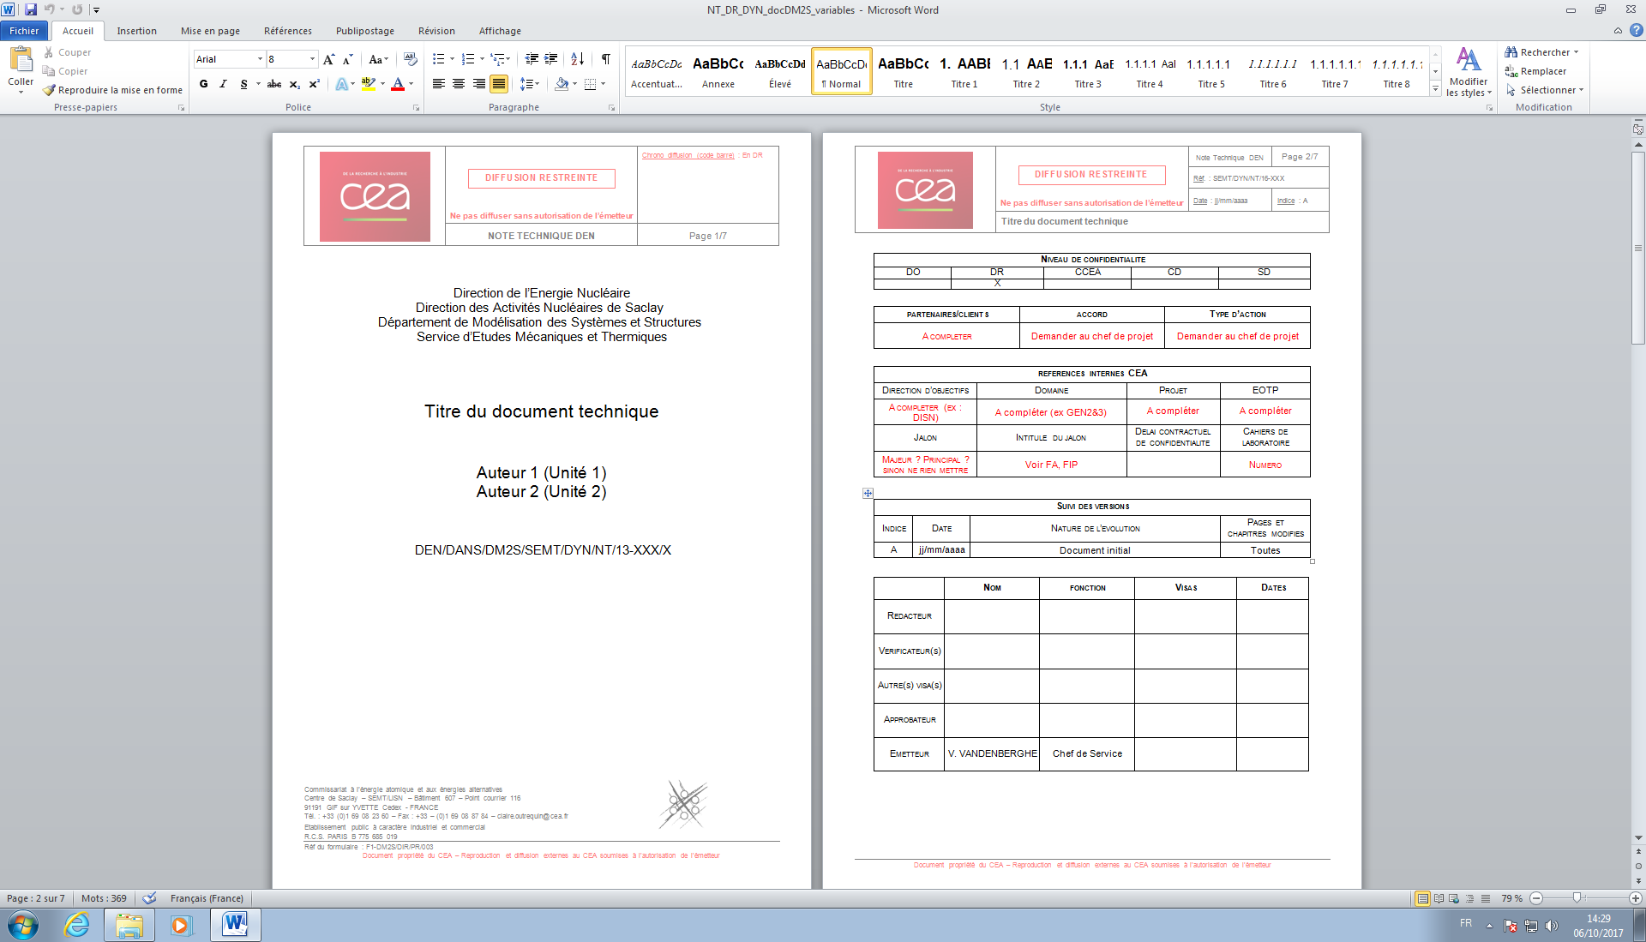
\ifdm@s@DiffusionRestreinte
…
\ifdm@s@haveBarCode{… {\dm@s@codebarre} …}
\if…
{CEA/DEN/DANS/DM2S/ \dm@s@referenceNumber/\dm@sdiffusion}
\dm@s@direction
…
\dm@s@titre
\dm@s@auteurAName
\ifdm@s@DiffusionNouR
\if…
\else
{\Large {\dm@s@ReferenceAName\ CEA/\dm@s@abrDirection/\dm@s@abrSousDirection/\dm@s@abrDepartement/\dm@s@referenceANumber}} \\
\fi
\else
{\Large {\textcolor{red}{\dm@s@ReferenceAName\ CEA/\dm@s@abrDirection/\dm@s@abrSousDirection/\dm@s@abrDepartement/\dm@s@referenceANumber}}} \\
\fi

