Slide 1
Predicting Horse Racing Results Metis Project 3
By: Patrick Bovard
February 9, 2021

Slide 2
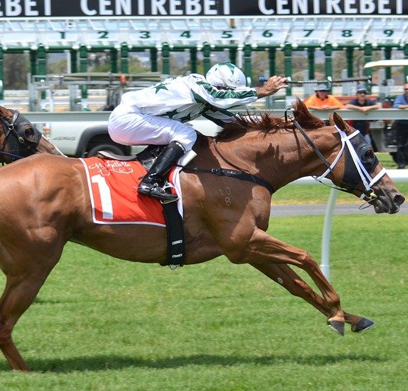
Agenda
Project Introduction
Methods and Feature Engineering
Final Model and Results
Use Example
Challenges
Future Improvements
Notes:
Image; https://cdn.pixabay.com/photo/2014/06/30/15/39/horses-380402_960_720.jpg

Slide 3
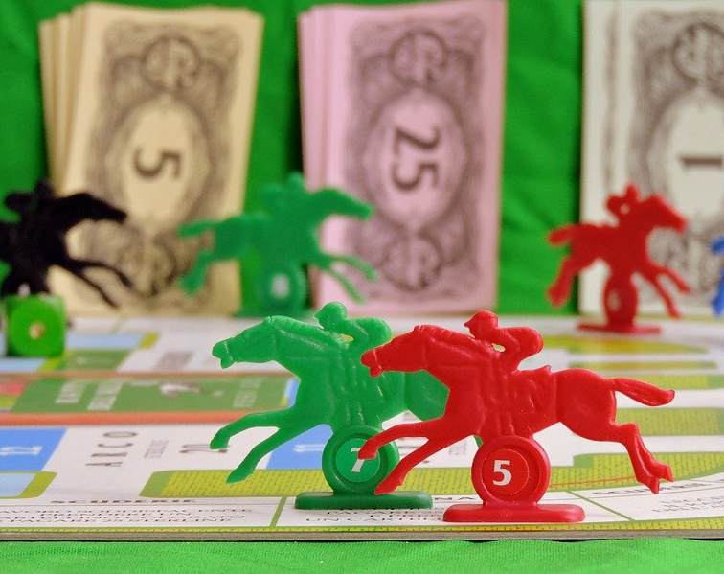
Horse Racing is a multi-billion-dollar industry
Prize money from races is over $3.5 billion per year *
Over $100 billion wagered annually on horse races*
Almost $16 billion wagered with the Hong Kong Jockey club in the last year alone**
Can machine learning be utilized to make informed race predictions?
*https://www.americasbestracing.net/the-sport/2017-american-horse-racing-vs-the-world-whats-the-same-whats-different
**https://www.drf.com/news/hong-kong-jockey-club-handles-158-billion-2019-20-season
Notes:
Image: https://cdn.pixabay.com/photo/2016/07/30/00/34/game-1556220_960_720.jpg

Slide 4

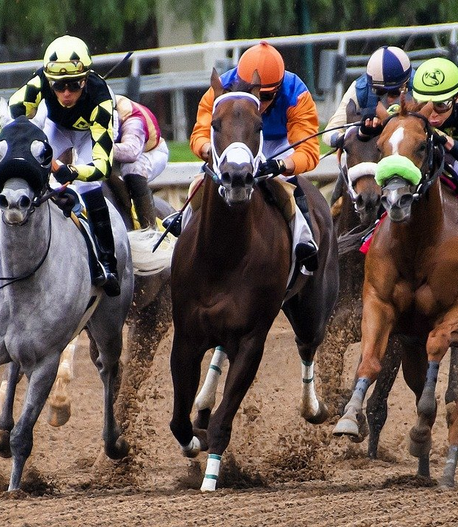
Project Goal: Build a model that can successfully predict horse racing results in Hong Kong
Data Set
Graham Daley’s Hong Kong Racing Data from Kaggle
Features:
Physical Horse Data
Previous Racing Stats
Comparison to the Field
Classification Classes:
Show (Place 1st, 2nd, or 3rd)
Not Show (Place 4th or lower)
Evaluation Metrics:
Precision
Fbeta (beta=0.5)
Notes:
Image: https://cdn.pixabay.com/photo/2018/11/12/17/04/horses-3811270_960_720.jpg

Slide 5




Tools such as Pandas, Python, PostgreSQL, and Scikit-Learn were used to iteratively build and improve a classification model
Precision: 60.7%
Fbeta: 0.474
Precision: 28.67%
Fbeta: 0.218
Precision: 54.4%
Fbeta: 0.299
Precision: 60.5%
Fbeta: 0.464
TUNING HYPERPARAMETERS
Included horse specific physical data
Horse rating, weight, age, sex, etc.
Added Previous Race Stats: Rolling Averages for Finish Time, Speed, etc.
Added comparison stats to field for weight, rating, etc.
Added odds to show, race distance, and horses in the race after observing residuals
Added top jockey/trainer, home country
Selected Model: XGBoost
Added Days Since Last Race, In Race Rolling Averages
Added strong interaction terms
Notes:
Pandas Image:https://www.google.com/imgres?imgurl=https%3A%2F%2Fupload.wikimedia.org%2Fwikipedia%2Fcommons%2Fthumb%2Fe%2Fed%2FPandas_logo.svg%2F1200px-Pandas_logo.svg.png&imgrefurl=https%3A%2F%2Fen.wikipedia.org%2Fwiki%2FPandas_(software)&tbnid=MTMzvicOHQ05jM&vet=12ahUKEwio-ZTDmK7uAhWLcqwKHZWyByAQMygAegUIARDHAQ..i&docid=Ygt6gmGWi6_zsM&w=1200&h=485&q=pandas%20python&ved=2ahUKEwio-ZTDmK7uAhWLcqwKHZWyByAQMygAegUIARDHAQ
- Scikit Learn logo:
https://www.google.com/url?sa=i&url=https%3A%2F%2Fen.wikipedia.org%2Fwiki%2FScikit-learn&psig=AOvVaw1PIq5qQhvyBZa9TEaKQHiV&ust=1611358724402000&source=images&cd=vfe&ved=0CAIQjRxqFwoTCIjzhJaZru4CFQAAAAAdAAAAABAD

Slide 6
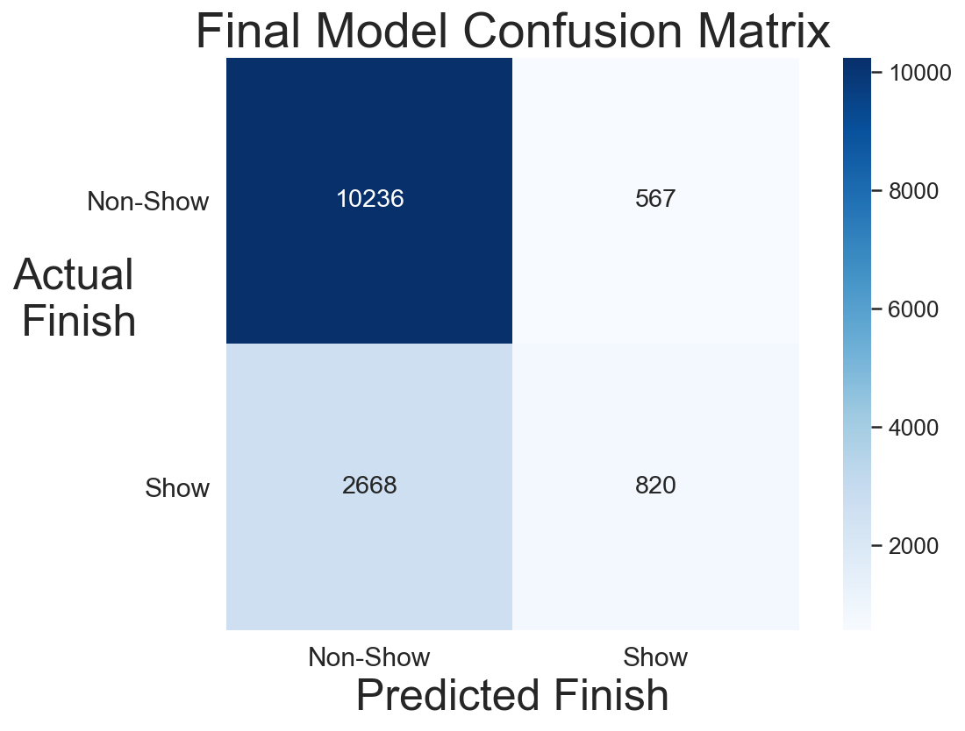
Final Model: XGBoost Classifier
Test Precision: 59.1%
Test Fbeta: 0.454
Features w/ most importance (gain):
Place Odds (several interaction terms)
Horse Rating
Applied Weight
Rolling Averages: Lengths Behind Leader, Speed, Time Drop
Career Show Rate
Top 10 Jockey/Trainer

Slide 7
The show probabilities from the model can be utilized to evaluate a racing field
Race 4659 - Card
By assigning probabilities, the model can go beyond hard classification
Horse | Show Odds | Show Probability | Race Result
1 | 1.9 | 43% | 8
2 | 2.5 | 42% | 2
3 | 2.5 | 38% | 4
4 | 2.2 | 35% | 11

Slide 8
The show probabilities from the model can be utilized to evaluate a racing field
Race 4659 - Card
By assigning probabilities, the model can go beyond hard classification
Case 1: Deciding between horses with similar odds
Horse | Show Odds | Show Probability | Race Result
1 | 1.9 | 43% | 8
2 | 2.5 | 42% | 2
3 | 2.5 | 38% | 4
4 | 2.2 | 35% | 11

Slide 9
The show probabilities from the model can be utilized to evaluate a racing field
Race 4659 - Card
By assigning probabilities, the model can go beyond hard classification
Case 1: Deciding between horses with similar odds
Case 2: Finding advantages against the odds
Horse | Show Odds | Show Probability | Race Result
1 | 1.9 | 43% | 8
2 | 2.5 | 42% | 2
3 | 2.5 | 38% | 4
4 | 2.2 | 35% | 11

Slide 10
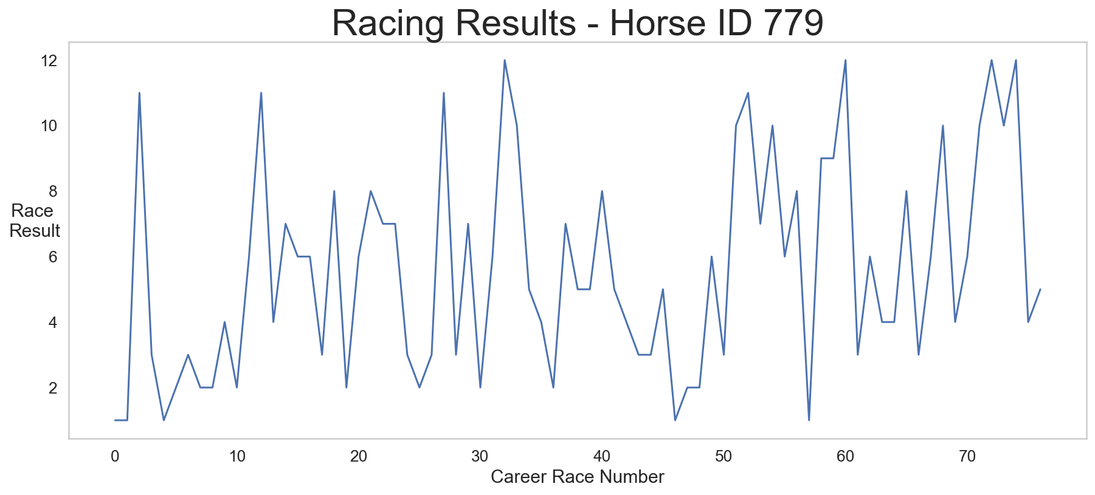
The model struggled on horses with lower career races, shorter distance races, and races with no dominant horse
False Positives:
Shorter distance – less time between show and non-show
False Negatives:
Heavy “underdogs” with less races
No clear favorite in the race
General Challenges
Very small differences between 3rd place and lower places
Trying to predict a variable result

Slide 11
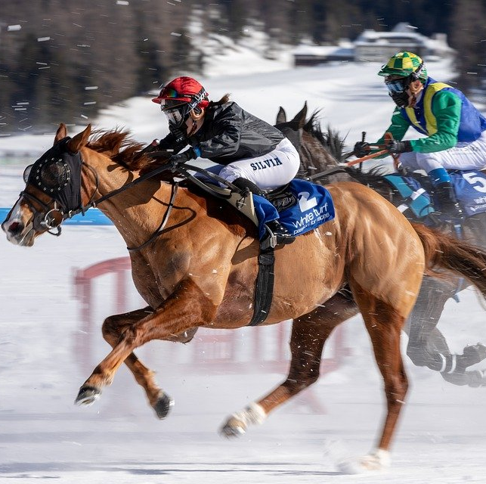
Future Improvements
More specialized models to reduce false negatives
Track
Track Configuration
Distance
Similar model for different markets – United States
Notes:
Image; https://cdn.pixabay.com/photo/2014/06/30/15/39/horses-380402_960_720.jpg

Slide 12

Thank you! Any questions?

Slide 13
Appendix

Slide 14
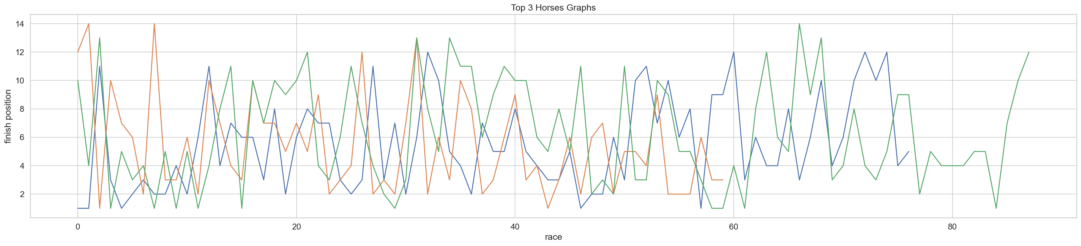
Horse Racing a highly variable sport to predict.
Above: top 3 horses in terms of number of shows
There tend to be “waves” in performance, with a lot of volatility
Led to adding some moving average metrics to the features

Slide 15
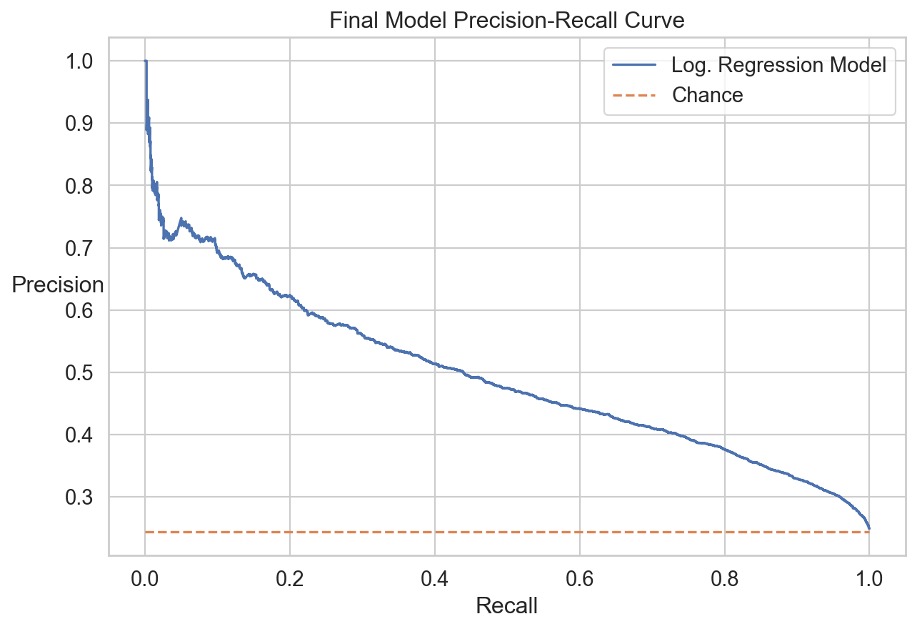
Final Model Precision-Recall Curve

Slide 16
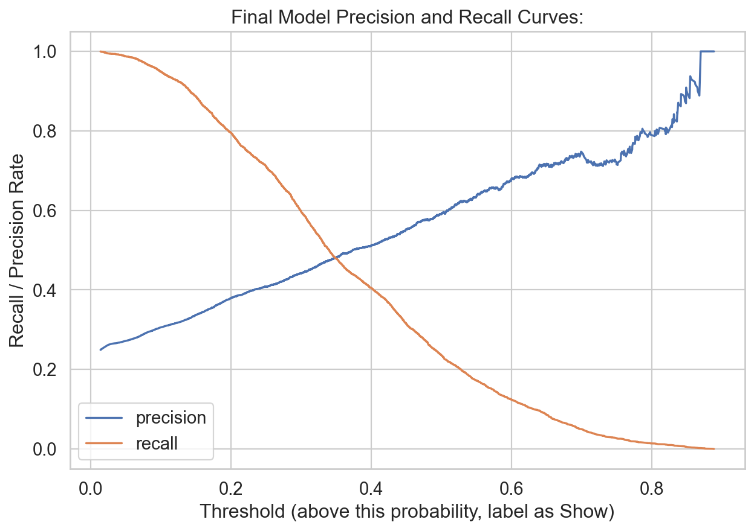
Final Model Precision and Recall Curves

Slide 17
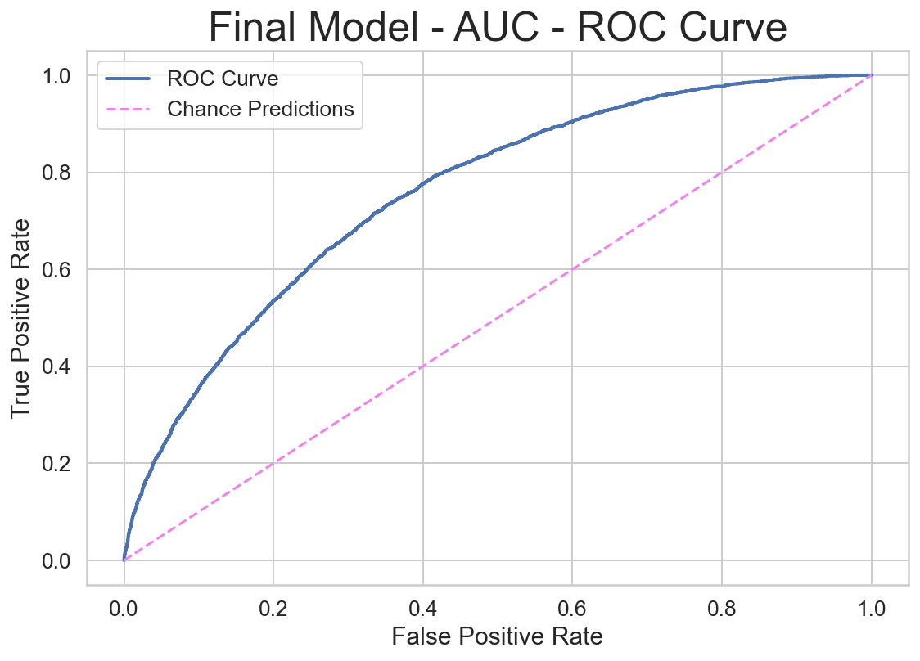
Final Model AUC ROC Curve

Slide 18
Final Model – False Positive Example
About 0.3 seconds between 5th and 1st
Less class differentiation
Race 4849 – 1200 m
Place | Finish Time | Show Probability
1 | 70.45 | 25%
2 | 70.48 | 56%
3 | 70.55 | 34%
4 | 70.71 | 87%
5 | 70.78 | 30%

Slide 19
Final Features List:
'actual_weight * place_odds', 'place_odds * three_race_rolling_average_distance_per_time', 'horse_rating * place_odds', 'place_odds + three_race_avg_mid_time', 'place_odds + three_race_rolling_average_distance_per_time', 'AUS', 'NZ', 'IRE', 'GB', 'USA', 'Other', 'horse_age', 'horse_rating', 'declared_weight', 'actual_weight', 'draw', 'place_odds', 'distance', 'three_race_rolling_avg_finish', 'three_race_rolling_average_lengths', 'three_race_rolling_average_time', 'three_race_rolling_average_distance_per_time', 'horses_in_field', 'field_rating_rank', 'diff_from_field_rating_avg', 'field_age_rank', 'diff_from_field_age_avg', 'diff_from_field_declared_wgt_avg', 'field_dec_wgt_rank', 'diff_from_field_handicap_wgt_avg', 'field_handicap_wgt_rank', 'career_races', 'career_shows', 'shows_in_last_5_races', 'three_race_rolling_average_len_len1', 'float_days_since_last_race', 'three_race_avg_mid_time', 'top_10_jockey', 'top_10_trainer', 'three_race_avg_mid_len_gain', 'career_show_rate', 'horse_type_Filly', 'horse_type_Gelding', 'horse_type_Horse', 'horse_type_Mare', 'horse_type_Rig'

Slide 20
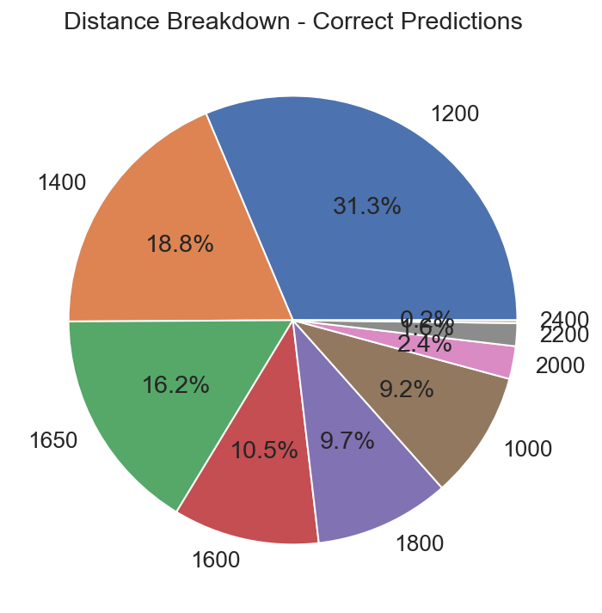
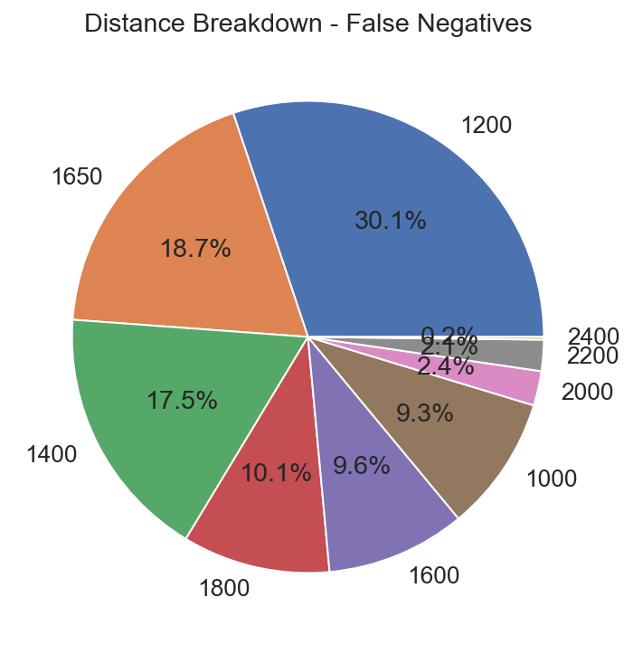
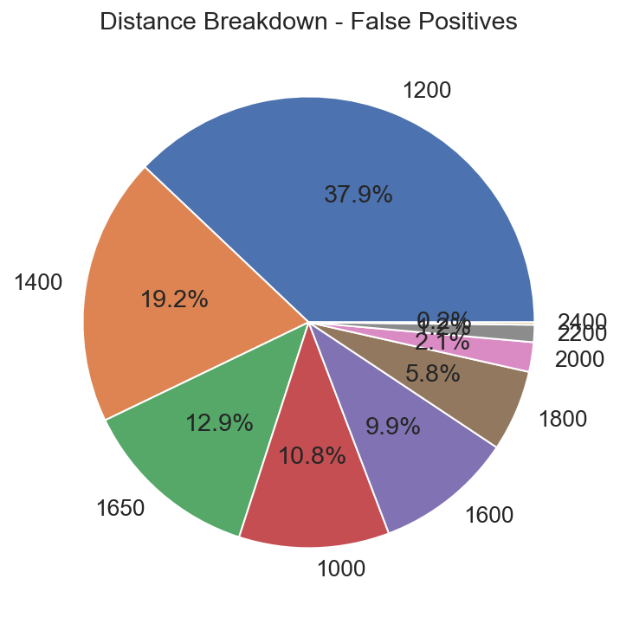
Race by Distance: Residuals (Final Model)
False Positives occurred in a higher proportion of races below 1600 m than the dataset as a whole.
False Negatives occurred on a more similar proportion compared to the dataset as a whole.

Slide 21

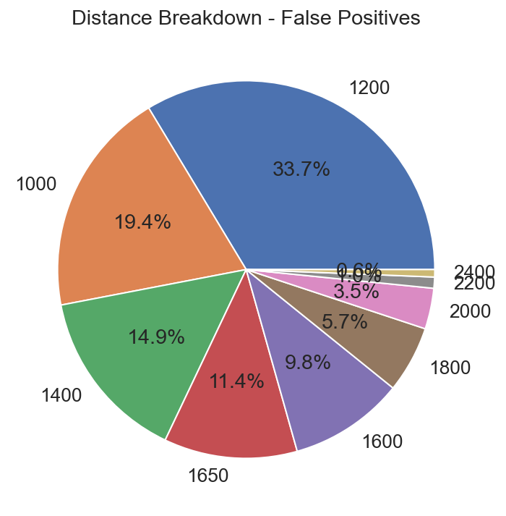
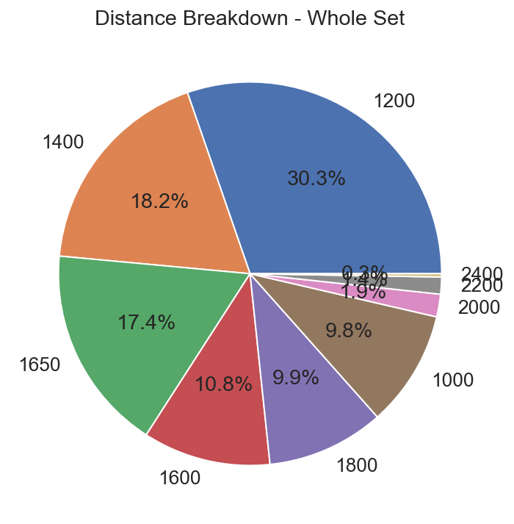
Race by Distance: Residuals (Model 3)
False Positives occurred in a higher proportion of races below 1600 m than the dataset as a whole.
False Negatives occurred on a more similar proportion compared to the dataset as a whole.

