Slide 1

Analyzing Presidential Debates
Metis Project 4
2/26/2021
By: Patrick Bovard

Slide 2

Agenda
Project Introduction / Motivation
Data Collection and Methods
Findings / Conclusions
General Election Debates
Party Primary Debates
Future Improvements
Notes:
Image: https://pixabay.com/illustrations/debate-election-politics-campaign-5684941/

Slide 3
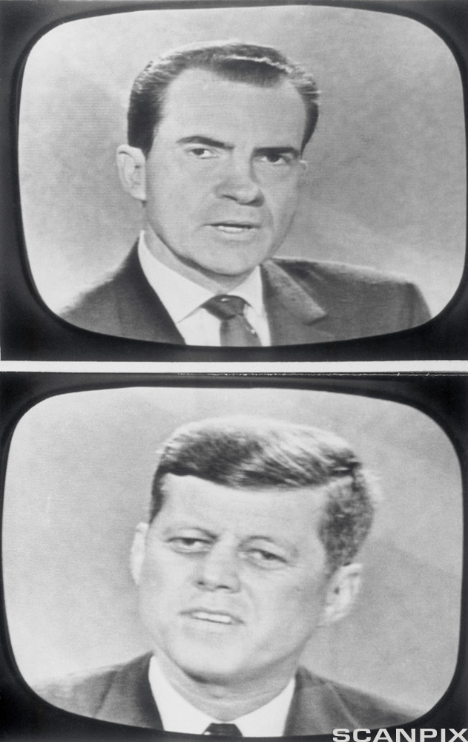
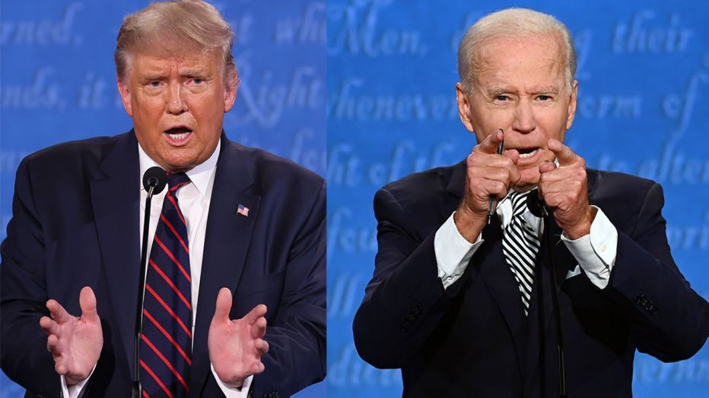
The televised Presidential Debate fundamentally changed the United States election process
Began with Kennedy v. Nixon in 1960
Intimate, live view of candidates
Now:
Large-scale television event
Years-long process: General election and primaries
Main Questions:
How have debates changed in topic over time?
Do parties tend to focus on certain topics?
Do party nomination winners tend to have distinct focuses compared to losers?
Notes:
Image: https://api.ndla.no/image-api/raw/U1251417.jpg

Slide 4
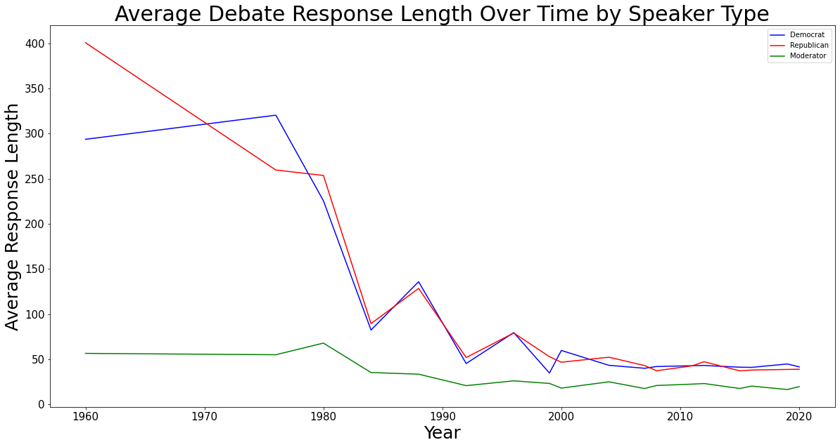
Data was scraped from all available presidential debate transcripts for analysis
General Elections: 1960-2020
Party Primaries: 2000-2020
Pre-processing
Lemmatization
TF-IDF Vectorization
“Document” = one paragraph
Tagged by speaker, date, party, and election result of speaker
Notes:
Image: https://images.foxtv.com/static.fox6now.com/www.fox6now.com/content/uploads/2020/09/932/524/biden-trump.jpg?ve=1&tl=1

Slide 5
Topic modelling via NMF revealed 8 major categories

Slide 6
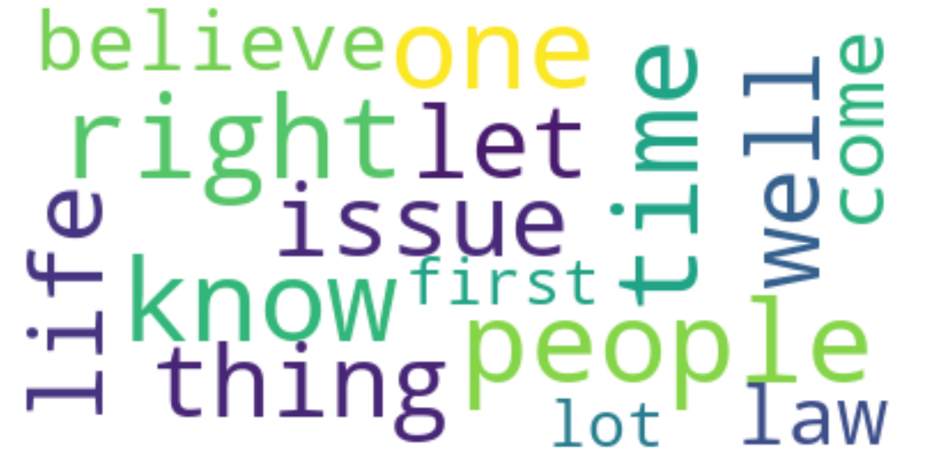
Topic modelling via NMF revealed 8 major categories
Campaign Issues

Slide 7
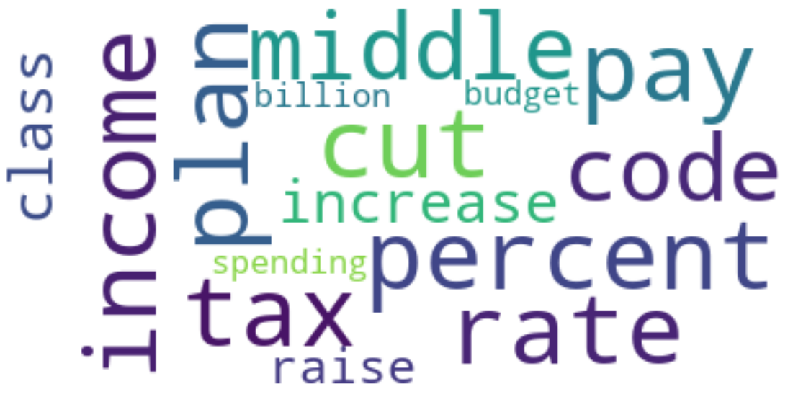
Topic modelling via NMF revealed 8 major categories
Campaign Issues
Taxes

Slide 8
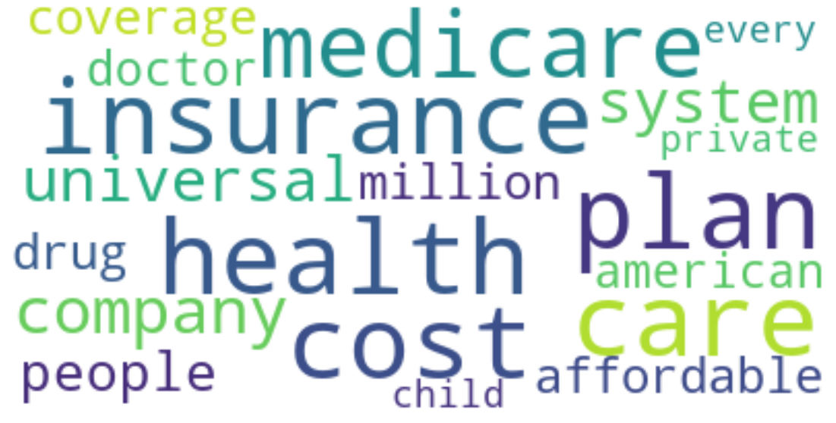
Topic modelling via NMF revealed 8 major categories
Campaign Issues
Taxes
Healthcare

Slide 9

Topic modelling via NMF revealed 8 major categories
Campaign Issues
Taxes
Healthcare
Education

Slide 10
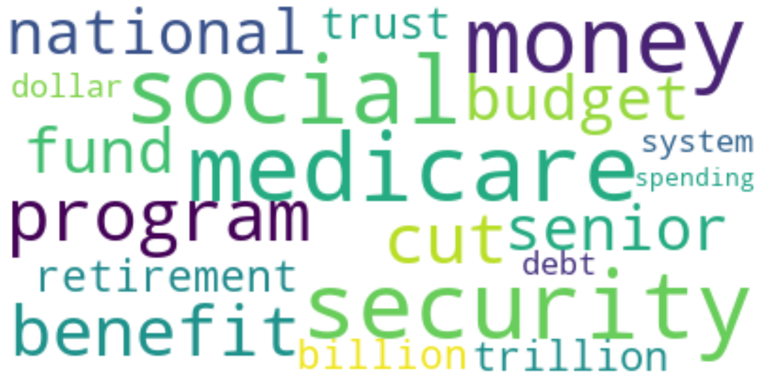
Topic modelling via NMF revealed 8 major categories
Campaign Issues
Taxes
Healthcare
Education
Social Security

Slide 11
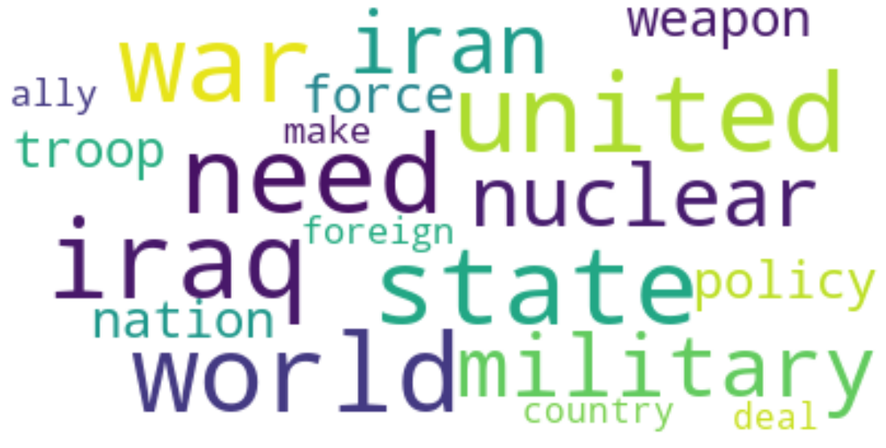
Topic modelling via NMF revealed 8 major categories
Campaign Issues
Taxes
Healthcare
Education
Social Security
Foreign Policy/Military

Slide 12
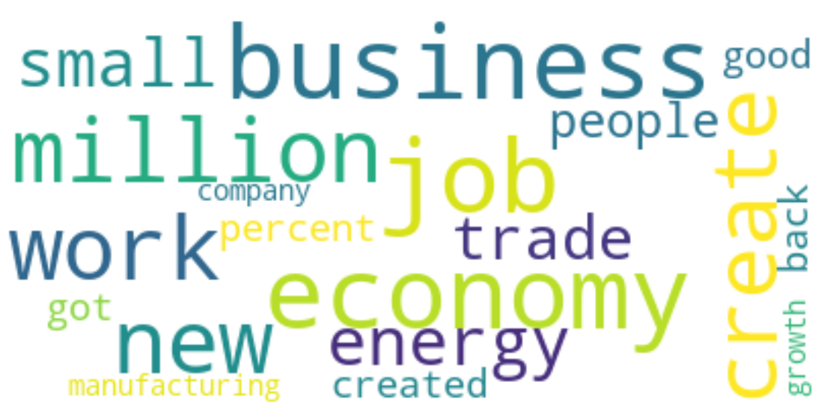
Topic modelling via NMF revealed 8 major categories
Campaign Issues
Taxes
Healthcare
Education
Social Security
Foreign Policy/Military
Domestic Economy

Slide 13
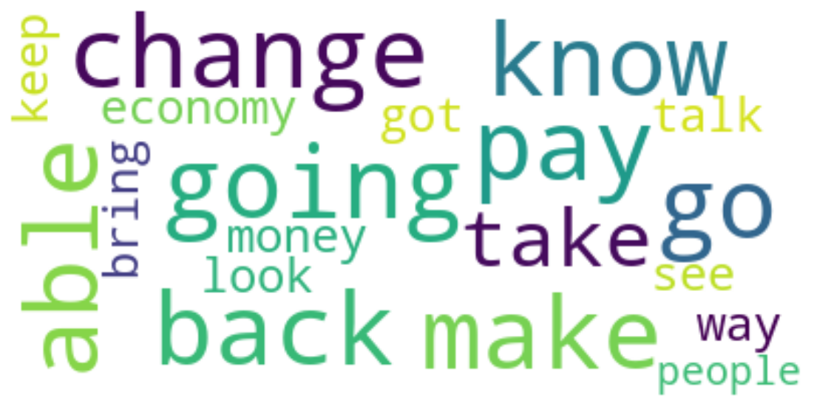
Topic modelling via NMF revealed 8 major categories
Campaign Issues
Taxes
Healthcare
Education
Social Security
Foreign Policy/Military
Domestic Economy
Debate Speak

Slide 14
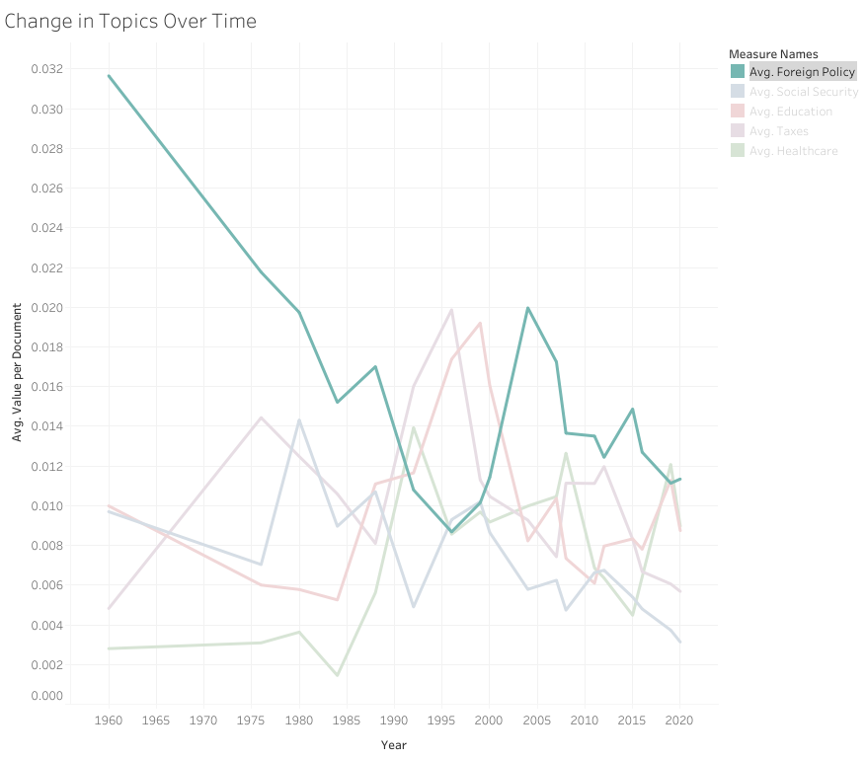
Focus on Foreign Policy has drastically decreased over time

Slide 15
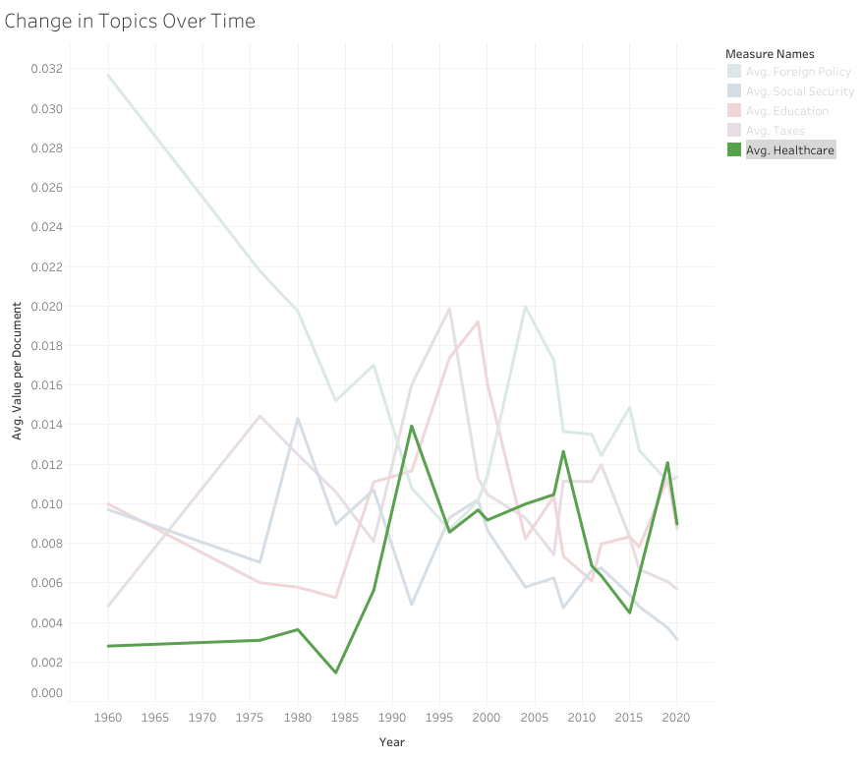
Healthcare has seen a substantial increase in discussion

Slide 16
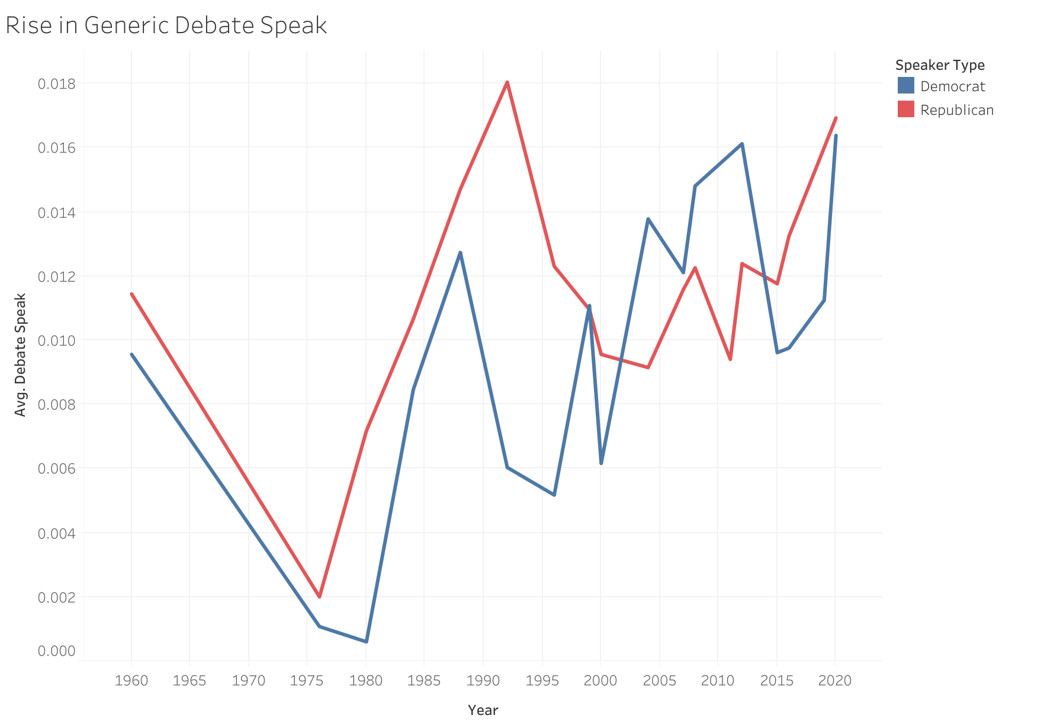
Generic “Debate Speak” has risen consistently over the last 30 years

Slide 17
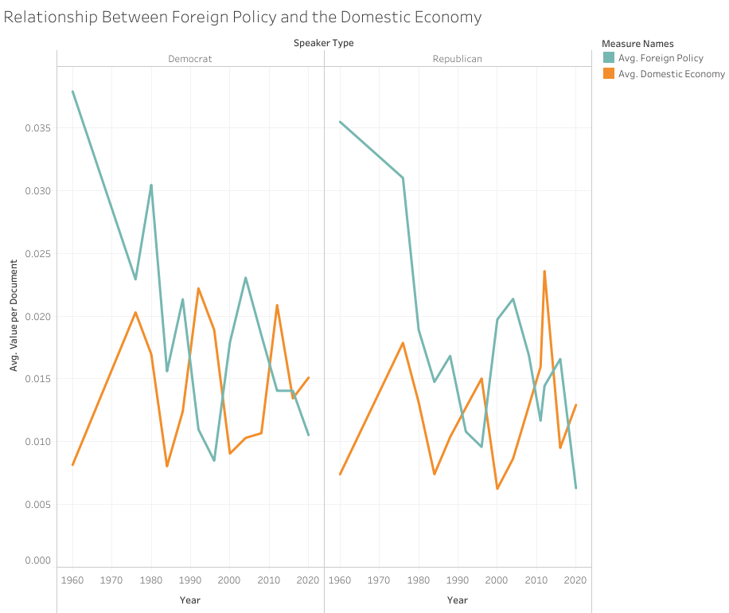
Republicans tend to win general elections when Foreign Policy is a higher debate focus

Slide 18
Democratic and Republican Primaries had many similar topics with different key words.
Topic | Democrat Key Word Example | Republican Key Word Example

Slide 19
Democratic and Republican Primaries had many similar topics with different key words.
Topic | Democrat Key Word Example | Republican Key Word Example
Taxes | Pay | Cut
Healthcare | Universal, Access | Market
Foreign Policy / Military | End, Home | Take, Make

Slide 20
Additionally, unique topics emerged within each party
Democrat Unique Topics | Republican Unique Topics

Slide 21
Additionally, unique topics emerged within each party
Democrat Unique Topics | Republican Unique Topics
Progressive Ideas | Religion in Education
Big Pharma | Border Security / Immigration

Slide 22
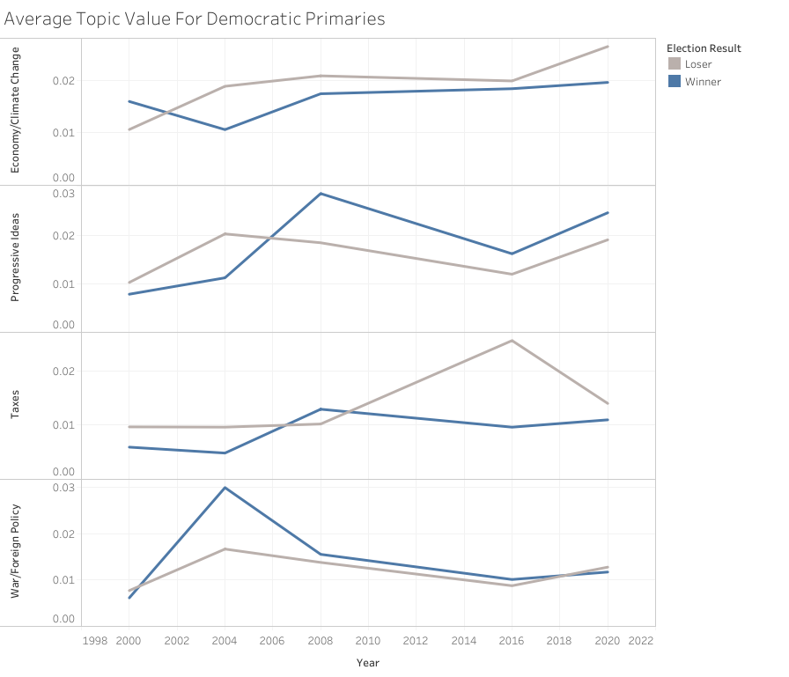
Successful Democratic candidates have tended to focus more on Progressive Ideas, and less on economic topics

Slide 23
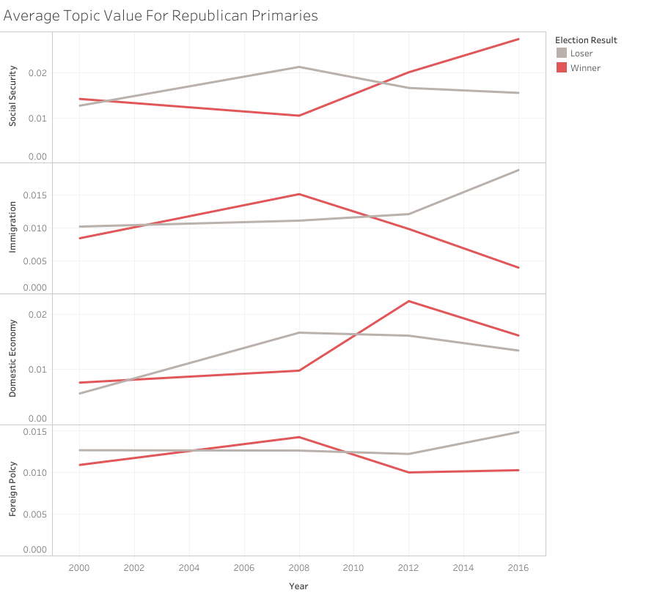
After McCain, successful Republicans have shifted more focus to Social Security and the Domestic Economy

Slide 24

Future Improvements
Next election cycle:
Candidate Recommendation System
Predictive Modeling on Elections
Training advanced word embeddings

Slide 25
Thank you!
Any Questions?

Slide 26
Appendix

Slide 27
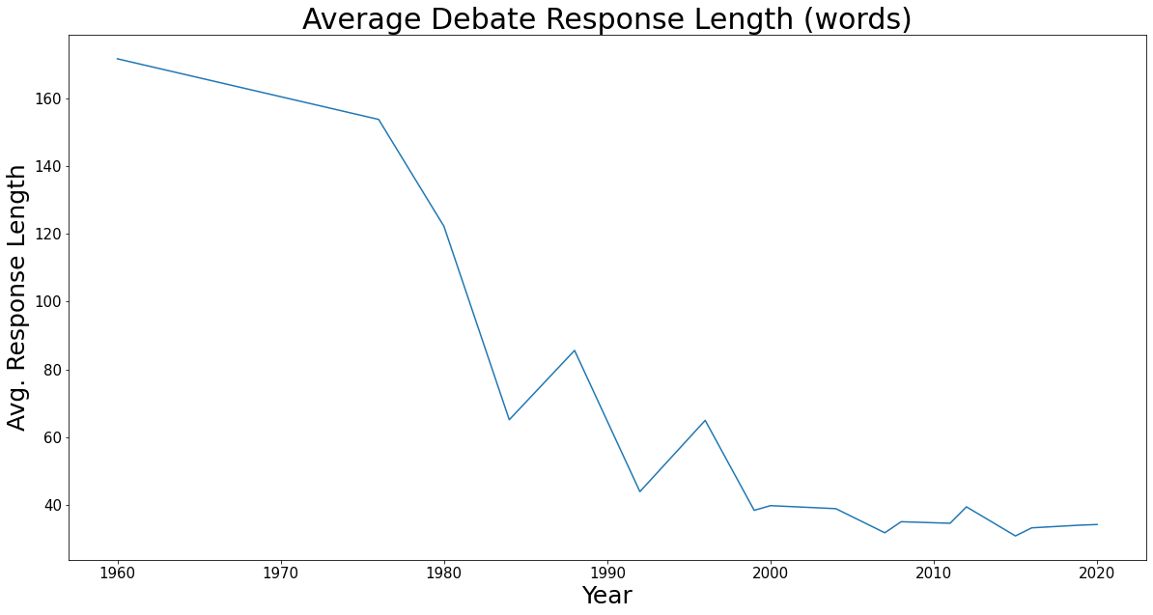
The average debate response length has decreased substantially over time

Slide 28
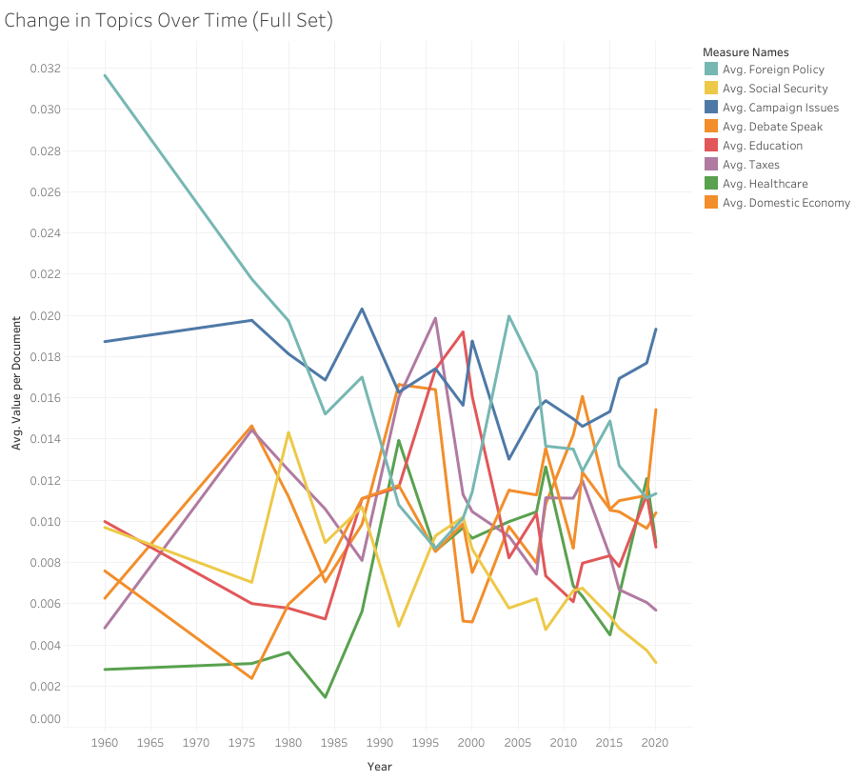
Full Data Set Changes Over Time

Slide 29
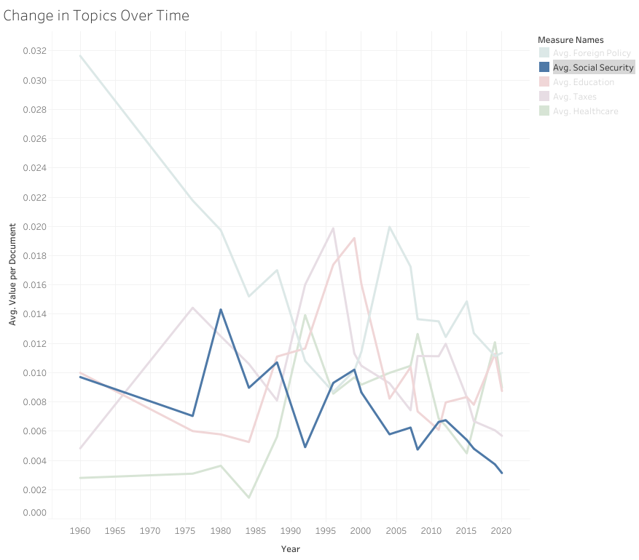
Focus on Foreign Policy and Social Security have steadily decreased over time

Slide 30
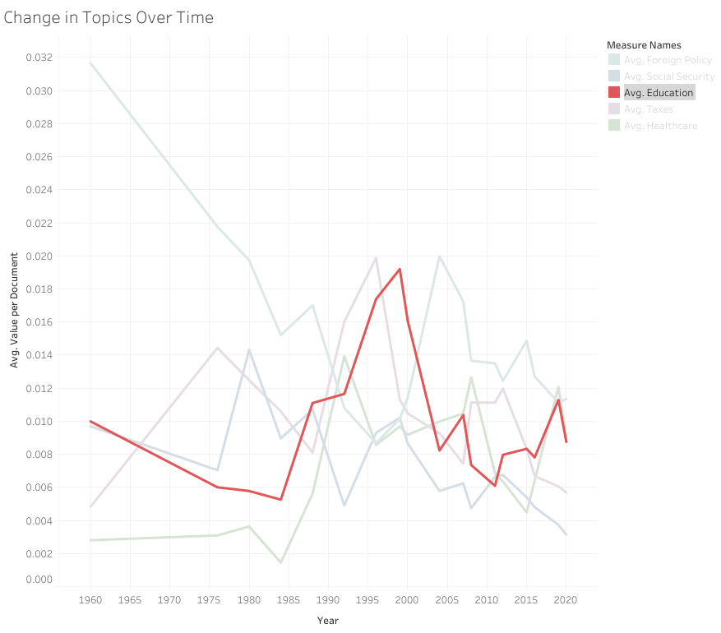
Education and taxes have a more cyclical nature

Slide 31
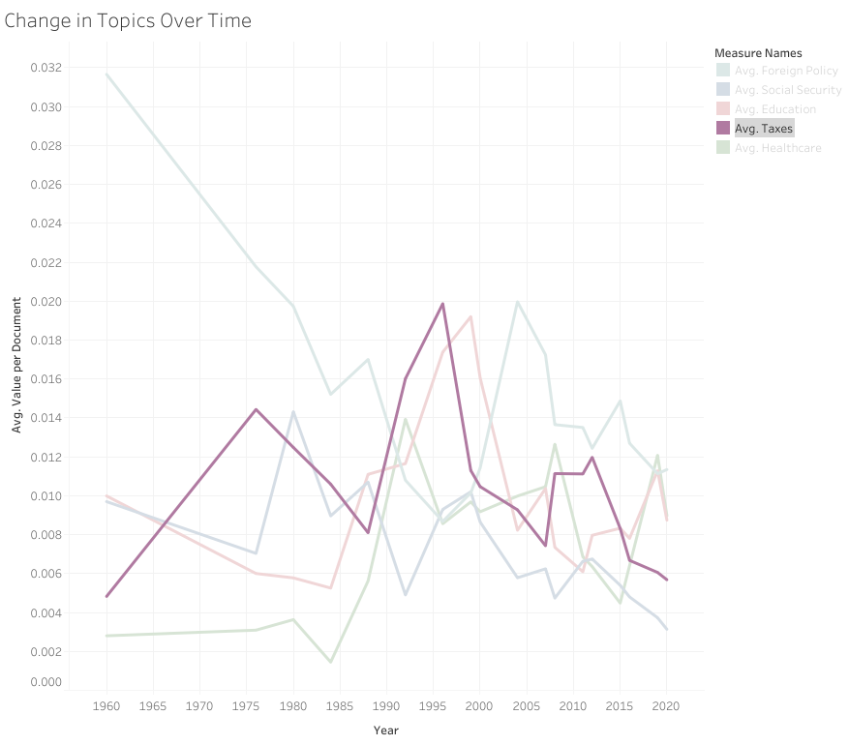
Education and taxes have a more cyclical nature

Slide 32
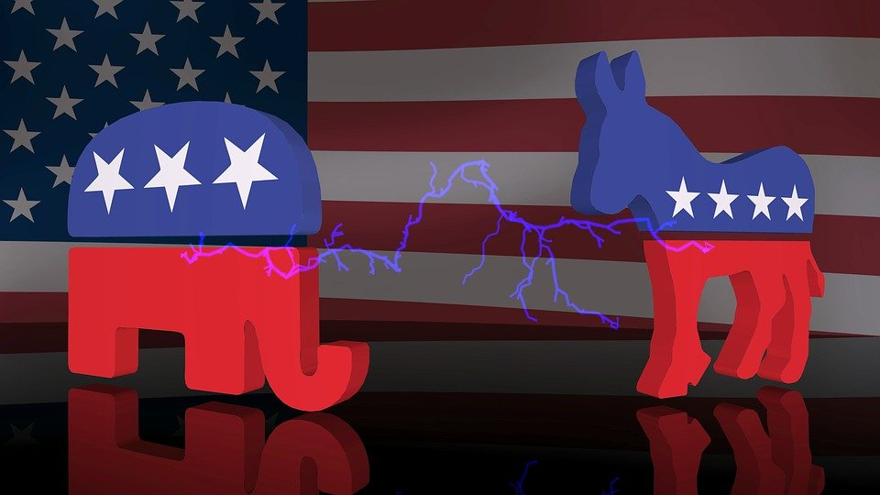
Topic modelling was run individually on Democratic and Republican primaries
Goal:
Do same topics emerge?
Are there any new topics?
New ways of describing same topics?

Slide 33
Full Corpus Final Topics and Key Words
Topic 1: ['people', 'know', 'one', 'right', 'time', 'thing', 'issue', 'well', 'like', 'life', 'let', 'believe', 'law', 'come', 'first', 'lot', 'way', 'look', 'got']
Topic 2: ['tax', 'cut', 'percent', 'income', 'pay', 'plan', 'rate', 'middle', 'code', 'increase', 'class', 'raise', 'spending', 'billion', 'budget', 'money', 'family', 'capital', 'fair']
Topic 3: ['health', 'care', 'insurance', 'plan', 'cost', 'medicare', 'company', 'system', 'universal', 'people', 'affordable', 'coverage', 'drug', 'million', 'doctor', 'american', 'private', 'every', 'child']
Topic 4: ['school', 'child', 'education', 'need', 'teacher', 'kid', 'parent', 'college', 'public', 'family', 'student', 'make', 'every', 'money', 'program', 'choice', 'go', 'help', 'federal']
Topic 5: ['going', 'make', 'go', 'know', 'back', 'change', 'able', 'pay', 'take', 'economy', 'money', 'way', 'see', 'talk', 'got', 'bring', 'look', 'keep', 'people']
Topic 6: ['security', 'social', 'medicare', 'money', 'program', 'benefit', 'cut', 'budget', 'national', 'fund', 'senior', 'retirement', 'trust', 'trillion', 'billion', 'system', 'debt', 'dollar', 'spending']
Topic 7: ['state', 'united', 'war', 'world', 'need', 'iraq', 'military', 'nuclear', 'iran', 'weapon', 'policy', 'troop', 'nation', 'force', 'foreign', 'ally', 'make', 'country', 'deal']
Topic 8: ['job', 'economy', 'business', 'million', 'work', 'create', 'new', 'energy', 'small', 'trade', 'people', 'percent', 'good', 'created', 'got', 'back', 'manufacturing', 'company', 'growth']

Slide 34
Democratic Primary Topics and Key Words:
Topic 1: ['people', 'know', 'one', 'state', 'right', 'united', 'time', 'well', 'like', 'gun', 'thing', 'woman', 'done', 'bill', 'come', 'fact', 'got', 'look', 'number', 'let’]
Topic 2: ['health', 'care', 'plan', 'universal', 'insurance', 'affordable', 'coverage', 'system', 'medicare', 'child', 'people', 'cost', 'every', 'million', 'single', 'access', 'american', 'provide', 'cover', 'everyone’]
Topic 3: ['tax', 'pay', 'percent', 'class', 'middle', 'income', 'wealth', 'family', 'paying', 'dollar', 'cut', 'people', 'money', 'raise', 'million', 'top', 'wealthy', 'rate', 'street', 'working’]
Topic 4: ['school', 'education', 'child', 'college', 'kid', 'teacher', 'public', 'every', 'student', 'free', 'go', 'tuition', 'debt', 'make', 'program', 'family', 'community', 'university', 'high', 'young’]
Topic 5: ['war', 'iraq', 'troop', 'iran', 'military', 'end', 'voted', 'combat', 'afghanistan', 'world', 'security', 'vote', 'policy', 'nuclear', 'home', 'weapon', 'force', 'foreign', 'united', 'continue’]
Topic 6: ['going', 'know', 'make', 'change', 'together', 'people', 'able', 'take', 'run', 'got', 'cost', 'forward', 'economy', 'talk', 'everybody', 'tell', 'way', 'problem', 'bring', 'something’]
Topic 7: ['need', 'job', 'trade', 'world', 'make', 'change', 'climate', 'energy', 'worker', 'deal', 'right', 'new', 'work', 'also', 'china', 'way', 'policy', 'agreement', 'fuel', 'help’]
Topic 8: ['company', 'insurance', 'drug', 'money', 'medicare', 'prescription', 'cost', 'profit', 'big', 'industry', 'system', 'private', 'healthcare', 'price', 'doctor', 'lobbyist', 'people', 'pharmaceutical', 'million', 'billion']

Slide 35
Republican Primary Topics and Key Words:
Topic 1: ['state', 'united', 'war', 'world', 'iran', 'military', 'nuclear', 'one', 'policy', 'take', 'weapon', 'iraq', 'foreign', 'nation', 'like', 'make', 'china', 'israel', 'trade', 'interest']
Topic 2: ['tax', 'cut', 'percent', 'income', 'plan', 'rate', 'code', 'pay', 'flat', 'spending', 'corporate', 'money', 'capital', 'rid', 'gain', 'raise', 'budget', 'lower', 'middle', 'fair']
Topic 3: ['health', 'care', 'insurance', 'cost', 'saving', 'plan', 'account', 'system', 'buy', 'medicare', 'market', 'medical', 'people', 'federal', 'patient', 'program', 'percent', 'take', 'money', 'medicaid']
Topic 4: ['life', 'school', 'child', 'right', 'pro', 'believe', 'parent', 'education', 'choice', 'law', 'court', 'family', 'make', 'every', 'decision', 'respect', 'human', 'god', 'abortion', 'federal']
Topic 5: ['job', 'economy', 'business', 'create', 'work', 'created', 'million', 'sector', 'energy', 'back', 'regulation', 'world', 'private', 'manufacturing', 'trade', 'make', 'small', 'china', 'creation', 'good']
Topic 6: ['going', 'security', 'social', 'program', 'back', 'money', 'go', 'change', 'spending', 'economy', 'trillion', 'take', 'save', 'washington', 'way', 'medicare', 'pay', 'dollar', 'keep', 'see']
Topic 7: ['need', 'border', 'law', 'system', 'military', 'immigration', 'secure', 'go', 'come', 'troop', 'ground', 'force', 'make', 'problem', 'isi', 'deal', 'way', 'enforcement', 'fence', 'also']
Topic 8: ['people', 'know', 'got', 'time', 'thing', 'let', 'lot', 'one', 'well', 'come', 'like', 'work', 'problem', 'look', 'go', 'way', 'washington', 'tell', 'done', 'party']

Slide 36
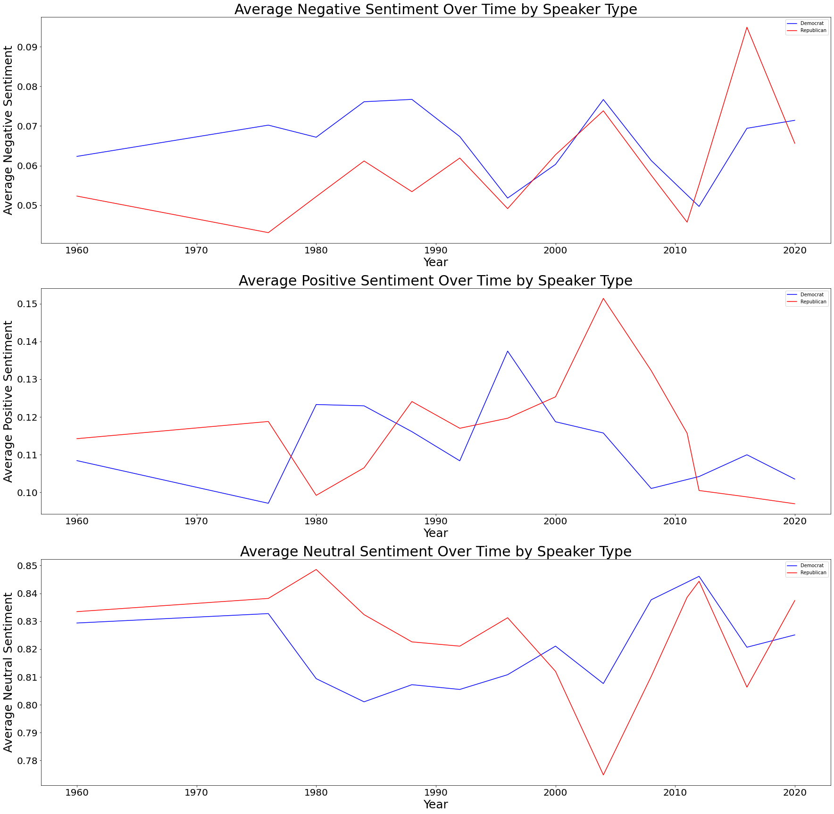
Large Discrepancies in Negative/Positive Sentiments indicate how certain campaigns were run.
2004
Bush v. Kerry
Early Iraq War, Good Enough Economy
Post-9/11

Slide 37
Large Discrepancies in Negative/Positive Sentiments indicate how certain campaigns were run.
2004
Bush v. Kerry
Early Iraq War, Good Enough Economy
Post-9/11
2016
Trump v. Clinton
Too soon?

Slide 38
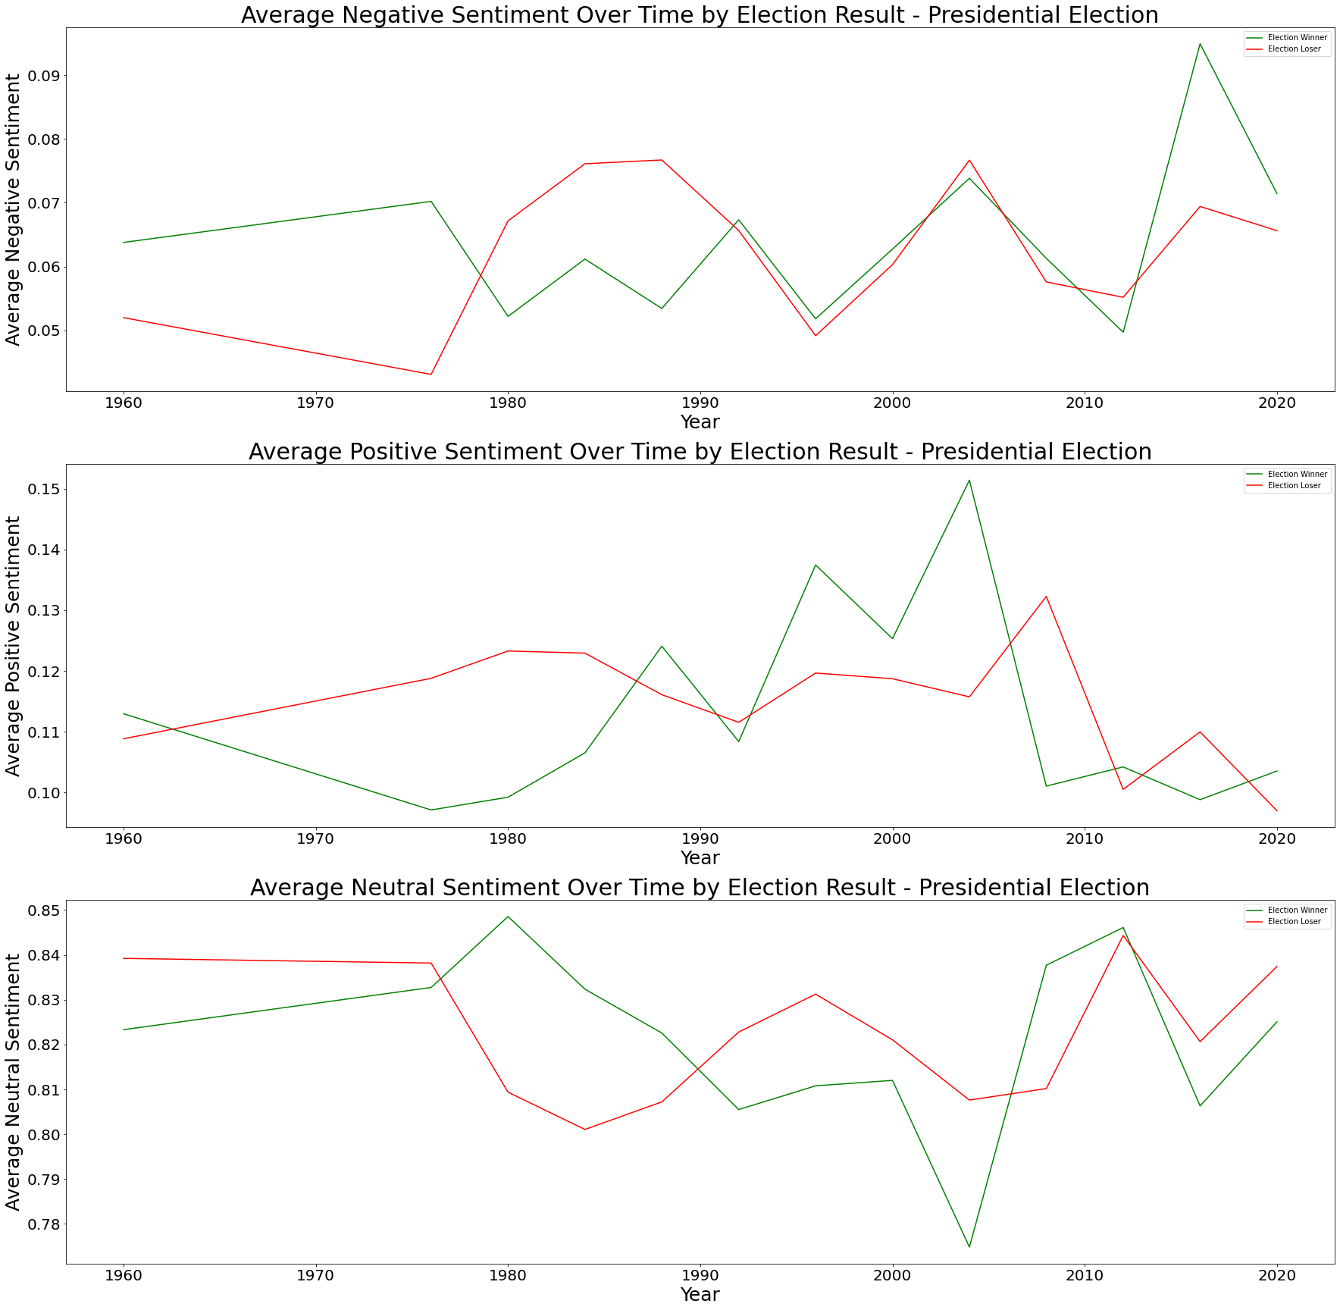
Sentiment Analysis: Election Winners and Losers

