Slide 1

Weed Detection in Agricultural Fields Using Deep Learning (CNN) Weed Detection in Agricultural Fields Using Deep Learning (CNN) Weed detection in Agricultural fields using Deep Learning(CNN)
UNIVERSITY OF AGRICULTURAL SCIENCES ,
COLLEGE OF AGRICULTURE,
GKVK, BANGLORE -560065
Team members:
Pallavi P Bhat (AMB2162)
Pavithra SP (AMB2168)
Pubali Niyogi (AMB2188)
SUBMITTED TO: Course Teacher
AI & ML in Agriculture
COA, GKVK – Bengaluru 560065

Slide 2
Contents
1. Introduction
6. Results and Discussion
2. Review of Literature
7. Summary & Conclusion
3. Objectives
8. Future Scope
4. Materials & Requirements
9. References
5. System Architecture
Weed Detection Using CNN | UAS Bengaluru

Slide 3
Introduction
Background & Current Trends
Weed competition reduces global crop yields by 10–30% annually in major cereal crops (FAO, 2023). Traditional management relies on uniform herbicide application — costly and environmentally damaging.
Rise of AI/ML in Weed Management
CNNs achieve >95% accuracy on plant classification tasks. Key trends: Drone/UAV imaging, Edge AI (Raspberry Pi, Jetson), Transfer Learning, and Variable-Rate Spraying reducing chemical usage by 50–90%.
Motivation
Integrating agriculture with AI and Deep Learning to enhance sustainability.
Weed Detection Using CNN | UAS Bengaluru

Slide 4
Problem Statement
The Challenge
Visual Similarity
Accurate weed-vs-crop binary classification in real agricultural field imagery remains technically difficult despite advances in plant ML.
High intra-class similarity between weeds and crop seedlings — especially at early growth stages — causes high false-positive rates in existing systems.
Scope of this Project
Expected Output
Design, train, and evaluate a custom CNN on the WeedCrop dataset (2,721 images) — benchmarking performance across baseline, dropout, augmentation, and hyperparameter tuning stages.
A trained and optimized CNN model that can accurately classify images as crop or weed with higher accuracy
Weed Detection Using CNN | UAS Bengaluru

Slide 5
Objectives
01
Design & Train CNN
Design and train a custom CNN architecture for binary weed-vs-crop image classification achieving ≥90% validation accuracy on the WeedCrop dataset.
02
Progressive Improvements
Implement and evaluate dropout regularization, early stopping, data augmentation, and hyperparameter tuning — quantifying each technique's contribution.
03
End-to-End ML Pipeline
Build a complete pipeline from raw YOLOv5 dataset preprocessing to training and evaluation.
Weed Detection Using CNN | UAS Bengaluru

Slide 6
Dataset Overview
Dataset Details
Dataset Split Summary
Source:
WeedCrop.v11.yolov5pytorch ( Kaggle )
Split | Total | Crop | Weed
Training | 2,368 | ~1,184 | ~1,184
Validation | 235 | ~117 | ~118
Test | 118 | ~59 | ~59
Total | 2,721 | — | —
Format:
YOLOv5 bounding box labels → binary class dirs
Classes:
Crop (class 0) | Weed (class 1)
Train:
2,368 images (~1,184 per class)
Validation:
235 images (~117 per class)
Test:
118 images (~59 per class)
Total:
2,721 images
Augmentations Applied:
Horizontal Flip · Random Rotation ±10% · Random Zoom ±10%
Preprocessing:
Resize 128×128, normalize [0–1], YOLO→Keras
Weed Detection Using CNN | UAS Bengaluru

Slide 7
Methodology / Approach
1
Data Preprocessing
YOLOv5 labels parsed → class dirs. Images resized to 128×128 and normalized to [0,1] via Rescaling layer.
2
CNN Architecture
3 Conv blocks (32→64→128 filters) + MaxPooling + Dense(128) + Adam + Binary Cross-Entropy.
3
Progressive Improvements
Stage 1: Baseline · Stage 2: Dropout(0.5) · Stage 3: EarlyStopping · Stage 4: Hyperparameter tuning · Stage 5: Data augmentation.
4
Evaluation & Metrics
Accuracy, Loss, Confusion Matrix, Epoch-wise training curves. Test set evaluation on 118 held-out images.
Weed Detection Using CNN | UAS Bengaluru

Slide 8
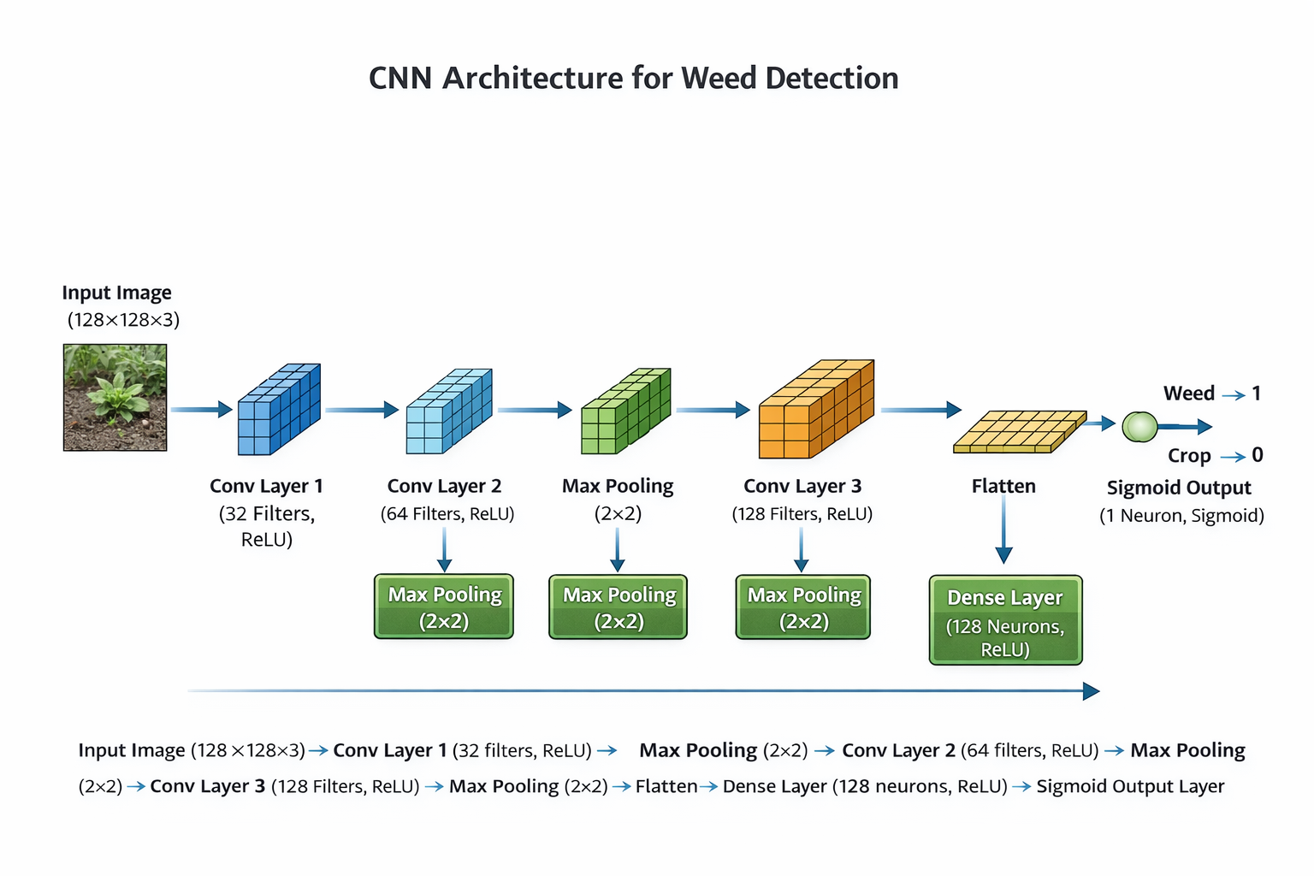

Slide 9
Tools and Technologies Used
Core Language
Deep Learning
Numerics
Python 3.10+
TensorFlow 2.13+ / Keras
NumPy 1.24
Visualization
Image Processing
Data Handling
Matplotlib 3.7
OpenCV 4.8
zipfile / os / shutil (built-in)
Dev Environment
Local IDE
Edge Deployment
Google Colab (T4 GPU, 12GB VRAM)
Jupyter Notebook 6.5
Raspberry Pi 4 + HQ Camera (12MP)
Weed Detection Using CNN | UAS Bengaluru

Slide 10
Results
98.14%
95.32%
89.83%
Baseline Train Acc.
Baseline Val. Acc.
Final Test Acc.
After 10 epochs
Stable from epoch 1
Loss = 0.2094
Baseline CNN — Epoch-wise Performance
Epoch | Train Accuracy | Train Loss | Val Accuracy | Val Loss
1/10 | 95.19% | 0.2039 | 95.32% | 0.1579
5/10 | 95.57% | 0.1247 | 95.32% | 0.2014
8/10 | 96.54% | 0.0897 | 95.32% | 0.2339
10/10 | 98.14% | 0.0591 | 95.32% | 0.2613
Weed Detection Using CNN | UAS Bengaluru

Slide 11
Discussion / Analysis
Key Insights
Hyperparameter Findings
Val accuracy plateau at 95.32% from epoch 1 shows early convergence. Diverging train/val loss by epoch 10 confirms mild overfitting, successfully mitigated by dropout and early stopping.
Best config: lr=0.001, dropout=0.5, batch=32. Lower LR (0.0001) improved generalization candidates. Higher LR (0.01) caused faster convergence but reduced stability.
Challenges
Agricultural Impact
Visual similarity between crop and weed seedlings at early growth stages. Small test set (118 images) causes variance in reported test accuracy vs validation accuracy.
A 89.83% accurate weed detector can enable GPS-guided precision sprayers to reduce herbicide usage by 50–80% vs uniform broadcast application.
Weed Detection Using CNN | UAS Bengaluru

Slide 12
Summary & Conclusion
1
CNN with 3 conv blocks (32→64→128 filters) achieved 95.32% validation accuracy on the WeedCrop dataset.
2
Dropout regularization (rate=0.5) reduced overfitting by forcing distributed feature learning in the dense layer.
3
Early Stopping (patience=3, restore_best_weights) is highly effective — stopped at epoch 4, preventing over-training.
4
Data augmentation (horizontal flip, rotation ±10%, zoom ±10%) yielded 89.83% test accuracy on unseen field data.
5
Complete end-to-end pipeline from YOLOv5 format → Keras export demonstrates practical deployability for precision agriculture.
Weed Detection Using CNN | UAS Bengaluru

Slide 13
Future Scope
Transfer Learning
UAV Integration
Fine-tune EfficientNetB0 / ResNet50 / MobileNetV3 — target >97% accuracy with fewer training epochs.
Deploy CNN on drone systems for autonomous field scouting at 2–5m altitude with georeferenced weed maps.
Multi-class Classification
Edge Deployment
Extend to species-level ID using DeepWeeds (9 species) for targeted herbicide selection.
Convert to TFLite (INT8 quantization) for Raspberry Pi 4 / NVIDIA Jetson Nano — >10 FPS real-time inference.
Semantic Segmentation
Variable-Rate Sprayers
Replace classifier head with U-Net / DeepLabV3+ for pixel-level weed density mapping.
Couple CNN detection with GPS-guided sprayers — reduce herbicide usage by 50–80% vs uniform broadcast.
Explainable AI (XAI)
Federated Learning
Apply Grad-CAM to visualize which image regions drive predictions — builds farmer trust.
Train across multiple farm datasets without centralizing raw imagery, addressing data privacy concerns.
Weed Detection Using CNN | UAS Bengaluru

Slide 14
References / Acknowledgements
[1] Bengio Y. et al. (2012). Practical Recommendations for Gradient-Based Training of Deep Architectures. Springer.
[2] Espejo-Garcia B. et al. (2020). Towards Weeds Identification Assistance Through Transfer Learning. Computers and Electronics in Agriculture, 171.
[3] FAO (2023). The State of Food and Agriculture 2023. Food and Agriculture Organization, Rome.
[4] Lottes P. et al. (2017). UAV-based Crop and Weed Classification for Smart Farming. IEEE ICRA.
[5] Mohanty S.P. et al. (2016). Using Deep Learning for Image-Based Plant Disease Detection. Frontiers in Plant Science, 7.
[6] Olsen A. et al. (2019). DeepWeeds: A Multiclass Weed Species Image Dataset. Scientific Reports, 9.
[7] Srivastava N. et al. (2014). Dropout: A Simple Way to Prevent Neural Networks from Overfitting. JMLR, 15(1).
Weed Detection Using CNN | UAS Bengaluru

Slide 15
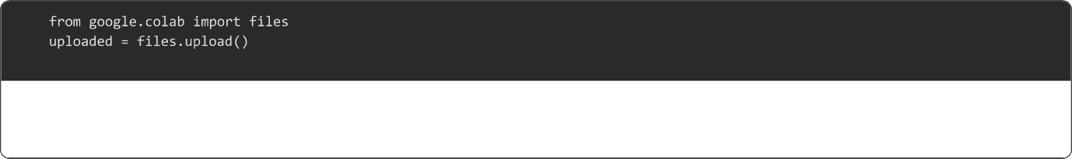


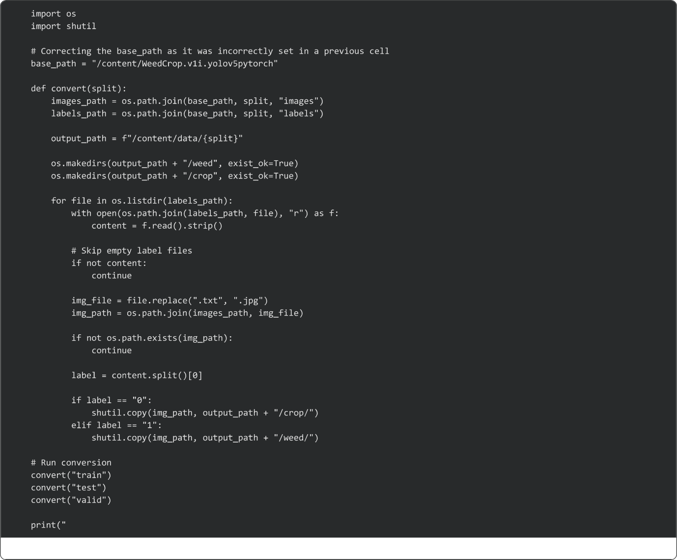


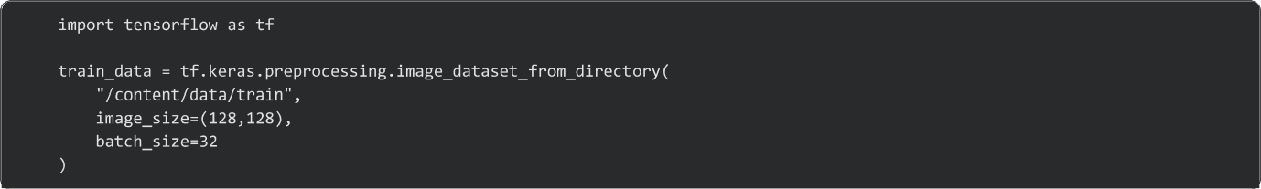

Slide 16
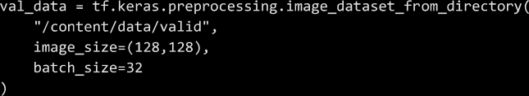
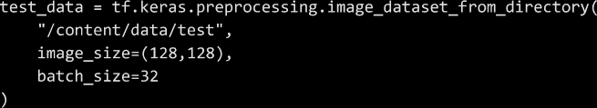

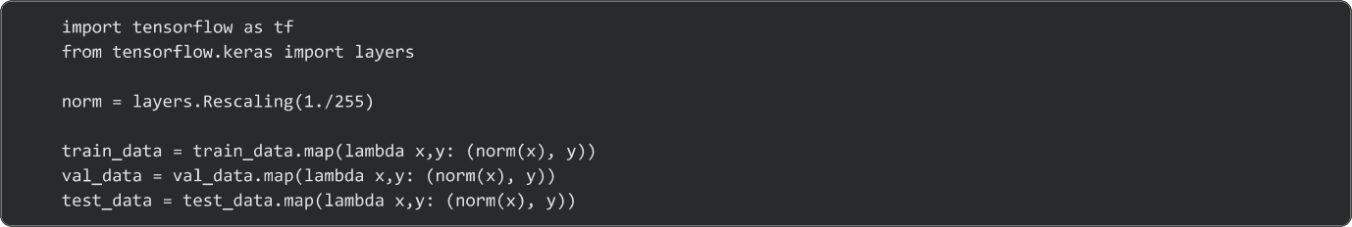
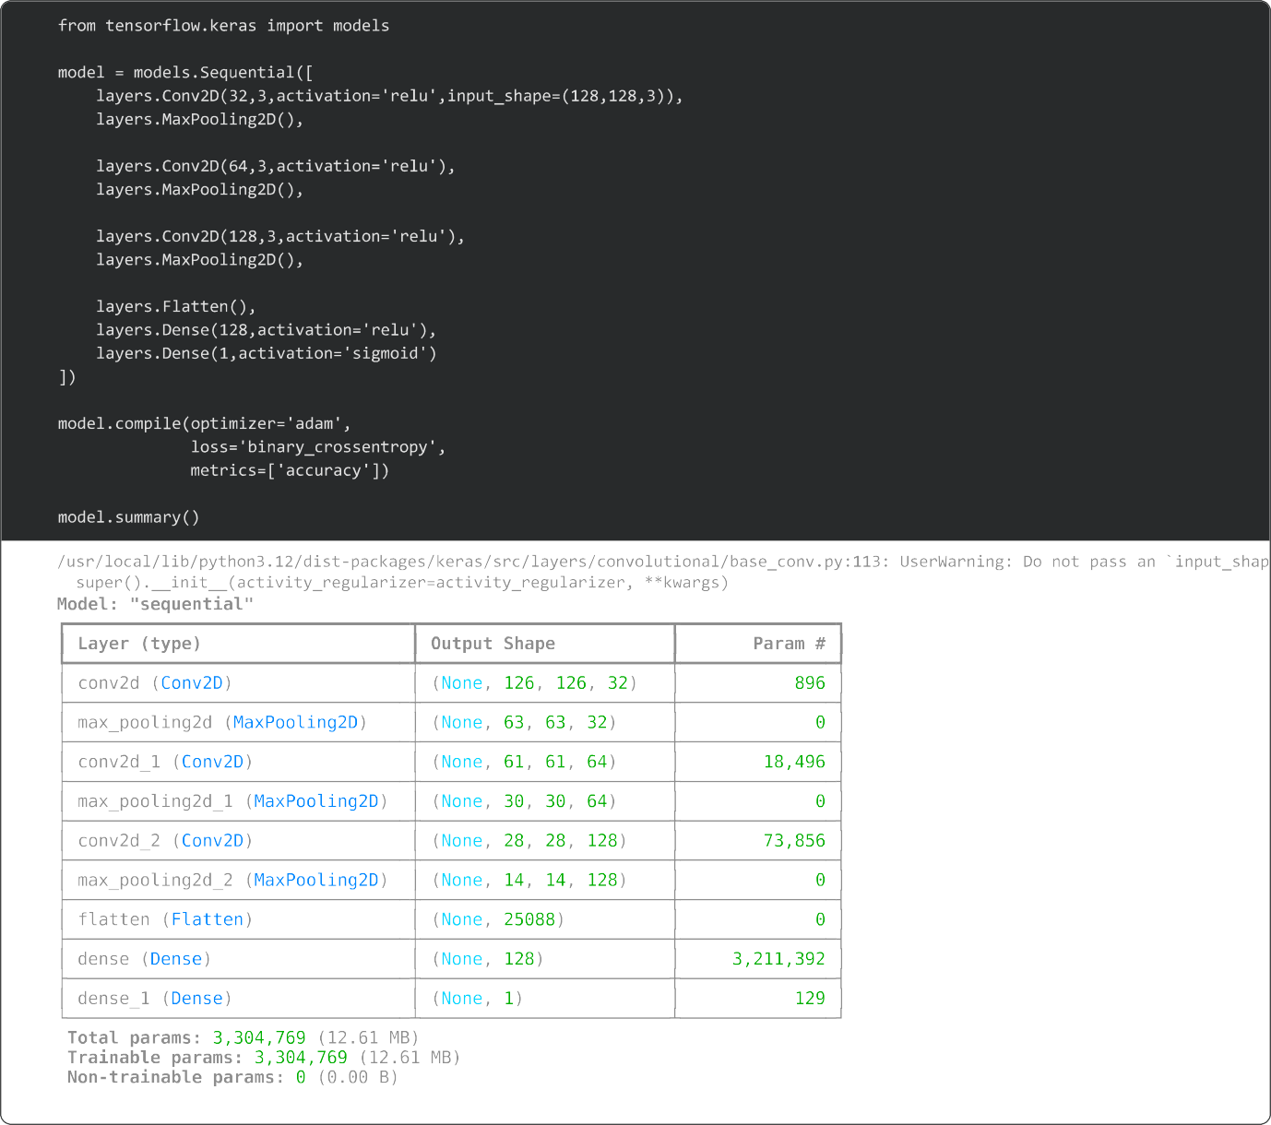

Slide 17
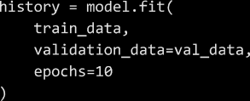
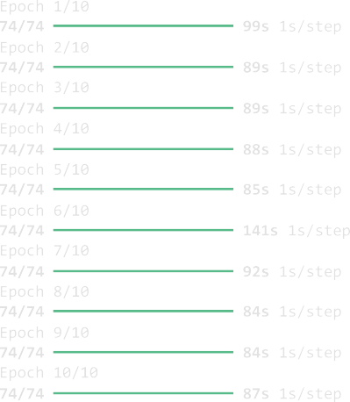
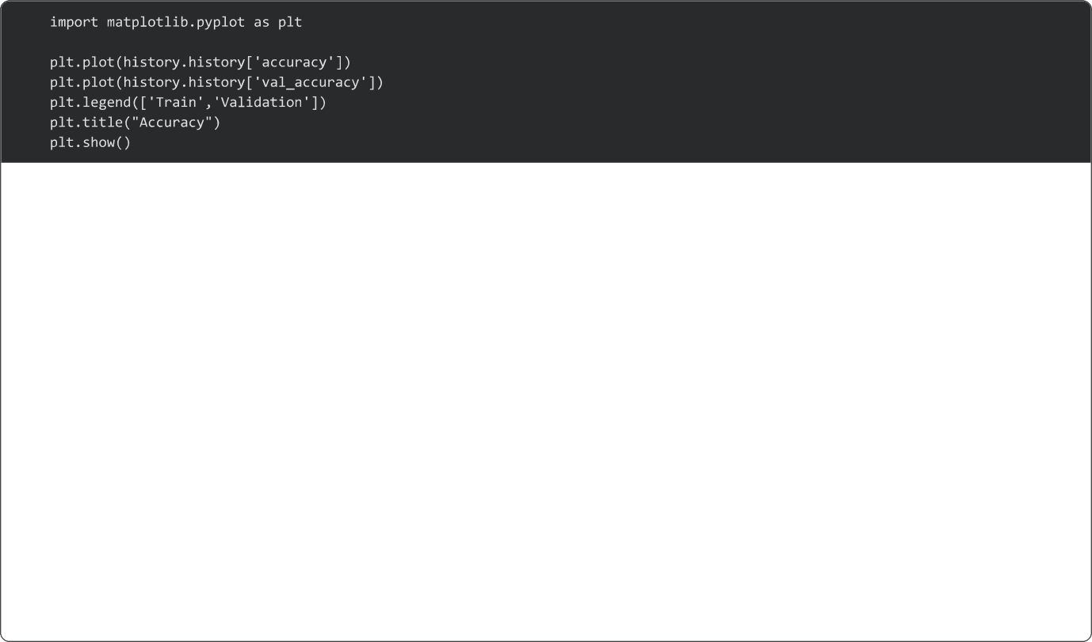
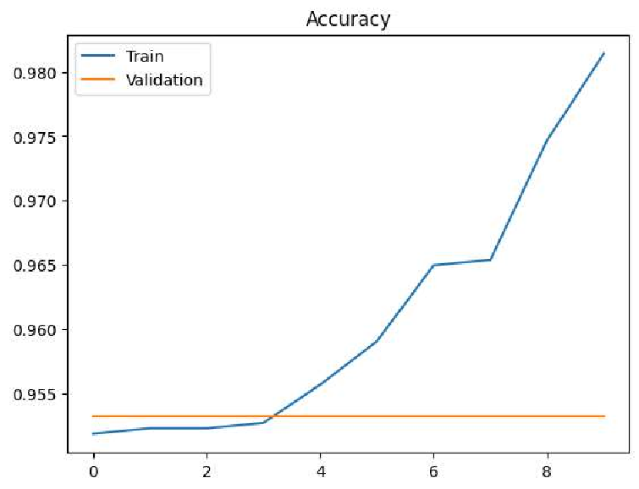
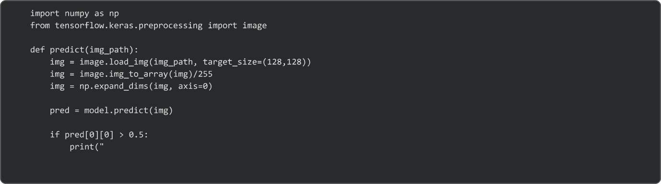



Slide 18
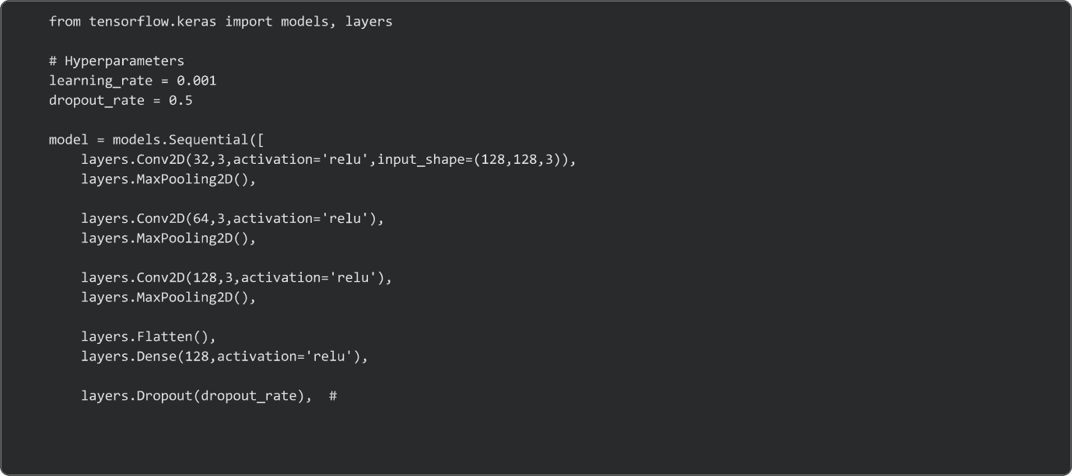

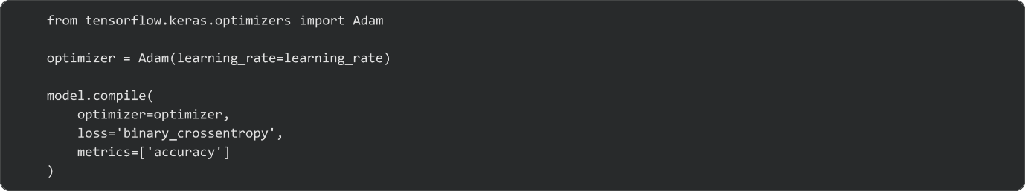
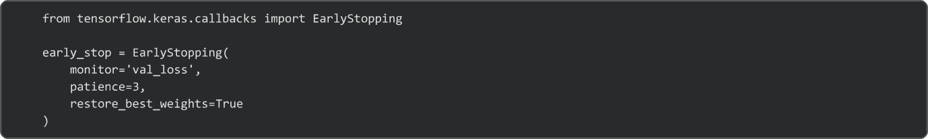
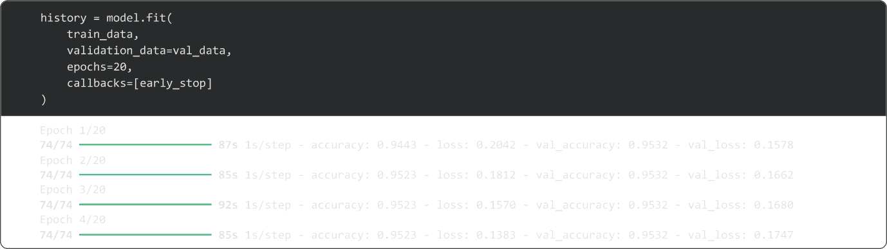

Slide 19
