Slide 1
Launching and execution of AWS EC2 instances

Slide 2
AWS Launch Instance Tutorials
AWS
https://aws.amazon.com/getting-started/tutorials/launch-a-virtual-machine/
YouTube
https://www.youtube.com/watch?v=Ix5IDuyamuY

Slide 3
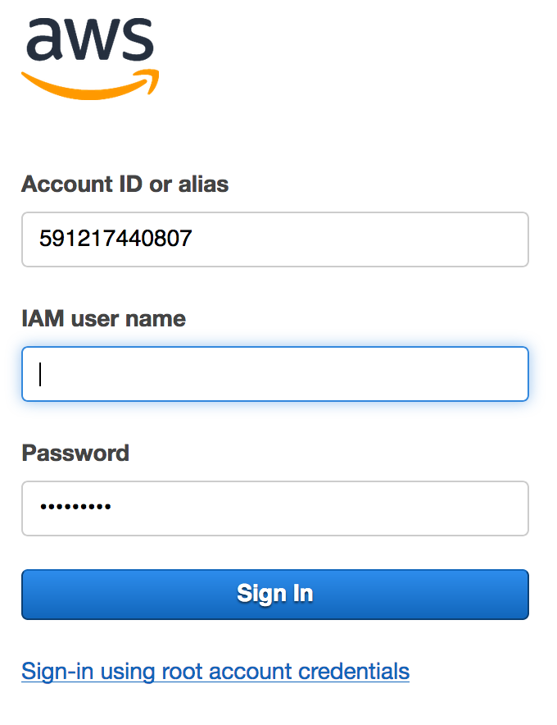
Console Login Link
https://591217440807.signin.aws.amazon.com/console

Slide 4
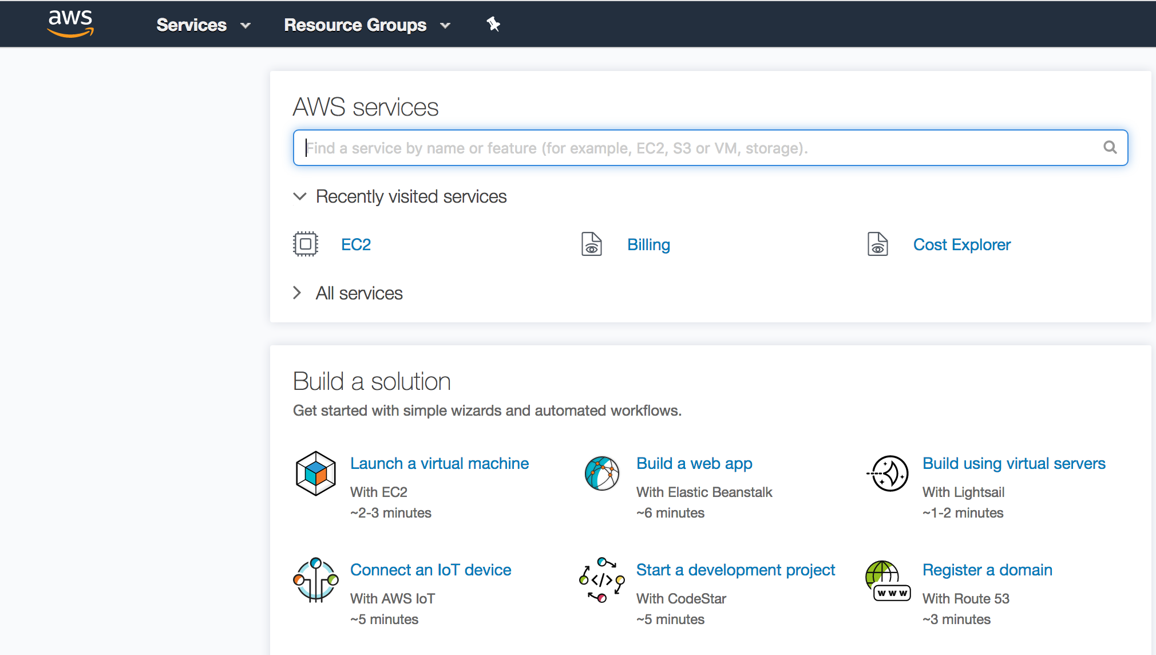
Click on EC2 link

Slide 5
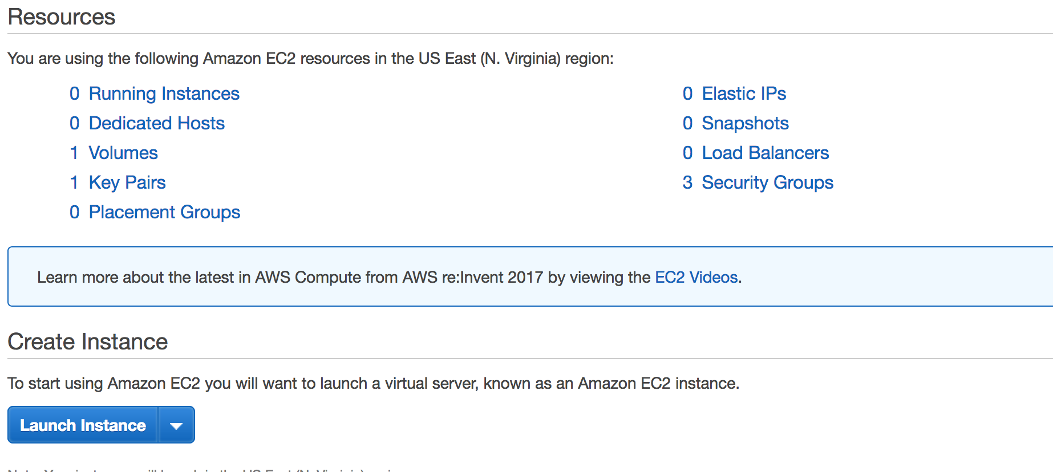
Your Dashboard and Select Launch Instance

Slide 6
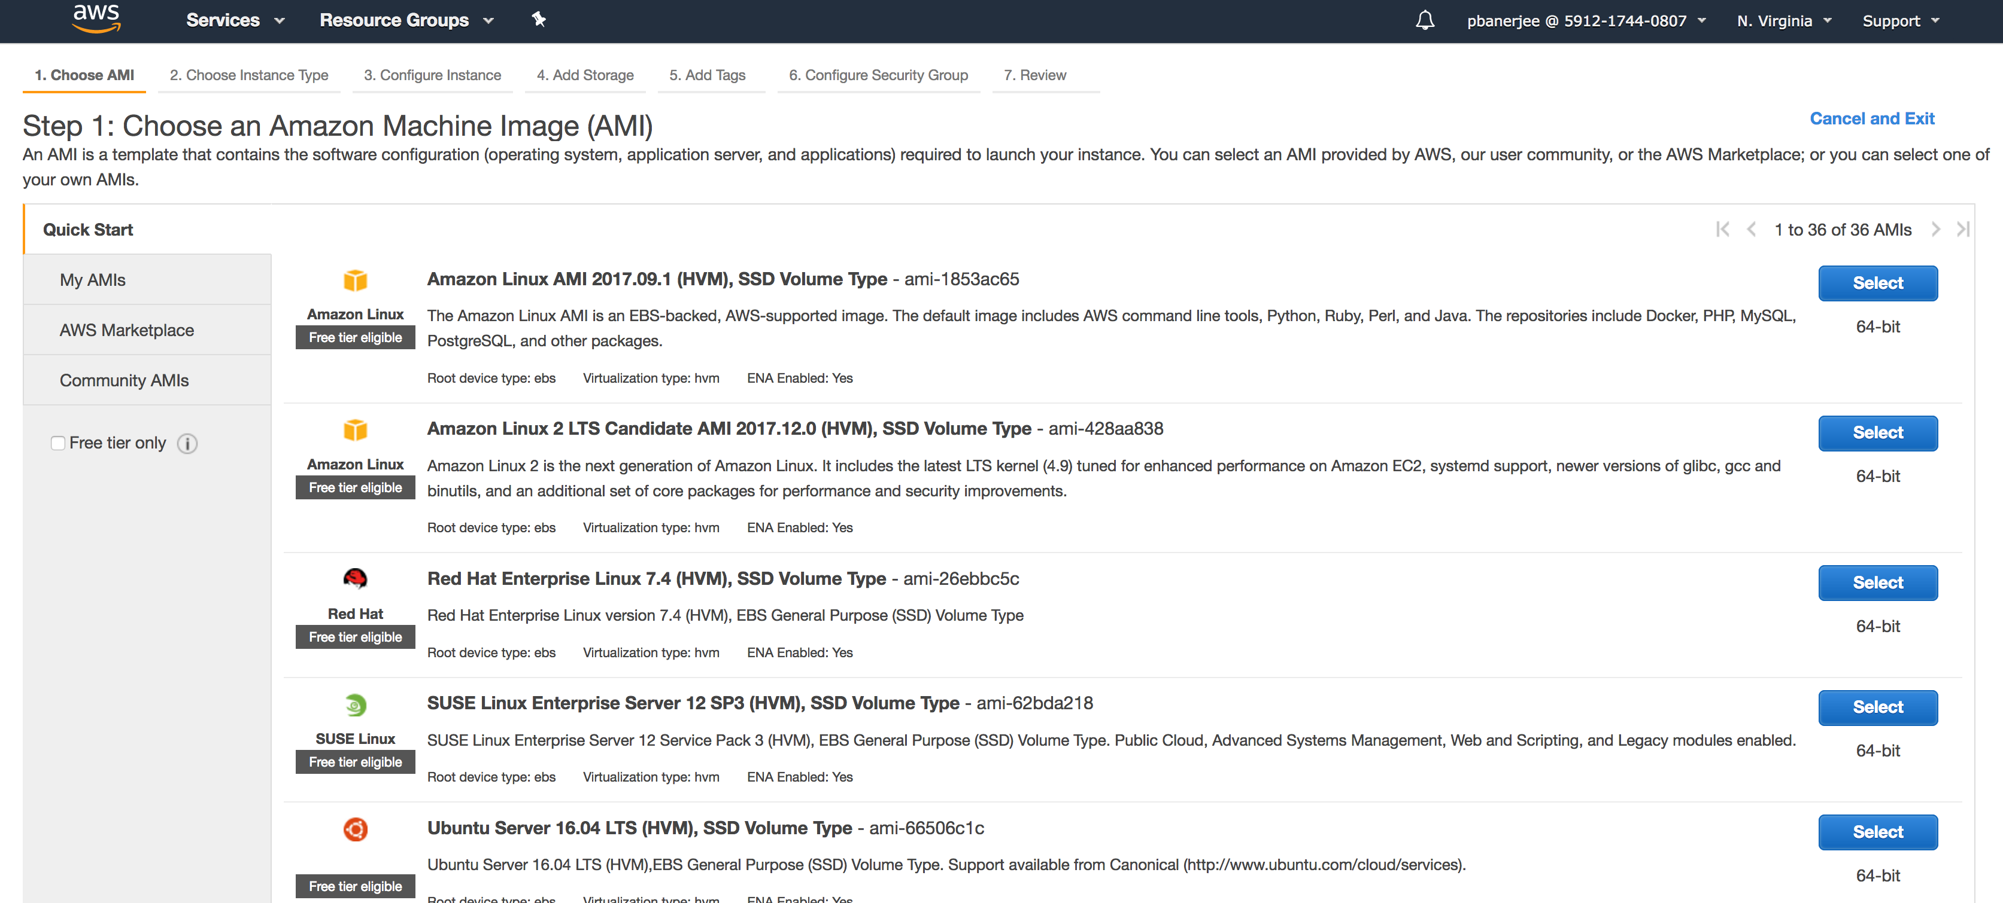
Select the Instance

Slide 7
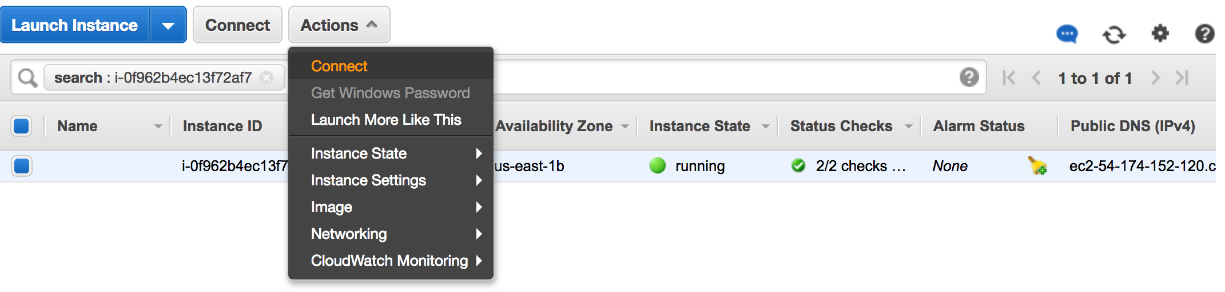
Launch Instance

Slide 8
Connect via Terminal
Ubuntu
ssh -i “path/nameofcertificate” ubuntu@PublicDNS/Public IP
Eg: ssh -i ubuntu1404.pem ubuntu@54.161.215.150
AWS troubleshooting reference page: https://docs.aws.amazon.com/AWSEC2/latest/UserGuide/TroubleshootingInstancesConnecting.html#TroubleshootingInstancesConnectingMindTerm

Slide 9
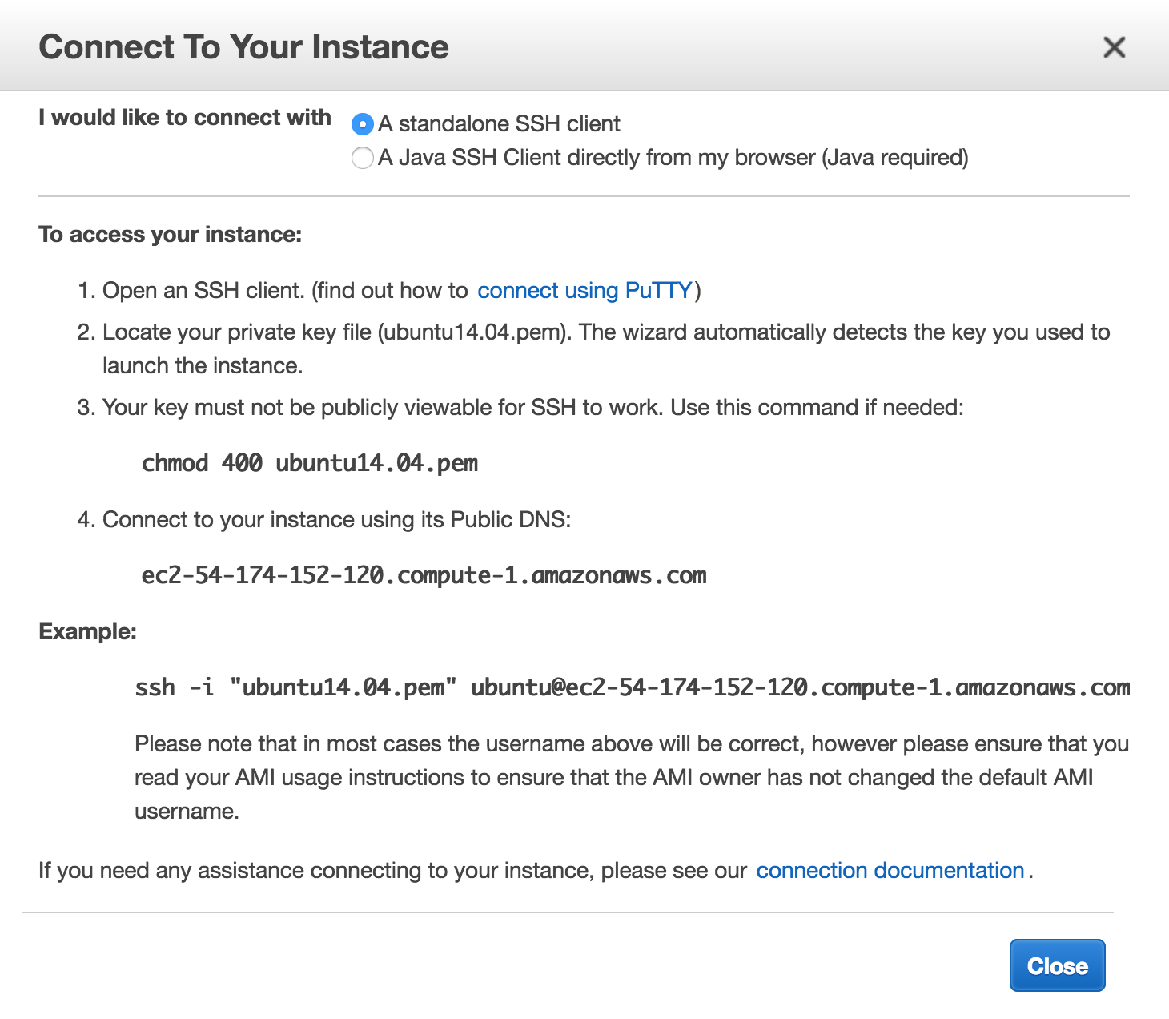
Key management and login via terminal

Slide 10
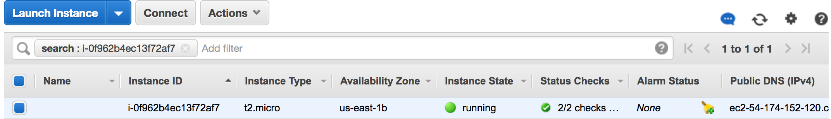
Instance Running

Slide 11
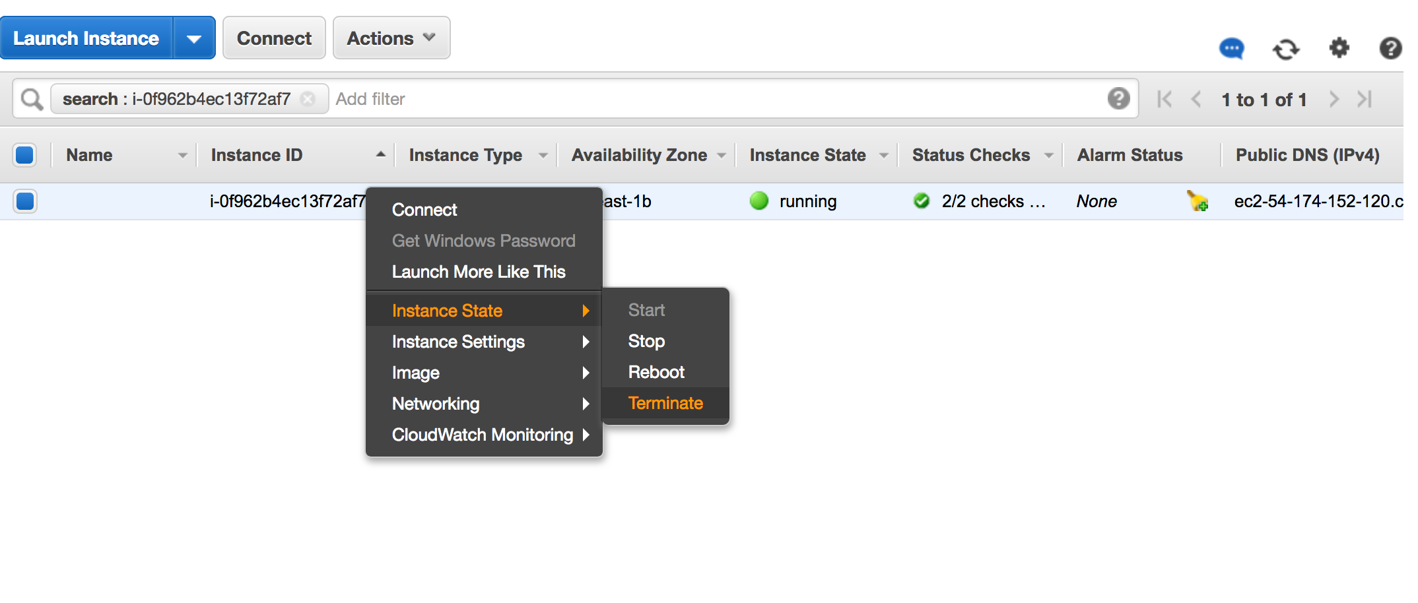
Terminate instance

Slide 12
Difference between STOP and Terminating AWS instances
https://docs.rightscale.com/faq/clouds/aws/Whats_the_difference_between_Terminating_and_Stopping_an_EC2_Instance.html

Slide 13
Transfer Data to AWS instance
$scp -i ~/Desktop/amazon.pem ~/Desktop/MS115.fa ubuntu@ec2-54-166-128-20.compute-1.amazonaws.com:~/data/

Slide 14
Download a file from Amazon instance to your laptop:
$scp -i ~/Desktop/amazon.pem ubuntu@ec2-54-166-128-20.compute-1.amazonaws.com:/data/ecoli_ref-5m-trim.fastq.gz ~/Download/

Slide 15
Install the following software on Ubuntu
Install pip
sudo apt-get install python-setuptools python-dev build-essential
sudo easy_install pip
Aws cli
pip install awscli --upgrade --user
sudo apt install unzip

Slide 16
If aws cli is not installed
Install pip
Install aws cli
aws configure
Access key -
Secret key -
Region –
Output format - none
sudo su –
aws s3 ls

Slide 17
Attach a volume
Create a volume
Gp2
Region selection
Attach volume
Attach the volume to a running instance
One the rway is also to attach an instance while create an instance by adding the storage option while EC2 configuration.

Slide 18
Command line mount a Volume
Log In
df –h
This will show the volume is attached or not
lsblk
It will return the blocks and get the name like sdva or nvme
ls -1 /dev/ | grep nvme
This will list the number of block devices
cd /
sudo mkdir data
sudo mkfs -t ext4 /dev/nvme1n1
sudo mount /dev/nvme1n1 /data
sudo chown -R ubuntu:ubuntu /data
df –hT
This will show if the volume is mounted now with T showing the ext4 filesystem
Lsblk
mount –a

Slide 19
Volume attach when reboot Ec2 instance
vi /etc/fstab
Add a line at the end of the file
/dev/nvme1n1 /data ext4 defaults,nofail 0 0

Slide 20
S3 bucket
Make bucket
aws s3 mb bucket_name
Remove bucket
aws s3 rb bucket_name
Sync bucket
aws s3 sync <source> <target> [--options]

Slide 21
Install Anaconda
wget https://repo.anaconda.com/archive/Anaconda3-5.2.0-Linux-x86_64.sh
bash Anaconda3-5.2.0-Linux-x86_64.sh
In order to activate the installation, you should source the ~/.bashrc file
source ~/.bashrc
conda

Slide 22
Install Bioconda
conda config --add channels defaults
conda config --add channels
conda-forge conda config --add channels bioconda

Slide 23
Install Bioinformatics Tools (RNA Seq)
Fastqc
Hisat2
Samtools
Htseq counts

Slide 24
Data Transfer S3
Reference Fastq
Reference GTF
Reference Index
Fastq files

Slide 25
Data transfer
From S3 to EC2
aws s3 sync s3://bucketname/ .
From EC2 to S3
aws s3 sync . s3://bucketname/
aws s3 sync foldername s3://bucketname/
From S3 to local
aws s3 cp s3://mikedataset/PO152BULK_alignments.vdjca .
aws s3 sync s3://remote_S3_bucket local_directory
Notes:
https://docs.aws.amazon.com/AWSEC2/latest/UserGuide/AmazonS3.html

