Slide 1
GLO Finance
AS-IS Process Map
End-to-End Finance Operations | 7 Swim Lanes | 8 Process Phases
Supplier & Factory MDM
EQOS · NeoGrid · SSUP Portal
Purchase Order Creation
LM/MM System · ISOS · OTM/BizTalk
Shipment Execution
OTM · BizTalk/RTA · FF Systems
Product Invoice Processing
ISOS/OTM BM · Documentum · EDI → OFI · MS Access
Freight Self-Billing
MS Access DB · Rolling File · Oracle Fusion · Tungsten
AR & Intercompany Billing
Oracle Fusion AR · RIMS (CE) · Oracle R12
Customs & Duty
OTM CSS/IMS · NBS/CM-UK · WTA Portal · DDA (TISL)
Tesco Global Finance | Confidential | 2024

Slide 2
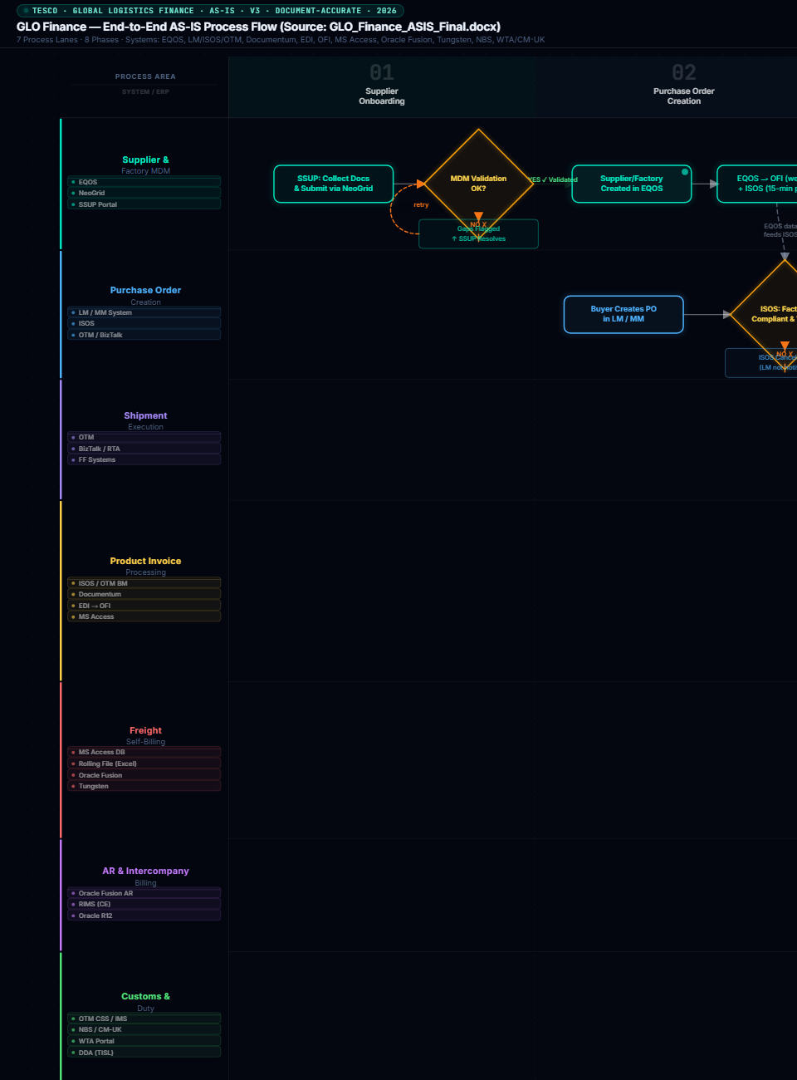
Phase 1-2: Supplier Onboarding & Purchase Order Creation
Phases 1 & 2 | Supplier Onboarding → Purchase Order Creation
Supplier Onboarding | Purchase Order Creation

Slide 3
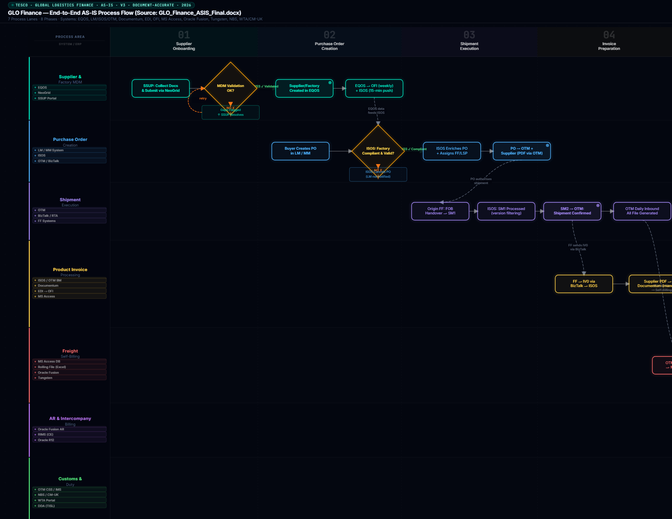
Phase 3-4: Shipment Execution & Invoice Preparation
Phases 3 & 4 | Shipment Execution → Invoice Preparation
Shipment Execution | Invoice Preparation

Slide 4
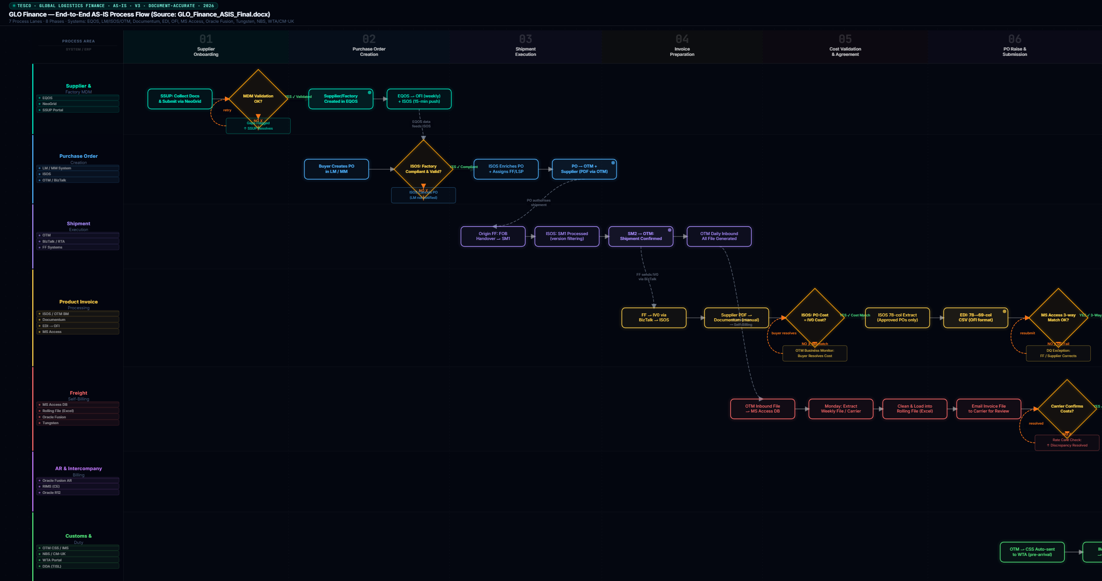
Phase 5-6: Cost Validation & PO Raise / Submission
Phases 5 & 6 | Cost Validation & Agreement → PO Raise & Submission
Cost Validation & Agreement | PO Raise & Submission

Slide 5
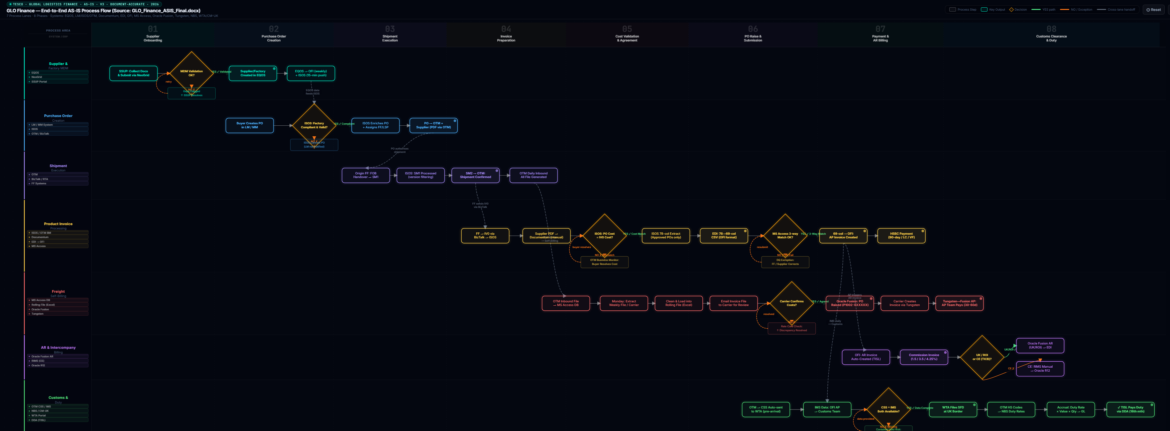
Phase 7-8: Payment & AR Billing & Customs Clearance / Duty
Phases 7 & 8 | Payment & AR Billing → Customs Clearance & Duty
Payment & AR Billing | Customs Clearance & Duty

