Slide 1
Vienna‘s rising Real Estate Prices
Similarities and price differences of Vienna‘s 23 districts.

Slide 2
The Issue and Potential Beneficiaries
Real estate prices in Vienna have risen 10% in the past year (+170% since 2000)
Prices are expected to keep rising:
Vienna is still cheap compared to international peers
Pertaining low interest rate environment
Consistently high growth of the city‘s population
Although housing quality is fairly homogenous throughout Vienna, prices are not
Potential Beneficiaries:
People that are interested in living in Vienna, who want to protect themselves from future price increases by taking advantage of current low interest rates

Slide 3



Used Data
Average real estate prices per square meter for all 23 districts (source: City of Vienna)
JSON-polygons for the official borders of each district (source: Open Data Austria)
Foursquare Location Data for Vienna (source: foursquare.com)

Slide 4
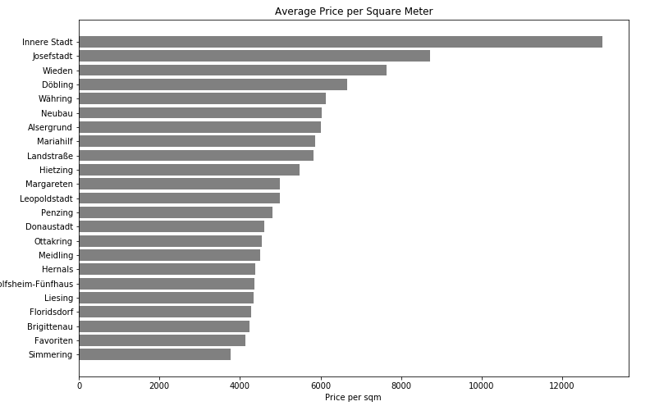
Methodology – Descriptive Analysis
Bar Chart:
outlier
Rudo

Slide 5
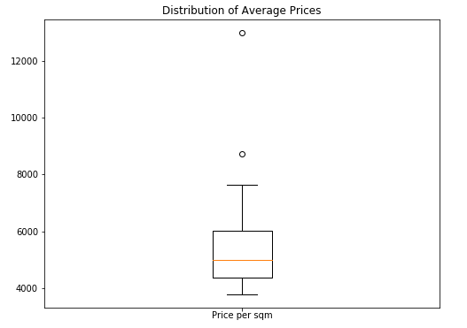
Methodology – Descriptive Analysis
Box Plot:
Innere Stadt

Slide 6
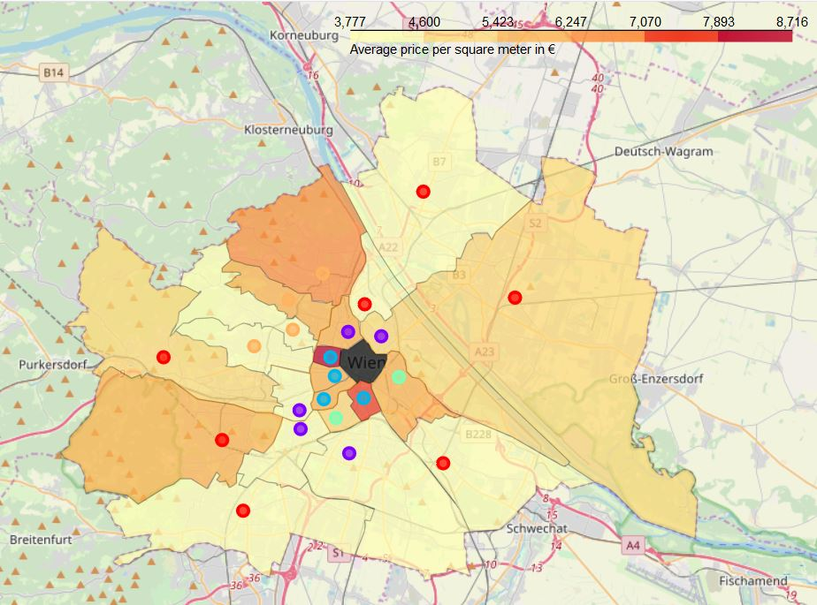
Methodology – Descriptive Analysis
Choropleth Map & Clustering (excluding „Innere Stadt“ as outlier):

Slide 7
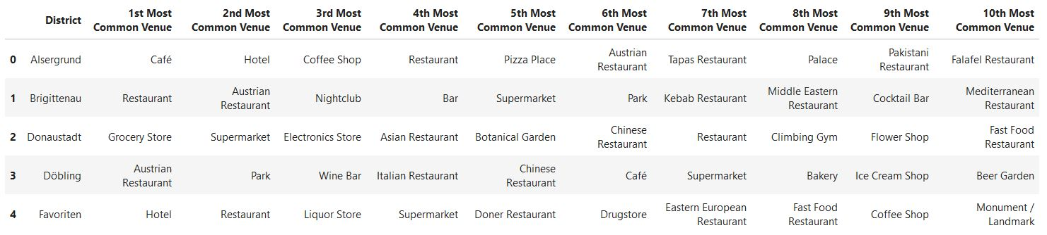
Methodology – Descriptive Analysis
Clusters were derived using the top 10 occurences in location data of the respective district:
Iterating through k-means clustering, it showed that 5 clusters are optimal to classify the similarities between districts

Slide 8
Methodology – Descriptive Analysis
Remarks:
As this analysis is primarily geared towards people who already live in Vienna or are familiar with the peculiarities of the city, the public and individual transport system as well their personal regional preferences, I desist from describing the different clusters in detail and let the segmentation speak for itself.

Slide 9
Results
Central districts tend to have higher prices and are fairly similar to each other with regards to location data
Districts exist with still very high proximity to the city center, but significantly lower prices
Prices rise again towards city boundaries

Slide 10
Discussion
Within all clusters, significant differences in prices can be found without sacrificing much of the amenities offered
Aside from north-western Vienna, similarly to the center, border districts seem to be fairly homogenous as well when it comes to location data, however there are also differences in prices
As the analysis primarily covers districts interesting for housing purposes, the central district „Innere Stadt“ (marked black) was excluded from the analysis due to being an outlier. However, as almost 120,000 Viennese commute to this district for work every day, proximity remains very desirable

Slide 11
Conclusion
There are opportunities to choose districts with similar characteristics for a lower price throughout all clusters
Interested parties should first decide which category of districts they would be interested in and afterwards proceed with analyzing the cheapest candidate
As Foursquare is not the primary location data platform used in Austria, it would probably be more fruitful to the carry out the analysis with data from Google Maps. However, as the objective of the project was to use the Foursquare API, the results still yield valuable insights.

