Slide 1
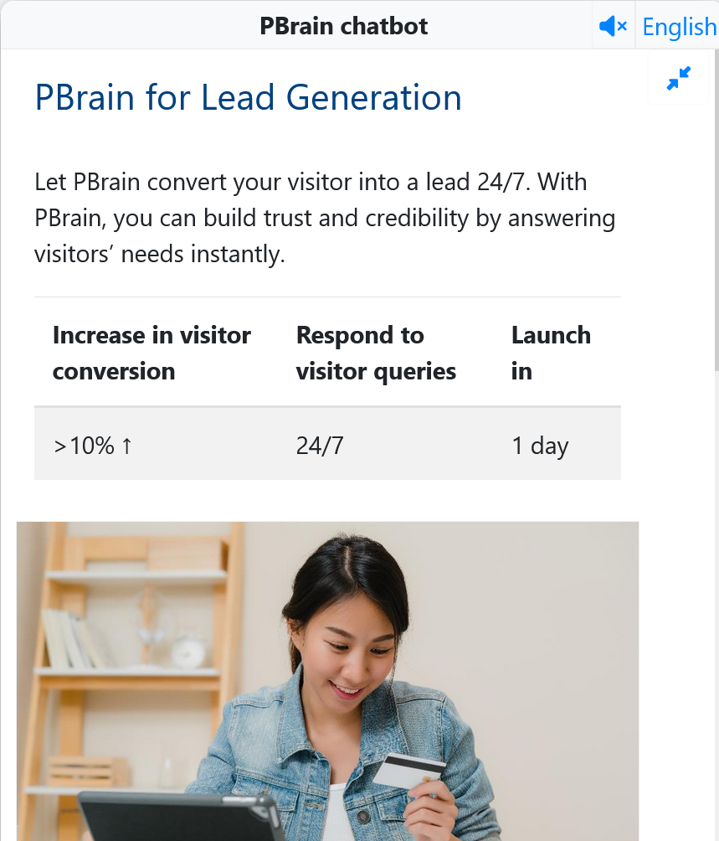
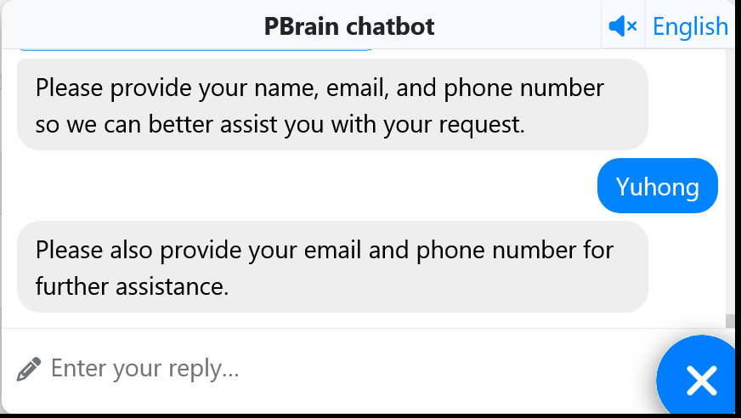

PBrain lead generation ChatGPT chatbot
Engage and convert visitors into leads
.biz

