Slide 1

Understanding Value at Risk
Patrick Browne

Slide 2
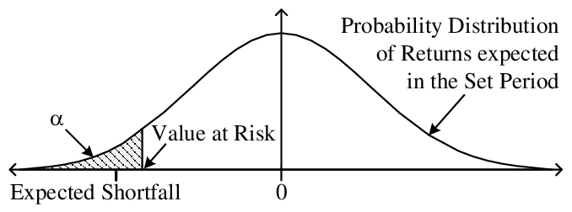
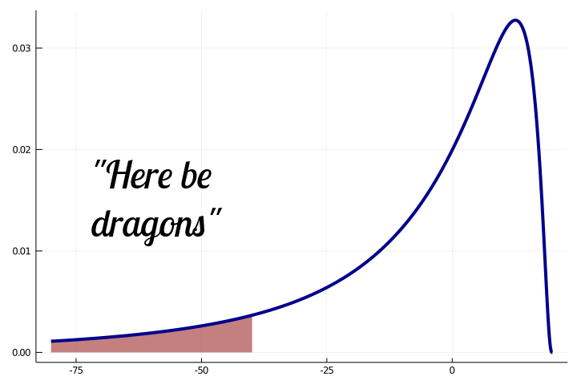
What is Value at Risk?
Value at risk (VaR) is a measure used to determine the downside risk of an investment or portfolio. It is an estimate of how much money a firm (typically a bank) might lose within a short time period, given normal market conditions and a certain probability.
The statistic is used to inform management of the risk profile of the firm to ensure that there aren’t surprises. It’s an easy statistic to understand (and misunderstand) and allows quants to express a risk estimate simply and clearly.
When calculating parametrically, we assume that the distribution of returns is normal and that there are no fat tails (not always the case, as returns aren’t a true random walk).
VaR is often used with expected shortfall (or CVaR, conditional value at risk) to provide a more accurate picture of downside risk.
2

Slide 3
Ways to calculate VaR
There are several different ways to calculate value at risk - today, I will go over three methods
Historical method
Variance-covariance method
Monte Carlo method
One of the easier methods to calculate, the historical method returns a non-parametric VaR based on the previous returns of the security or portfolio
Fundamental assumption is that the past is a good indicator of the near-future
The variance-covariance method, also known as the parametric method, uses historical price movements of a security or portfolio and uses probability theory to calculate the maximum loss
Fundamental assumption is that returns are normally distributed and like past returns
Uses a variance-covariance matrix to calculate volatility
The Monte Carlo method simulates downside risk by using historical data
Again, assumes some continuity of historical returns; however, you can change this to reflect a non-normal distribution if desired
3

Slide 4
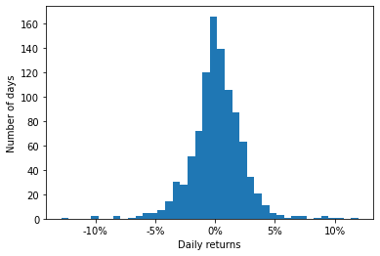

One Security VaR
This is an example of calculating VaR using Apple’s stock (AAPL)
$$VaR_{AAPL}=95\%CI\left(\frac{v_{i}}{v_{i−1}}\right)$$
$$=\left(3.26\%\right)$$
What does this mean?
Here, we are saying (with 95% confidence) that AAPL’s share price will not exceed losses greater than 3.26% over a one-day period.
This can be multiplied by your position to give an amount of money (e.g., $3,260)
To do this for a portfolio, you simply calculate daily returns for that portfolio (assuming no redistributions)
4

Slide 5
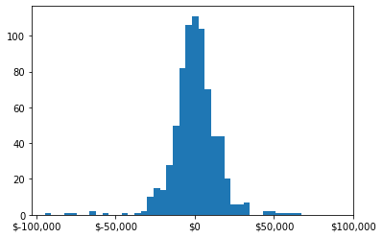
Historical method
Each of the next three slides goes through a different calculation of the current VaR of the Boston University Investment Club portfolio. Note that the estimated current value of the portfolio is $775,575.24
95%
99%
Day | 1 | 2 | 3 | 4 | 5
95% VaR | -$20,661.73 | -$29,220.10 | -$35,787.17 | -$41,323.46 | -$46,201.04
99% VaR | -$33,411.55 | -$47,251.06 | -$57,870.50 | -$66,823.10 | -$74,710.49
Portfolio composition is from late 2021 and may not reflect current positions of the club
5

Slide 6
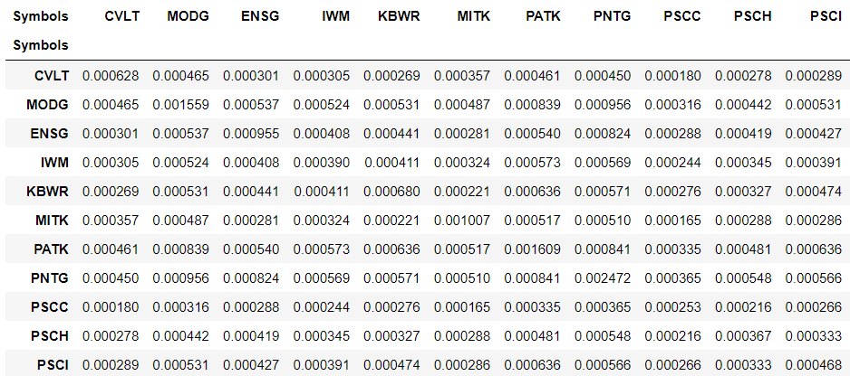
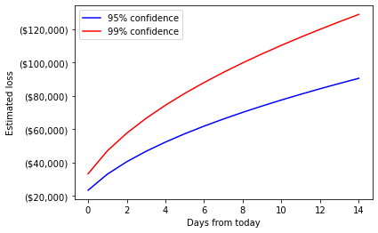
Variance-covariance method
The image on the right is the covariance matrix for the portfolio, used to determine the volatility (standard deviation) of each security. The graph below maps expected losses up to 15 days from today.
Day | 1 | 2 | 3 | 4 | 5
95% VaR | -$23,394.67 | -$33,085.07 | -$40,520.77 | -$46,789.35 | -$52,312.09
99% VaR | -$33,298.55 | -$47,091.26 | -$57,674.78 | -$66,597.10 | -$74,457.82
6

Slide 7
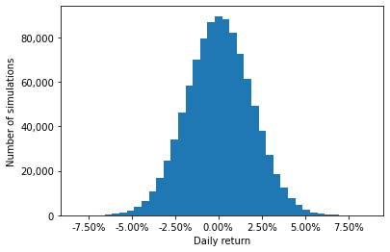
Monte Carlo method
The distribution of returns using this method is similar to that of the parametric method; however, you can adjust the parameters of the Monte Carlo simulation to create non-normal distributions if desired
95%
99%
Day | 1 | 2 | 3 | 4 | 5
95% VaR | -$23,389.09 | -$33,077.17 | -$40,511.09 | -$46,778.18 | -$52,299.60
99% VaR | -$33,271.68 | -$47,053.26 | -$57,628.24 | -$66,543.36 | -$74,397.73
7

Slide 8
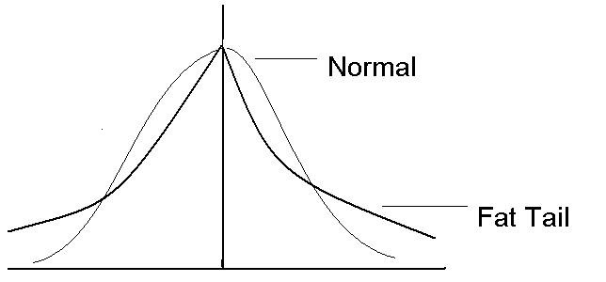
Criticisms of VaR – a non-exhaustive list
False sense of security – people with a weaker understanding of this statistic may misunderstand or make incorrect assumptions
Underestimate risk in a worst-case scenario
Underestimate frequency (by definition, events outside the 95% confidence interval are expected once every 20 events)
Can lead to excessive risk-taking and leverage
Full of assumptions
Are returns actually normal?
Are market conditions usual?
Cannot estimate risk of black swan events
Ignores tails of risk distribution
However, these can be supplemented with other statistics such as CVaR and RVaR (range value at risk)
Not a coherent risk measure
Violates the sub-additive property
8

Slide 9


Famous asset managers on VaR
“A 99% Value-at-Risk calculation does not evaluate what happens in the last one percent… This is like an airbag that works all the time, except when you have a car accident.”
- David Einhorn
“If you don’t invest in risk management, it doesn’t matter what business you’re in: it’s a risky business.”
- Gary Cohn
“A turkey is fed for 1,000 days by a butcher, and every day confirms to the turkey (and the turkey’s economics department, and the turkey’s risk management department, and the turkey’s analytical department) that the butcher loves turkeys, and every day brings more confidence to the statement. But on day 1,001, there will be a surprise for the turkey…”
- Nassim Nicholas Taleb
9

Slide 10
Appendix

Slide 11
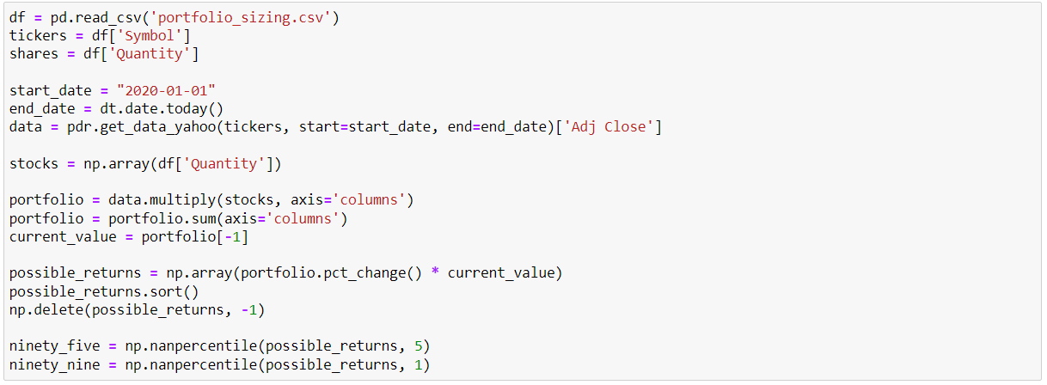
Example Code
This code example comes from setting up the data and using the historical method
11

Slide 12
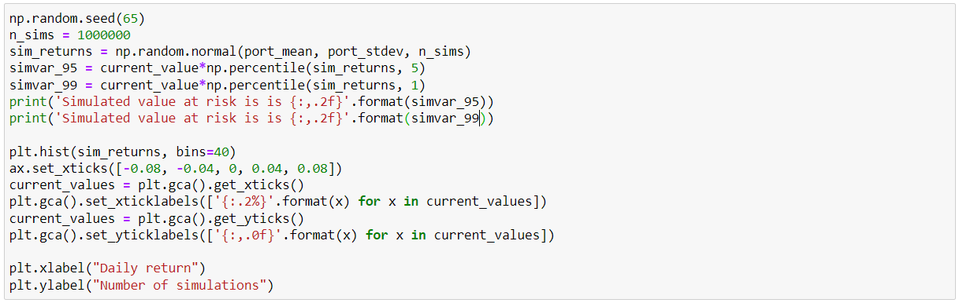
More Example Code
This code example comes from using the Monte Carlo method & plotting it
11

