Slide 1


Why I am using it
by pete brumm
2012/04/19

Slide 2
Background
15 years in professional software development
    10 years java, 6 years ruby
15 successful years with SQL databases
    (Oracle, Mysql, Sybase, Sql Server)
Designed SQL database apps with DB file sizes > 500GB
Apps that average 100M page views a day

Slide 3
why MongoDB over SQL
Fewer Tables. link tables can be embedded
no more ALTER TABLE’s.
Atomic operations. $inc $addToSet $pop
Upsert operations.
  db.people.update( { name:"Joe" }, { $inc: { x:1, y:1 } }, true );
Easier Replication/Failover (although sql db’s are catching up)
GridFS for storing Files. Replicates with rest of data

Slide 4
why MongoDB over other NOSQL
Powerful Ad hoc Query language (similar to sql)
  Doesn’t depend on map-reduce to access data
multi field indexes
  including indexing into arrays, hashes

Slide 5
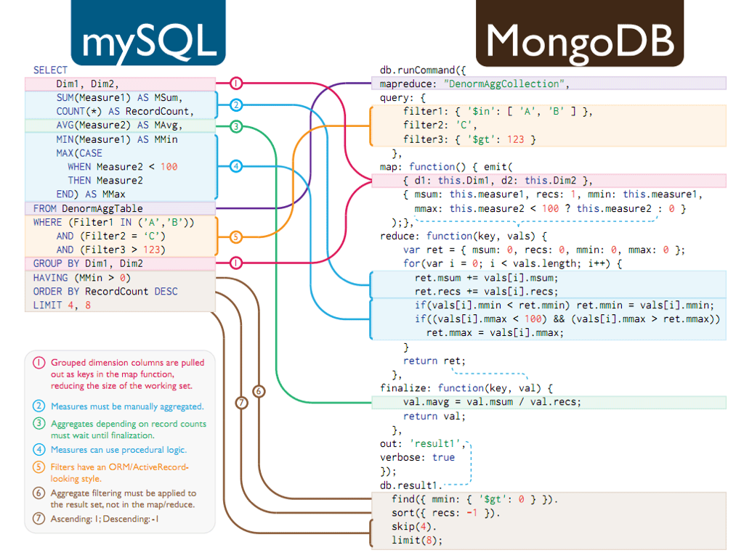
http://nyccto.wordpress.com/2011/03/10/sql-to-mongodb-mapping-infographic/

Slide 6
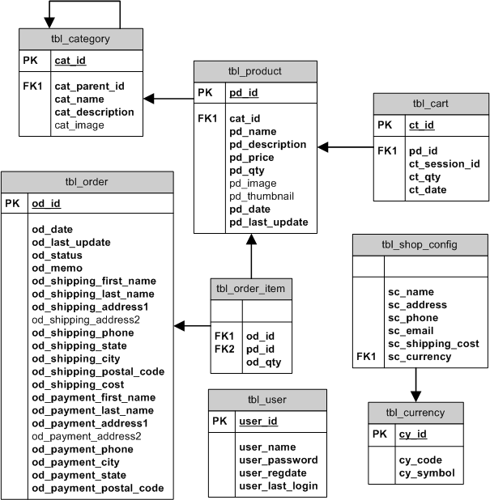
Simple Sql Cart Design
http://www.phpwebcommerce.com/shopping-cart-database-design.php

Slide 7
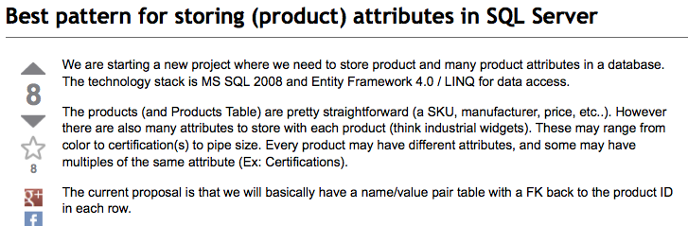
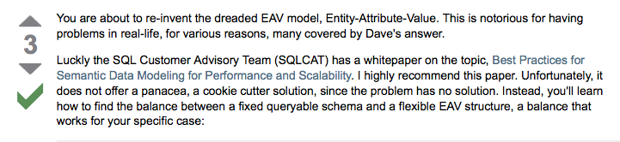
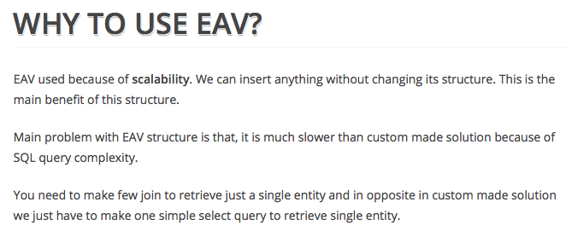
What about Product attributes

Slide 8
MongoDB Way
users
products
{ "_id": 5, "email": "pete@petebrumm.com", "address": {"addr1": "Test Address", "addr2": "", "city": "", "state": "", "zip": ""}}
{ "_id": 3, "name": "Test Product", "category_ids": [1], "price": 19.95, "currency": "usd", 'attrs': [ {"id": 2, v: "White"} ]}
categories
attributes
{ "_id": 1, "name": "Root Category", "path": [],}
{ "_id": 7, "name": "Health", "path": [1],}
{ "_id": 2, "name": "Color", "searchable": true, "values": ["Red", "White", "Green"], "category_ids": [1], "val_products": { "red": [5], "white": [3] }}
carts
{ "user_id": 5, "status": "open", "items": [ {
"product_id": 3,
"qty": 1,
"name": "Test Product",
"price": 19.95,
"currency": "usd"
} ]}

Slide 9
Demo

Slide 10
Gotchas & Recommendations
don’t forget to use $set or other atomic operation on updates
    Otherwise you are replacing existing doc instead of updating it
run on 64bit OS
I don’t recommend windows for production
Map reduce is not for realtime queries. (also not multi core)
Use Replica Sets
indexes can only have one array
Use MongoID ruby gem

Slide 11
links
http://www.mongodb.org/
Rails and MongoDB with MongoID
    http://railsapps.github.com/tutorial-rails-mongoid-devise.html
http://www.10gen.com/presentations
Sql to mongo query mapping
  http://www.mongodb.org/display/DOCS/SQL+to+Mongo+Mapping+Chart

