Slide 1
Hake, age and environmental factors

Slide 2
Le Cren’s body condition
Model the length-weight relationship and the parameters a and b:
  W = aL^b
Can use the a and b parameters to then estimate expected weight W`, and Le Cren’s body condition metric, K, as:
  K = W_{obs} / W`

Slide 3
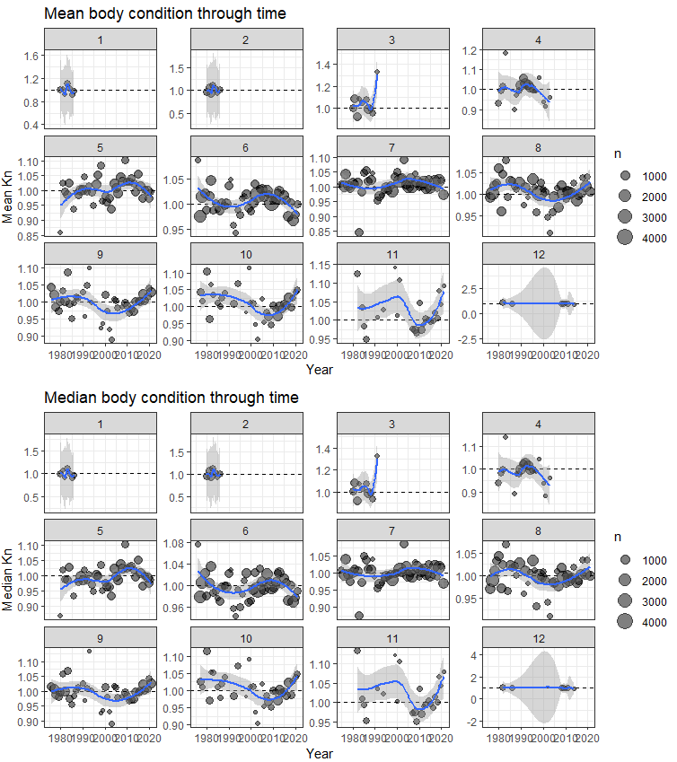
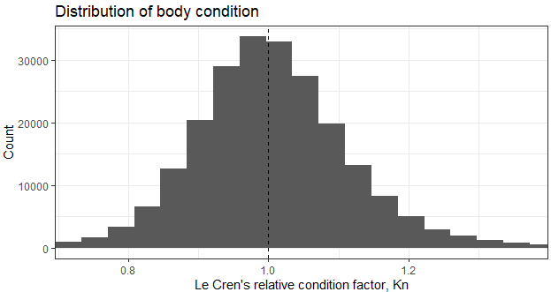
Le Cren’s body condition

Slide 4
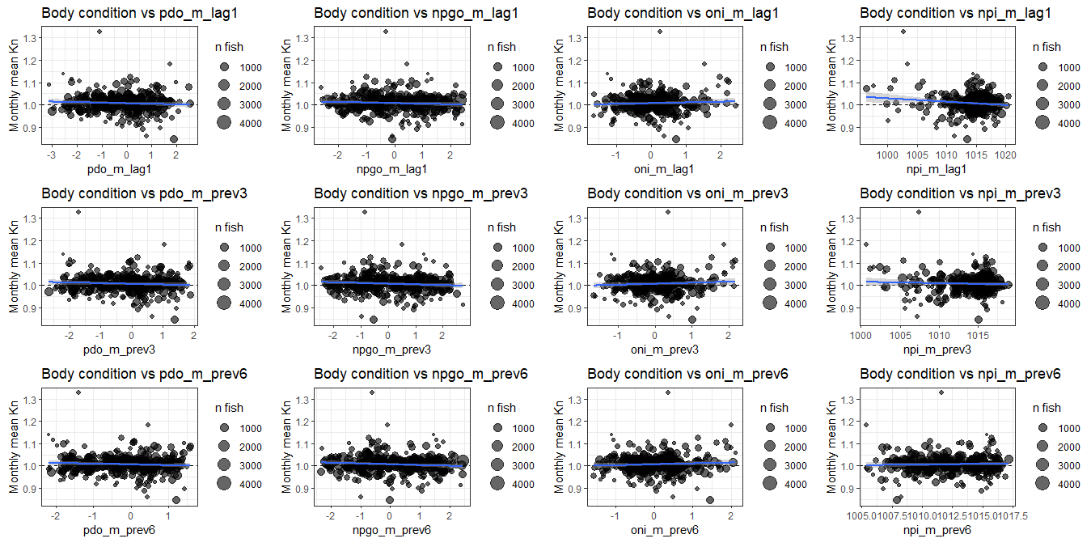

Slide 5
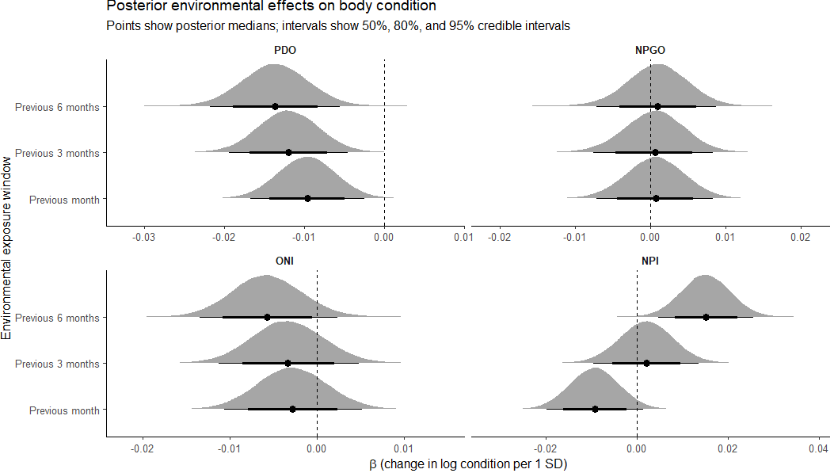

Slide 6
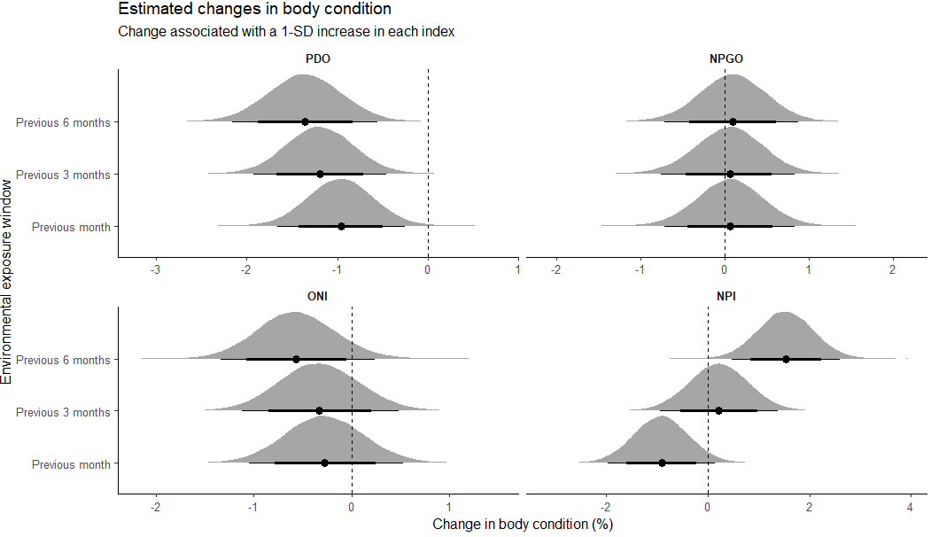

Slide 7
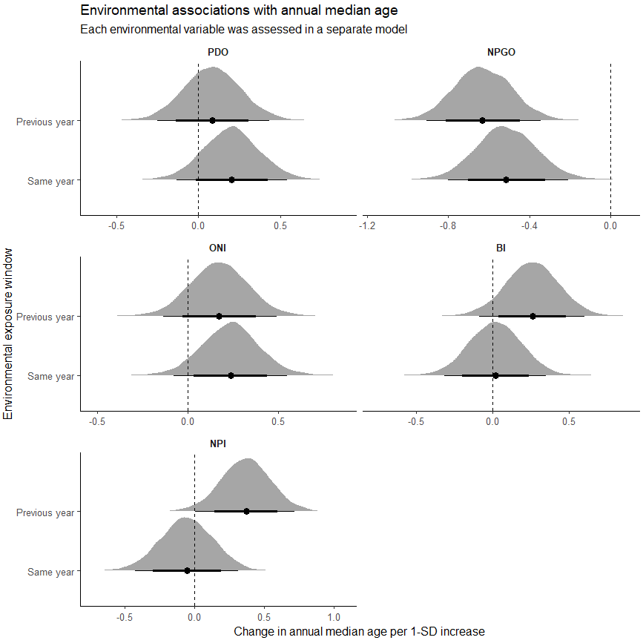
Annual median age with env covariates

Slide 8
Explanation of findings
PDO negative effects on body condition
PDO slight positive effects on mean age (+ve PDO = older pop’n)
NPGO negative effects on mean age (+ve NPGO = younger pop’n)
PDO and NPGO are independent orthogonal phases of EOF, but have been linked to be negatively correlated as of recent (1980)
Strong +ve NPGO could lead to greater productivity along CC thus increasing recruitment and lowering (ie younger) age class
Notes:
Maybe look at specific months during sampling – April potentially?
Hypotheses of what the driving mechanisms are for the trends with age changes.

Slide 9
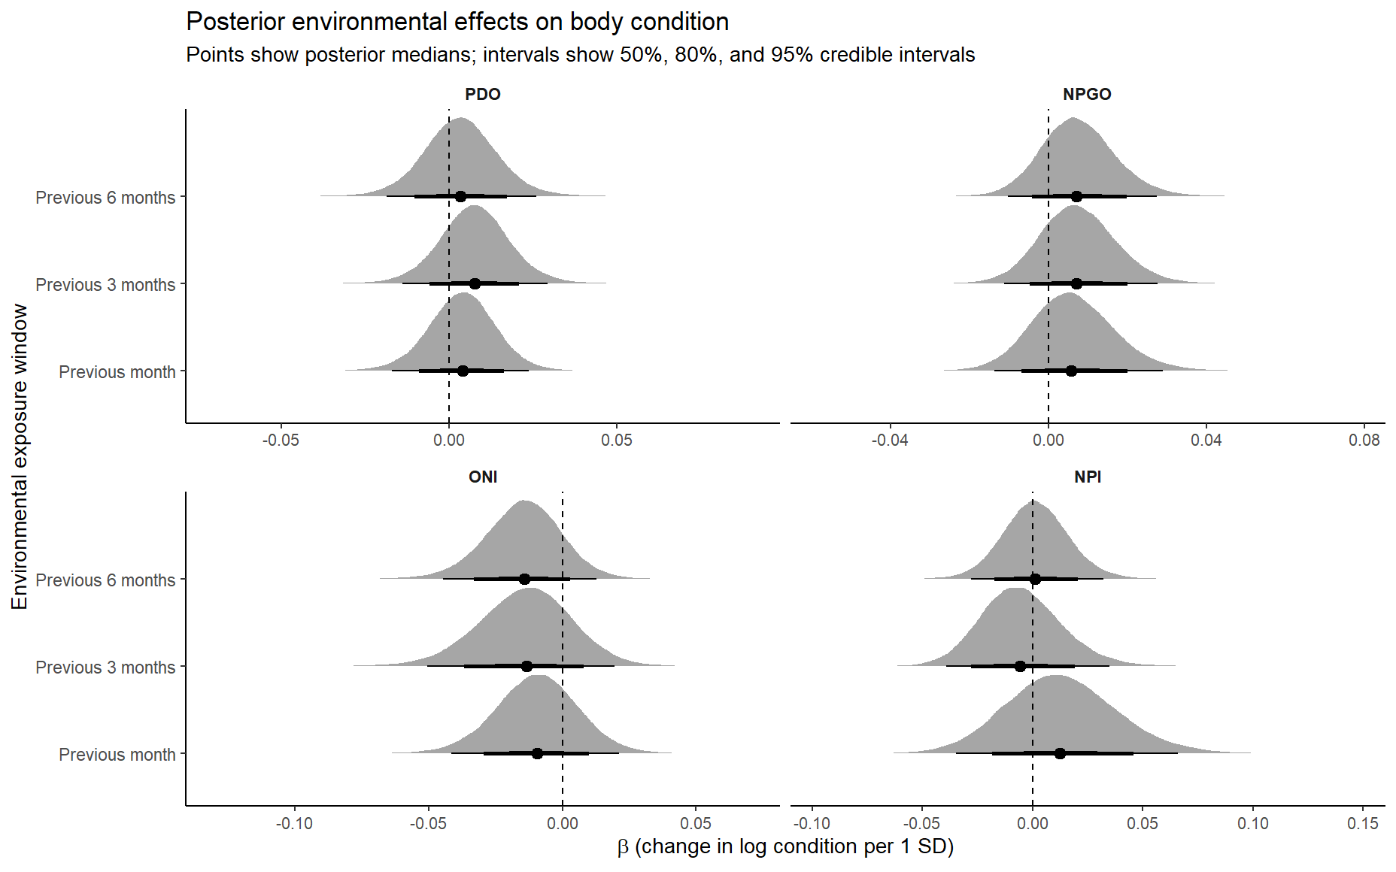
Just Canada data

Slide 10
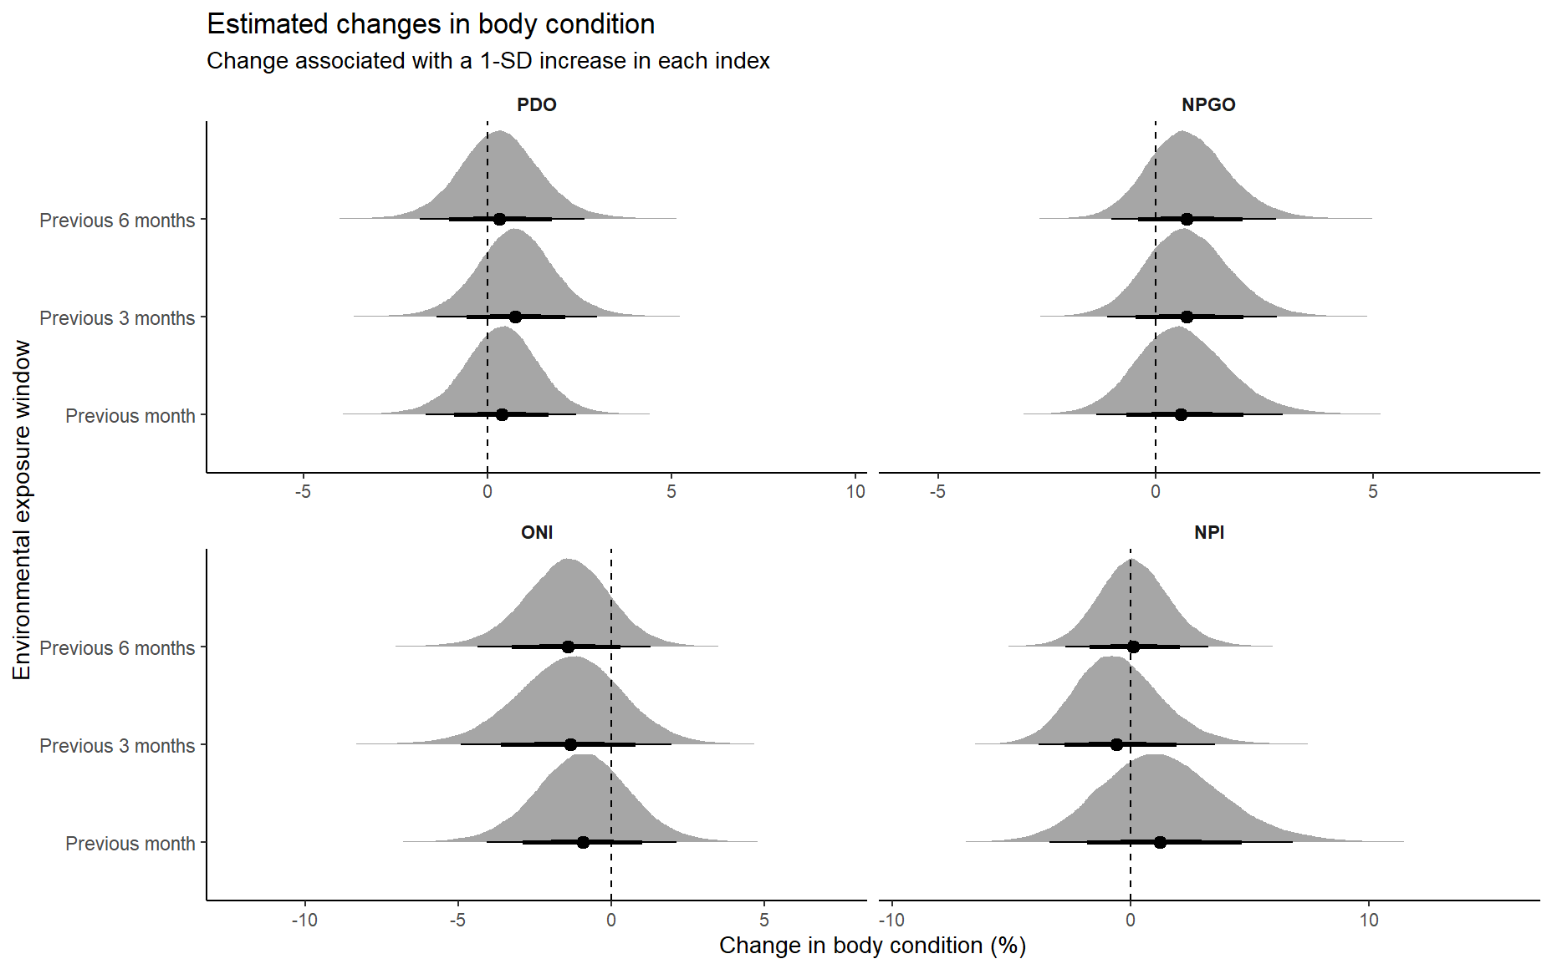
Just Canada data

Slide 11
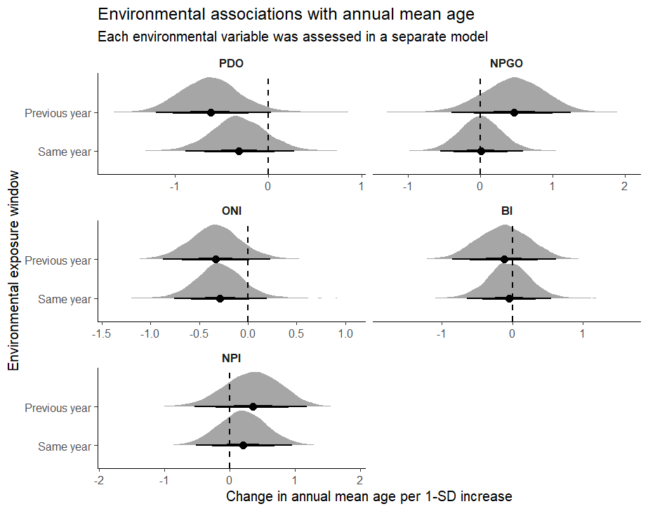
Just Canada data

Slide 12
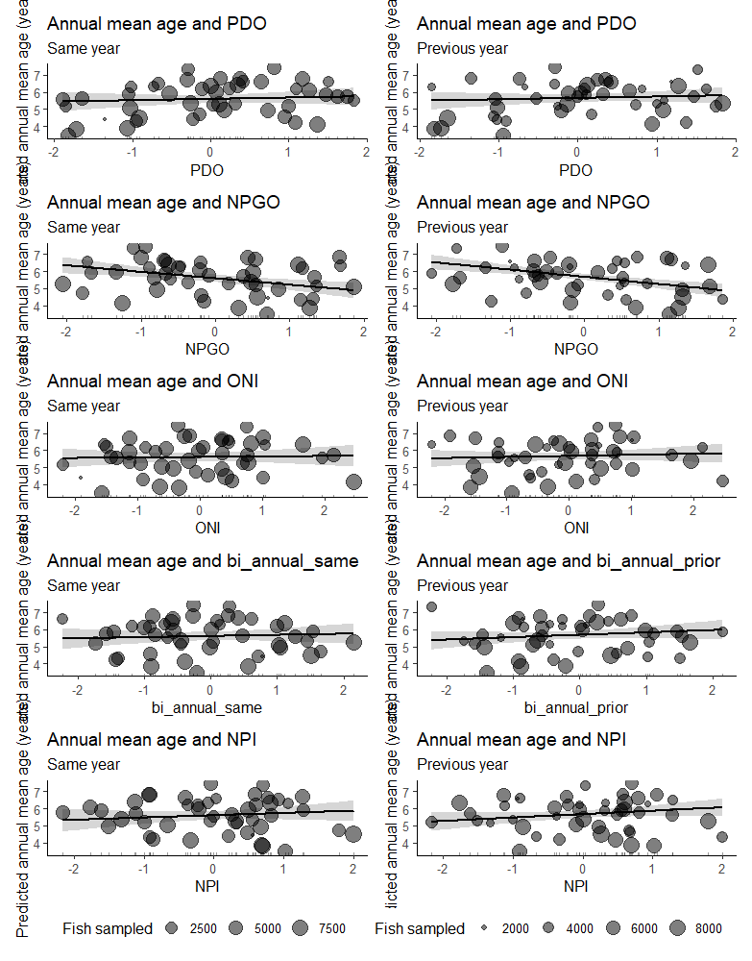
Just Canada data

Slide 16
OUTPUT

Slide 17
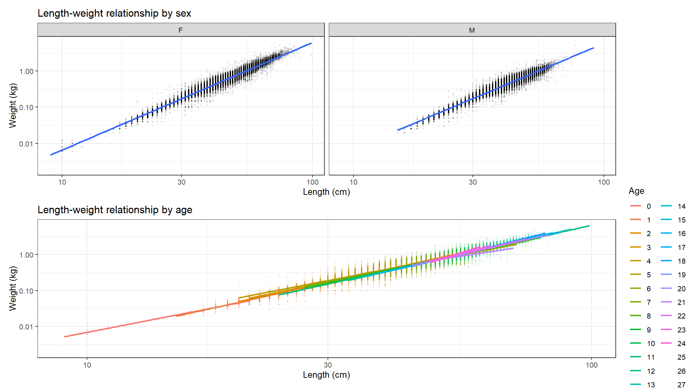
Best fit model includes all factors
But not the best for estimating condition for use in an environmental analysis
Models:
m_lw5.1: log_weight ~ log_length + Sex + factor(Month) + (1 | Source) + , zi=~0, disp=~1
m_lw5.1: (1 | Year), zi=~0, disp=~1
m_lw3.1: log_weight ~ log_length * Sex + factor(Month) + (1 | Source) + , zi=~0, disp=~1
m_lw3.1: (1 | Year), zi=~0, disp=~1
m_lw2.1: log_weight ~ log_length * Sex + Age_yrs + factor(Month) + (1 | , zi=~0, disp=~1
m_lw2.1: Source) + (1 | Year), zi=~0, disp=~1
m_lw1.1: log_weight ~ log_length * Sex + log_length * Age_yrs + factor(Month) + , zi=~0, disp=~1
m_lw1.1: (1 | Source) + (1 | Year), zi=~0, disp=~1
Df AIC BIC logLik deviance Chisq Chi Df Pr(>Chisq)
m_lw5.1 17 -309310 -309135 154672 -309344
m_lw3.1 18 -309761 -309575 154899 -309797 452.8 1 < 2.2e-16 ***
m_lw2.1 45 -318507 -318043 159299 -318597 8800.1 27 < 2.2e-16 ***
m_lw1.1 69 -322897 -322185 161518 -323035 4437.9 24 < 2.2e-16 ***
---
Signif. codes: 0 ‘***’ 0.001 ‘**’ 0.01 ‘*’ 0.05 ‘.’ 0.1 ‘ ’ 1

Slide 18
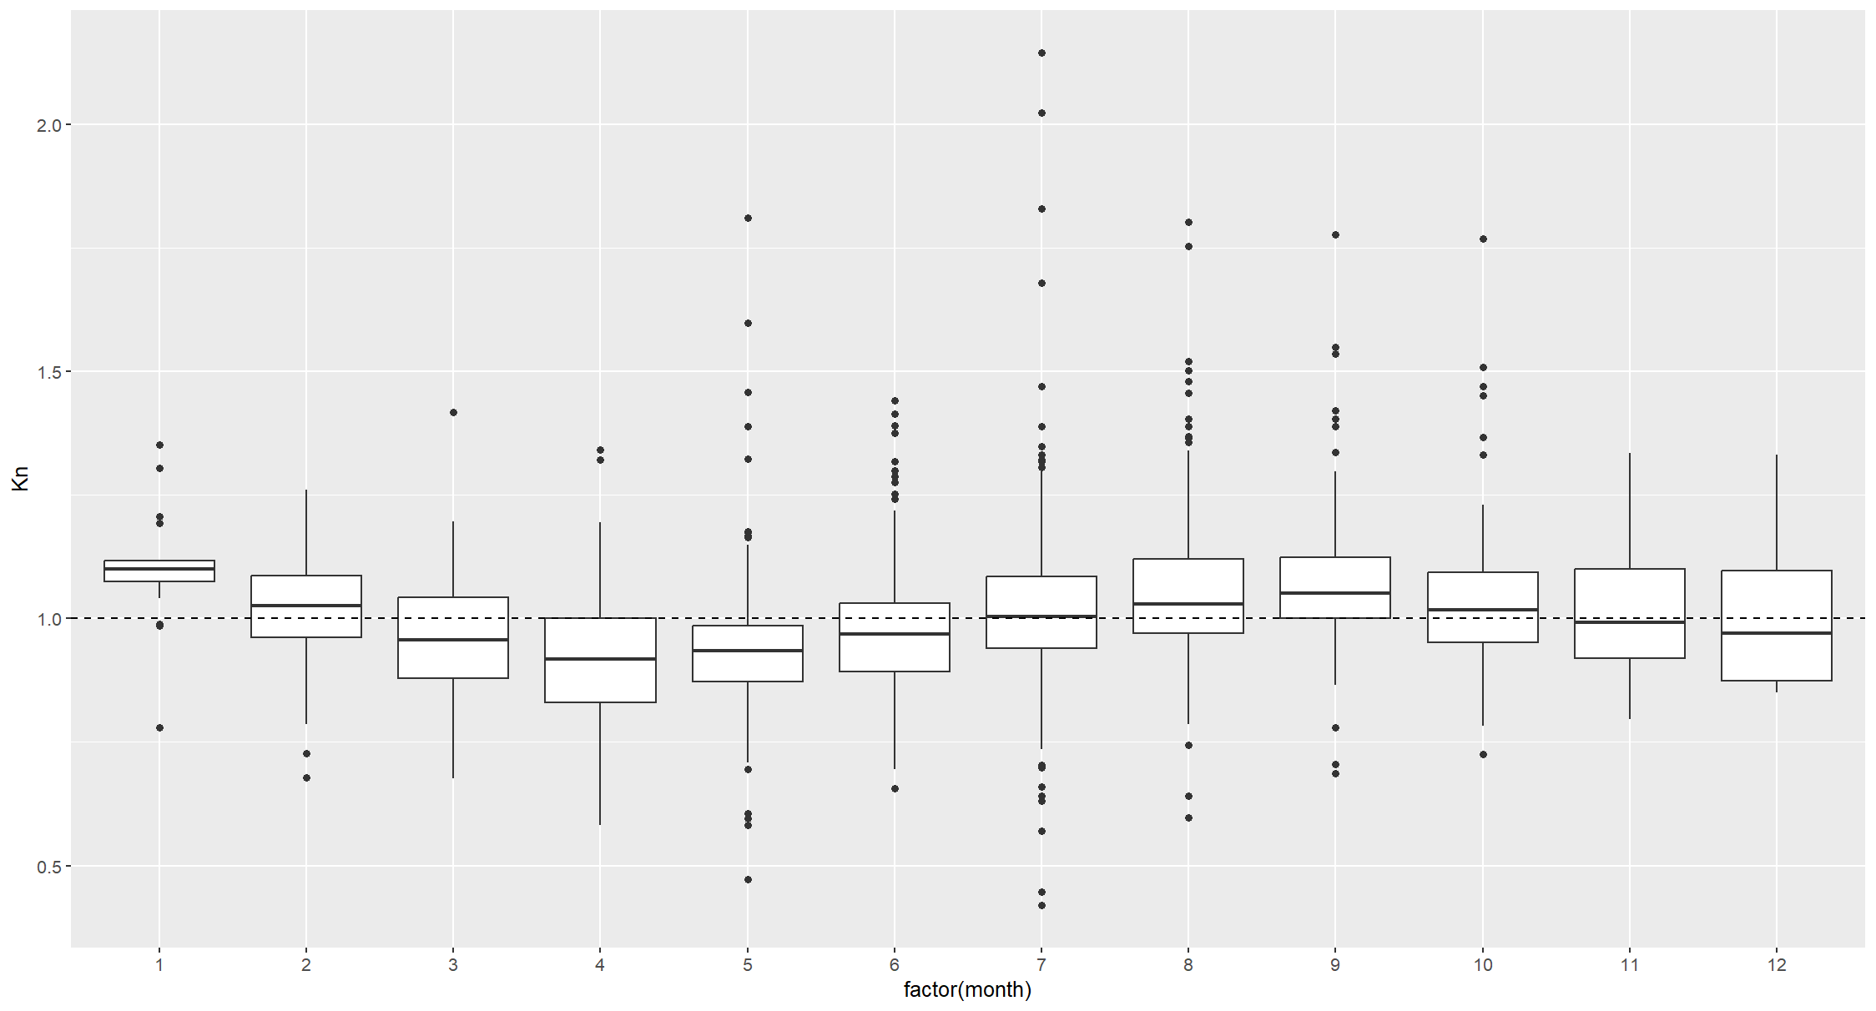
Body condition and month

Slide 19
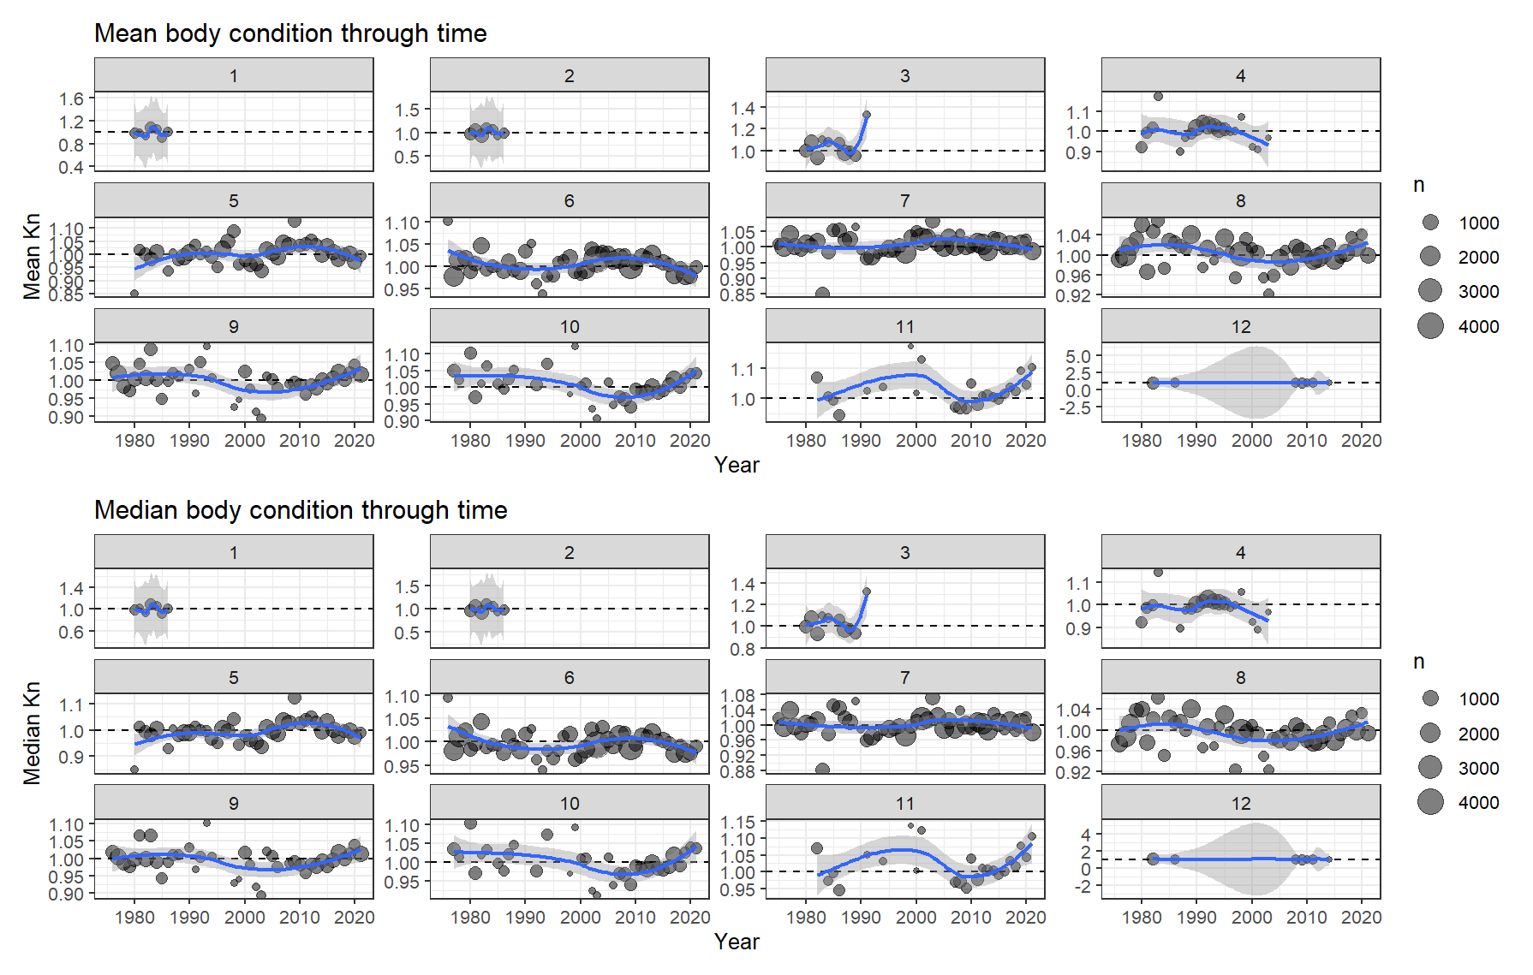
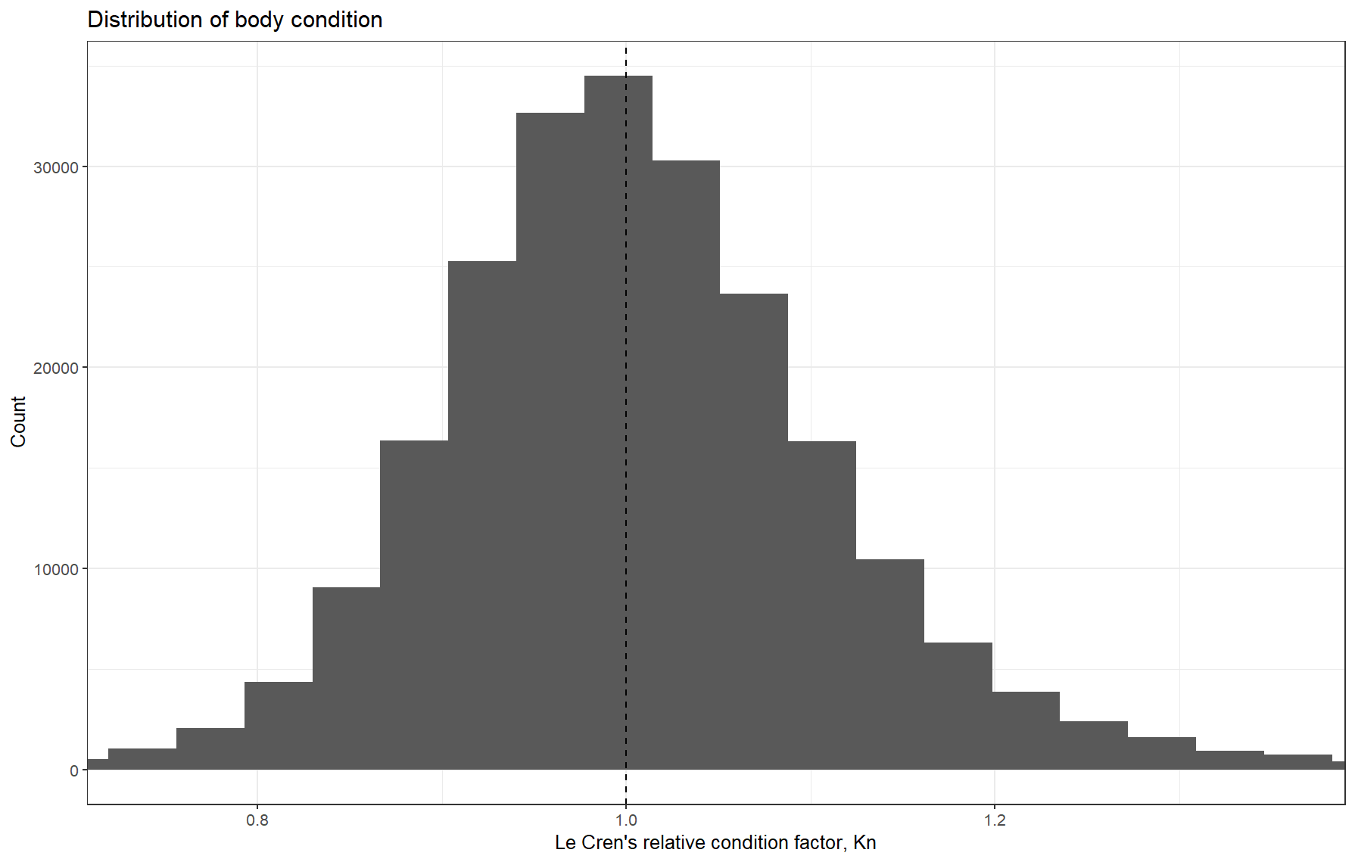
Model 1.1 results

Slide 20
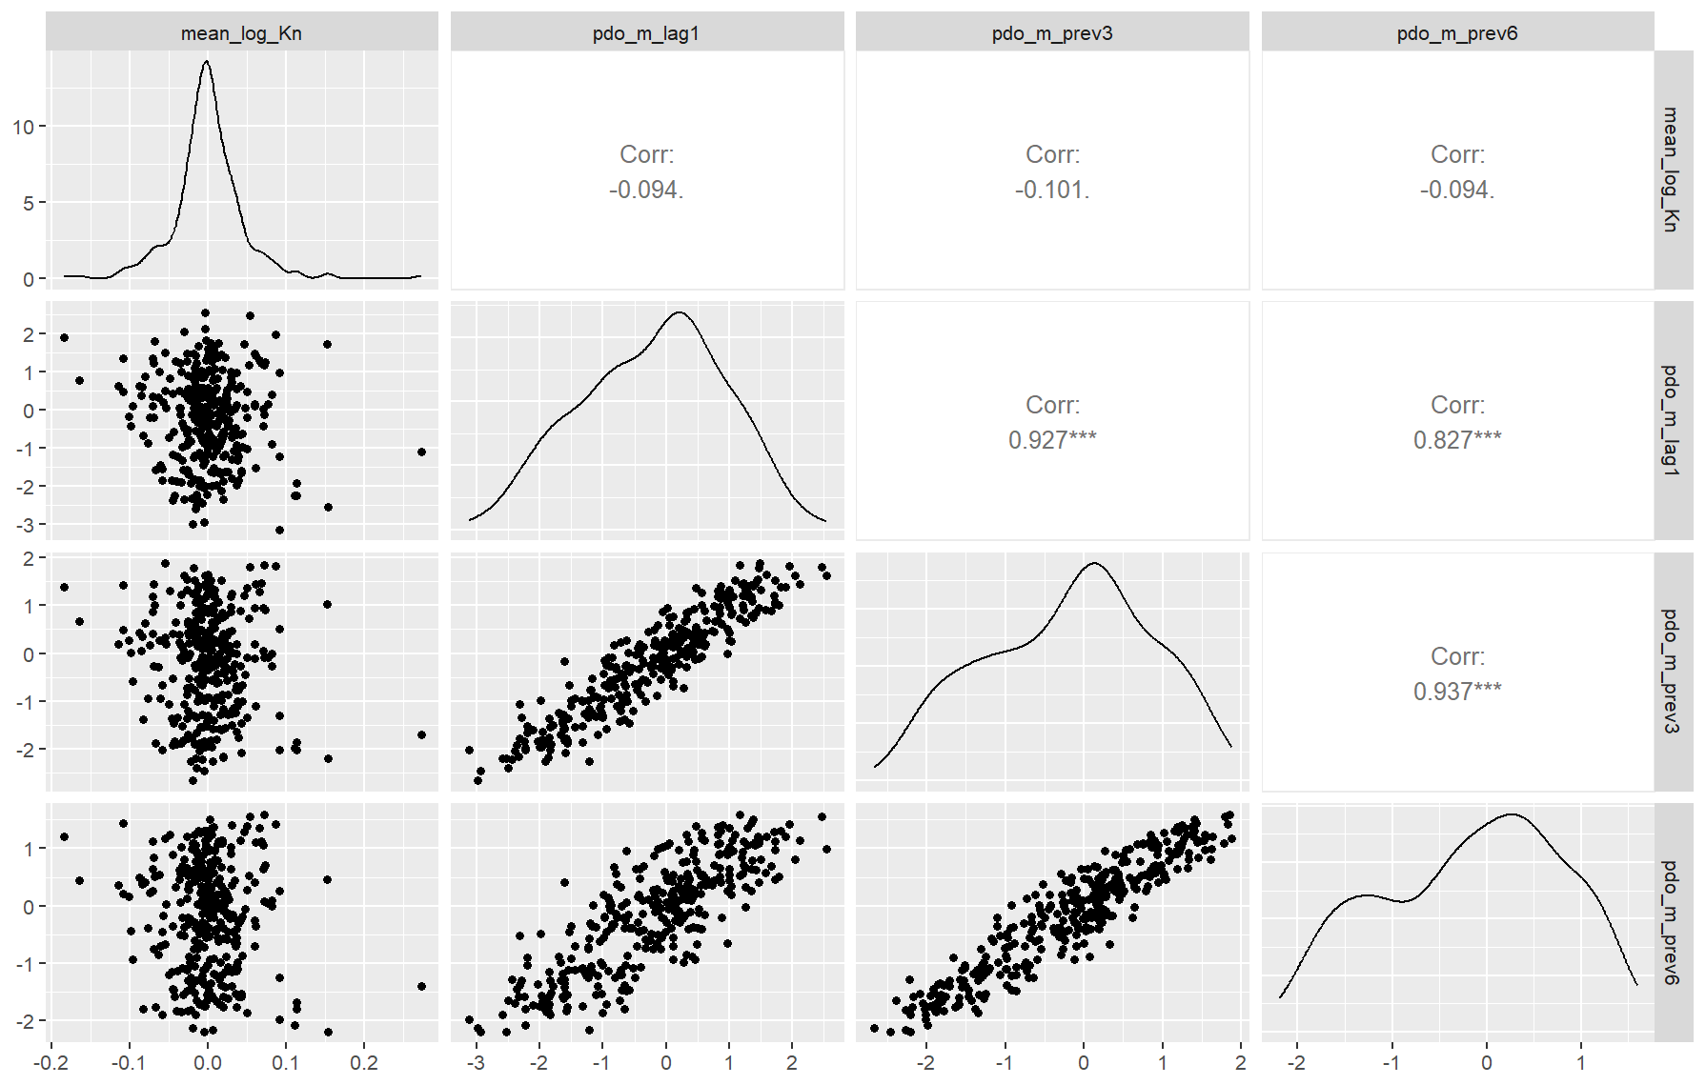
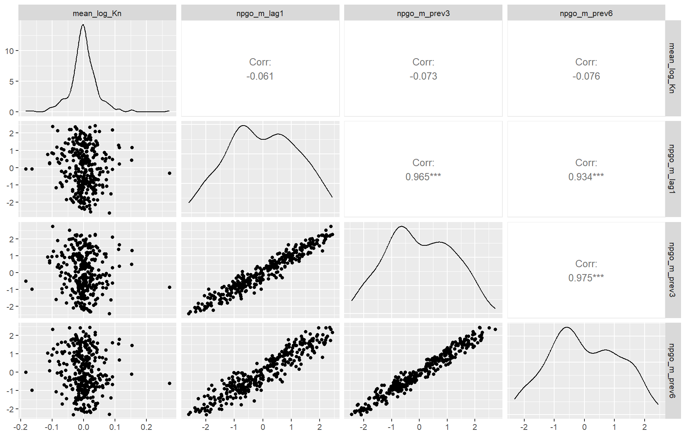
Env data plots
PDO and NPGO

Slide 21
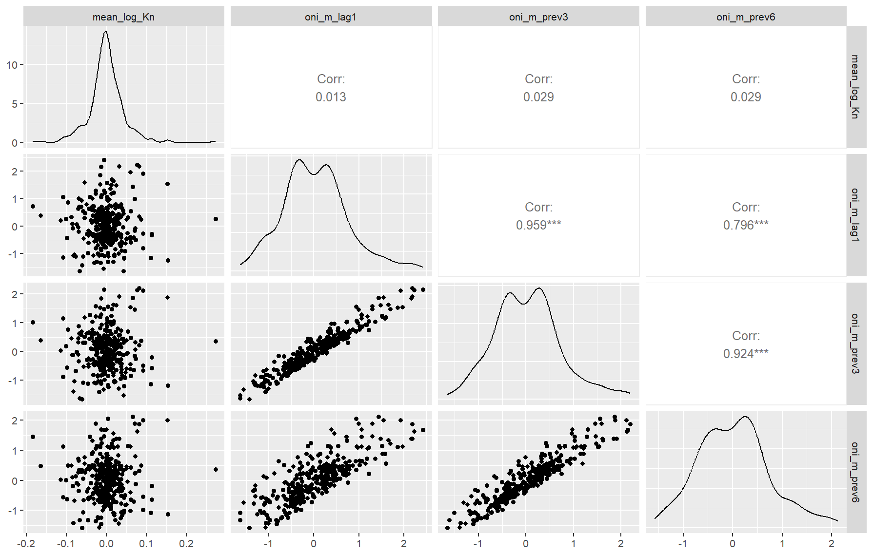
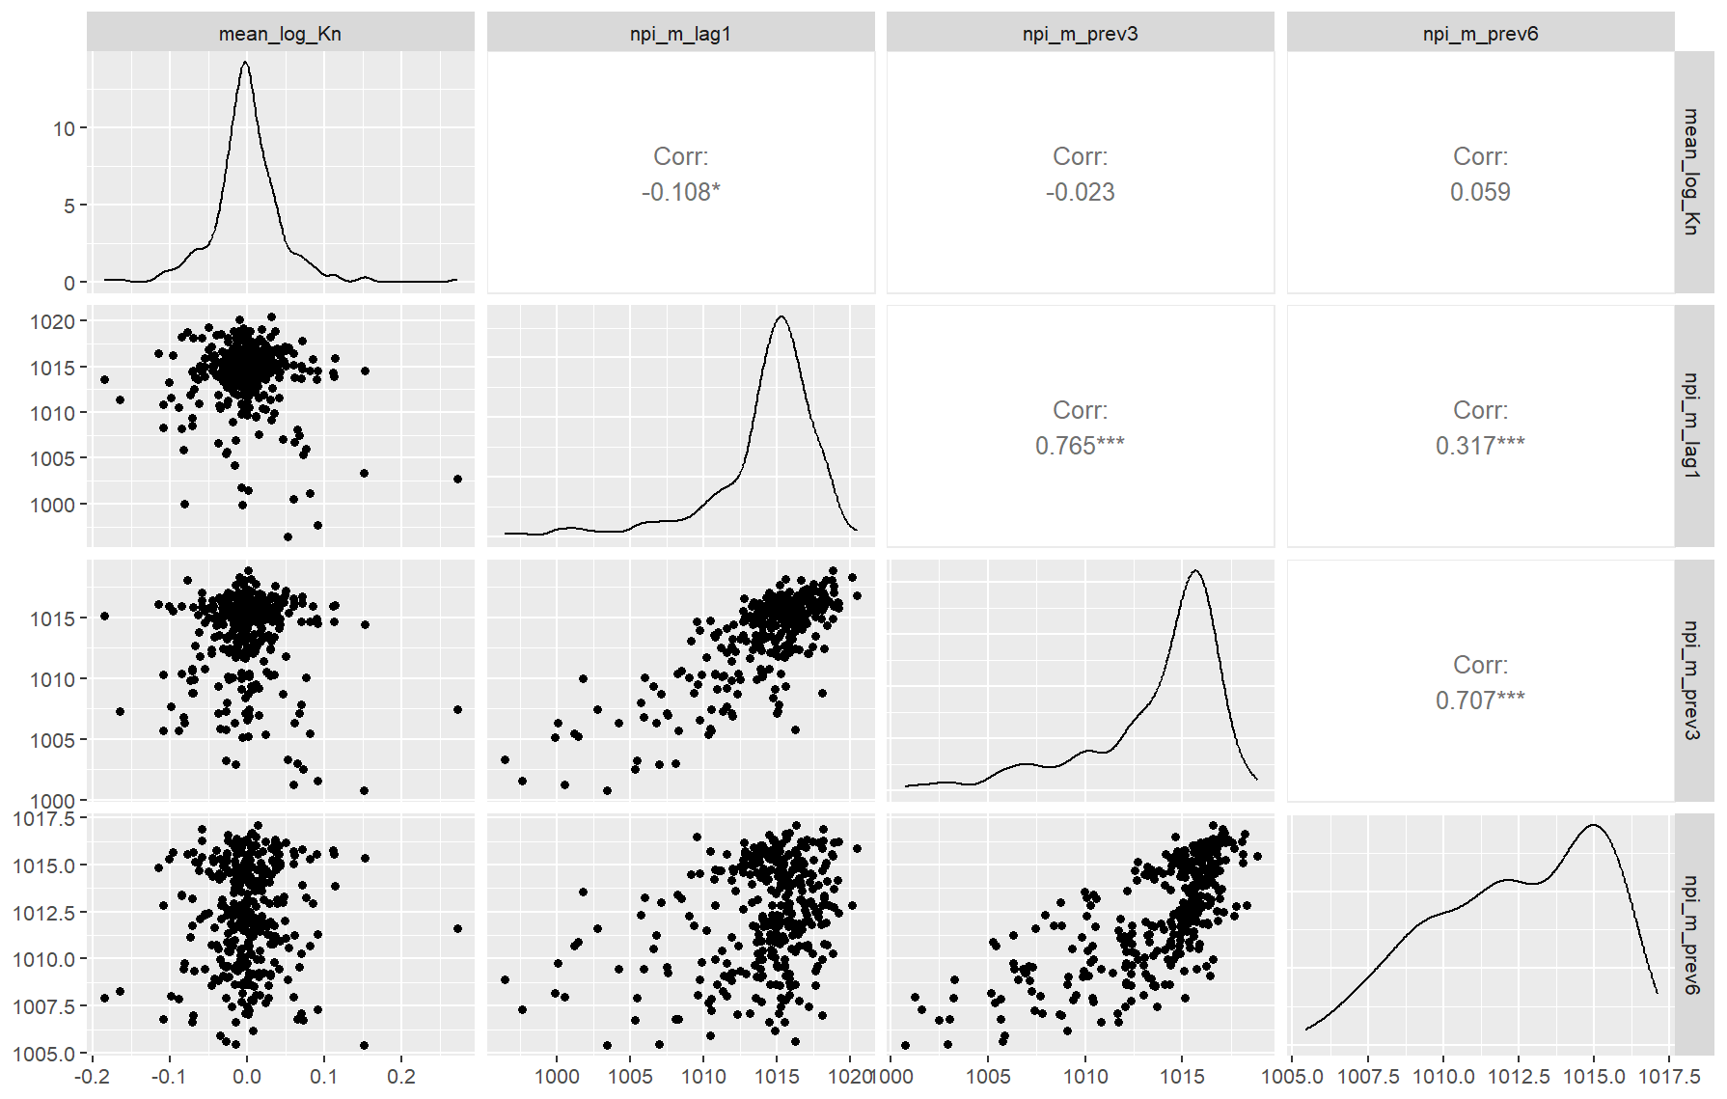
Env data plots
ONI and NPI

Slide 22
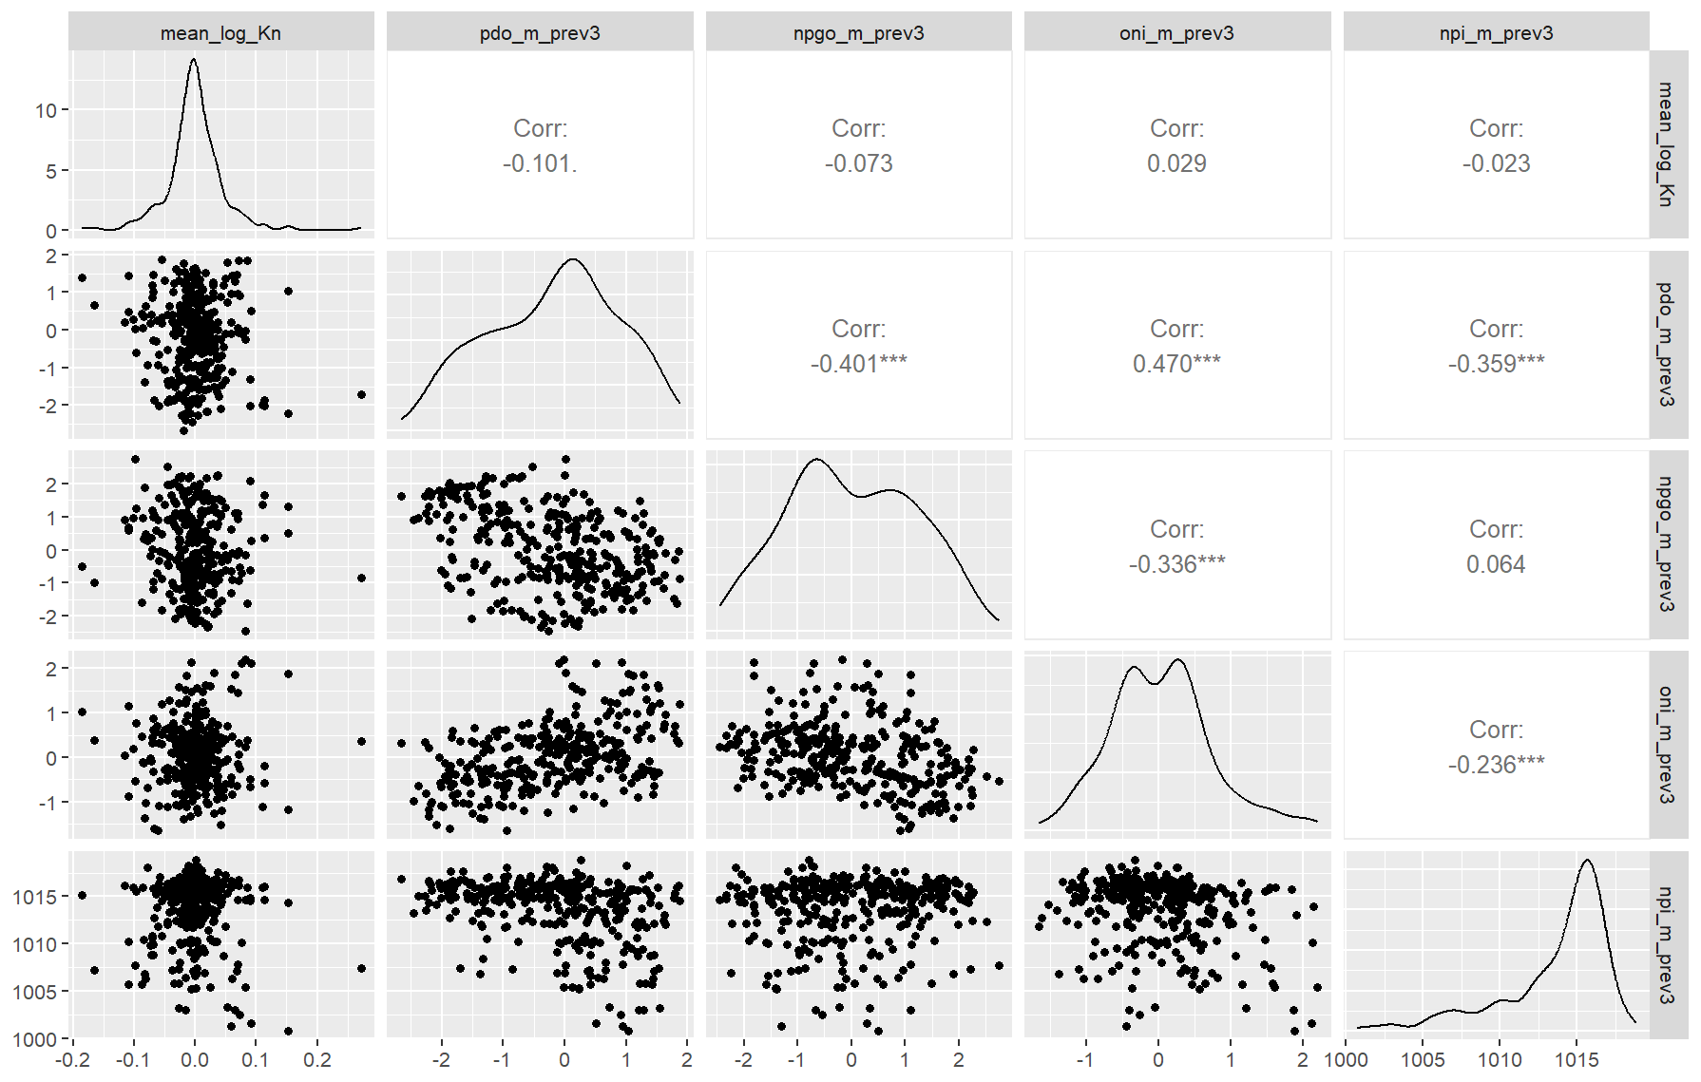
Env data plots

Slide 23
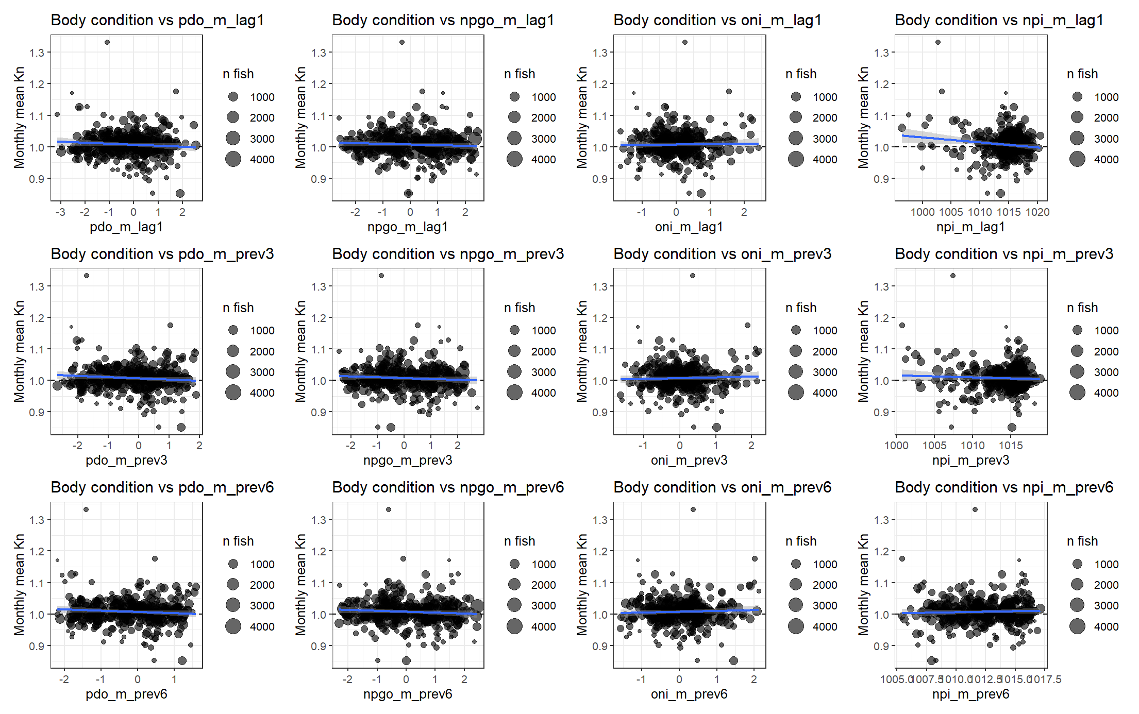
Mixed effects env effects model with m1.1

Slide 24
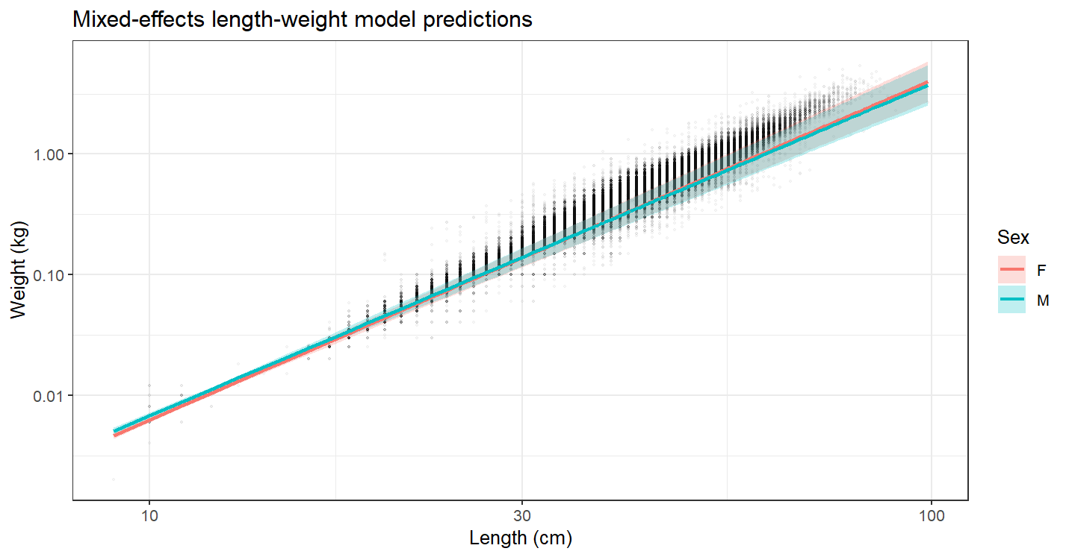
Mixed effects model prediction with m1.1

Slide 25
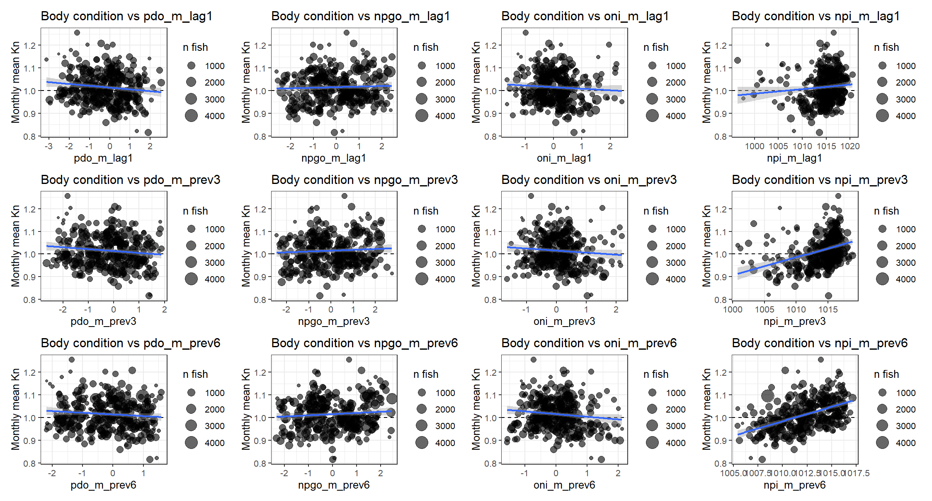
Mixed effects env effects model with m7.1 (only length and sex as predictors)

Slide 26
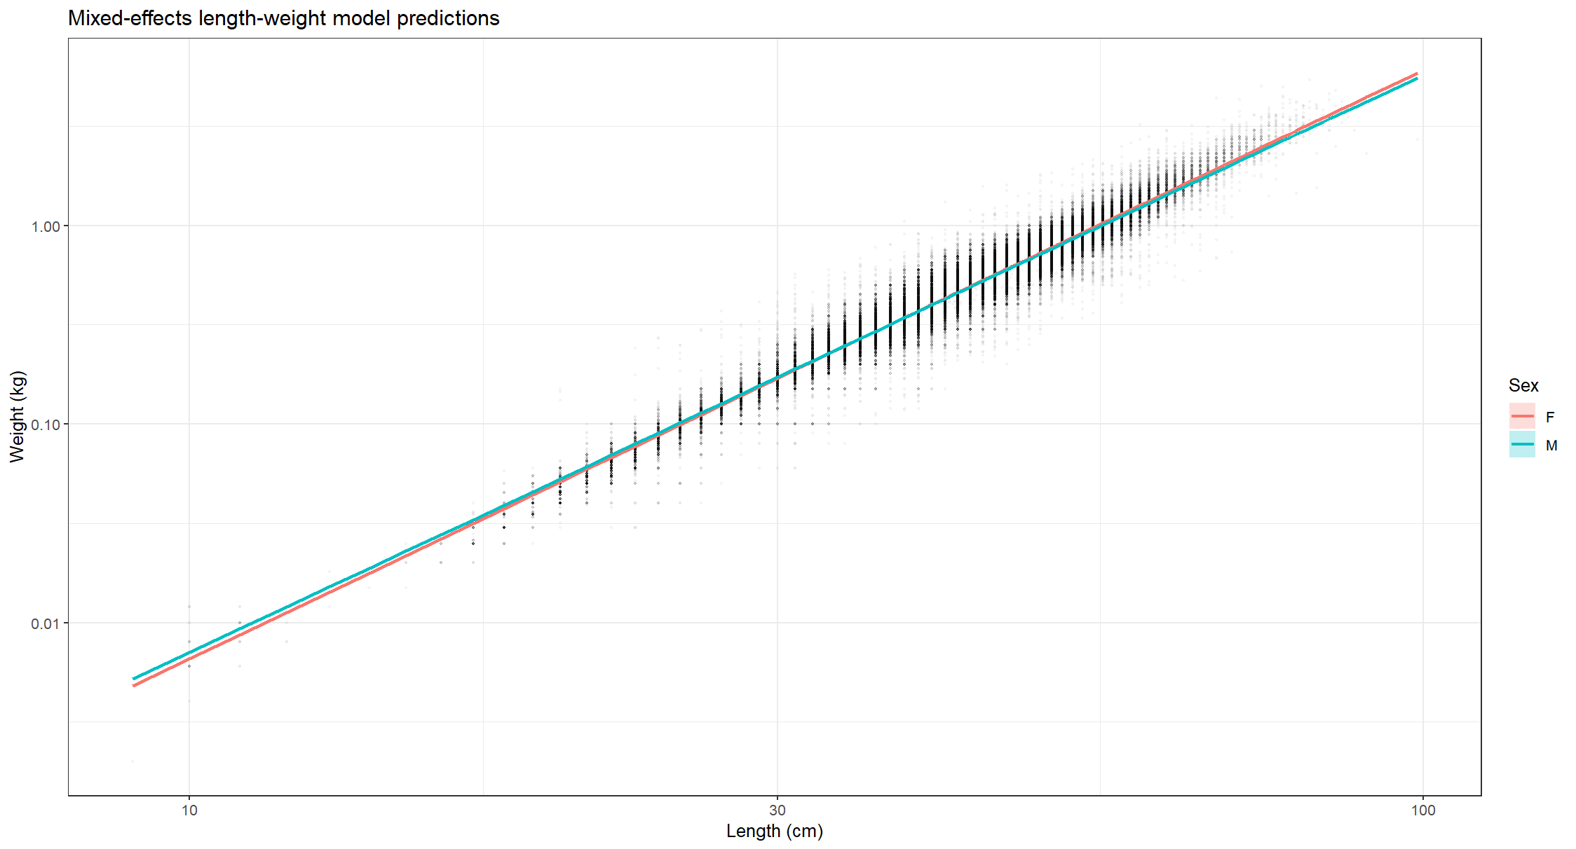
Mixed effects model prediction with m7.1

Slide 27
Bayesian length weight

Slide 28
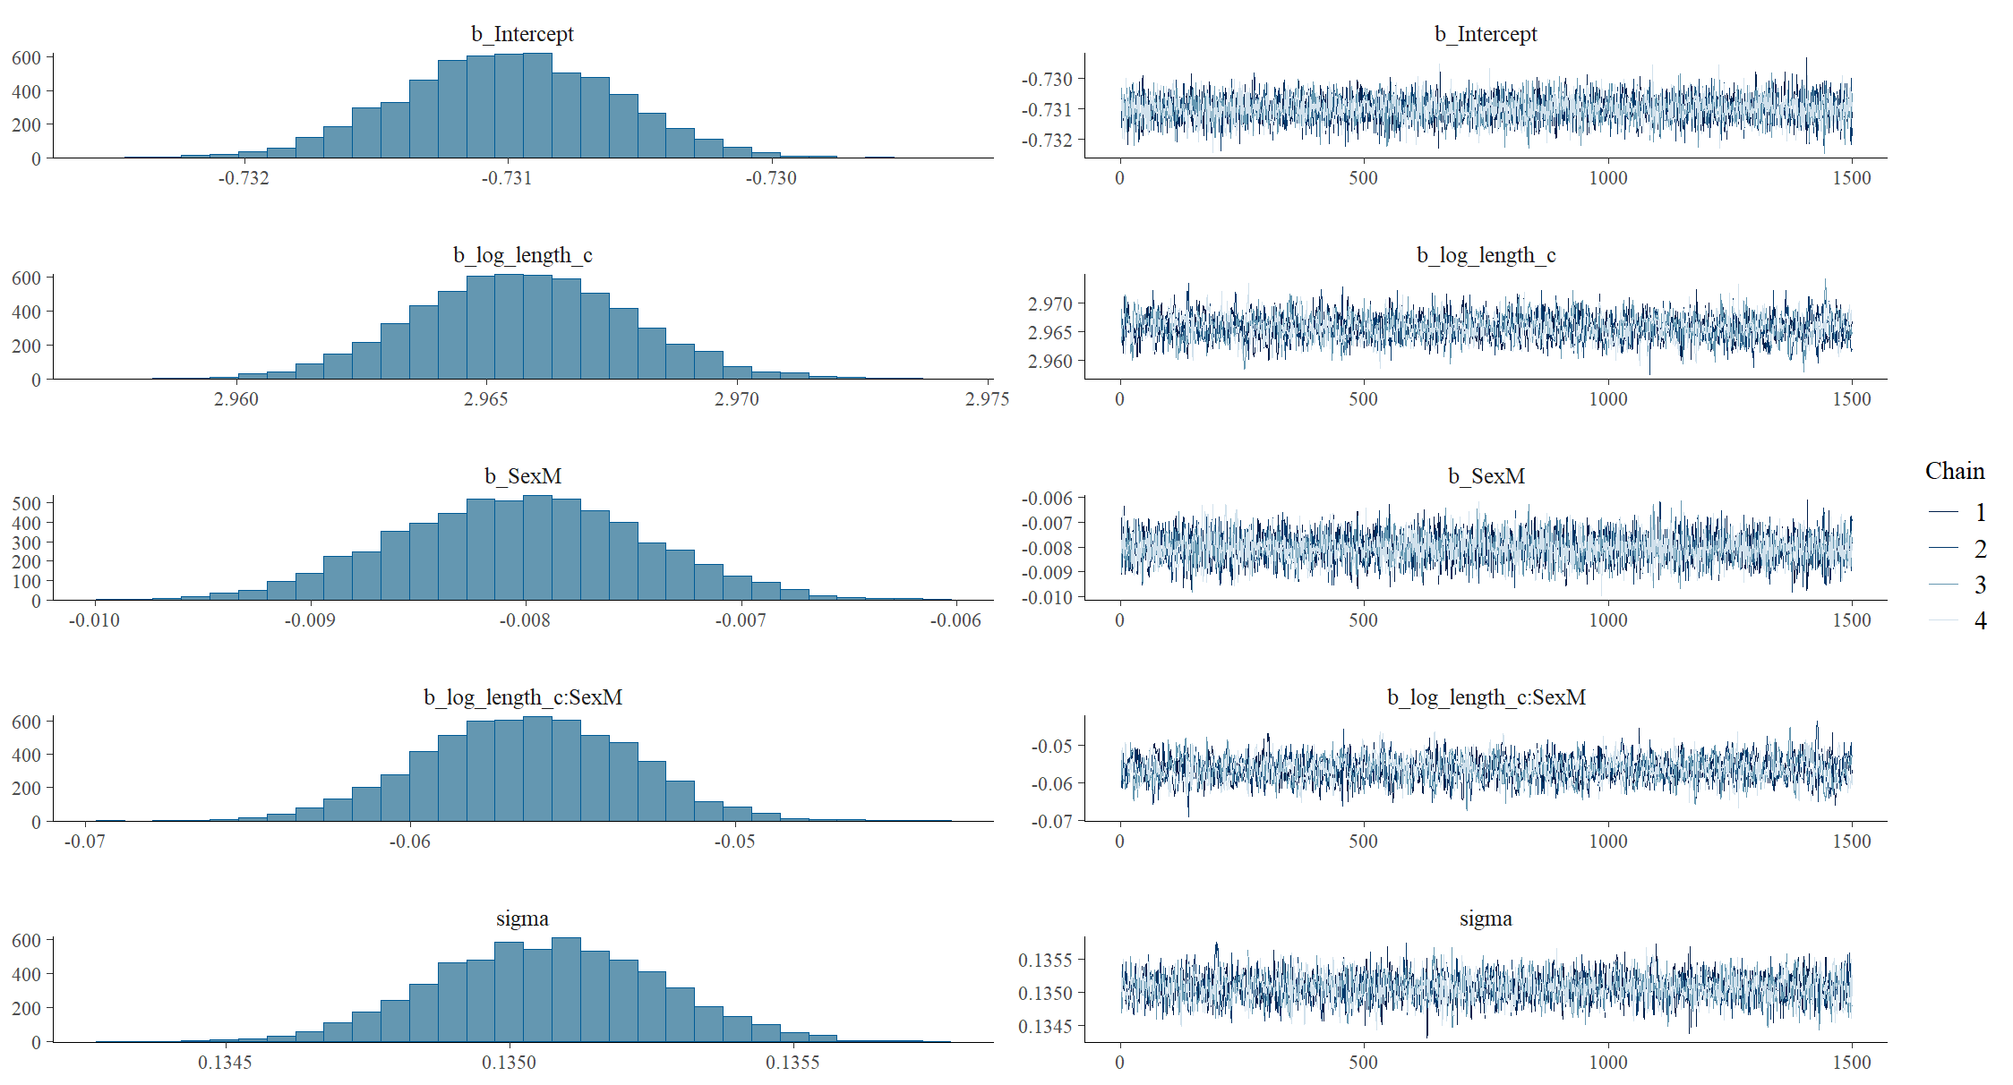

Slide 29
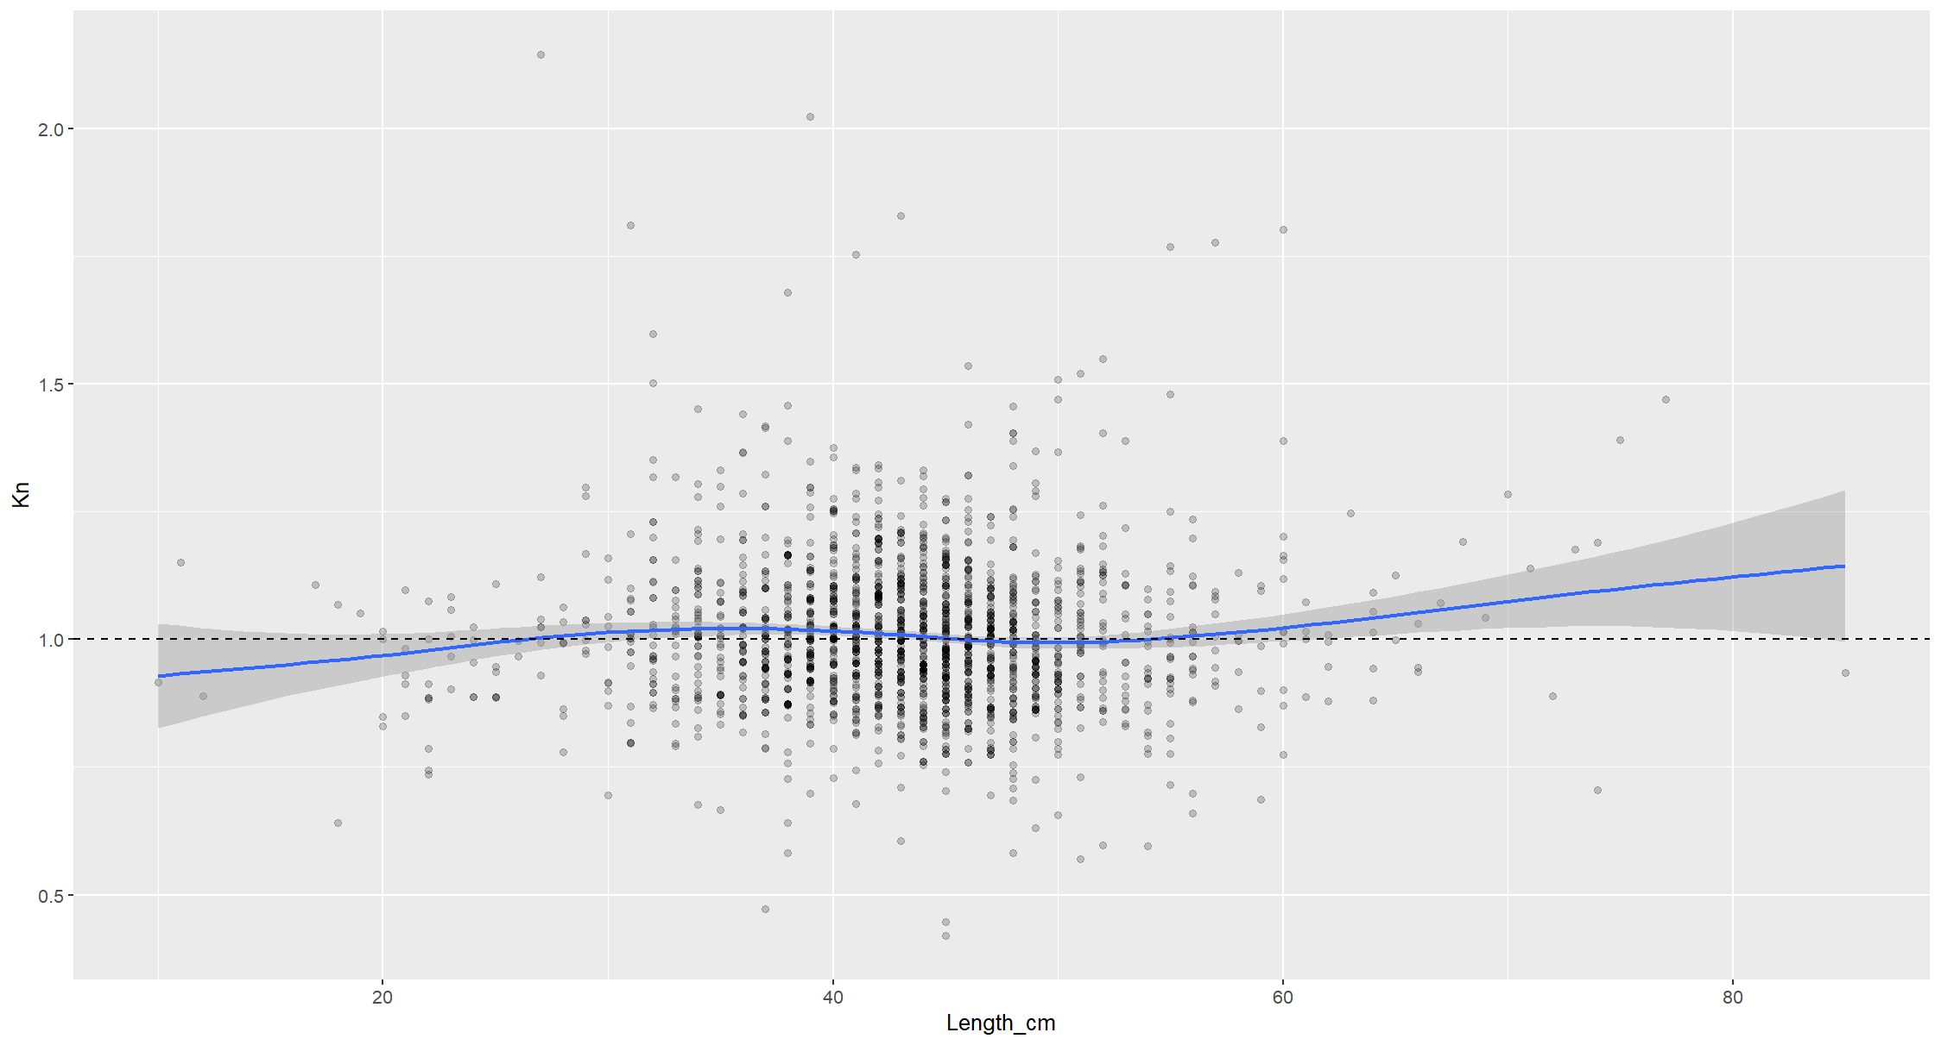

Slide 30
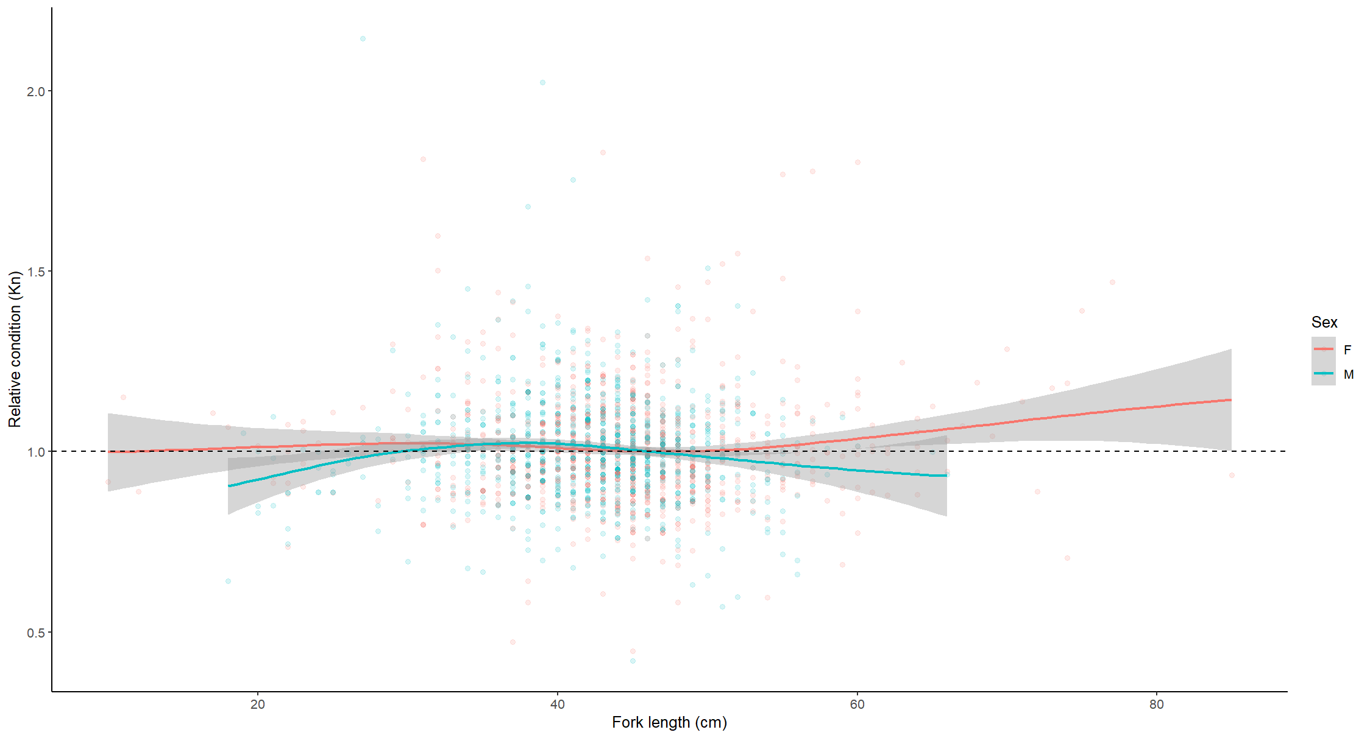

Slide 32
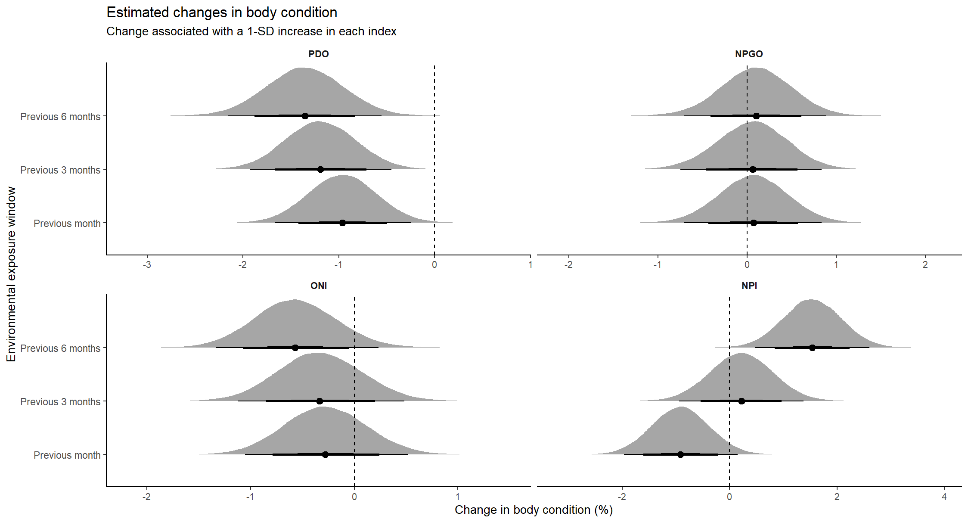
Bayesian posteriors of body condition and env variables

Slide 33
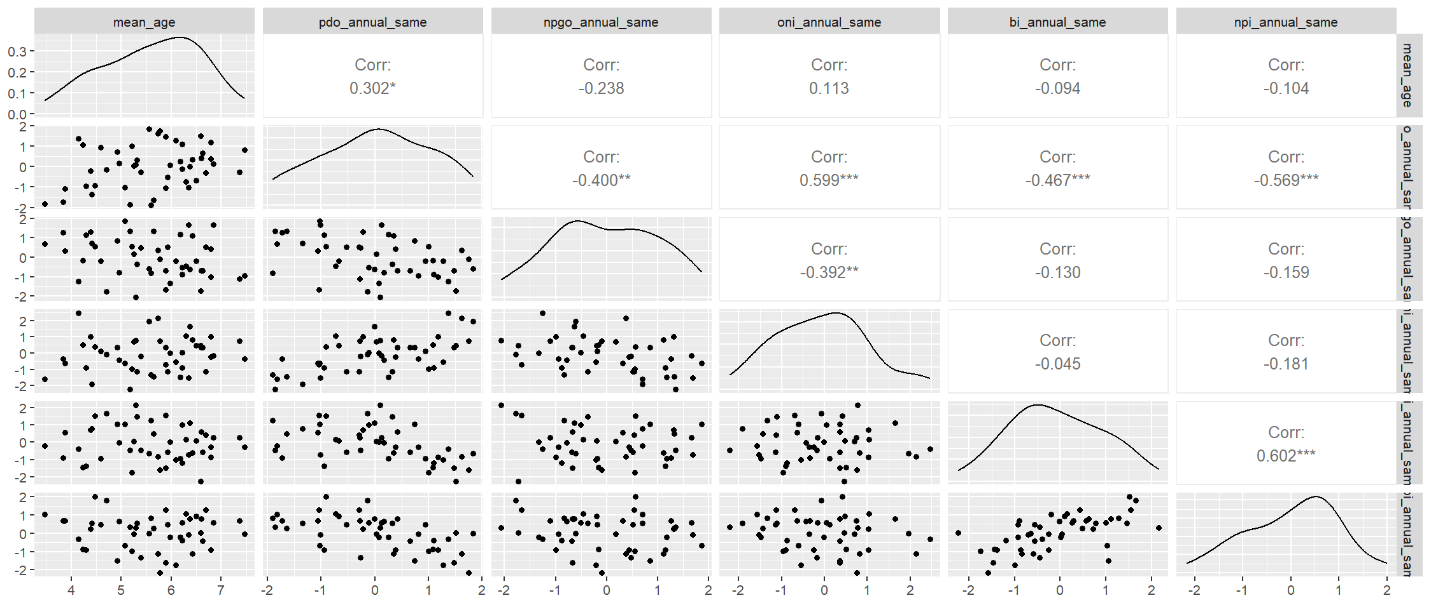
Mean age with current year indices

Slide 34

Mean age with prior year indices

Slide 35
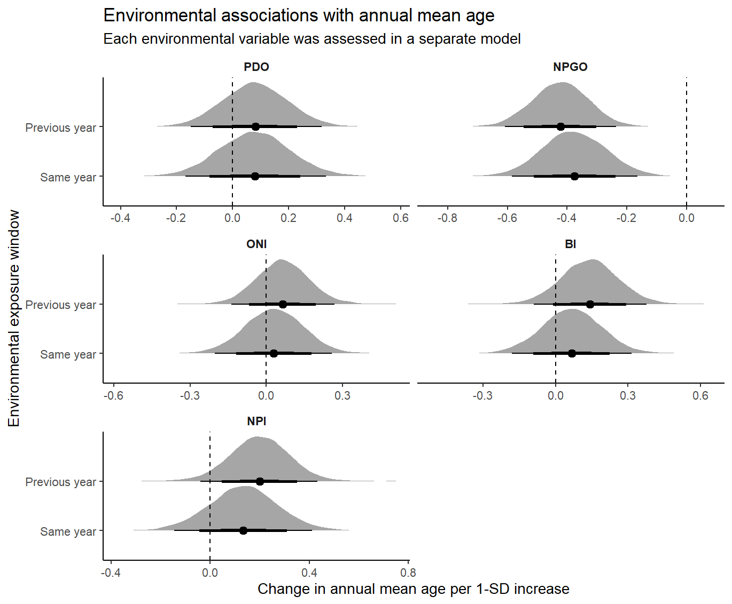
Annual mean age and env indices

Slide 36
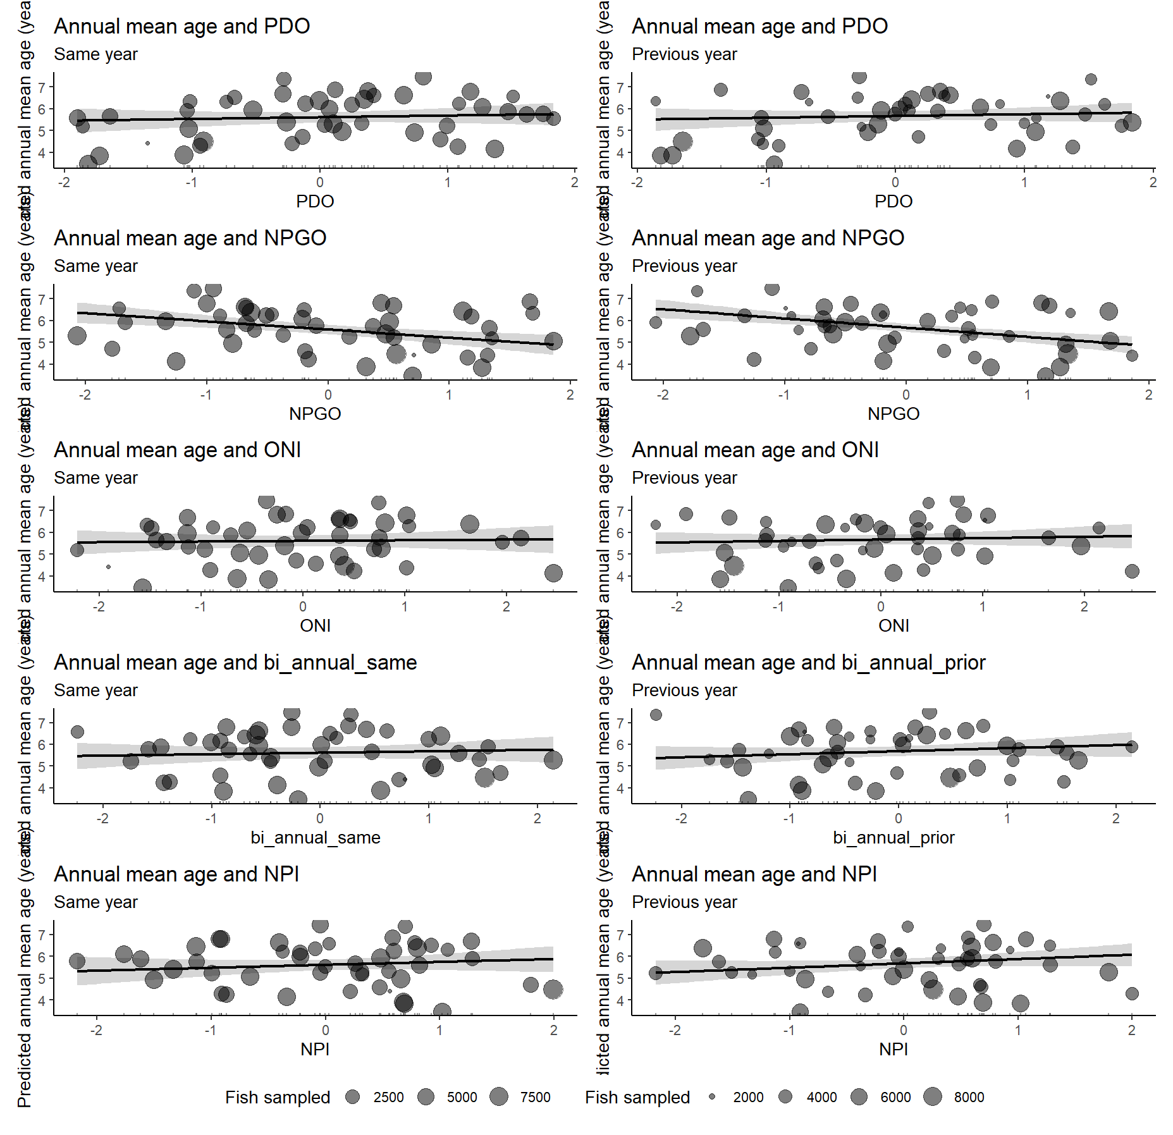

Slide 37
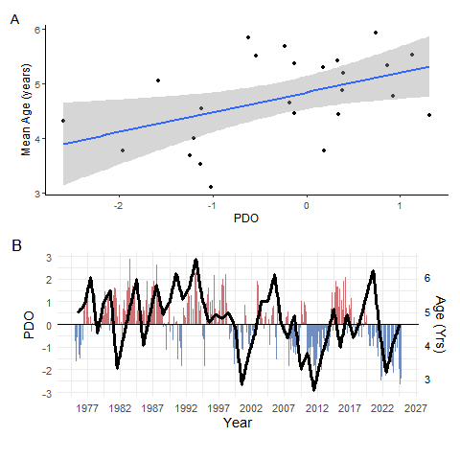

Slide 38
