Slide 1
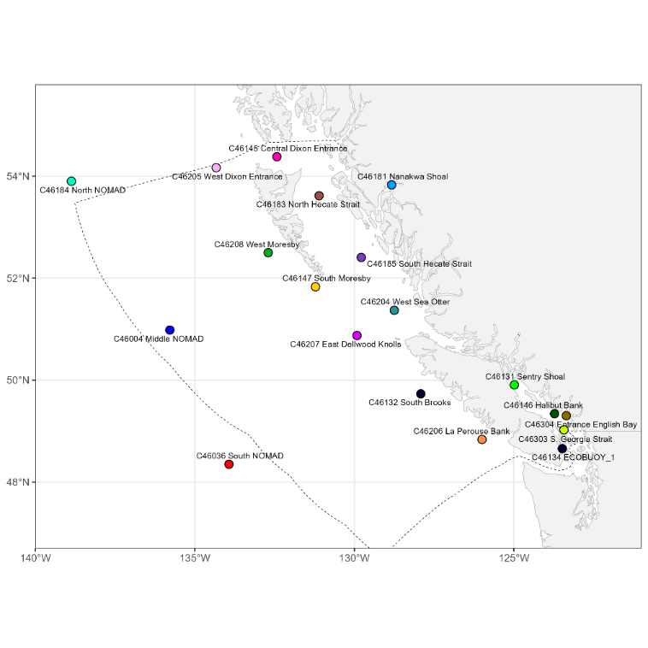
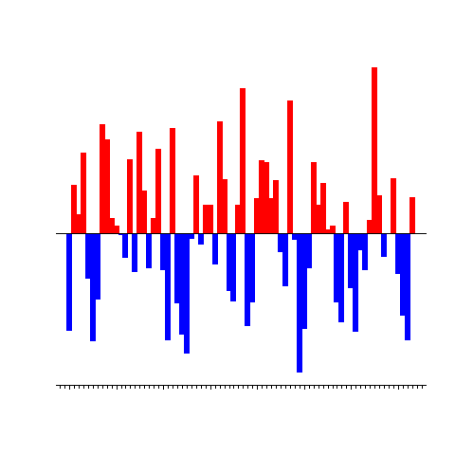
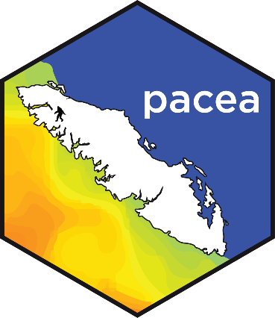



LIVE DEMO here during the poster session
pacea: an R package of ecosystem information to help facilitate
an ecosystem approach to fisheries management
Andrew Edwards & Travis Tai
el Niño?
pacea is freely available at https://github.com/pbs-assess/pacea and currently contains:
204,373 calculations of daily sea surface temperature based on data from 19 buoys.
outputs from the spatial British Columbia continental margin model, a coupled physical-biogeochemical model by Peña et al. (2019). Variables are for 40,580 spatial cells across Canada’s Pacific Exclusive Economic Zone, and are given as 27 years of monthly means (from 1993 to 2019). The variables are:
dissolved oxygen concentration
pH
salinity
temperature
depth-integrated phytoplankton
depth-integrated primary production.
NOAA’s spatial Optimum Interpolation Sea Surface Temperature record, that incorporates observations from different platforms (satellites, ships, buoys, and Argo floats), provided as weekly and monthly means from Sep 1981 onwards.
9 climatic and oceanographic indices, such as the Pacific Decadal Oscillation and those related to El Niño.
estimates of abundances for Harbour Seals and Pacific Hake.
Coming soon: Pacific Herring estimates of abundance and zooplankton anomalies.

