Slide 1
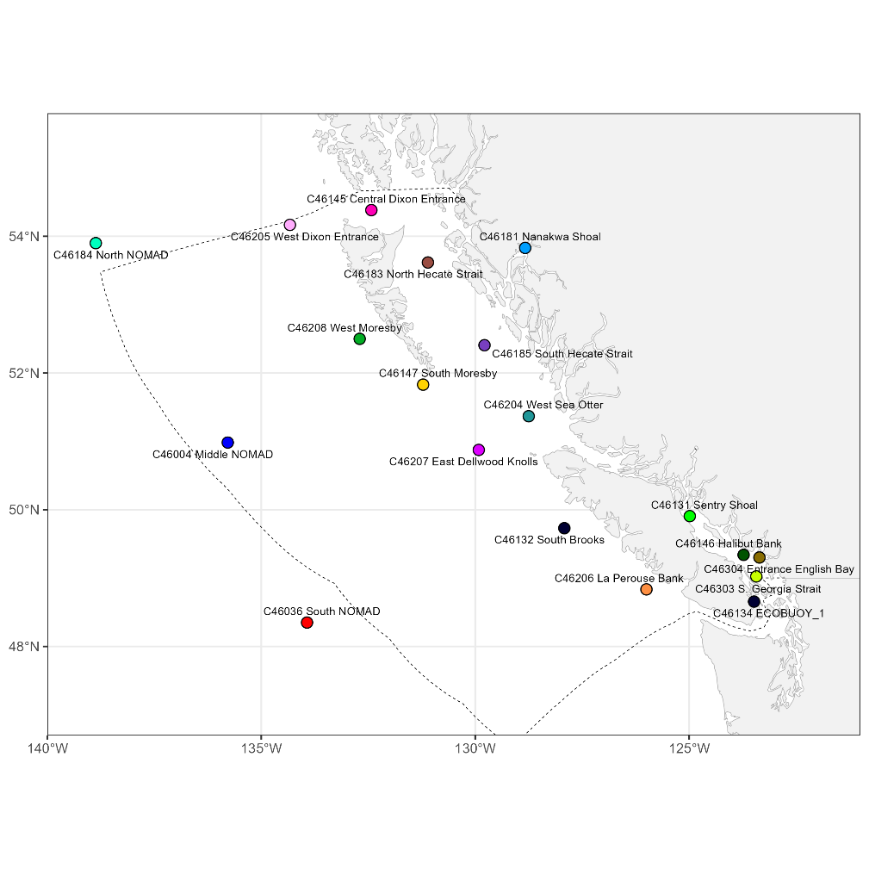
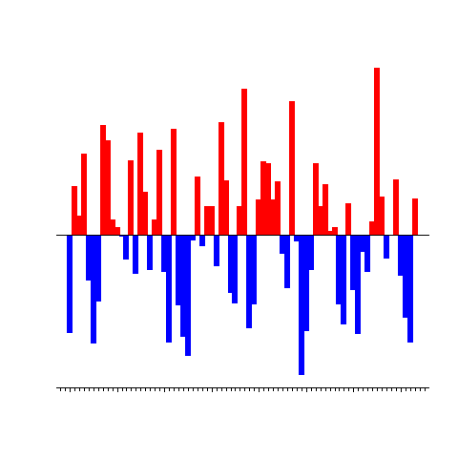



LIVE DEMO during the poster session – come and find us!
pacea: an R package of ecosystem information to help facilitate
an ecosystem approach to fisheries management
Andrew Edwards & Travis Tai
el Niño?

