Slide 1
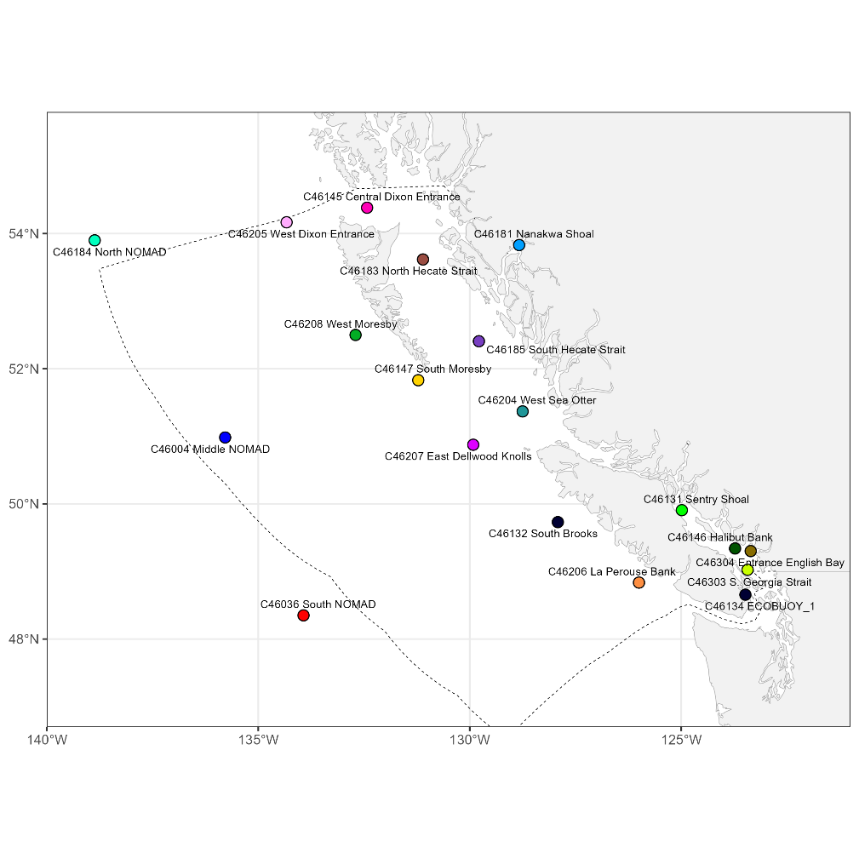
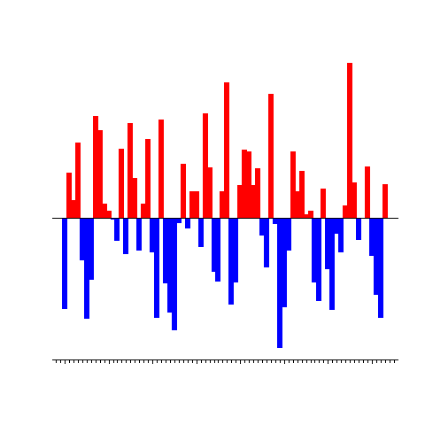



pacea: an R package of ecosystem information to help facilitate
an ecosystem approach to fisheries management
Andrew Edwards^{1,2} & Travis Tai¹
¹Pacific Biological Station, Fisheries and Oceans Canada, Nanaimo, BC.
²Dept. of Biology, University of Victoria, Victoria, BC.
el Niño?
DFO/NMFS Climate & Fisheries
Pacific Working Group, Jan 2024

