Slide 1
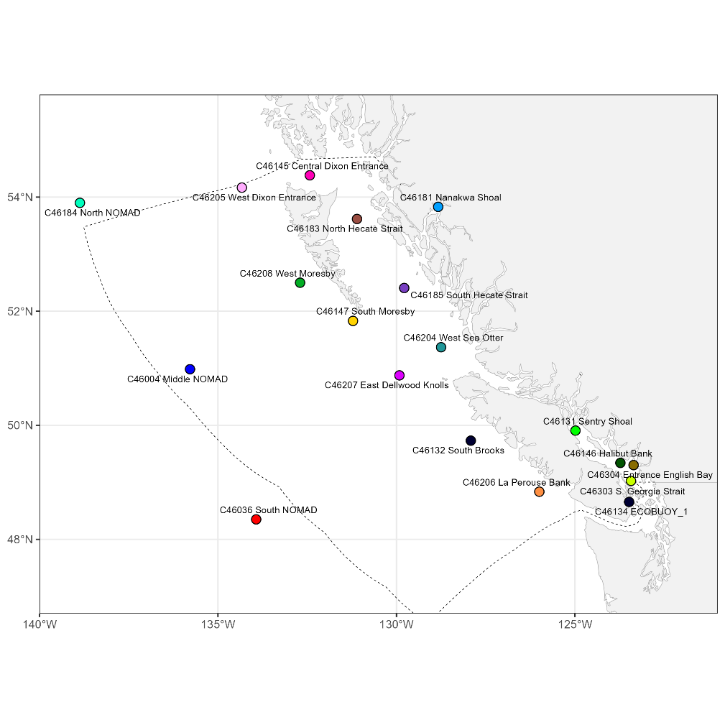
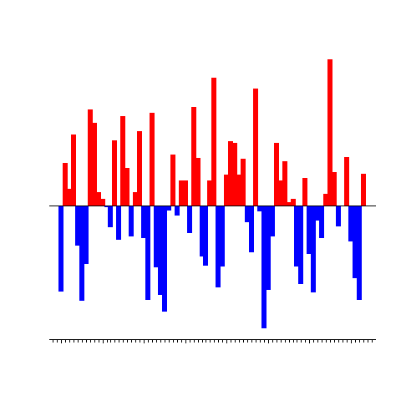



Introducing pacea: an R package of ecosystem information to help facilitate an ecosystem approach to fisheries management
Andrew Edwards & Travis Tai
Pacific Biological Station, Fisheries and Oceans Canada, Nanaimo, BC.
el Niño?
PBS
Friday 10th November 2023

