Slide 1
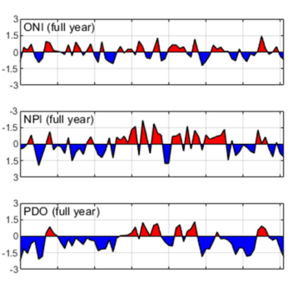
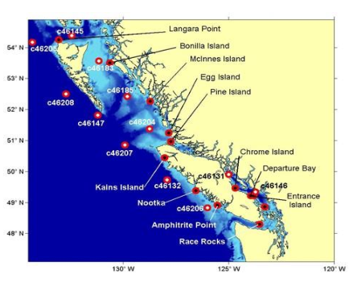
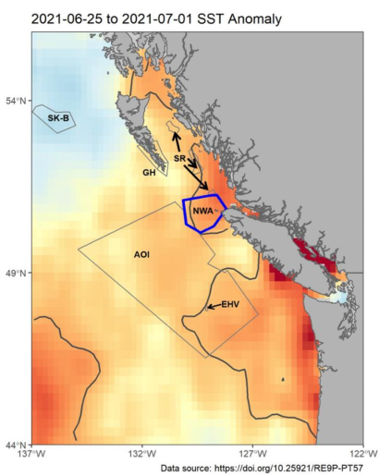
Introducing pacea: an R package to amalgamate
Pacific data to help operationalise an ecosystem
approach to fisheries management
Andrew Edwards & Travis Tai
Pacific Biological Station, Fisheries and Oceans Canada, Nanaimo, BC.
pacea
EBM MSP talk
Friday 13th October 2023

Slide 2
Motivation
Revised Fisheries Act: “… the Minister shall take into account the environmental conditions affecting a fish stock.”
Yet <50% of DFO’s stock assessments currently use environmental data.
Only 28% of assessments in Pacific Region use environmental data.
Leading cause of not using environmental data is availability of the data.
Kulka et al. (2022). An Accounting of Integration of Environmental Variables in Fishery Stock Assessments in Canada. Can. Tech. Rep. Fish. Aquat. Sci. 3473: viii + 79 p.
https://publications.gc.ca/collections/collection_2022/mpo-dfo/Fs97-6-3473-eng.pdf

Slide 3
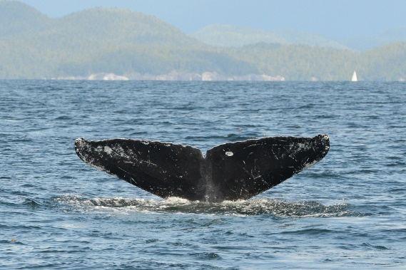
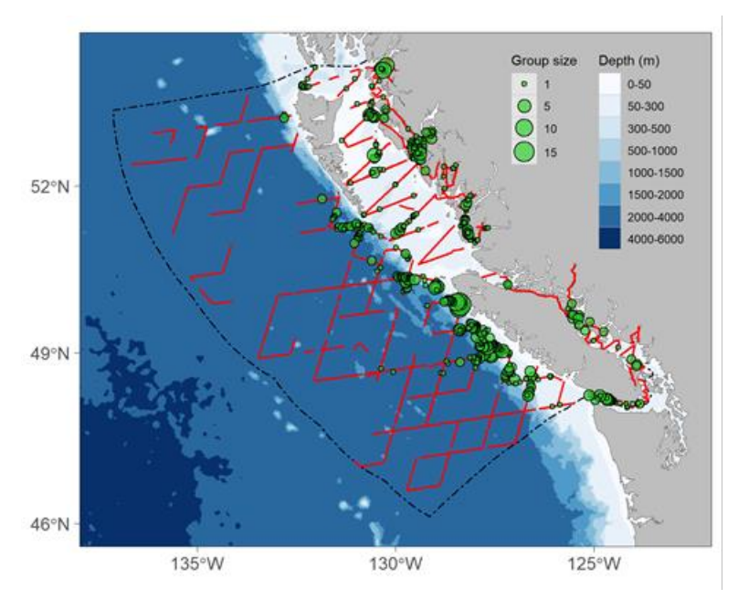
Motivation (based on a true story)
sightings of Humpback
See Doniol-Valcroze et al. (2022) in last year’s SOPO report.
Density plot courtesy Brianna Wright.
Survey sightings of Humpback Whales
Estimated densities
Modelling

Slide 4
Motivation (based on a true story)
sightings of Humpback
Survey sightings of Humpback Whales
Estimated densities
Modelling
SST ?

Slide 5
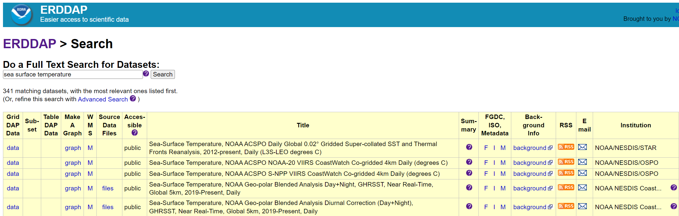
Motivation (based on a true story)
A search for sea surface temperature yields an overwhelming number (341) of choices.
Likely requires some data wrangling to be usable – usually takes way, way, way longer than anticipated.
So SST analysis did not happen.

Slide 6
Motivation
Similarly, ROMS (Regional Ocean Modelling System) outputs are available from Angelica Peña (a DFO oceanography).
But still requires extensive coding to convert results from netCDF files into R.

Slide 7
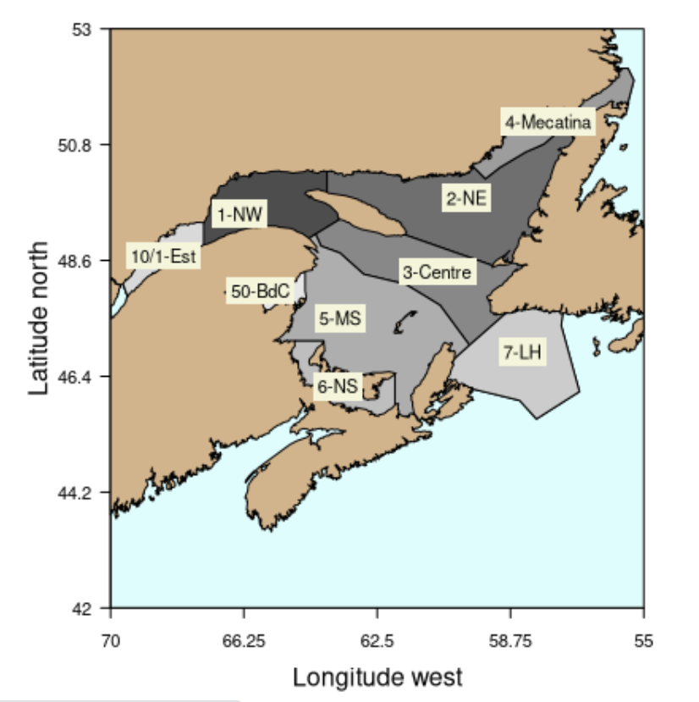
Motivation
Similarly, ROMS (Regional Ocean Modelling System) outputs are available from Angelica Peña.
But still requires extensive coding to convert results from netCDF files into R.
“Open Data” is not enough.
Hence, the pacea R package, motivated by
the GSLea package for the Gulf of St. Lawrence.
Primary audience is Pacific DFO stock assessment
scientists, but usable by anyone (need minimal working
knowledge of R).
Duplisea et al. (2020). gslea: the Gulf of St Lawrence ecosystem
approach data matrix R-package. R package version 0.1 https://github.com/duplisea/gslea

Slide 9
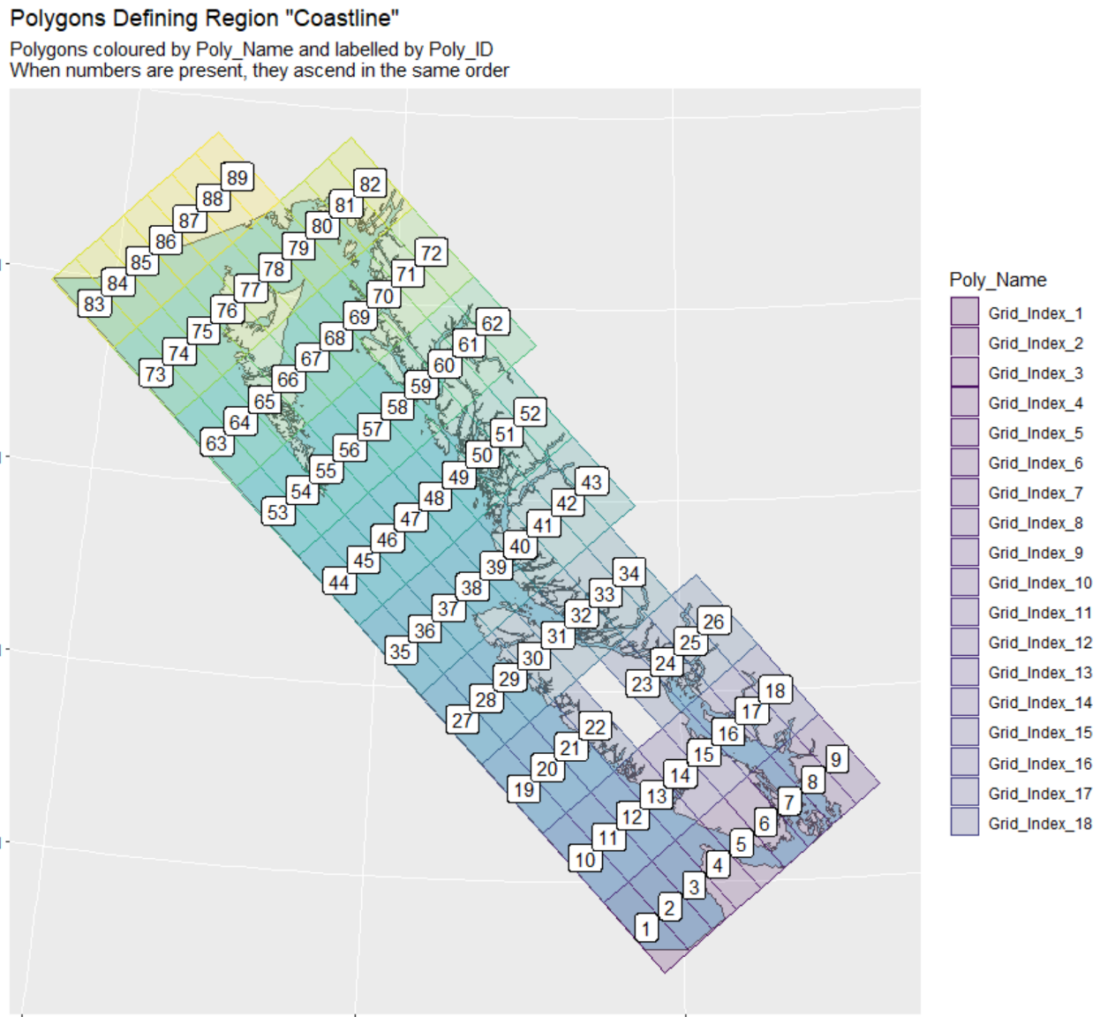
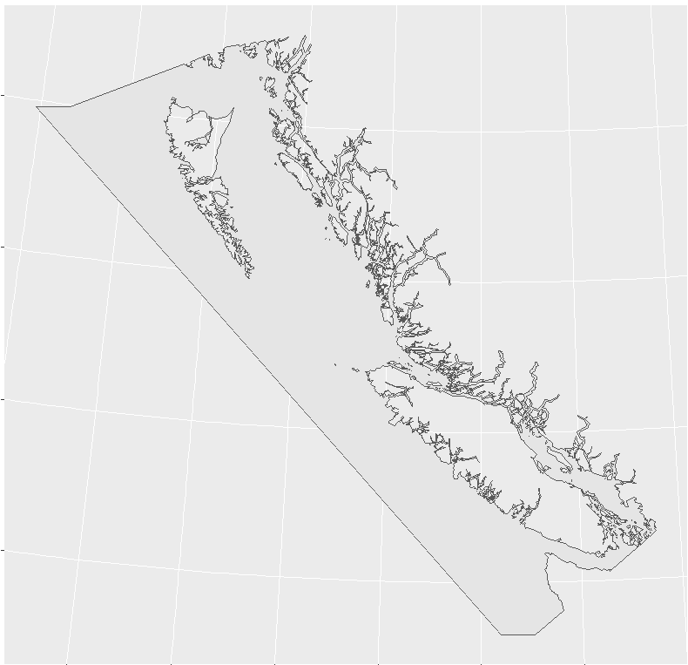
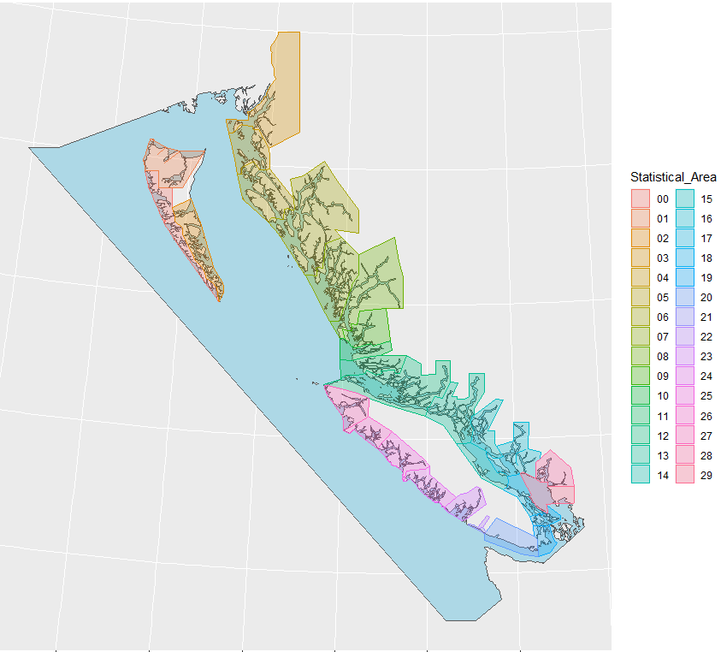
Spatial data
Spatial data will be stored on a master grid (likely 2 km x 2km), conceptually similar to:
Currently working on finalising the master grid size.

Slide 10
PACea fundamentals
It’s an R package
All data fully documented, including citations and sources, and vetted by experts
Fancy spatial stuff done behind the scenes – users can export as simple data frames or .csv files
Traceable and updatable – each dataset to have reproducible code showing how it was made
Fully open source and downloadable from GitHub
Vignettes showing example applications and plotting
Continually expand with more datasets
Contains temporal, spatial, and spatiotemporal datasets

Slide 11
Example datasets initially being incorporated
ROMS output from Angelica Peña:
temperature at the sea surface and at various depths
oxygen at various depths
salinity at various depths
primary production
chlorophyll
pH at different depths and depth of aragonite saturation
sea-surface temperature from satellite measurements (one of the ERDDAP datasets)
lighthouse temperature time series
oceanographic indices such as Pacific Decadal Oscillation, Oceanic Niño Index, Southern Oscillation Index
Monthly resolution where possible.

Slide 12
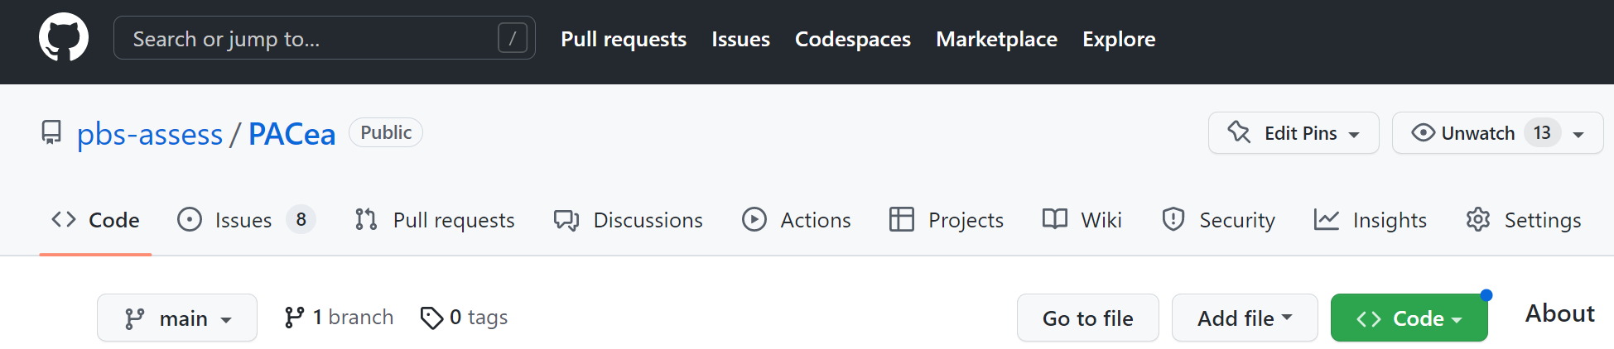
Openly available at github.com/pbs-assess/PACea
Not yet operational, but once it is we will ensure it remains usable even as we expand it.
Dealing with spatial data is tricky (many options and R packages), but users will be able to use simple data frames of lon, lat, and (say) sea-surface temperature.

Slide 13
What PACea is not
Not going to be the sole repository for detailed raw data (not replacing existing databases).
Not replacing Open Data, but utilsing it and making it easier to incorporate into analyses.
“Organise your data you'll find those connections” – Mark Leblanc (CHS),
emphasising benefits of storeable and shareable data (Oct 2022 All Staff).
Acknowledgments
Thanks to Angelica Peña, Kelsey Flynn, Chris Rooper, Lindsay Davidson, Jessica Nephin, Brianna Wright, Charles Hannah, Patrick Thompson, and others for earlier feedback at the planning stage. CSRF for funding.

