Slide 1
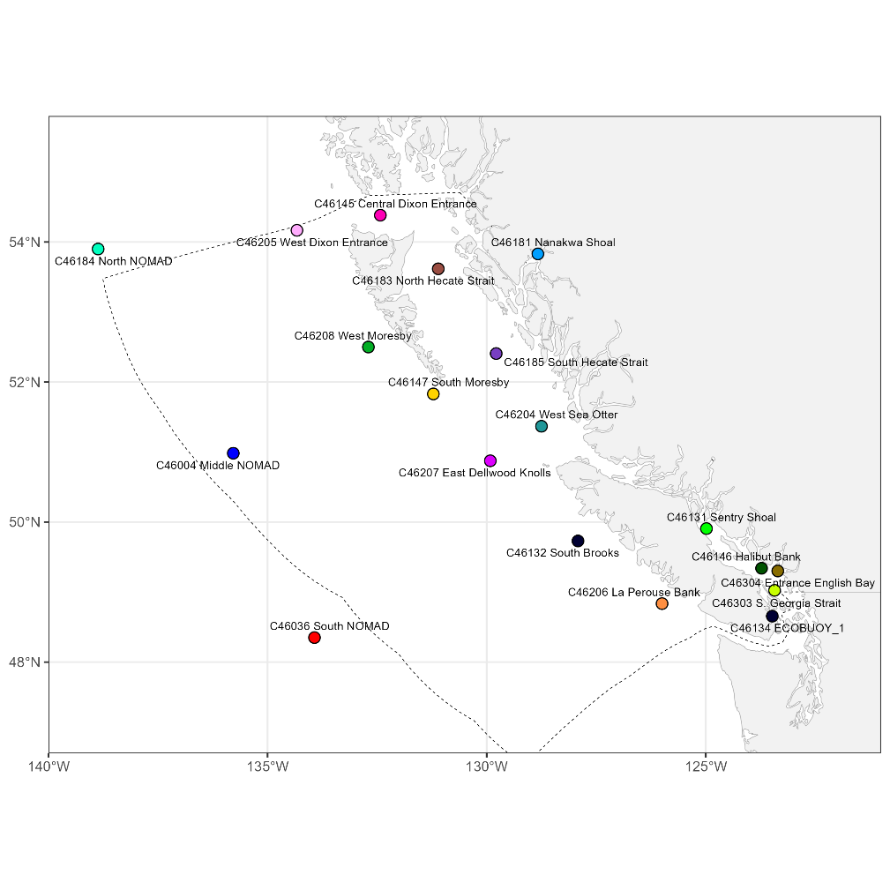
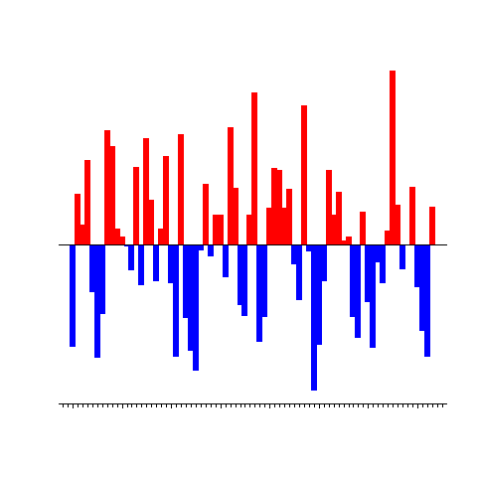



Introducing pacea: an R package of ecosystem information to help facilitate an ecosystem approach to fisheries management
Andrew Edwards^{1,2} & Travis Tai¹
¹Pacific Biological Station, Fisheries and Oceans Canada, Nanaimo, BC.
²Dept. of Biology, University of Victoria, Victoria, BC.
el Niño?
Ecostats, UVic.
Tuesday 21st November 2023

