Slide 1
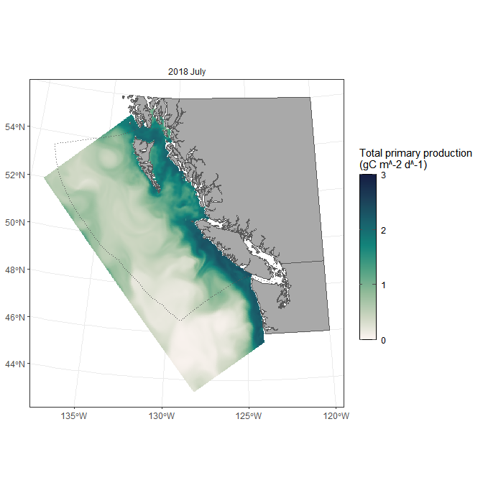
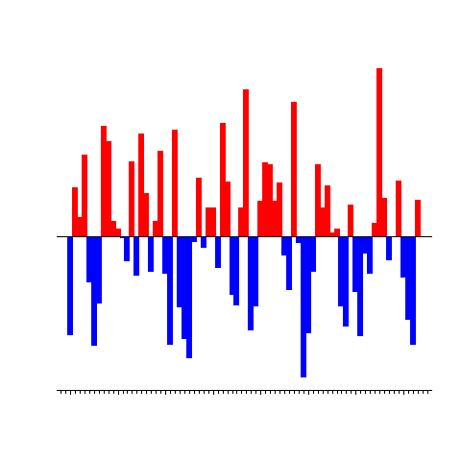
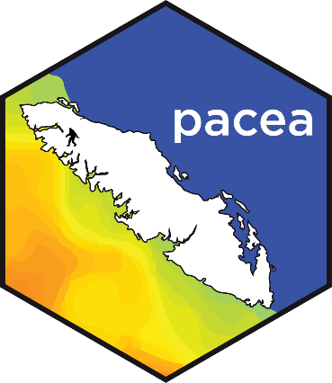


Live demo here during the poster session – see what’s new
New information added to pacea since (and thanks to) last year’s State of the Pacific Ocean meeting
Andrew Edwards
el Niño?
The R package pacea is available at https://github.com/pbs-assess/pacea . New features added in the last year include:
Temperature and salinity from the Hindcast of the Salish Sea (HOTSSea) physical oceanographic model (statistics for each month from 1980-2018 on a 2x2 km grid for five depth ranges)
zooplankton biomass anomalies for the Strait of Georgia for 25 species groups
Pacific Herring spawning stock biomass and recruitment estimates (with uncertainty) for the five major stocks
the North Pacific Current Bifurcation Index indicating the north-south variation of where the North Pacific Current bifurcates into the northward-flowing Alaska Current and the southward-flowing California Current, associated with salmon productivity
amalgamation of such data to create an ecosystem summary specific for Pacific Hake, using new function ecosystem_summary_hake(), that was included in the 2025 stock assessment

