Slide 1
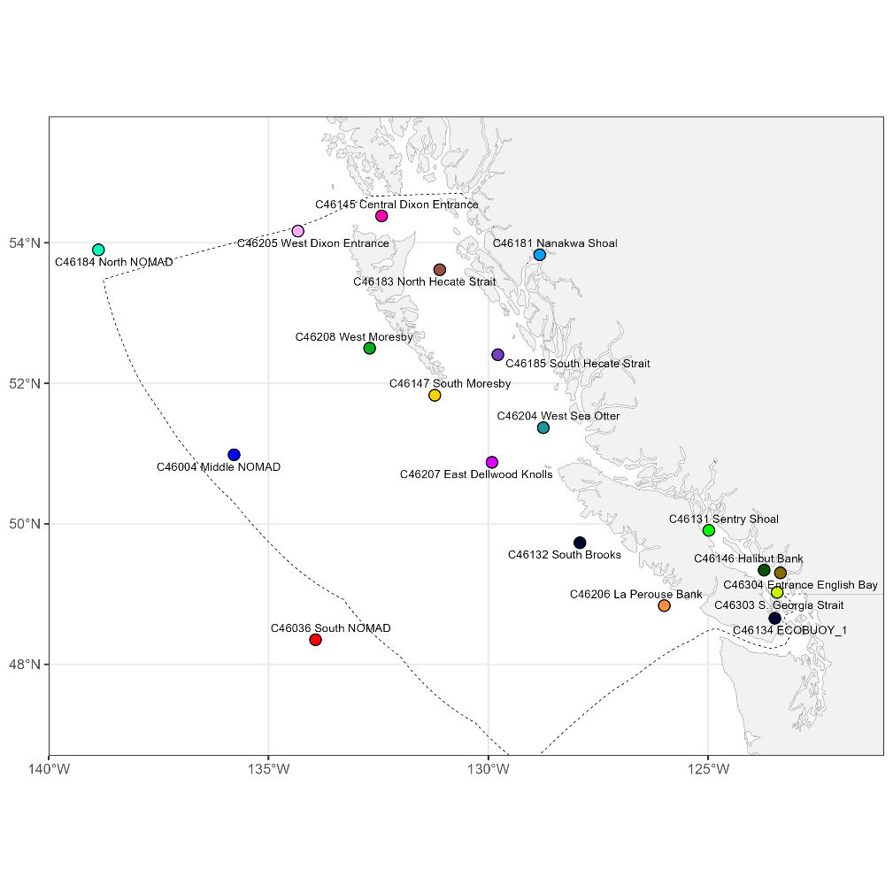
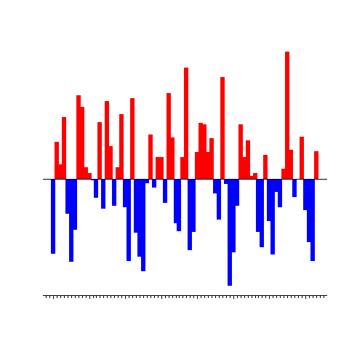



Live demo during the poster session
pacea: an R package of ecosystem information to help facilitate
an ecosystem approach to fisheries management
Andrew Edwards
el Niño?
If online see the “What’s new” section of:
github.com/pbs-assess/pacea

