Slide 1
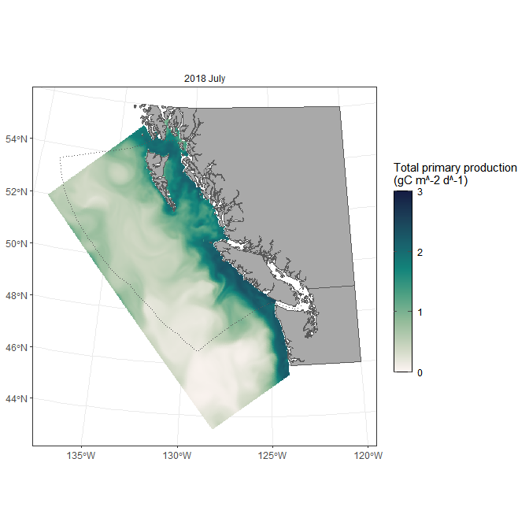
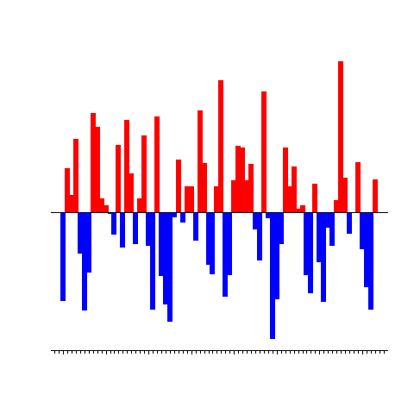
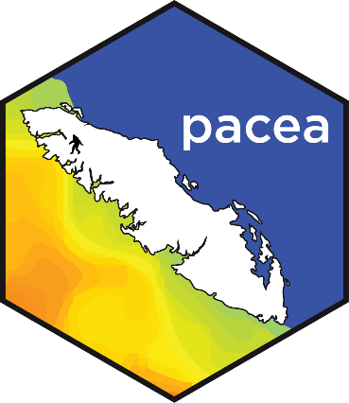


Live demo here during the poster session
pacea: an R package of Pacific ecosystem information to help facilitate an ecosystem approach to fisheries management
Andrew Edwards
el Niño?
The R package pacea is available at https://github.com/pbs-assess/pacea
New this year: Fraser River discharge (for the salmon folks)
Much information updated monthly or annually.
Uses of pacea (that we know of):
Stock assessments for:
  Petrale Sole
  Dover Sole
  Yelloweye Rockfish
  Pacific Hake
Other:
  body condition of 35 demersal fish species (English et al., 2026)
  Salmon Prize prediction project
  spatial densities of humpback whales
  fluctuations of infectious hematopoietic necrosis virus (IHPV) in Sockeye Salmon

