Slide 1
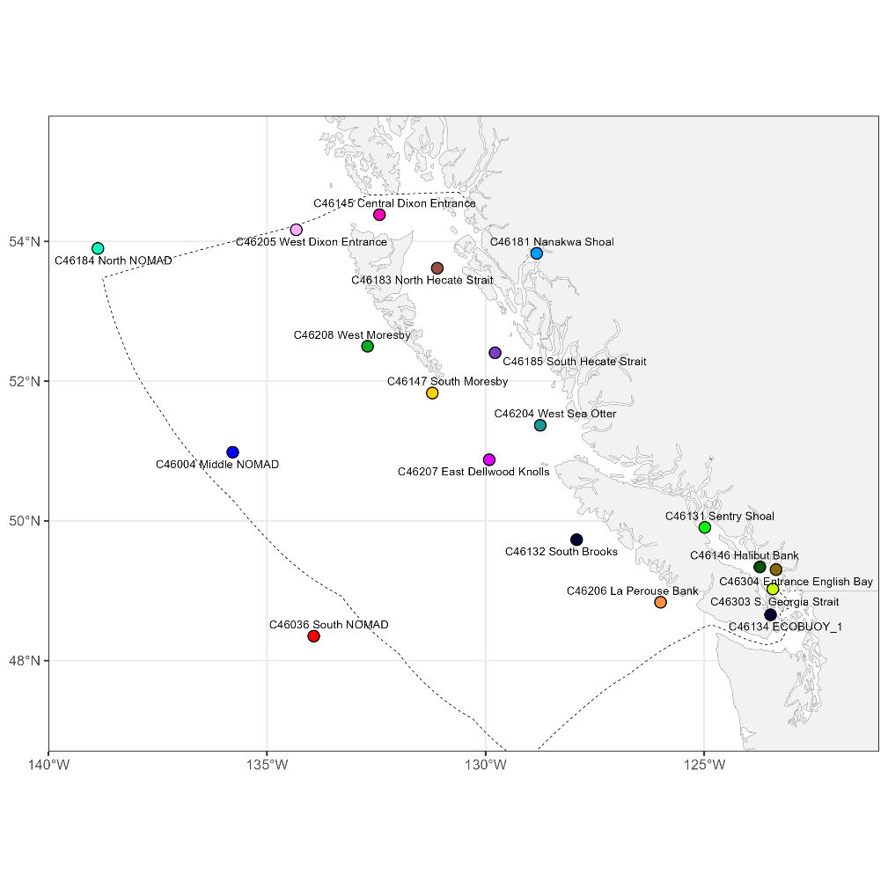
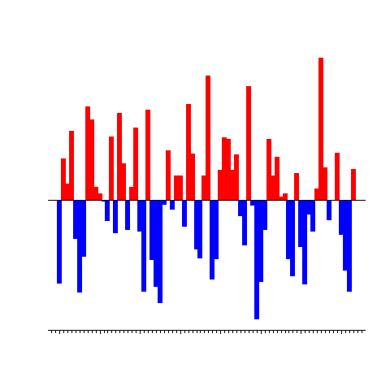



pacea: An R package of Pacific ecosystem information to help facilitate an ecosystem approach to fisheries management
Andrew Edwards¹, Travis Tai¹, and Andrea Hilborn²
¹Pacific Biological Station, Fisheries and Oceans Canada, Nanaimo, BC.
²Institute of Ocean Sciences, Fisheries and Oceans Canada, Sidney, BC.
el Niño?
National EA R package workshop, 17th November 2026

