Slide 1
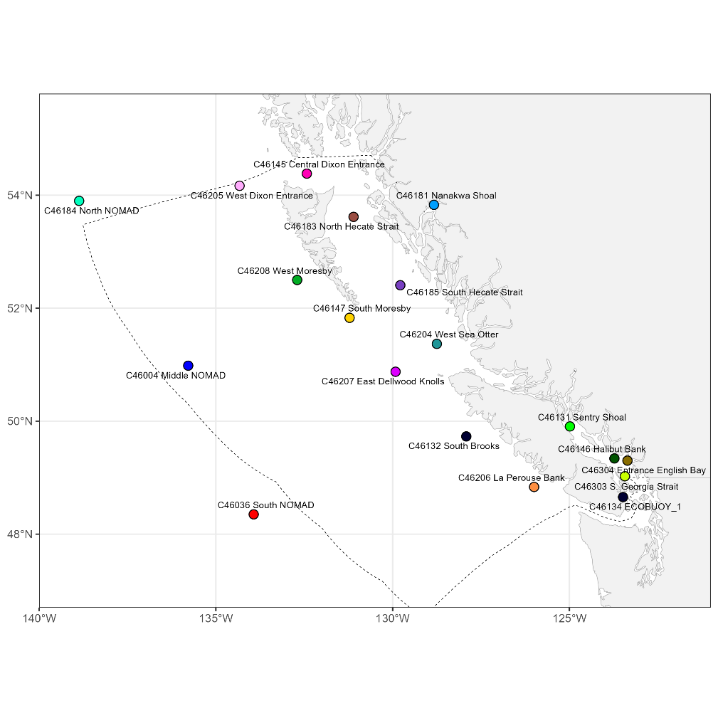
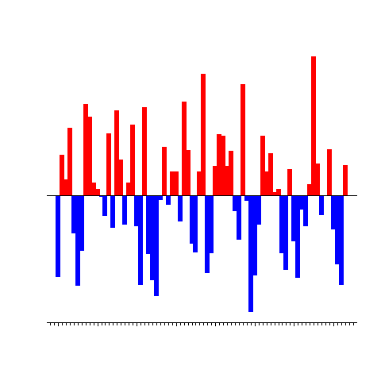
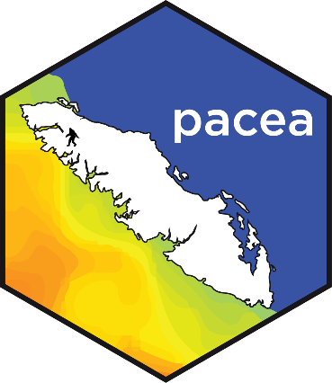
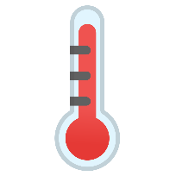

New information added to pacea since (and thanks to)
last year’s SOPO
Andrew Edwards
Pacific Biological Station, Fisheries and Oceans Canada, Nanaimo, BC.
el Niño?
State of the Pacific Ocean, Sidney, Mar 2025

