Slide 1
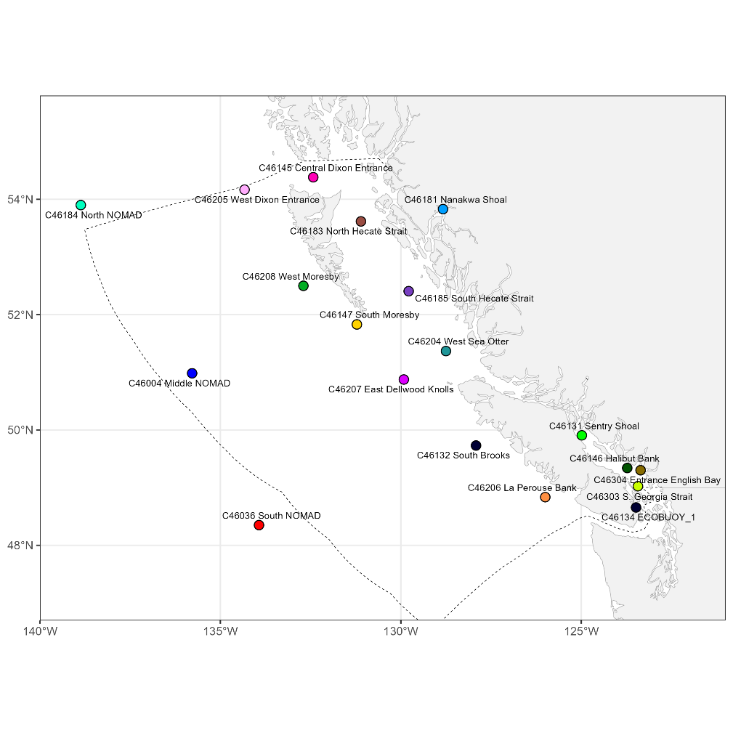
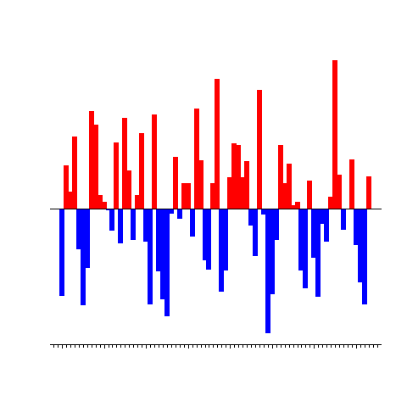
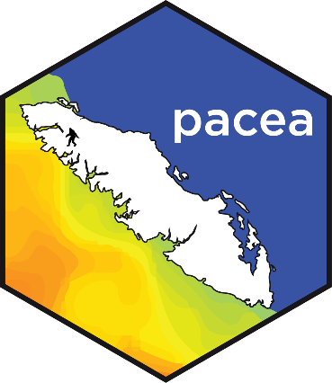
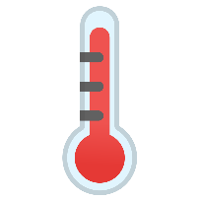

New Canadian and US information added to pacea
(since last year)
Andrew Edwards
Pacific Biological Station, Fisheries and Oceans Canada, Nanaimo, BC.
el Niño?
DFO/NMFS Climate & Fisheries
Pacific Working Group, Seattle, Jan 2025

