Slide 1
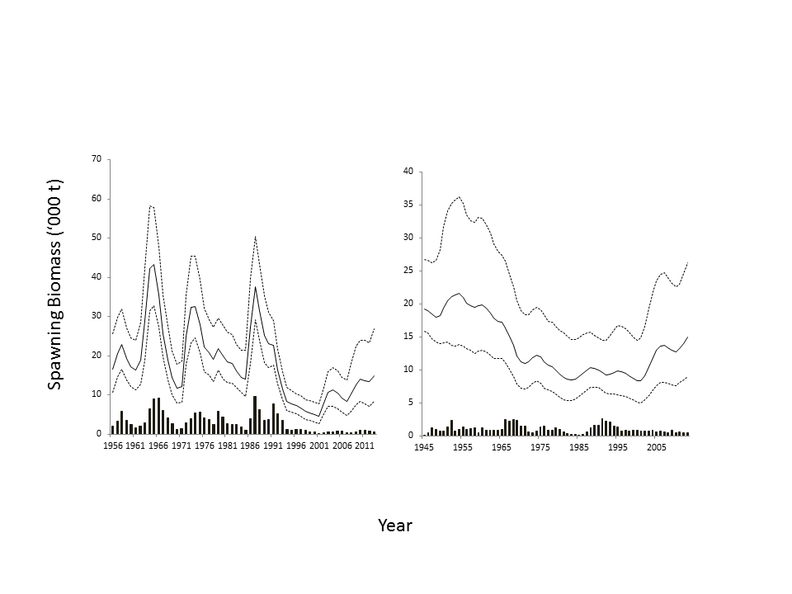
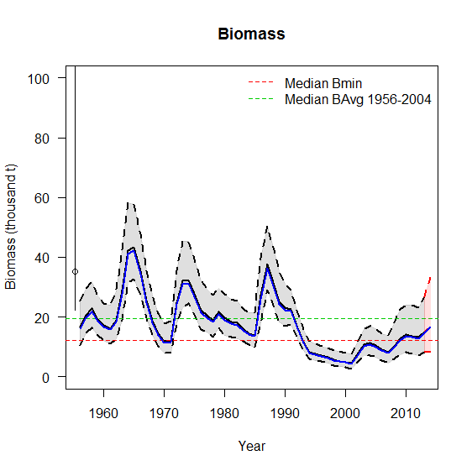
Alternative harvest control rules for Pacific Cod and Rock Sole*
The issue:
Large uncertainty in natural mortality (M) for both species
Pacific cod: possible density dependence in M
Rock Sole: Large range of possible values for M (choice of prior probability distribution)
Unreliable estimates of F_{MSY} and B_{MSY} for calculation of operational control points (OCPs) in the Harvest Control Rule (HCR)
Need to understand performance of “history-based” and alternative OCPs
*Forrest, R.E., Holt, K.R., Kronlund, A.R. Performance of alternative harvest control rules for two Pacific groundfish stocks with uncertain natural mortality: bias, robustness and trade-offs. Fisheries Research 206: 259-286

Slide 2
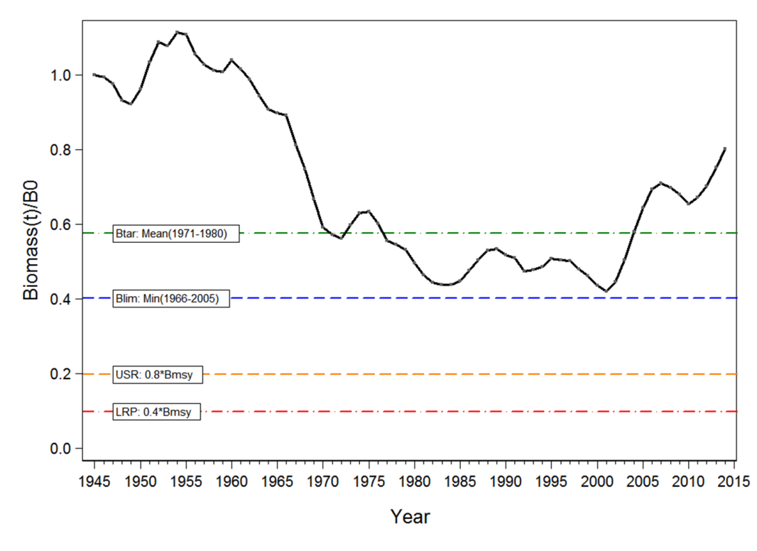
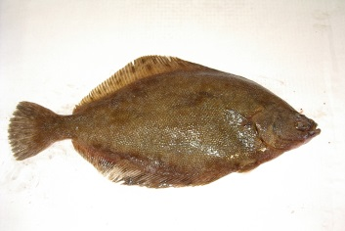
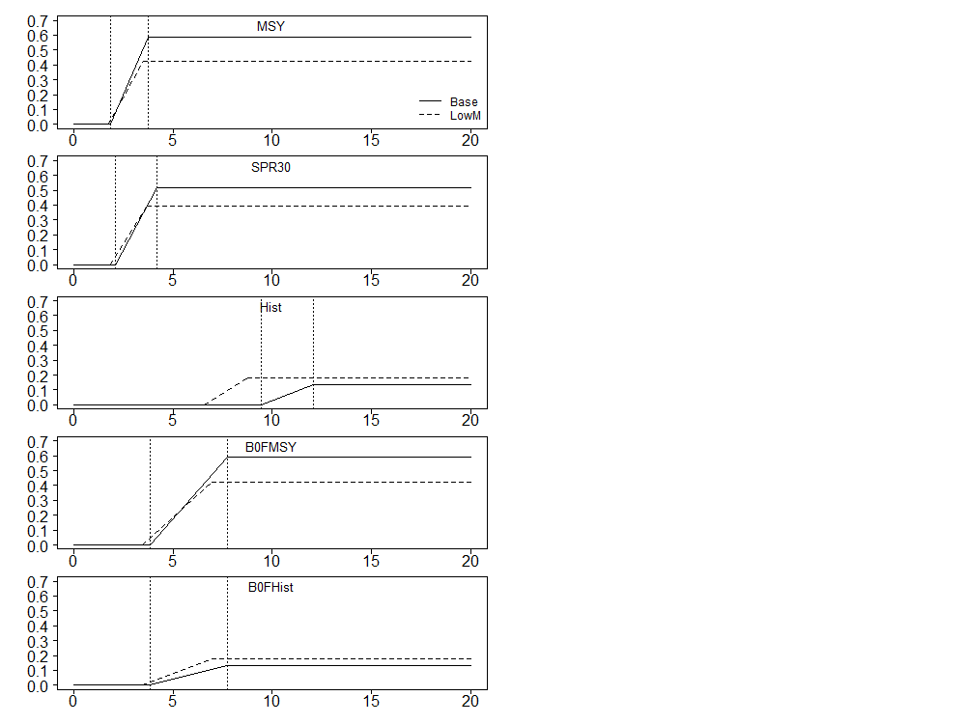
“History-based” vs “MSY-based” (and three other) Operational Control Points (OCPs)
OCPs
Fishing mortality rate
Spawning biomass

Slide 3

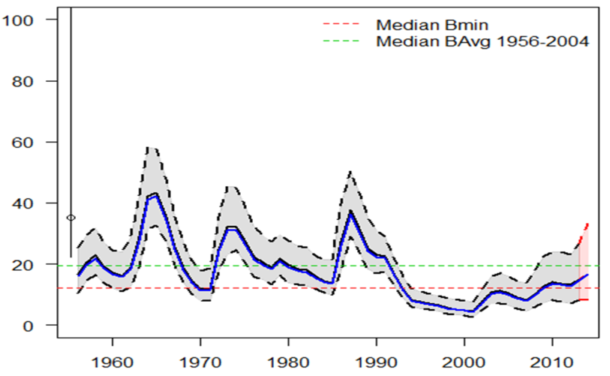
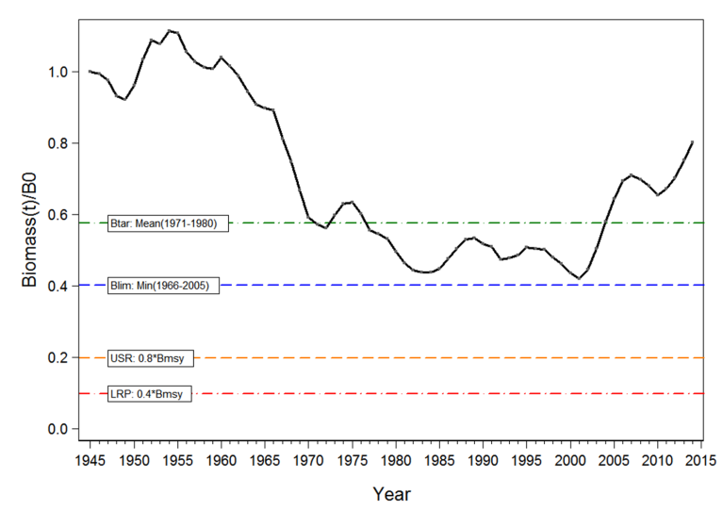
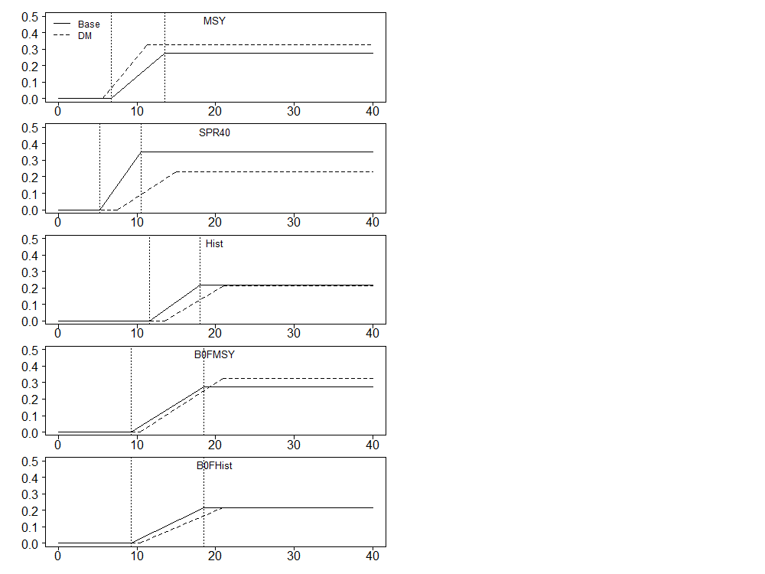
“History-based” vs “MSY-based” OCPs
Fishing mortality rate
Fishing mortality rate
Spawning biomass
Spawning biomass

Slide 4
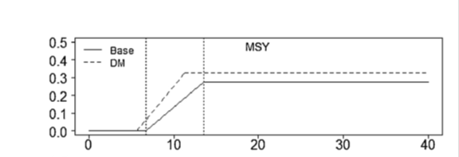
Harvest Control Rules

Slide 5

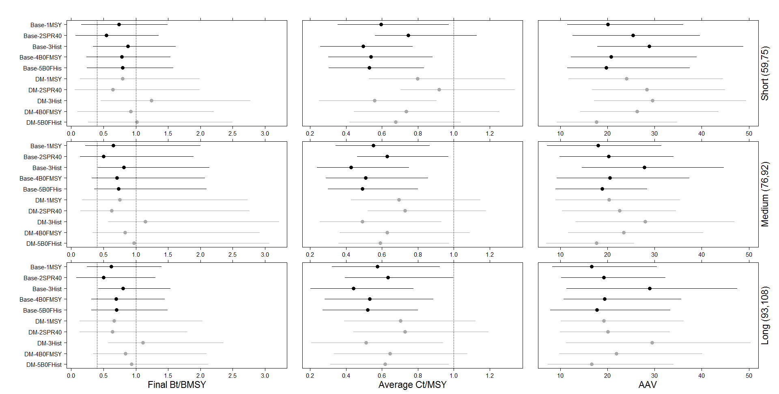
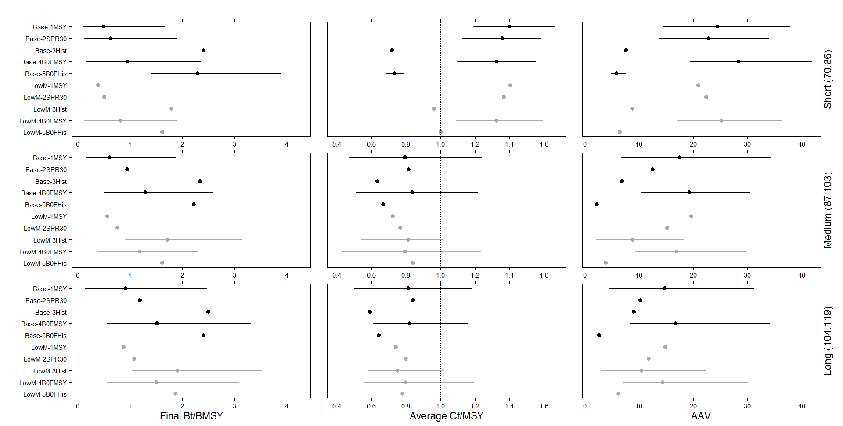
Results – two M scenarios
Base
Depensatory M
Base
Lower M
Final Bt/BMSY
Final Bt/BMSY

Slide 6
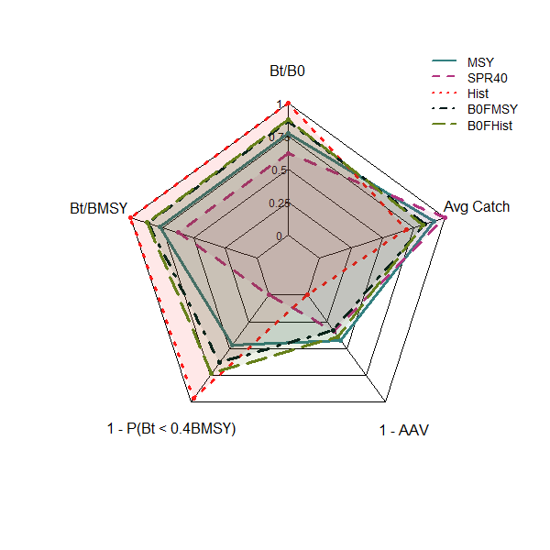
Results: Trade-offs

Slide 7
Lessons learned …
History-based OCPs outperformed MSY-based and other OCPs in terms of performance but there were trade-offs in terms of catch and catch variability.
Trade-offs differed between species and scenarios.
Mechanisms for performance differed between species, M scenarios and HCRs.
Bias propagated through assessments in different directions under different HCRs … choice of OCP affects data, which affects bias and performance.
Closed loop simulation studies could be applied more broadly to help managers and stakeholders understand trade-offs in choices of HCRs.

