Slide 1
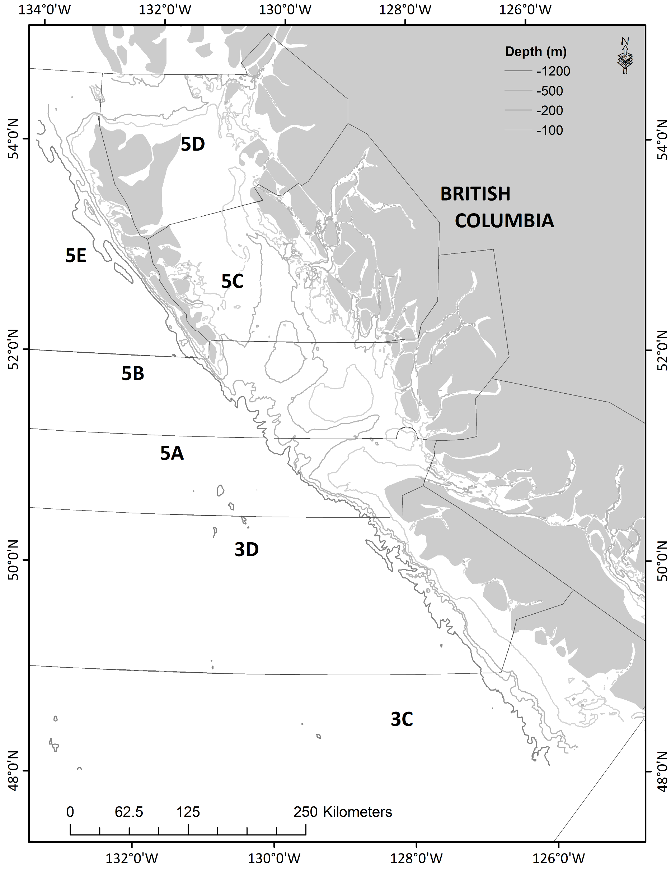
HECATE STRAIT
QUEEN CHARLOTTE SOUND
WEST COAST VANCOUVER ISLAND

