Slide 1
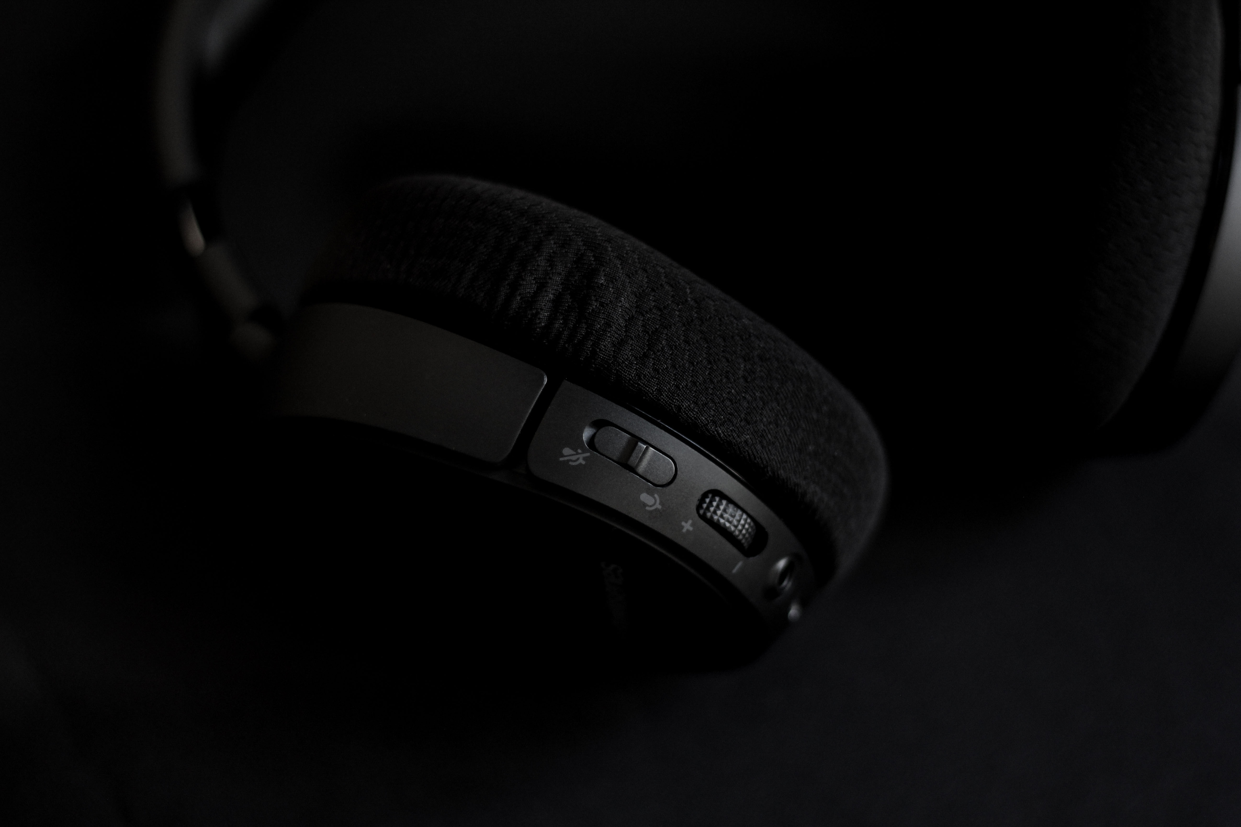
COAI
Course Outcome Artificial Intelligence

Slide 2

Problem Statement
Students struggle to improve their test scores because they don’t know exactly which concepts or skills are sabotaging their progress. On the other hand, teachers find it challenging to address these shortcomings effectively, as each student may have unique blind spots.

Slide 3



What we do?
Flaw analysis
Tactic
Report

Slide 4



Flow Analysis.
Upload Paper
Upload Data
Analysis
Response
Upload your question paper here
Upload your Course outcome data
Analysis of fed data
Response with respect to data

Slide 5
Flaw Analysis.
Llama2 7b model for the analysis for the non answered or incorrectly answered questions, Taking CO data as baseline it will predict most possible outcome
Flaw analysis

Slide 6
The Tactic.
After flaw identification AI suggests you most appropriate answer where you most likely lack or which concept or which formula specfically
Tactic

Slide 7
The Report.
The obtained repsonse is files in a .txt extension file or any other template file very much organised response
Report

Slide 8

Connect Us.
COAI
Github website page

Slide 9

Open to Queries
COAI

