Slide 1
z
ζ
N′
O
x
M′
y
N(ξ,0,0)
M
M0
ξ
P(0, η,0)
N0
P′
η
α
Q
ϐ
M1
R
N1
P1

Slide 2
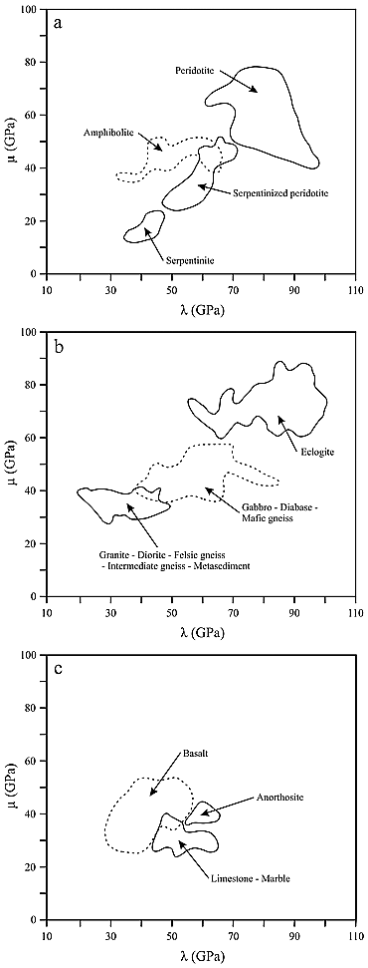

Slide 3






Тензор на напр.
P
z
$$τ_{n}$$
A
ds
$$σ_{n}$$
n
$$t_{y}$$
$$t_{x}$$
n
$$t_{n}$$
y
x
$$t_{z}$$

Slide 4



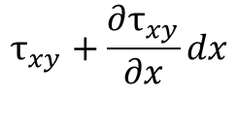


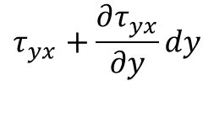

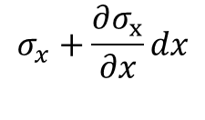

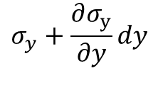

$$y$$
$$σ_{y}+\frac{∂σ_{y}}{∂y}dy$$
$$τ_{yx}+\frac{∂τ_{yx}}{∂y}dy$$
$$τ_{xy}+\frac{∂τ_{xy}}{∂x}dx$$
$$σ_{x}$$
$$f_{2}$$
$$τ_{xy}$$
$$f_{1}$$
$$σ_{x}+\frac{∂σ_{x}}{∂x}dx$$
O
$$τ_{yx}$$
$$x$$
$$σ_{y}$$

