Slide 1
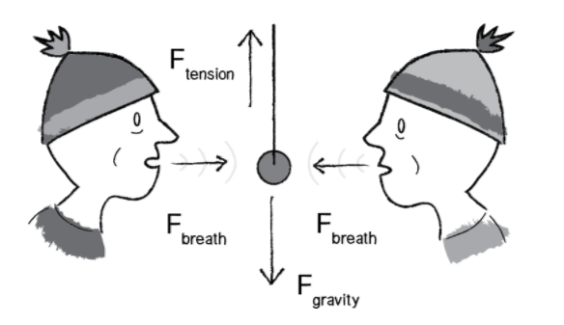
Forces – The Laws of Motion
The definition of force that we care about is much more formal and comes from Isaac Newton’s laws of motion:
A force is a vector that causes an object with mass to accelerate.
Let’s look at Newton’s three laws of motion in relation to the concept of a force.
Newtons First Law
An object at rest stays at rest and an object in motion stays in motion.
However, this is missing an important element related to forces. We could expand it by stating:
An object at rest stays at rest and an object in motion stays in motion at a constant speed and direction unless acted upon by an unbalanced force.
In our Processing world, we could restate Newton’s first law as follows
Mouse (480,180)
An object’s PVector velocity will remain constant if it is in a state of equilibrium.
Mover04.js

Slide 2
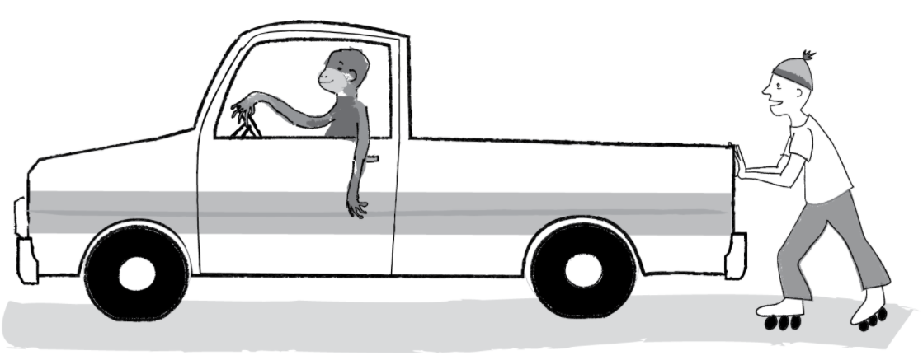
Skip to Newtons 3rd Law
Newtons Third Law
For every action there is an equal and opposite reaction.
Let’s say you push against a wall. The wall doesn’t actively decide to push back on you. There is no “origin” force. Your push simply includes both forces, referred to as an “action/reaction pair.”
Forces always occur in pairs. The two forces are of equal strength, but in opposite directions.
Try pushing on a stationary truck. Although the truck is far more powerful than you, unlike a moving one, a stationary truck will never overpower you and send you flying backwards. The force you exert on it is equal and opposite to the force exerted on your hands. The outcome depends on a variety of other factors.
If we calculate a Vector f that is a force of object A on object B, we must also apply the force — P5.Vector.mult(f,-1);—that B exerts on object A.
Mouse (480,180)
Mover04.js

Slide 3
Newtons 2nd Law – the most important law
Newtons Second Law
Force equals mass times acceleration.
Now, in the world of Processing, what is mass anyway? Aren’t we dealing with pixels? To start in a simpler place, let’s say that in our pretend pixel world, all of our objects have a mass equal to 1. F/ 1 = F. And so:
Acceleration is directly proportional to force and inversely proportional to mass. This means that if you get pushed, the harder you are pushed, the faster you’ll move (accelerate). The bigger you are, the slower you’ll move.
A = F
The acceleration of an object is equal to force. This is great news. After all, we saw in Chapter 1 that acceleration was the key to controlling the movement of our objects on screen. Location is adjusted by velocity, and velocity by acceleration. Acceleration was where it all began. Now we learn that force is truly where it all begins.
Weight vs. Mass
The mass of an object is a measure of the amount of matter in the object (measured in kilograms).
Weight, though often mistaken for mass, is technically the force of gravity on an object. From Newton’s second law, we can calculate it as mass times the acceleration of gravity (w = m * g). Weight is measured in newtons.
Density is defined as the amount of mass per unit of volume (grams per cubic centimeter, for example).
Note that an object that has a mass of one kilogram on earth would have a mass of one kilogram on the moon. However, it would weigh only one-sixth as much.
Mouse (480,180)
Mover04.js

Slide 4
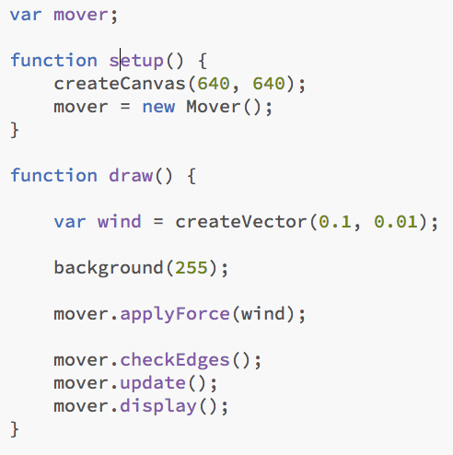
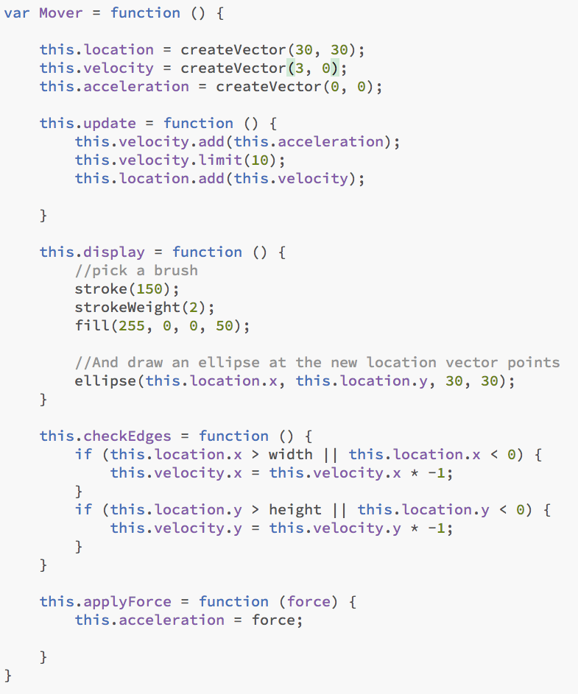
Lets look at our Mover Class
sketch25.js
Newtons Second Law
class Mover {
this.location = createVector(200,100);
this.velocity = createVector(3,3);
this.acceleration = createVector(0,0);
}
Now our goal is to be able to add forces to this object, perhaps saying:
mover.applyForce(wind);
or
mover.applyForce(gravity);
And in our Mover class we will need a function called applyForce()
this.applyForce = function(force) {
this.acceleration = force;
}
Mouse (480,180)
Mover01.js

Slide 5
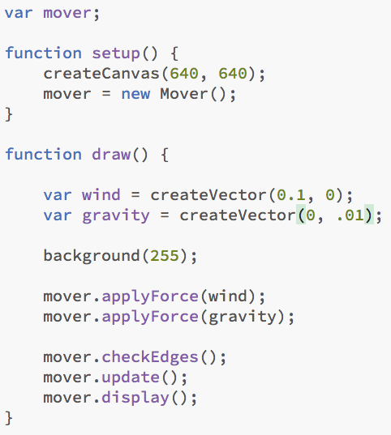
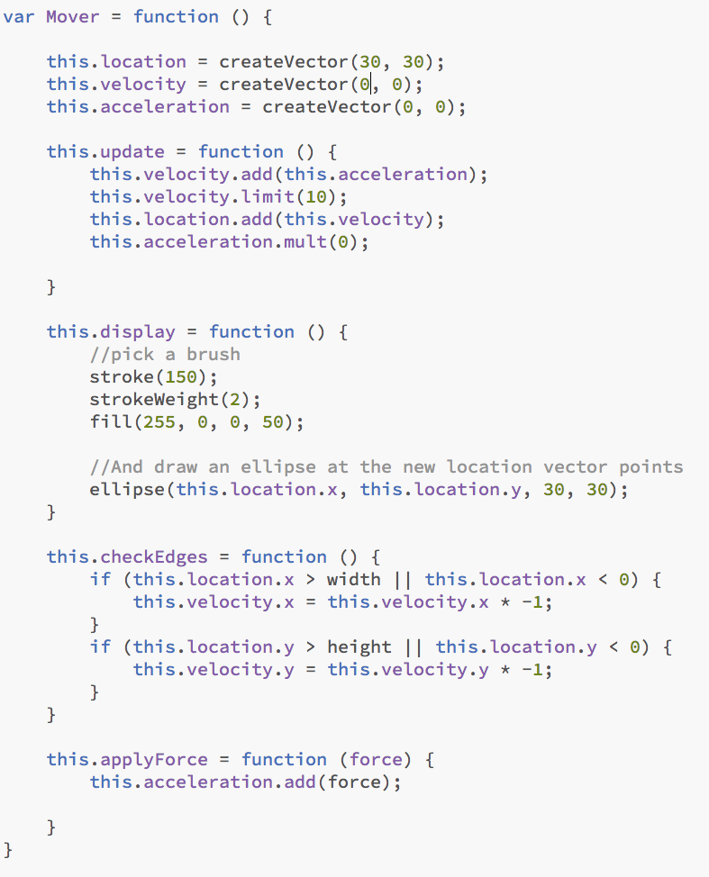
Force Accumalation!!!!
The Problem with our mover class at the moment is that if we want to have multiple forces like:
sketch26.js
mover.applyForce(wind);
mover.applyForce(gravity);
If Applied at the same time the structure of our code does not allow for force accumalation. If we call applyForce() more than once, it overrides each previous call. How are we going to handle more than one force?
Net Force equals mass times acceleration.
What we need to do is add our force to acceleration for each force present. On each update loop we need to reset acceleration to 0
These are new
Mouse (480,180)
Mover02.js

Slide 6
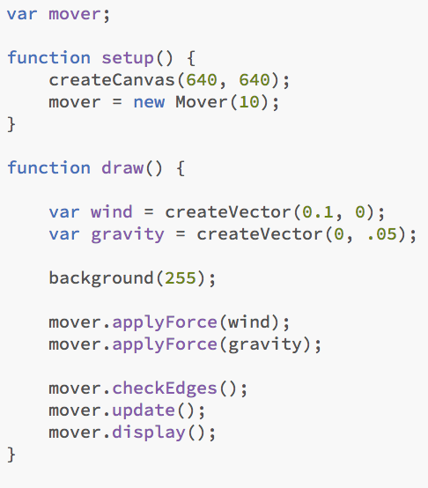
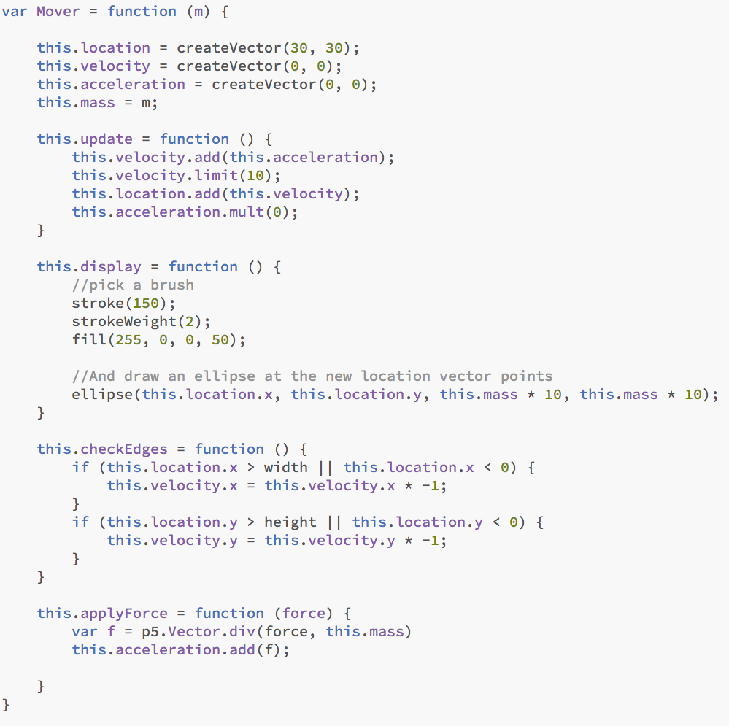
Dealing with Mass...F=MA!!!
Incorporating mass is as easy as adding an instance variable to our class, but we need to spend a little more time here because a slight complication will emerge.
sketch27.js
It should also be noted that, for demonstration purposes, we’ll tie mass to pixels (drawing, say, a circle with a radius of 10). This will allow us to visualize the mass of an object. In the real world, however, size does not definitely indicate mass. A small metal ball could have a much higher mass than a large balloon due to its higher density.
Remember we don’t want to affect the force vector itself so we use a static function to calculate the acceleration
this.applyForce = function (force) {
var f = p5.Vector.div(force, this.mass)
this.acceleration.add(f);
}
We are also introducing a parameter being based from the new Mover(m). This allows us to create a new Mover object with a defined mass. We also use this mass to define the size of the circle.
Mouse (480,180)
Mover03.js

Slide 7
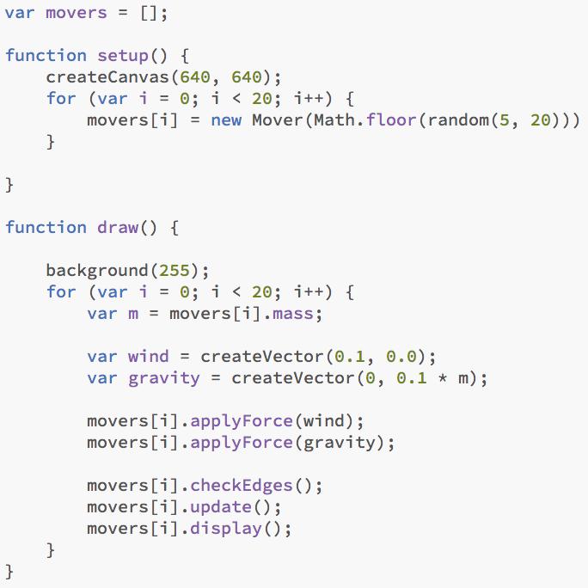
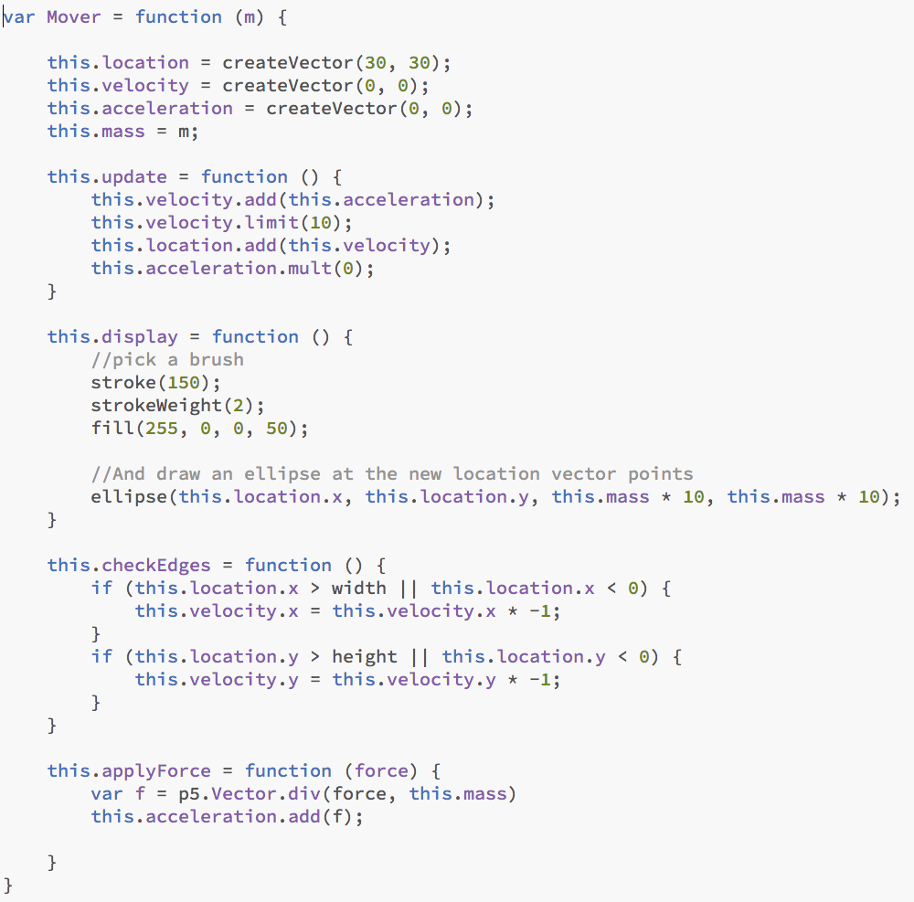
Gravity on Earth
sketch28.js
You may have noticed something woefully inaccurate about this last example. The smaller the circle, the faster it falls. There is a logic to this; after all, we just stated (according to Newton’s second law) that the smaller the mass, the higher the acceleration. But this is not what happens in the real world.
If you were to climb to the top of the Leaning Tower of Pisa and drop two balls of different masses, which one will hit the ground first? According to legend, Galileo performed this exact test in 1589, discovering that they fell with the same acceleration, hitting the ground at the same time. Why is this?
As we will see later in this chapter, the force of gravity is calculated relative to an object’s mass. The bigger the object, the stronger the force. So if the force is scaled according to mass, it is canceled out when acceleration is divided by mass.
Mouse (480,180)
Mover04.js

Slide 8
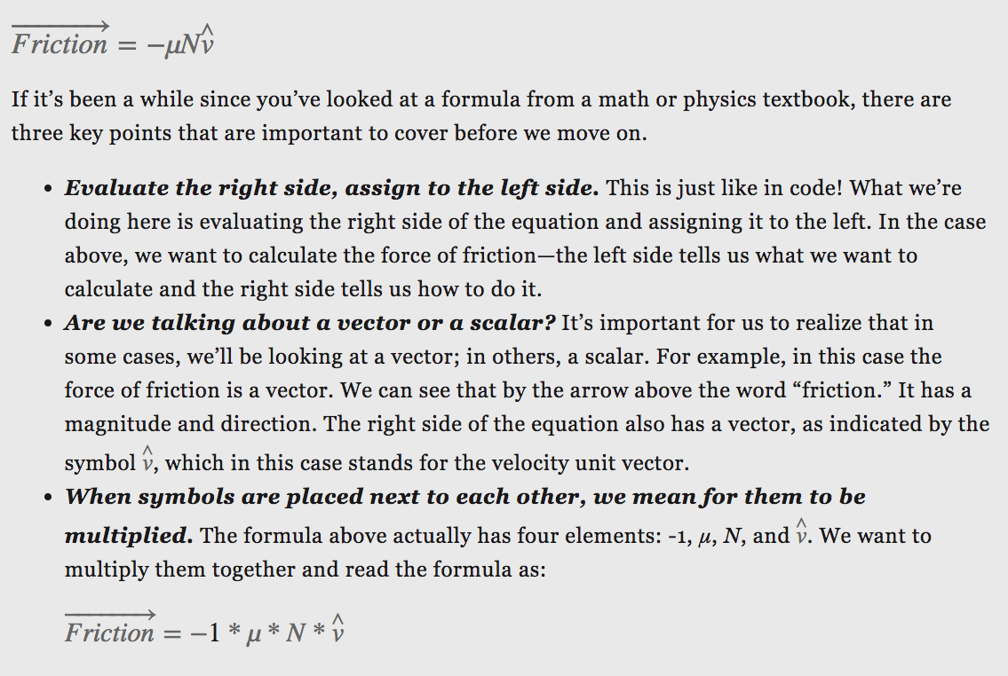
Using Formula
Mouse (480,180)

Slide 9
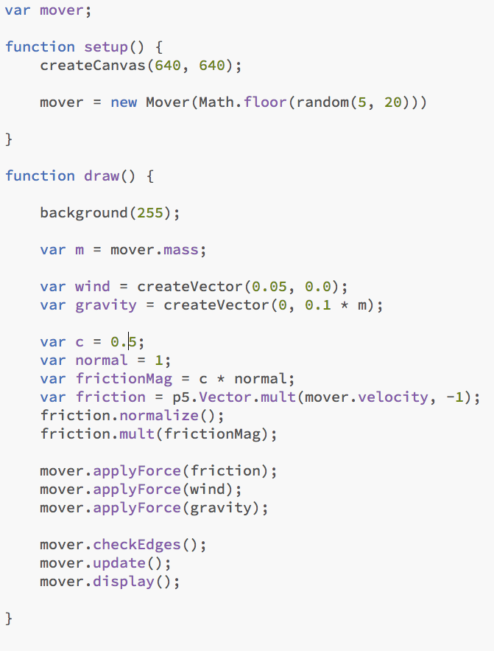
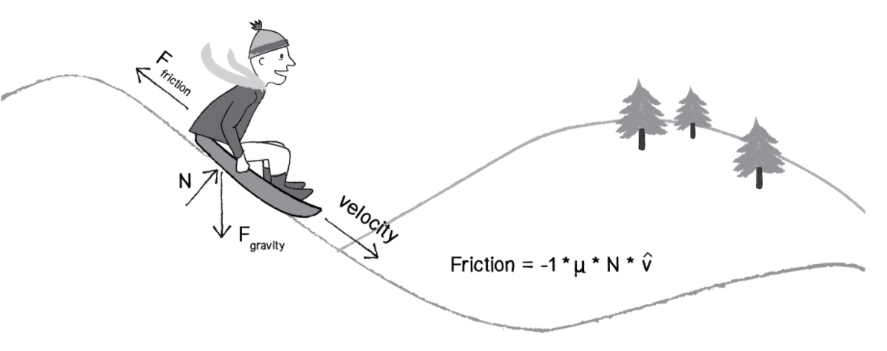
Friction
sketch29.js
Friction is a dissipative force. A dissipative force is one in which the total energy of a system decreases when an object is in motion. Let’s say you are driving a car. When you press your foot down on the brake pedal, the car’s brakes use friction to slow down the motion of the tires. Kinetic energy (motion) is converted into thermal energy (heat). Whenever two surfaces come into contact, they experience friction.
Mouse (480,180)
Mover05.js

