Slide 1
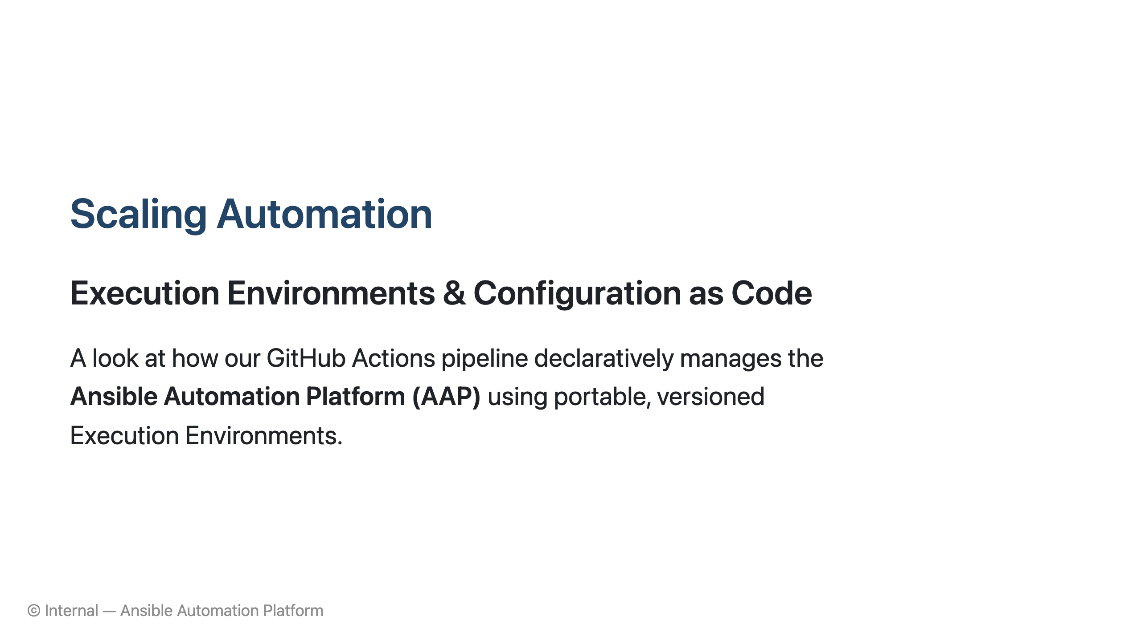
Notes:
**Presenter Notes:** * **Analogy:** Think of Configuration as Code for AAP like a recipe book for a master chef. The recipe book (code) guarantees the dish (Ansible automation) turns out perfectly every single time, no matter who is cooking, instead of relying on memory or manual steps.

Slide 2
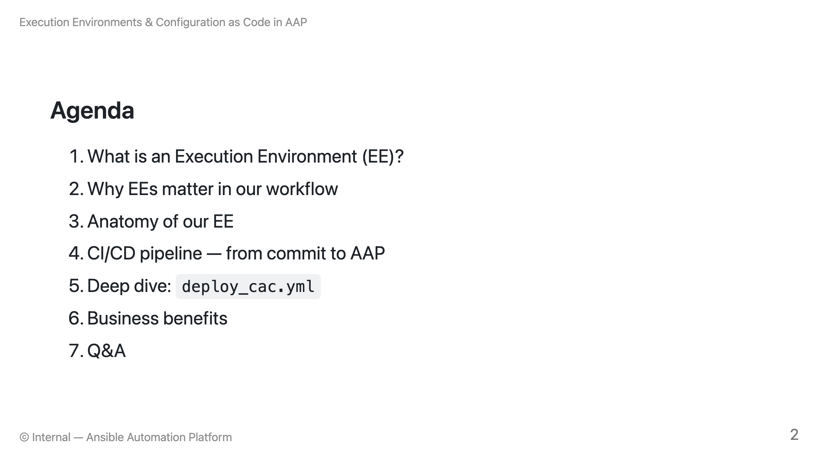
Notes:
**Presenter Notes:** * **Analogy:** If our Ansible Automation Platform (AAP) is a massive factory, today we are going to look at the blueprints (our code) and the specialized workers (Execution Environments) that keep the factory running smoothly and automatically.

Slide 3
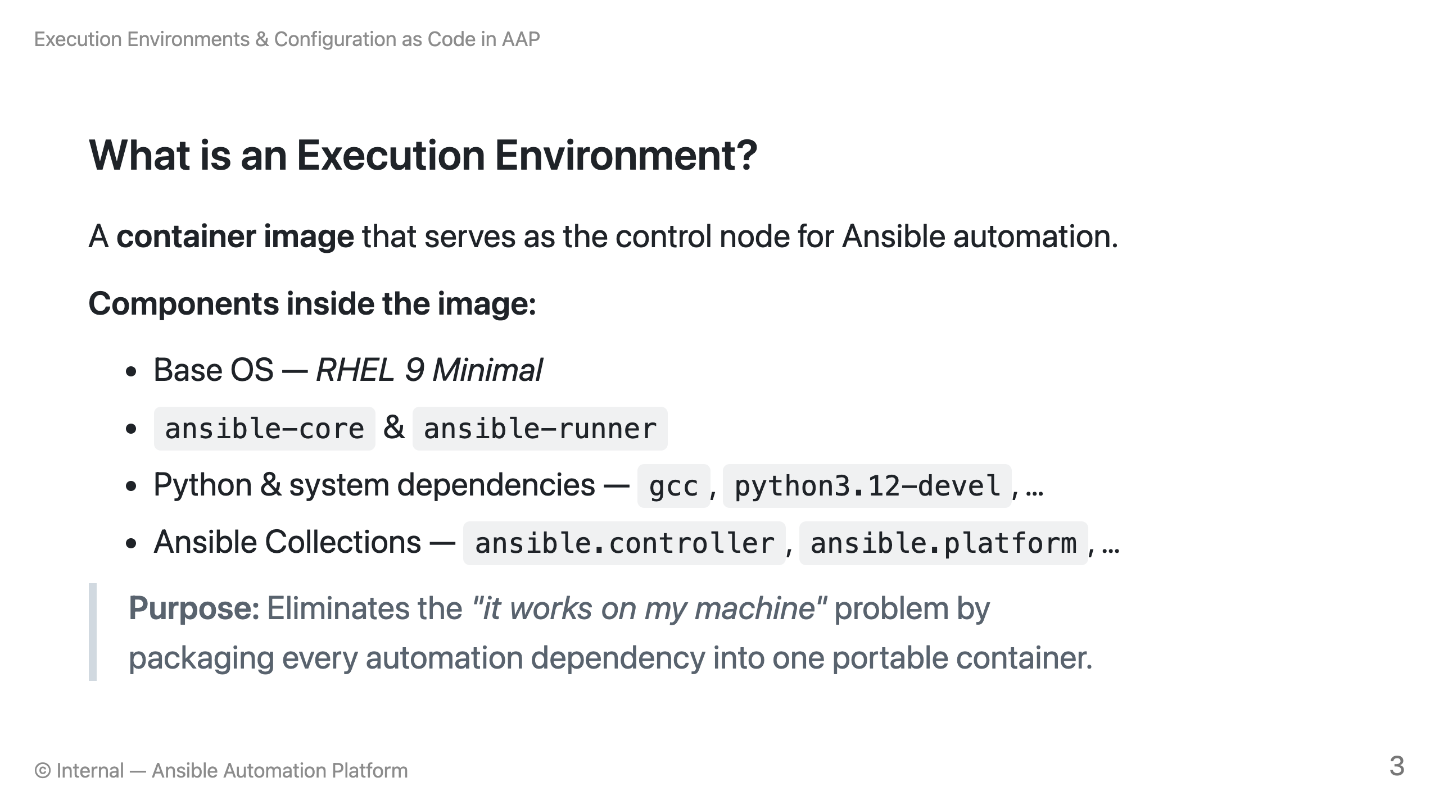
Notes:
**Presenter Notes:** * **Analogy:** Think of an Execution Environment (EE) like a fully-equipped food truck. You don't just show up to an event and hope they have an oven, ingredients, and utensils; you bring the entire kitchen with you. The EE brings the OS, Ansible, Python, and Collections all packaged in one truck. No matter where you park (or run the automation), you have everything you need to cook the exact same meal.

Slide 4
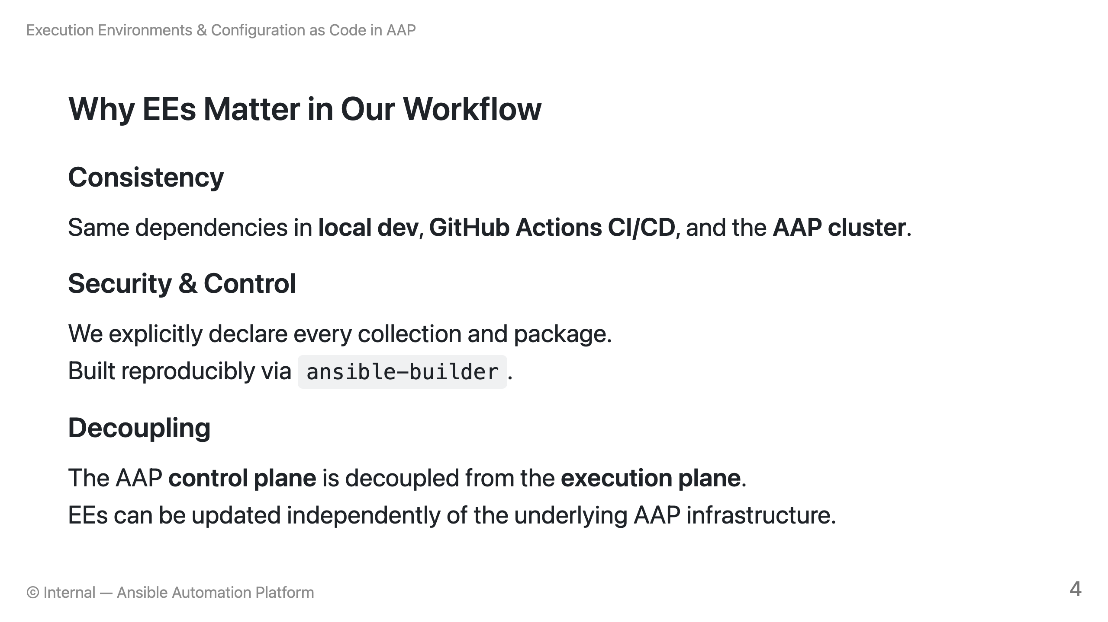
Notes:
**Presenter Notes:** * **Analogy for Consistency:** Like shipping a fully assembled car instead of a box of loose parts. You know it will drive. * **Analogy for Security & Control:** Like a detailed manifest on a cargo ship. We know exactly what's inside and nothing sneaks on board. * **Analogy for Decoupling:** Like separating the conductor (AAP Control Plane) from the orchestra (Execution Plane). You can bring in new instruments or musicians without having to replace the conductor or the stage.

Slide 5
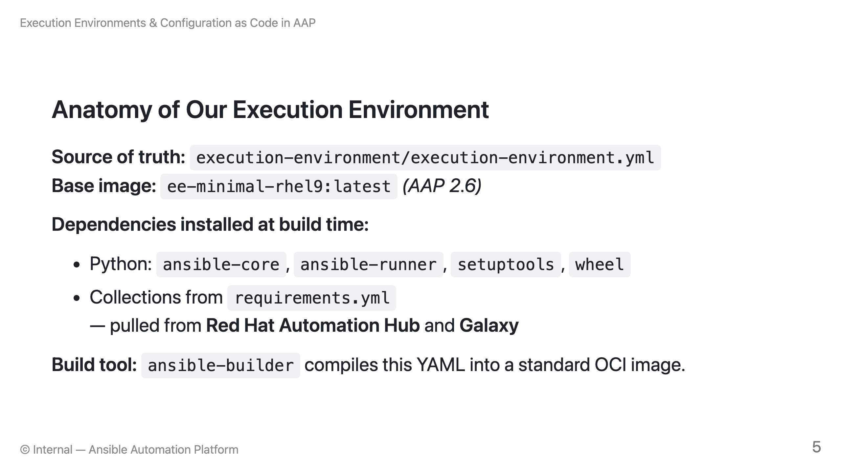
Notes:
**Presenter Notes:** * **Analogy:** Think of `execution-environment.yml` as the architectural blueprint, and `ansible-builder` as the construction crew. You tell the crew what foundation you want (base image) and what specific tools you need (Python dependencies, Ansible Collections). The crew then builds a standardized, modular pod (the container image) that can be safely dropped onto any site.

Slide 6
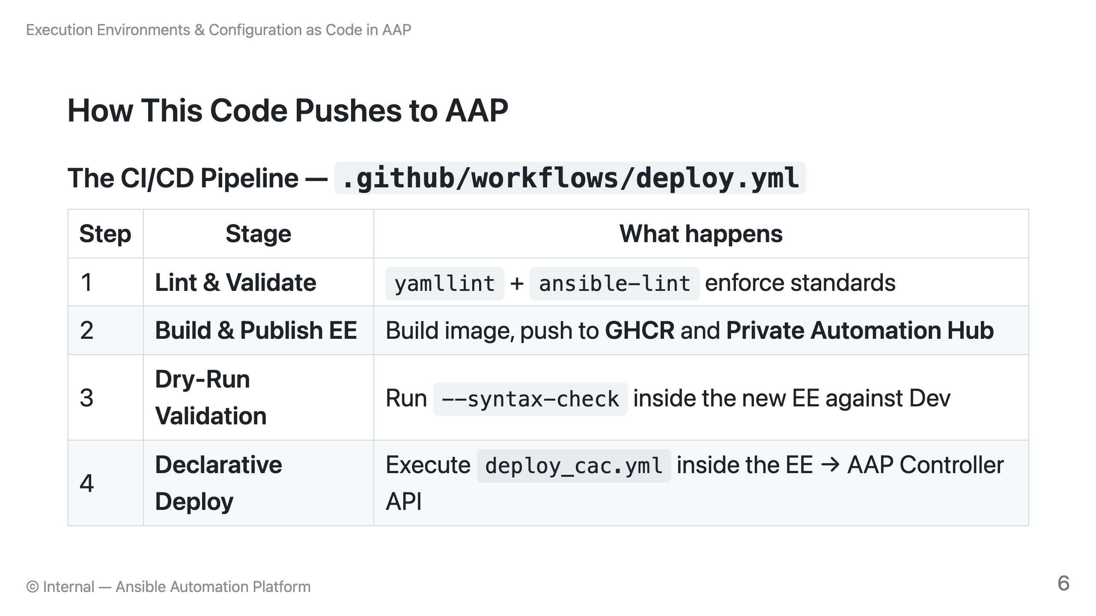
Notes:
**Presenter Notes:** * **Analogy:** Think of the CI/CD pipeline like an automated assembly and delivery line: * **Step 1 (Lint):** Quality Control checking the raw parts before assembly. * **Step 2 (Build/Publish):** Boxing up the final product and storing it safely in the warehouse. * **Step 3 (Dry-Run):** A test drive on a closed track to ensure it works. * **Step 4 (Deploy):** Safely delivering the final product to the showroom (AAP) exactly as ordered.

Slide 7
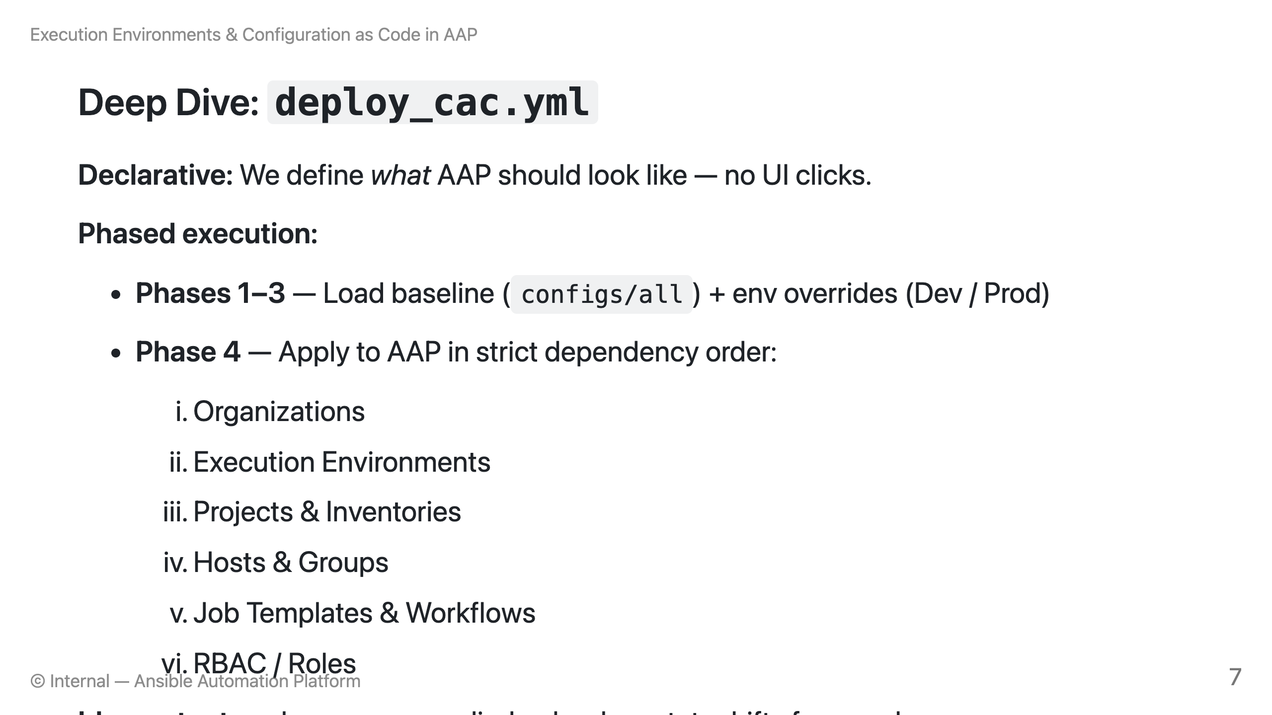
Notes:
**Presenter Notes:** * **Analogy:** Think of this phased execution like setting up a brand new restaurant. You don't just throw things in randomly. * First, you lease the building (Organizations). * Then, you bring the kitchen tools (Execution Environments). * Next, you stock the pantry (Projects/Inventories) and map the tables (Hosts). * Then, you create the menu (Job Templates). * Finally, you assign the staff their roles (RBAC). * **Declarative & Idempotent:** You give the contractor a picture of the finished restaurant. They look at what's already there and *only* build what's missing, rather than tearing it all down and starting from scratch.

Slide 8
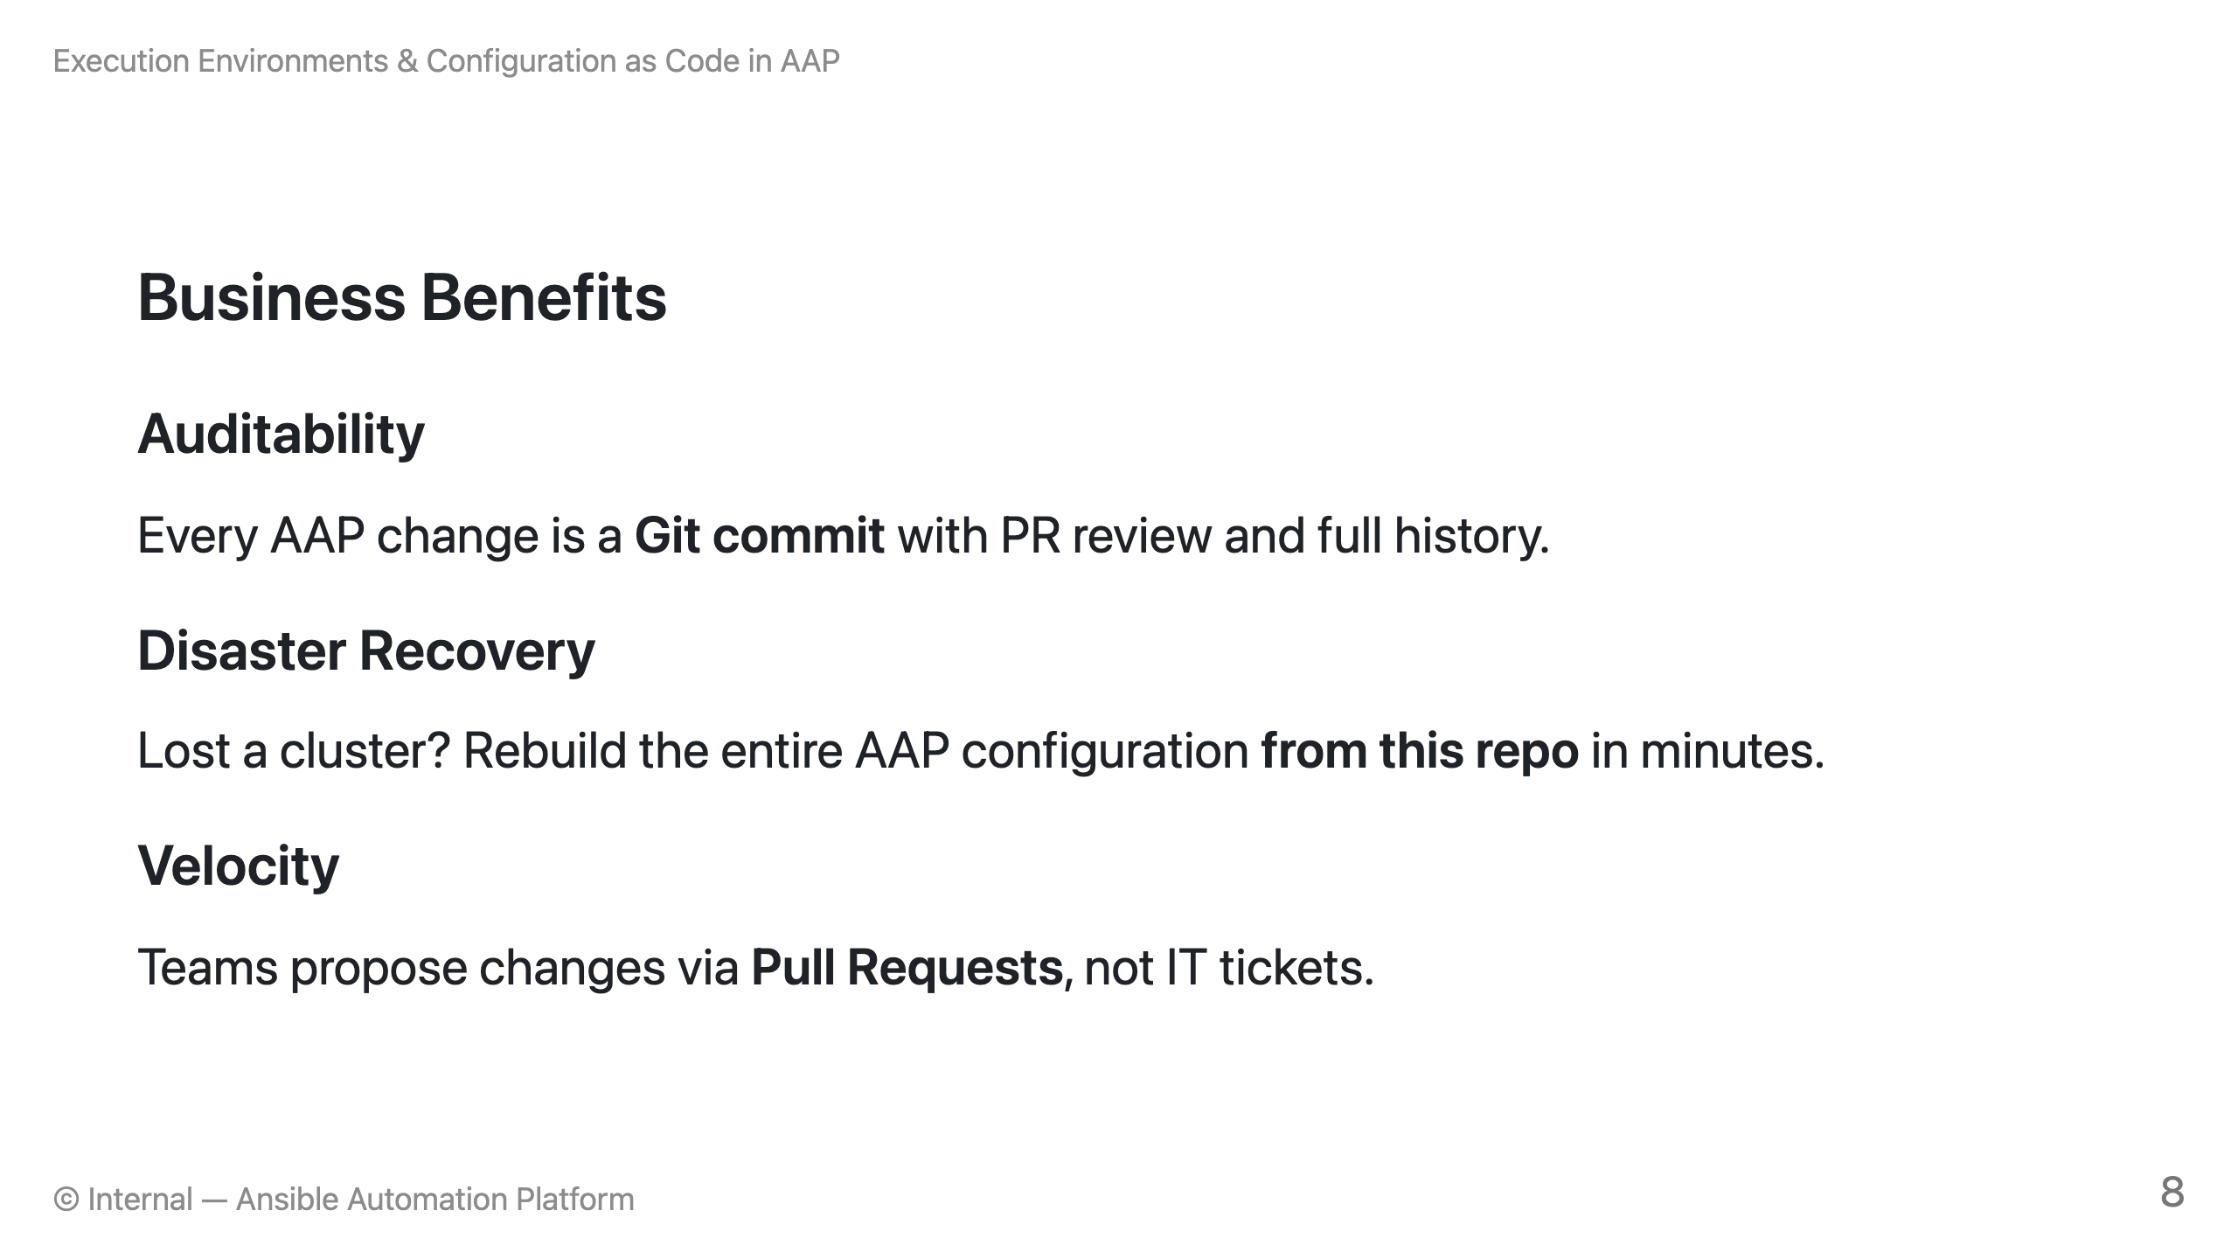
Notes:
**Presenter Notes:** * **Analogy for Auditability:** Like an airplane's black box combined with a security camera. We know exactly who changed what, when, and why. * **Analogy for Disaster Recovery:** Like having a magical 3D-printer blueprint for your entire office building. If the building burns down, you don't panic—you just click 'print' and rebuild it exactly as it was. * **Analogy for Velocity:** Instead of waiting in a slow line at the DMV to file a paper form (a traditional IT ticket), you're ordering off a self-serve digital menu (Pull Requests) and letting the automated kitchen process your request.

Slide 9
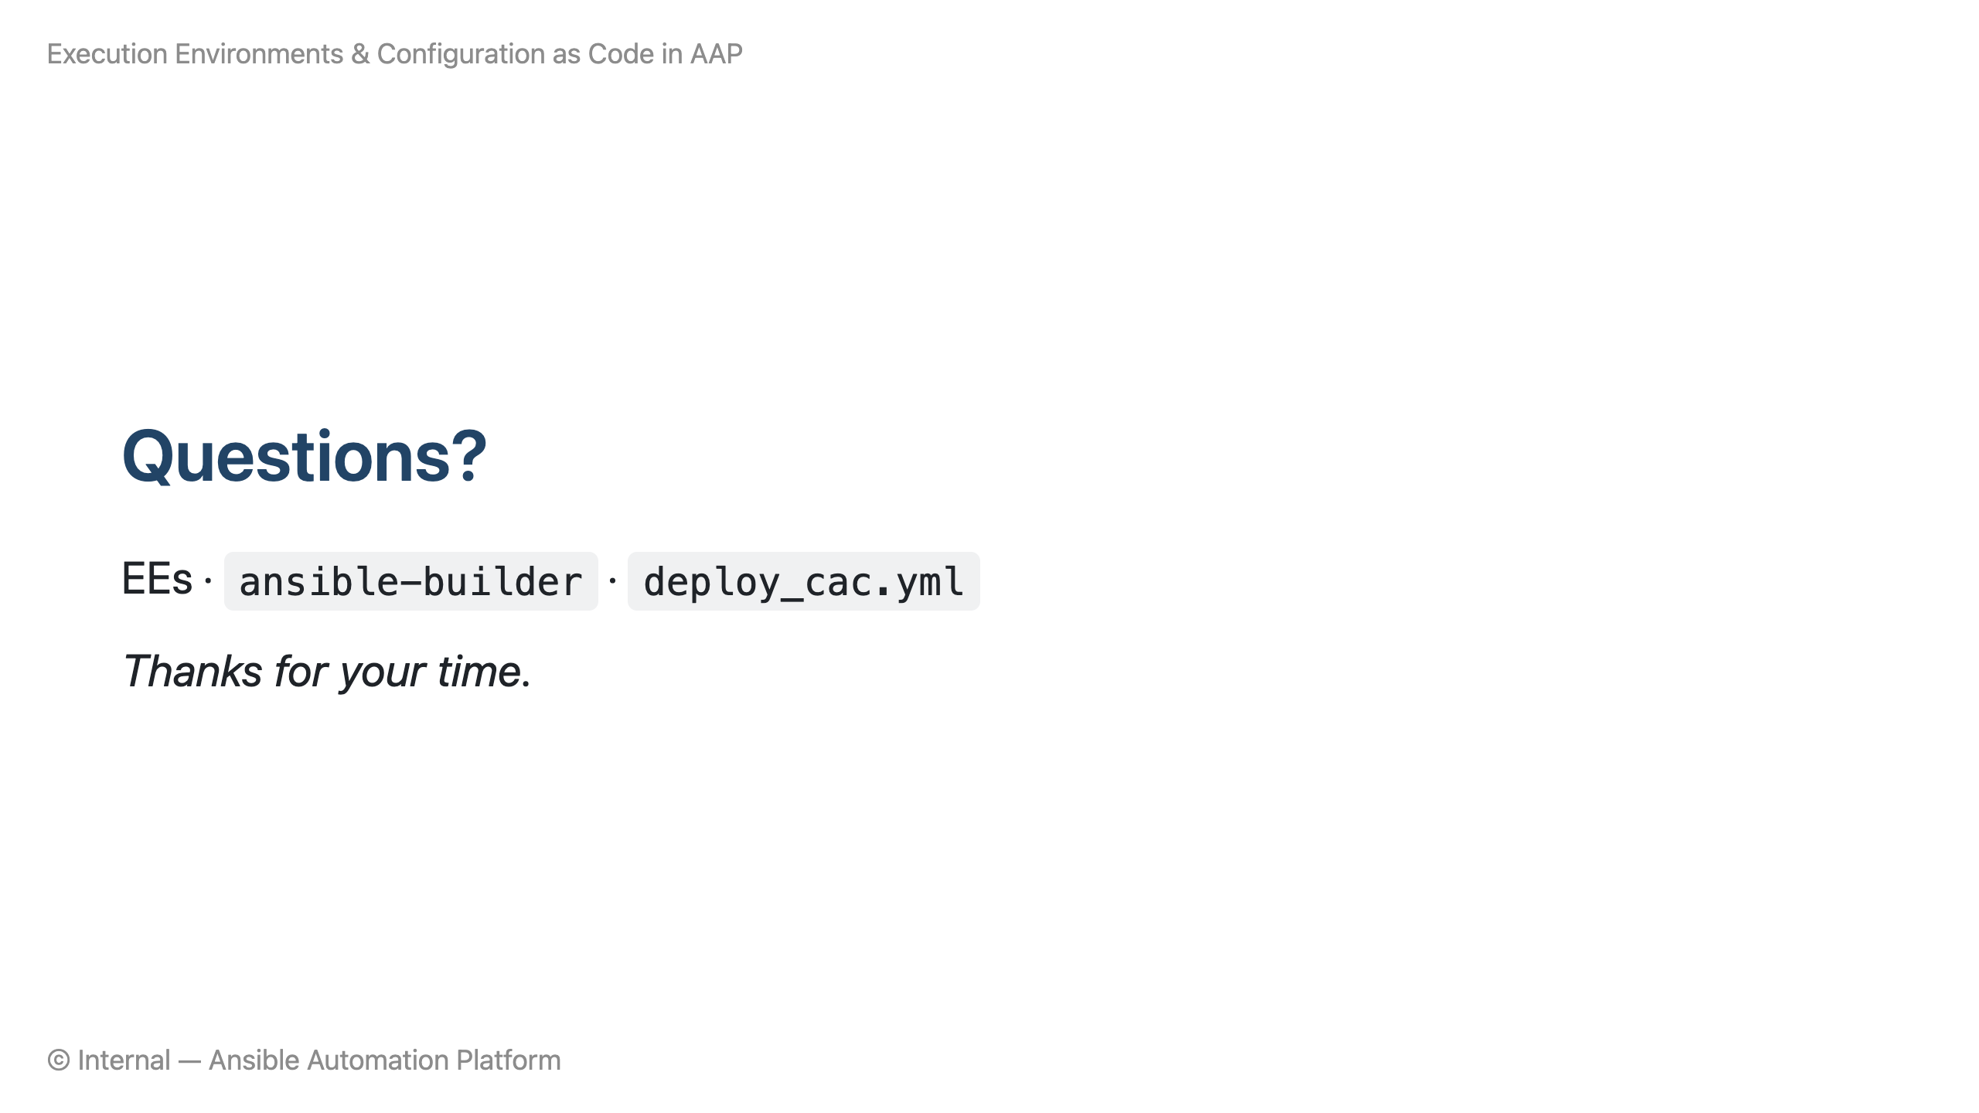
Notes:
**Presenter Notes:** * **Analogy Summary:** Remember, AAP is the factory, EEs are the food trucks bringing everything we need, and Configuration as Code is the blueprint guaranteeing it's built the exact same way every time!

