Slide 1
Summary Input from Engineering
Growing challenges
Concerned about reliability
Issues with uncentralized data
Issues with slowness
Challenges with software installations
Insufficient hardware resources
Insufficient software licenses
No HPC

Slide 2
Engineering Apps and Utilities
Cadence
Synopsys
Denali
ARC
Denali
Matlab
Novas
Mentor
Xilinx
Spotfire
Gmake
Gcc
Svn
Python
Nomachine
VNC
Tcl.TK
Java
Perl
Emacs
VIM

Slide 3
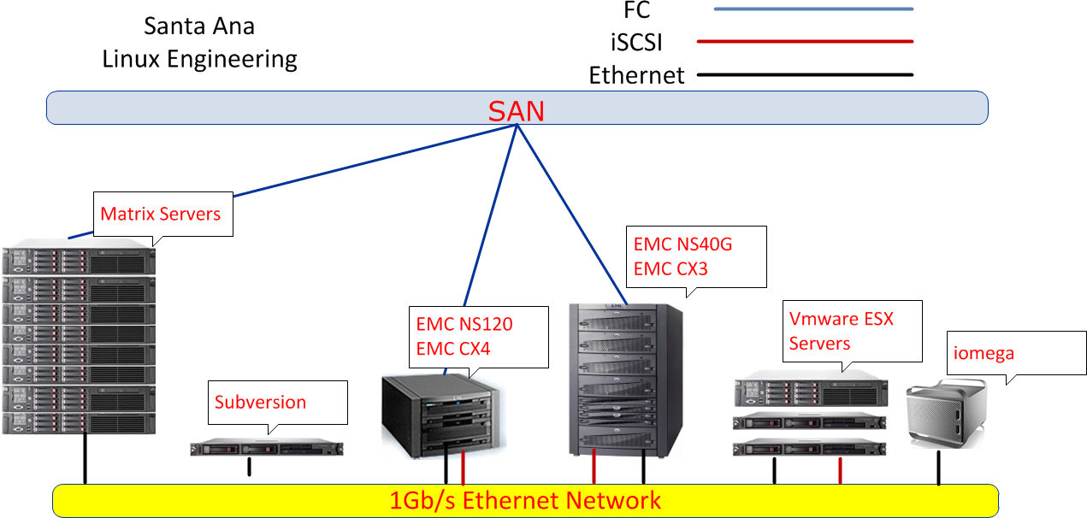
Unnecessary complexity
Uncentralized storage
Inefficient use of processing power
Very basic use of Virtualization advantages
Overloaded login hosts
No High Performance Computing
Non-redundant critical servers

Slide 4
