Slide 1
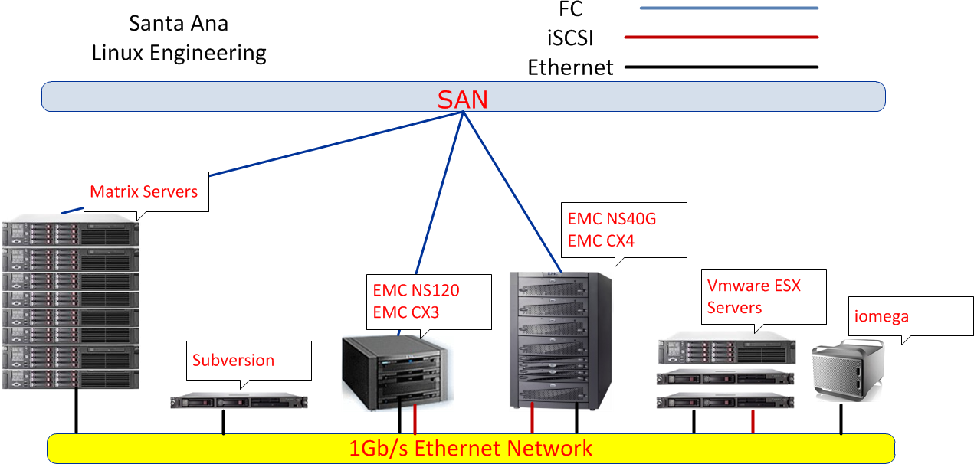
Unnecessary complexity
Uncentralized storage for critical services
Inefficient use of processing power
Very basic use of Virtualization advantages
Overloaded login hosts
No High Performance Computing
Non-redundant critical servers

Slide 2
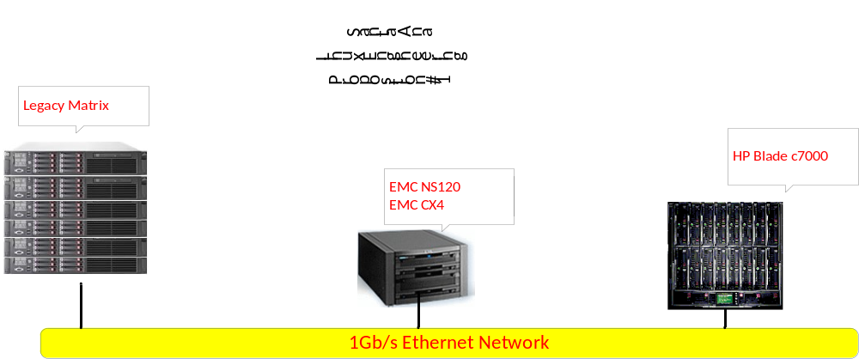
Meets business requirements
Reliable
Reduced complexity
Simple
Scalable
Redundant
Server consolidation
Reduced DC management costs
Improved functionality
Increased performance
Increased ROI
60% space savings
Less energy consumption
Accelerate solution deployment
HPC enabled

Slide 3
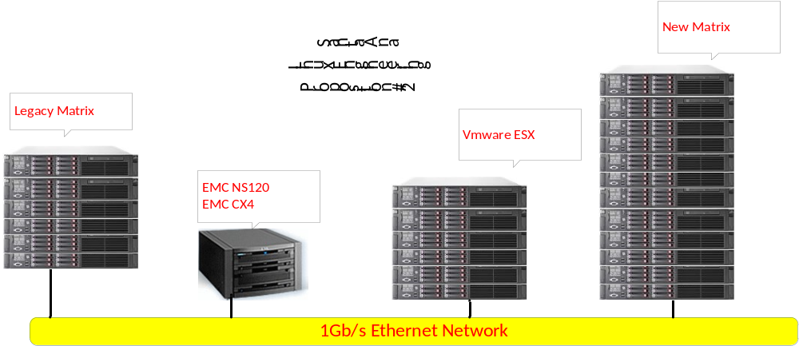
Meets business requirements
Reliable
Reduced complexity
Simple
Scalable
Redundant
Server consolidation
Improved functionality
Increased performance
Increased ROI
HPC enabled

