Slide 1
Summary Input from Engineering
Growing challenges
Concerned about reliability
Issues with uncentralized data
Issues with slowness
Challenges with software installations
Insufficient hardware resources
Insufficient software licenses
No HPC

Slide 2
Engineering Apps and Utilities
Cadence
Synopsys
Denali
ARC
Denali
Matlab
Novas
Mentor
Xilinx
Spotfire
Gmake
Gcc
Svn
Python
Nomachine
VNC
Tcl.TK
Java
Perl
Emacs
VIM

Slide 3
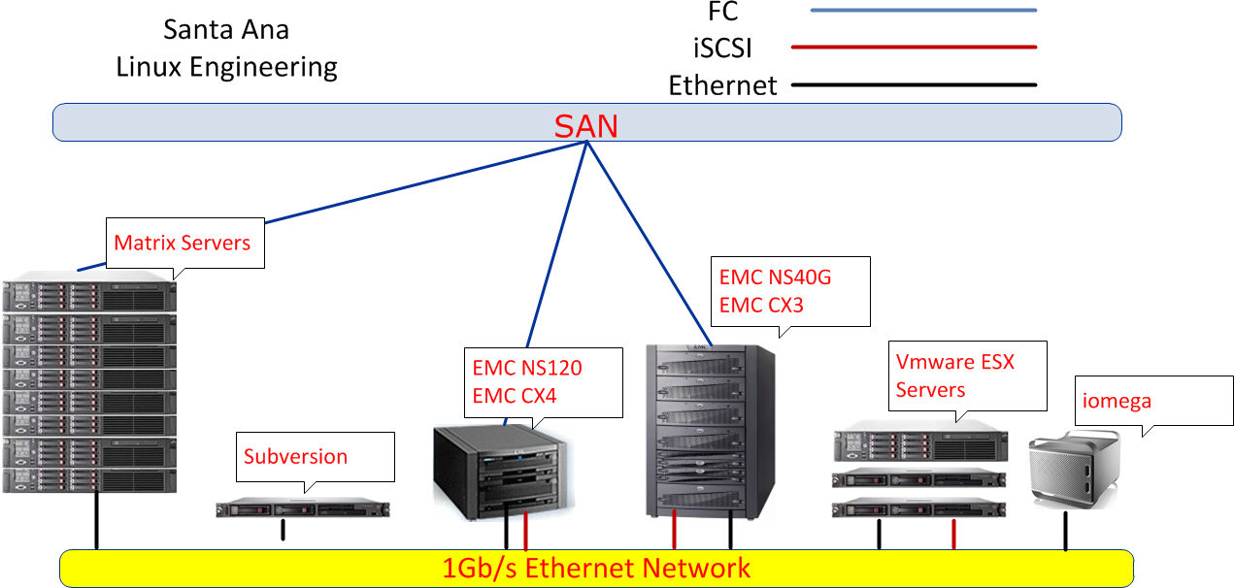
Unnecessary complexity
Uncentralized storage
Inefficient use of processing power
Very basic use of Virtualization advantages
Overloaded login hosts
No High Performance Computing
Non-redundant critical servers

Slide 4
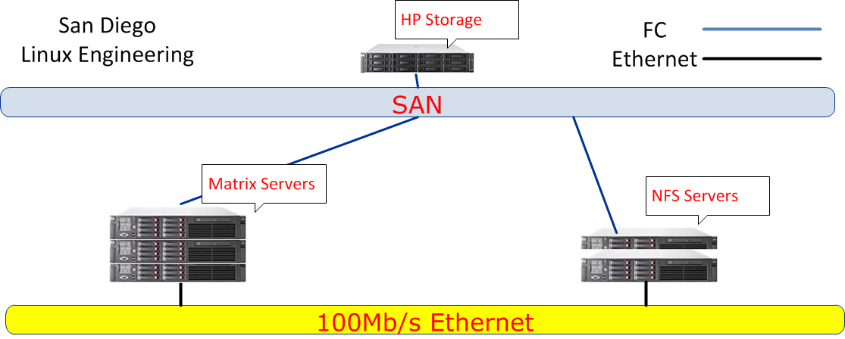

Slide 5
SA Hardware Details
 | Memory (GB) | / (GB) | SWAP (GB) | /localdisk (GB) | /temp (GB) | OS | CPU | Brand | Notes
samatrix01 | 32 | 13 | 66 | 150 | 0 | AS4 U6 | Xeon 5570@2.93Ghz, 16 cores | DL380G6
samatrix02 | 16 | 13 | 5 | 150 | 0 | AS4 U5 | AMD Opteron 270@1.9Ghz. 2 cores | ??Clone?? | License server
samatrix03 | 32 | 13 | 67 | 150 | 0 | AS4 U6 | Xeon 5570@2.93Ghz, 16 cores | DL380G6
samatrix04 | 32 | 13 | 66 | 150 | 0 | AS4 U6 | Xeon 5570@2.93Ghz, 16 cores | DL380G6
samatrix05 | 32 | 13 | 63 | 150 | 0 | AS4 U6 | Xeon 5570@2.93Ghz, 16 cores | DL380G6
samatrix06 | 64 | 13 | 65 | 150 | 0 | AS4 U6 | Xeon 5570@2.93Ghz, 16 cores | DL380G6
samatrix07 | 132 | 13 | 94 | 150 | 0 | AS4 U8 | Xeon 5540@2.53Ghz, 16 cores | DL360G6
samatrix08 | 148 | 13 | 67 | 150 | 0 | AS4 U8 | Xeon 5680@3.3Ghz, 24 cores | DL380G7
sasvn | 2 | 25 | 2 | 0 | 0 | AS4 U5 | Xeon 3050@2.1Ghz, 2 cores | DL320G5
saesx01 | 2 | 5 | 500MB | 0 | 0 | ESX 3.0 | Xeon 3050@2.1Ghz, 2 cores | DL320G5
saesx02 | 6 | 5 | 500MB | 0 | 0 | ESX 3.0 | Xeon 3050@2.1Ghz, 2 cores | DL320G5
saesx03 | 16 | 5 | 5 | 0 | 0 | ESX 3.5 | Xeon 5506@2.1Ghz, 4 cores | DL360G6

Slide 6
SD Hardware Details
 | Memory (GB) | / (GB) | SWAP (GB) | /localdisk (GB) | /temp (GB) | OS | CPU | Brand | Notes
sdmatrix01 | 32 | 8 | 100 | 0 | 0 | AS4 U8 | Xeon 5540@2.53Ghz, 16 cores | DL360G6
sdmatrix02 | 32 | 8 | 10 | 0 | 0 | AS4 U8 | Xeon 5540@2.53Ghz, 16 cores | DL360G6 | License server
sdmatrix03 | 32 | 100 | 34 | 0 | 0 | AS4 U8 | Xeon 5540@2.53Ghz, 16 cores | DL360G6
sdnfs01 | 3 | 70 | 5 | 959 | 0 | RHEL 5.4 | Xeon 5140@2.3Ghz, 2 cores | DL380G6
sdnfs02 | 4 | 17 | 15 | 0 | 0 | AS4 U8 | AMD Opteron@2.8Ghz, 4cores

Slide 7
TW Hardware Details
 | Memory (GB) | / (GB) | SWAP (GB) | /localdisk (GB) | /temp (GB) | OS | CPU | Brand | Owner
twmatrix01 | 32 | 60 | 34 | 160 | 50 | AS4 U5 | Xeon 2.83x8 | HP DL380G5 | Franco Huang;Willis Chen(2)
twmatrix02 | 32 | 60 | 34 | 150 | 50 | AS4 U5 | Xeon 2.83x8 | HP DL380G5 | Willis Chen(1); Danny's team* (1)
twmatrix03 | 64 | 60 | 66 | 150 | 50 | AS4 U5 | AMD Opteron 2353x8 | HP DL385G2 | Vladimir (for internal synthesis trial run) Joe Shih (FPGA)
twmatrix04 | 64 | 60 | 66 | 150 | 50 | AS4 U5 | AMD Opteron 2353x8 | HP DL385G2 | David Lee(1)
twmatrix05 | 64 | 60 | 64 | 150 | 50 | AS4 U5 | AMD Opteron 2353x8 | HP DL385G2 | David Lee(4)
twmatrix06 | 32 | 60 | 34 | 160 | 50 | AS4 U5 | AMD Opteron 2353x8 | HP DL385G2 | David Lee(2)
twmatrix07 | 32 | 60 | 34 | 172 | 50 | AS4 U5 | AMD Opteron 2353x8 | HP DL385G2 | Public for architecture team and implementation team
twmatrix08 | 32 | 60 | 35 | 172 | 50 | AS4 U7 | AMD Opteron 2832x8 | HP DL385G5p | Chita Li
twmatrix09 | 32 | 60 | 35 | 172 | 50 | AS4 U7 | AMD Opteron 2832x8 | HP DL385G5p | Wei Ting;David Lee(3)
twmatrix10 | 32 | 60 | 34 | 172 | 50 | AS4 U5 | Xeon 3.0x4 | HP DL380G5 | Danny's team* (2)
twmatrix11 | 32 | 60 | 34 | 148 | 50 | AS4 U5 | AMD Opteron 2220x4 | HP DL380G5 | Chita Li
twmatrix12 | 64 | 35 | 68 | 150 | 25 | AS4 U8 | Xeon E5540x2 | HP DL360G6 | David(5)
twmatrix13 | 64 | 20 | 409 | none | share with / | AS4 U8 | Xeon E5540x2 | HP DL360G6 | David(6)
twmatrix14 | 64 | 20 | 409 | none | share with / | AS4 U8 | Xeon E5540x2 | HP DL360G6 | David(7)
twmatrix15 | 96 | 20 | 409 | none | share with / | AS4 U8 | Xeon E5540x2 | HP DL360G6 | David(8)

Slide 8
MY Hardware Details
 | Memory (GB) | / (GB) | SWAP (GB) | /localdisk (GB) | /temp (GB) | OS | CPU | Brand | Owner
mymatrix01 | 16 | 13 | 2 | 150 | 0 | AS4 U5 | Xeon 3x4 | DL380G5
mymatrix02 | 16 | 13 | 16 | 150 | 0 | AS4 U6 | AMD Opteron 2220x4 | DL385G2
mymatrix03 | 16 | 13 | 16 | 150 | 0 | AS4 U6 | AMD Opteron 2220x4 | DL385G2
mymatrix04 | 16 | 13 | 16 | 150 | 0 | AS4 U5 | AMD Opteron 2220x4 | DL385G2
mymatrix05 | 32 | 13 | 16 | 150 | 0 | AS4 U6 | AMD Opteron 2356x8 | BL465CG5
mymatrix06 | 32 | 13 | 2 | 150 | 0 | AS4 U6 | AMD Opteron 2356x8 | BL465CG5
mymatrix07 | 64 | 13 | 16 | 150 | 0 | AS4 U6 | AMD Opteron 2356x8 | BL465CG5
mymatrix08 | 64 | 13 | 16 | 150 | 0 | AS4 U6 | AMD Opteron 2356x8 | BL465CG5

