Slide 1
Application Performance Management for Virtualized Applications Systems
Bernd Harzog
CEO, Applications Performance Management Experts
bernd.harzog@apmexperts.com

Slide 2
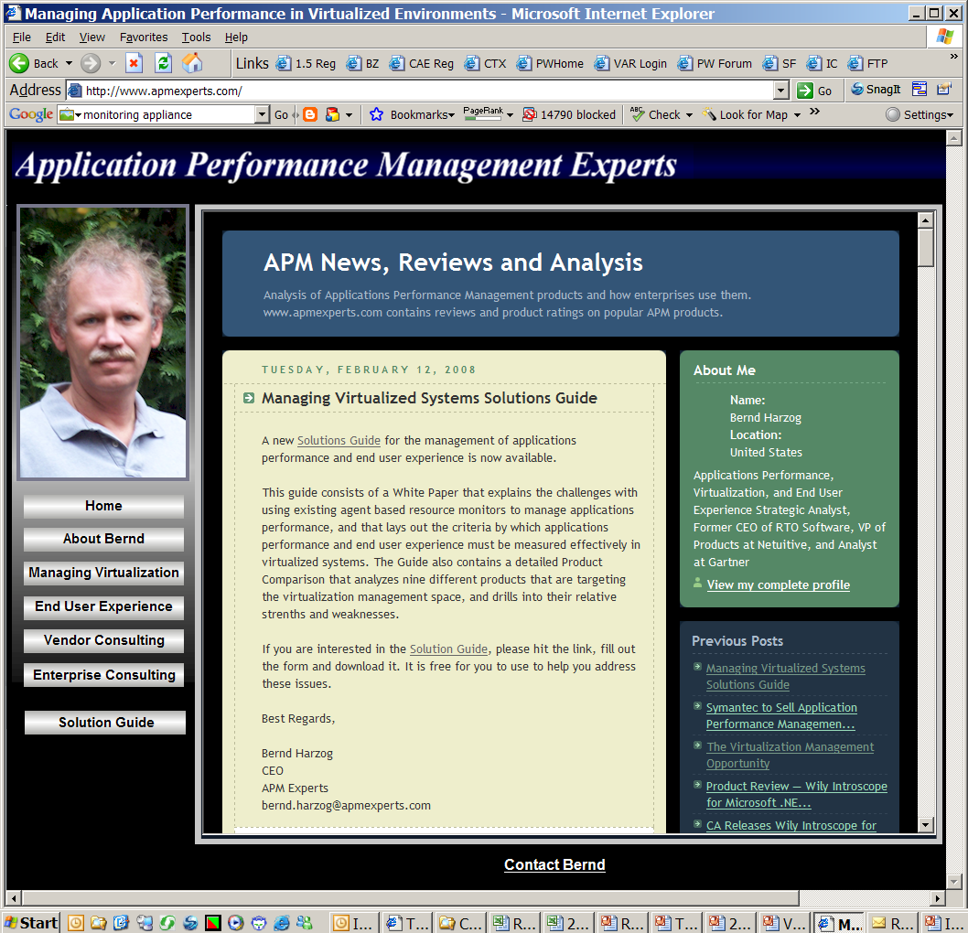
Bernd Harzog — APM Experts www.apmexperts.com
Analysis and Consulting Firm Focused upon:
  Applications Performance Management
  End User Experience Management
  Management of Virtualized Applications Systems
Clients include vendors offering
solutions in this market, and
enterprises seeking APM solutions
Key Findings
  Despite billions of dollars spent on
  infrastructure monitoring solutions,
  applications performance and user
  experience remain largely unsolved
  problems
  Incumbent management framework
  vendors are not leading the charge
  Virtualizing servers and desktops
  creates an entire new set of
  problems

Slide 3
What Exactly is Applications Performance Management?
Old Definition (Performance = Resource Usage)
  Monitor the environment supporting the application
  Monitor how the application is using the key resources in the environment (CPU, Memory, Network, Storage)
  Build an understanding of “normal” resource usage
  Monitor the availability of the environment
  Alert when resource usage is above normal or a component becomes unavailable
New Definition (Performance = Response Time)
  Monitor the response time of the production application system to requests made by users or other applications
  Understand user behavior within the application
  Focus upon performance received and performance achieved

Slide 4
APM, ITIL, SLM and BSM
Buzzword Decode
BSM – Business Service Management – the idea that the business buys “services” from IT
ITIL – a methodology for organizing processes in IT
SLM – Service Level Management – the high level way to measure the quality of the service that IT is delivering
APM – the details of measuring the performance of the applications that are the subject of SLM agreements, and BSM contracts.
The new APM is essential in order to be able to deliver SLM, and BSM
Service Requests
Service Contracts
Service Costs
SLAs
SLAs
Cost Aggregation
Service Metrics
(usage, availability, response time, etc)
Data Collection
Data Mediation
External Systems

Slide 5
Application Performance Management – Before Virtualization
Frameworks
Resource Monitoring Agents on Servers
Agentless Server and Network Monitoring
IT Correlation
J2EE and .Net Applications Management
HTTP Appliances
Synthetic Transactions
End User PC Agents

Slide 6







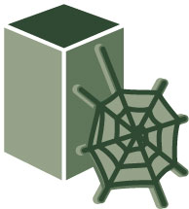
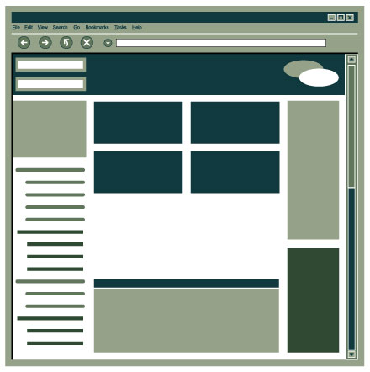




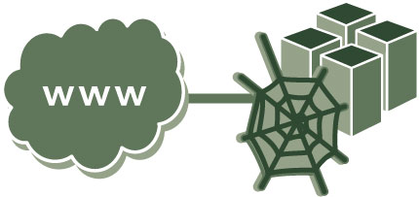


Frameworks
Frameworks measure availability of the infrastructure not degradations in response time.
SAP
PSFT
Siebel
Key Vendors:
CA
IBM
HP (Mercury)
BMC
Load Balancer
Network
Firewall
Switch
Portal
Mainframe
Router
Database
Web
Servers
Applications
Web Services
Databases
Advantages:
Work for every application
Are the well understood
incumbent method
Disadvantages:
Don’t measure response time
Miss the end user perspective
Get broken by the
virtualization process
3rd Party Applications

Slide 7
Server Based Agents
Server agents measure the key resources (CPU, Memory, Disk I/O, Disk Capacity, and Network I/O) used by each application. Performance problems are related to misuse of resources, not degradations in response time.
Agent
SAP
Agent
PSFT
Agent
Agent
Siebel
Key Vendors:
CA
IBM
HP (Mercury)
BMC
NetIQ
Load Balancer
Agent
Agent
Network
Firewall
Switch
Portal
Mainframe
Router
Database
Web
Servers
Applications
Agent
Web Services
Databases
Agent
Advantages:
Work for every application
Are the well understood
incumbent method
Disadvantages:
Don’t measure response time
Miss the end user perspective
Get broken by the
virtualization process
3rd Party Applications
Agent

Slide 8
Agentless Server and Network Monitoring
A probe uses WMI and SNMP to collect data from agents built into servers and network devices
SAP
PSFT
Key Vendors:
Microsoft (SCOM)
HP (Sitescope)
What’s Up Gold
Cittio
Load Balancer
Network
Firewall
Switch
Portal
Mainframe
Router
Database
Web
Servers
Applications
Monitoring Station
Web Services
Databases
Advantages:
Work for every application
Are the well understood
incumbent method
Disadvantages:
Don’t measure response time
Miss the end user perspective
Get broken by the
virtualization process
3rd Party Applications

Slide 9
IT Correlation
Correlate data from many products – learn normal patterns – abnormal patterns are “problems”
SAP
PSFT
Key Vendors:
Netuitive
Integrien
ProactiveNet
(BMC)
Load Balancer
Network
Firewall
Switch
Portal
Mainframe
Router
Database
Web
Servers
Applications
Correlation Engine
Web Services
Databases
Advantages:
Horizontal across a wide range
of products and environments
Automate alarm management
Disadvantages:
Use data from other products
Have no virtualization specific
data or features
Are trying to sell “Analytics”
3rd Party Applications

Slide 10
J2EE and .Net Applications Management
These products measure web server response time, and dive deeply into the J2EE applications server or .Net applications server supporting the business rules layer of the application.
SAP
PSFT
Agent
Siebel
Key Vendors:
CA (Wily)
IBM
HP (Mercury)
Compuware
Symphoniq
Load Balancer
Agent
Network
Firewall
Switch
Portal
Mainframe
Router
Database
Web
Servers
Applications
Web Services
Databases
Advantages:
Work for every J2EE or .Net
web application
Provide drill down diagnostics
into application and DB layers
Disadvantages:
Only work for certain web
applications
Typically very expensive
Get broken by the
virtualization process
3rd Party Applications

Slide 11
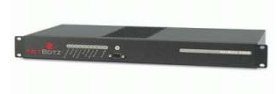
HTTP Appliances
HTTP appliances sit on a mirror or spanned port of the switch that supports the load balancers and web servers. They see every HTTP transaction, and measure its response time.
SAP
PSFT
Request
Siebel
Key Vendors:
CA (Wily)
Coradiant
HP (Mercury)
Compuware
Load Balancer
Network
Firewall
Switch
Portal
Mainframe
Router
Database
Web
Servers
Applications
Response
Web Services
Databases
Advantages:
Work for every web app
See true response times
at the web server
Are not impacted by
virtualization
Disadvantages:
Every transaction must be
defined
Miss the end user perspective
Only work for HTTP/S apps
3rd Party Applications

Slide 12
Synthetic Transaction Scripts
Script agents are installed on selected desktops. Key transactions are run before users start the work day. Allows for verification of key processes before they are needed in production.
SAP
PSFT
Script
Siebel
Key Vendors:
HP (Mercury)
Compuware
IBM (Tivoli)
Tevron
Borland (Segue)
Load Balancer
Network
Firewall
Switch
Portal
Mainframe
Router
Database
Web
Servers
Applications
Script
Web Services
Databases
Advantages:
Measure response times
and transaction times
Provide pre-emptive
monitoring and diagnostics
Disadvantages:
Script creation/maintenance
Simulation, not user reality
Get broken by VDI
3rd Party Applications

Slide 13
End User PC Based Agents
End user PC based agents sit on the actual end user workstations. Some (Knoa) have deep understanding of actual applications and transactions. Others mainly measure the resources used by applications on desktops
SAP
PSFT
Agent
Siebel
Key Vendors:
Knoa
Symphoniq
Aternity
Serden
Load Balancer
Network
Firewall
Switch
Portal
Mainframe
Router
Database
Agent
Web
Servers
Applications
Web Services
Databases
Advantages:
Measure true response times
and transaction times
Provide a true end user
perspective
Disadvantages:
Are only available for a
limited number of applications
Require agents on desktops
Get broken by VDI
3rd Party Applications

Slide 14
APM with Virtualized Application Systems
APM was not a solved problem before you virtualized
APM was becoming both more important (due to BSM), and more difficult (due to rapid change in applications systems) before you virtualized
Everyone wants more virtualization (and more ROI) more quickly
Virtualization creates some new APM challenges – and requires some new approaches

Slide 15
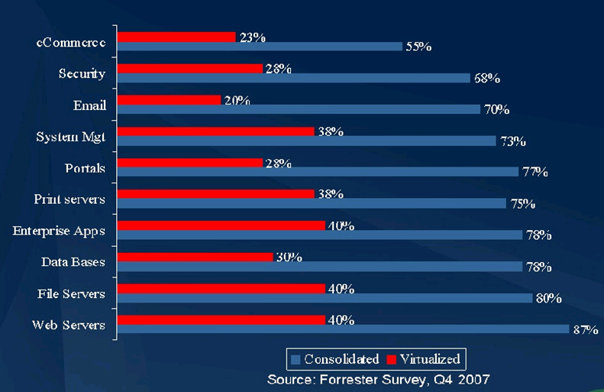
How Virtualized Are You?

Slide 16
New Problems Created by Virtualization
Time Shift (Clock Drift)
  Time based measurements taken within a VM Guest will be shifted by the degree to which that Guest is scheduled out by the host
More moving parts (hypervisor, app streaming, etc.)
  Example – If you stream an app to a Guest instance of XP and the app loads slowly, where in the bottleneck?
Dynamic Guest instantiation and location
  Understanding of “normal” based upon a static physical environment for an APM agent no longer works
Density creates new bottlenecks
  Concentrated load is now placed upon Networks and the SAN
VDI breaks end user response time measurement
  Example – counting response time to a transaction at the desktop no longer works

Slide 17
New Approaches Needed in APM for Virtualized Systems
Resource based APM no longer works
Response time becomes the critical measure of service
Response time needs to be measured “from the outside in”
Both response time between Guests within a Host, and between Guests on different Hosts needs to measured
SAN contention and configuration bottlenecks need to be exposed
Virtualization platform vendors (VMware, Microsoft, Citrix) will provide products that manage their platforms
Additional products will be needed to measure applications service level, response time and end user experience

Slide 18
Virtualization Aware Approaches
APM products must now monitor response time within hosts (between guests), and between hosts, without falling prey to measurement corruption due to clock sharing and time drift.
SAP
VMhost#1
PSFT
Siebel
Key Vendors:
HTTP Appliances
Akorri
vmSight
Network
Firewall
Switch
Portal
Mainframe
Load Balancer
Router
Database
Web
Servers
Applications
Web Services
VDI
VMhost#4
VMhost#2
Databases
Advantages:
Focus upon virtualized
applications, operating systems,
and storage arrays
Are not broken by the
virtualization process
Disadvantages:
The need to sell Management
on the need for yet another
monitoring solution
3rd Party Applications
VMhost#3

Slide 19
HTTP Appliances
APM products must now monitor response time within hosts (between guests), and between hosts, without falling prey to measurement corruption due to clock sharing and time drift.
SAP
VMhost#1
PSFT
Request/
Response
Siebel
Key Vendors:
CA (Wily)
Coradiant
HP (Mercury)
Compuware
Network
Firewall
Switch
Portal
Mainframe
Load Balancer
Router
VMhost#4
Database
Web
Servers
Applications
Web Services
VDI
VMhost#2
Databases
Advantages:
Work for every web app
See true response times
at the web server
Are not impacted by
virtualization
Disadvantages:
Every transaction must be
defined
Miss the end user perspective
Miss req./resp. within a Host
Only work for HTTP/S apps
3rd Party Applications
VMhost#3

Slide 20
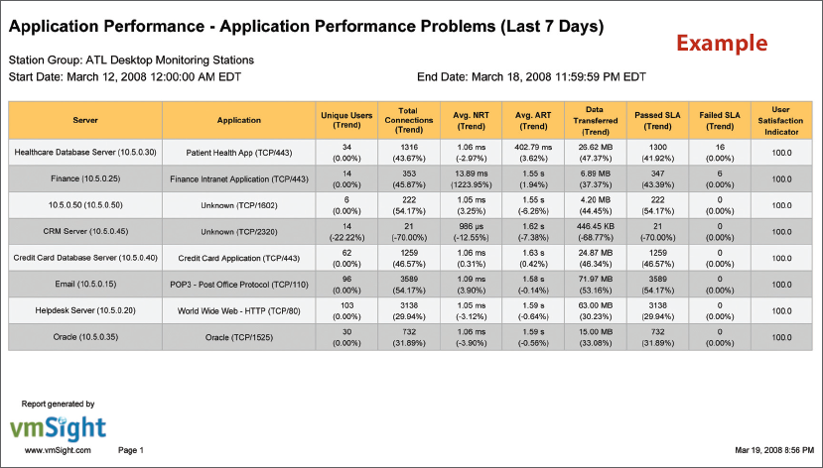
vmSight
Connector ID: patented method to identify users and applications in network packets
Monitoring Stations: Virtual appliance in each VMware Host connected to a virtual switch
vmSight Center: Virtual appliance for monitoring and reporting
Unique Metrics
  Application Response Time
    By Application
    By User
  User Satisfaction Indicator
  Network Response Time

Slide 21
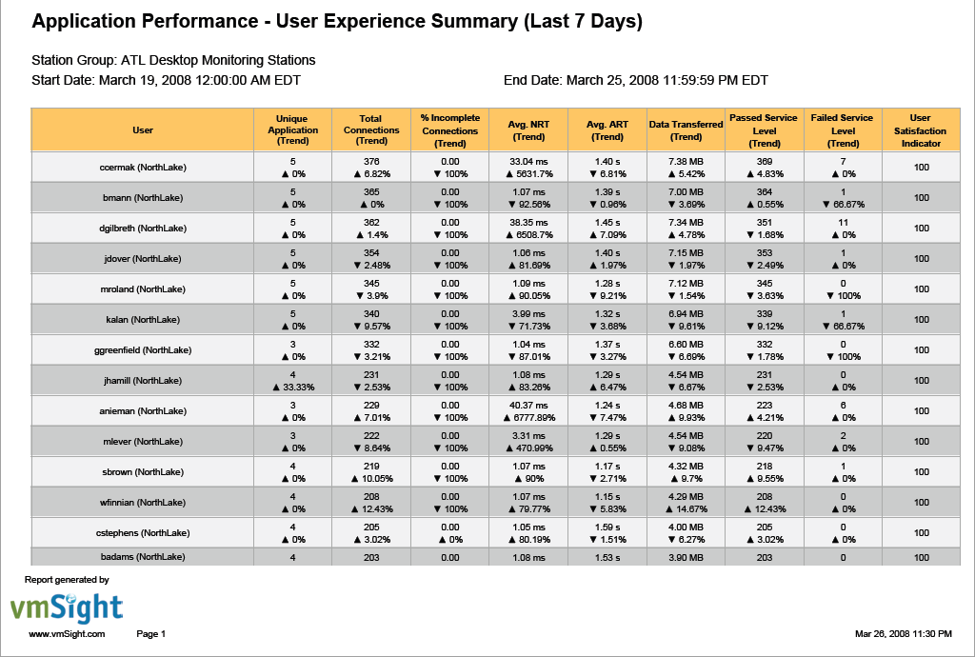
vmSight

Slide 22
Questions?

Slide 23
Thank You

