Slide 1


Pros and Cons of Licensing/Pricing Models
Jill H. Jones, J.D.
Freescale Semiconductor, Inc.
EDA Contract Manager
jill.jones@freescale.com
Logo Area for
Speaker

Slide 2
Pros of the Perpetual License
Perpetual usage right (pay once, run forever
or at least 20 years)
High return on investment (ROI) if software used more than a few years and is a major software solution
Ability to bail out of annual maintenance
One time negotiation (in theory)

Slide 3

Cons of the Perpetual License
Large upfront payment
Licensed but unused software
Stiff annual maintenance fees
Must buy upgrades
No access to new technology
Limited or no remix provision

Slide 4
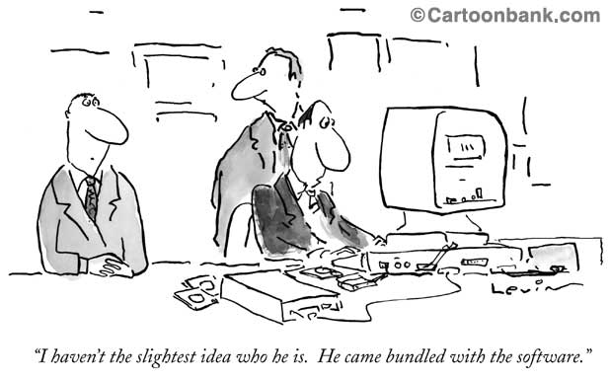

Slide 5

Pros of the Subscription
License for Vendor
Predictable revenue stream
Bundle into one fee:
  Right to software
  Automatic updates
  Postcontract customer support (PCS)
Opportunity to expand business

Slide 6

Pros of Subscription
License for Customer
Lower up front cost
Manage cash flow (budget)
Flexibility with shorter licensing period
Remix allowed
Switch to another vendor
  If business value lacks (unused software)
  If technology needs change

Slide 7

Cons of Subscription
License for Vendor
Must sell value on an ongoing basis
Less revenue upfront

Slide 8
Cons of Subscription
License for Customer
Possible higher cost; Higher renewal rates
Administrative costs increase with frequent renewals for multiple vendors

Slide 9

Goldilocks Theory of
Software Licensing
Not too much, not too little, but just right
How to determine the actual need?
Usage tracking
Global float allows effective use of licenses 24/7 for distributed engineering design
Remember: you can buy more but cannot give back

Slide 10

Goldilocks Continued
EDA ideal: charged only when the tool is used
Utility model; Pay as you go
Challenges
  Revenue recognition
  Budget forecasting
  Procurement approval cycle

Slide 11

“Just Right” is Hard in the EDA World
More complex and new designs = more complex and expensive EDA tools
Customer growth or reduction in employees
  Divestiture clause in license agreement
  Mechanism to add licenses at favorable rate
Vendor mergers or acquisitions
  Software disappears
  Bundling into new products (new costs!)

Slide 12
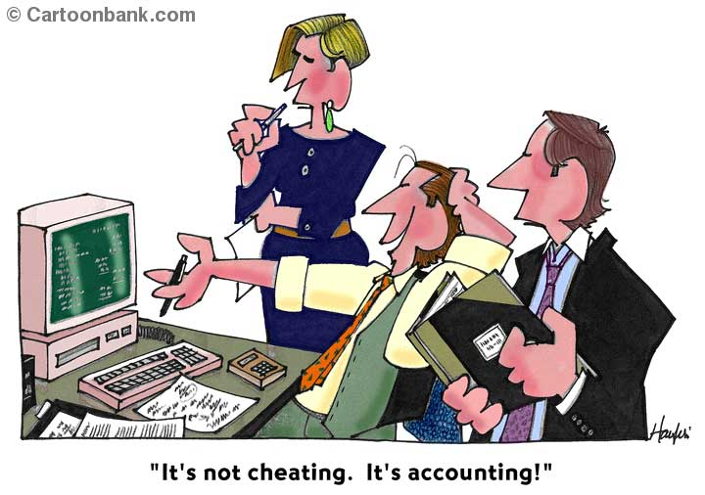

Slide 13
What is Software Revenue Recognition?
Generally accepted accounting principles (GAAP) for integrity of financial statements
Software companies strive to recognize revenue as soon as possible to meet quarterly guidance
Recognizing revenue too early
  Overstate revenue
  Computer associates: executives indicted for backdating contracts; CEO resigns; Stock plummets

Slide 14
Four Elements Required to Recognize Revenue
1. Persuasive evidence of an arrangement exists
    Written contract signed by both parties
    No side agreements or special deals
2. Delivery has occurred
    Electronic delivery of license keys (access code)
    Customer takes immediate possession of software

Slide 15

Four Elements Continued
3. Fee is fixed or determinable
    Extend beyond 12 months after delivery?
    Overcome by showing history of collecting fees under extended payment terms
4. Collectibility is probable
    Demonstrate successful payment history
    Assign a credit limit for new customer

Slide 16
Optimize Revenue Stream: Recognize Revenue Upfront
Clearly state in contract when delivery will occur and where
Acceptance occurs upon delivery
Most of payment must occur within 12 months of delivery
None of the license fee can be refundable
Multi element contract – software and services as single arrangement

Slide 17
Optimize Revenue Stream: Recognize Revenue Upfront
Unspecified upgrades allowed as part of maintenance
No future software products (can buy more of same products); No new technology
No return of products; Remixes (exchange) allowable
Warranties cannot be viewed as cancellation rights

Slide 18

Business Needs Drive the License Model
Corporate business need drives the license model
Technology matters but is secondary
Vendor: immediate revenue recognition bolsters cash flow
Customer: return on investment (ROI) and business value = software not lying idle

Slide 19
Perpetual License Model
ISSUES | PERPETUAL
Duration | Long, 20-99 yrs
Payment terms | Min. 75% w/in 1 yr
Revenue | Up front in full
New Technology | None
Maintenance | Separate fee
Future Business | Minimized

Slide 20
Term License Model
ISSUES | TERM
Duration | 3 - 5 yrs
Payment terms | Min. 75% w/in 1 yr
Revenue | Up front in full
New Technology | None
Maintenance | Separate fee
Future Business | Increased by renewal

Slide 21
Time Based License (TBL)/Subscription Model
ISSUES | TBL/SUBSCRIPTION
Duration | 3 - 5 yrs
Payment terms | Extended payment
Revenue | Ratably over term
New Technology | Current book price
Maintenance | Bundled into fee
Future Business | Increased by renewal

Slide 22
Similarities and Differences
ISSUES | PERPETUAL | TERM | TBL SUBSCRIPTION
Duration | X | √ | √
Payment terms | √ | √ | X
Revenue | √ | √ | X
New Technology | √ | √ | X
Maintenance | √ | √ | X
Future Business | X | √ | √

Slide 23
How The EDA License
Model Works
$3M TBL subscription license for 3 years = revenue recognized $1M per year for 3 years
$3M term license = $3M recognized upon delivery
$5M perpetual license = $5M recognized upon delivery

Slide 24
Lessons Learned
Customer must sell management on the technology deal by emphasizing business value ROI aka“what’s in it for us?”
Customer can increase ROI by leveraging vendor’s end of quarter revenue needs.
Vendor must engage customer’s finance, business, legal, and technology teams early in the deal and show ROI.
Vendor needs to explain contract terms in view of revenue recognition requirements.
jill.jones@freescale.com

