Slide 1
Image Recovery in the Infrared Domain via Path-Augmented
Compressive Sampling Matching Pursuit
CVPR 2019
Perception Beyond the Visible Spectrum
June 16, 2019
Tegan H. Emerson*, Colin C. Olson, Anthony Lutz
US Naval Research Laboratory
Optical Sciences
Washington, DC

Slide 2
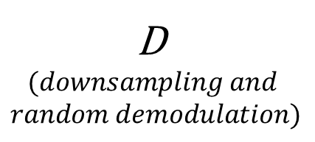
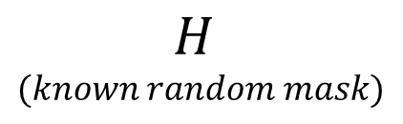
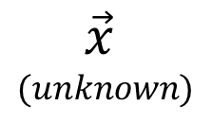
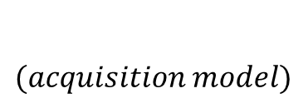
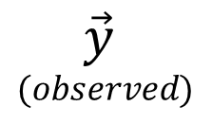
Motivation and Acquisition Model
$$(acquisition model)$$
Motivation: The cost of high-res IR focal plane arrays is prohibitive and labeled high-res IR images are rare
FL
FL
FL
FL
$$\vec{y}$$
$$(observed)$$
D
$$(downsampling and$$
$$random demodulation)$$
$$\vec{x}$$
$$(unknown)$$
$$H$$
$$(known random mask)$$
Fourier Plane
Goal: Use our knowledge of the acquisition model together with the theory of compressive sensing to recover higher-resolution images from lower-resolution focal plane arrays

Slide 3
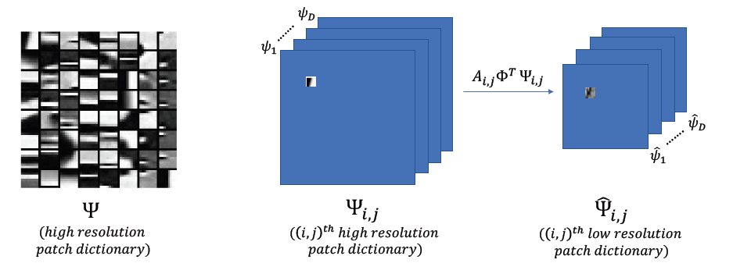
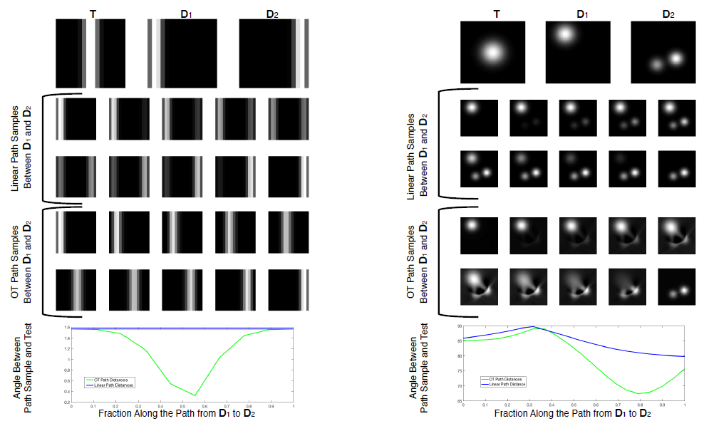








Path-Augmented Image Recovery
Builds on the foundation of the well-known CoSaMP algorithm
Uses a path-augmentation step to search for more representative atoms
$$ψ_{1}$$
$$ψ_{∗}$$
$${\hat{ψ}}_{1}$$
$${\hat{ψ}}_{∗}$$
$$A_{i,j}Φ^{T}$$
t=0
…..
t= $t_{∗}$
$${\hat{ψ}}_{2}$$
$$ψ_{2}$$
t=1
…..
Samples along the 2-Wasserstein geodesic between the two most-correlated high-resolution dictionary patches.

Slide 4
Results and Future Directions
We compared PAIR to standard CoSaMP using three different performance metrics: PSNR, SSIM, and PEA which is a measurement of the edge fidelity between the true and the recovered image.
For all three metrics PAIR yields improved performance for low sparsity levels.
Results were obtained utilizing an unsophisticated patch-stitching algorithm, we believe better stitching will improve overall performance.
In future we’ll compare PAIR to deep learning frameworks for high-resolution image recovery.

