Slide 1



Borrow from Anywhere Pseudo Multi-modal Object Detection in Thermal Imagery Chaitanya Devaguptapu¹, Ninad Akolekar¹, Manuj M Sharma², Vineeth N Balasubramanian¹ ¹Indian Institute of Technology, Hyderabad, INDIA
²ANURAG-DRDO, INDIA

Slide 2
Key Ideas
The Need
Proposed Method
Thermal datasets low quality, small in size (95K images, KAIST)
Leverage large-scale RGB datasets
Paired RGB-Thermal data hard to collect
Can we generate RGB from thermal? How to use?
Should work with SOTA object detectors.
Borrow useful features from rich domains like RGB (9M images, Open Images)
Operate even when there are no paired thermal-RGB images
Generate pseudo RGB using GANs
Use multi-modal approach for object detection
Can be extended to any region CNN based object detector
Devaguptapu et al, Borrow from Anywhere, CVPRW PBVS 2019

Slide 3
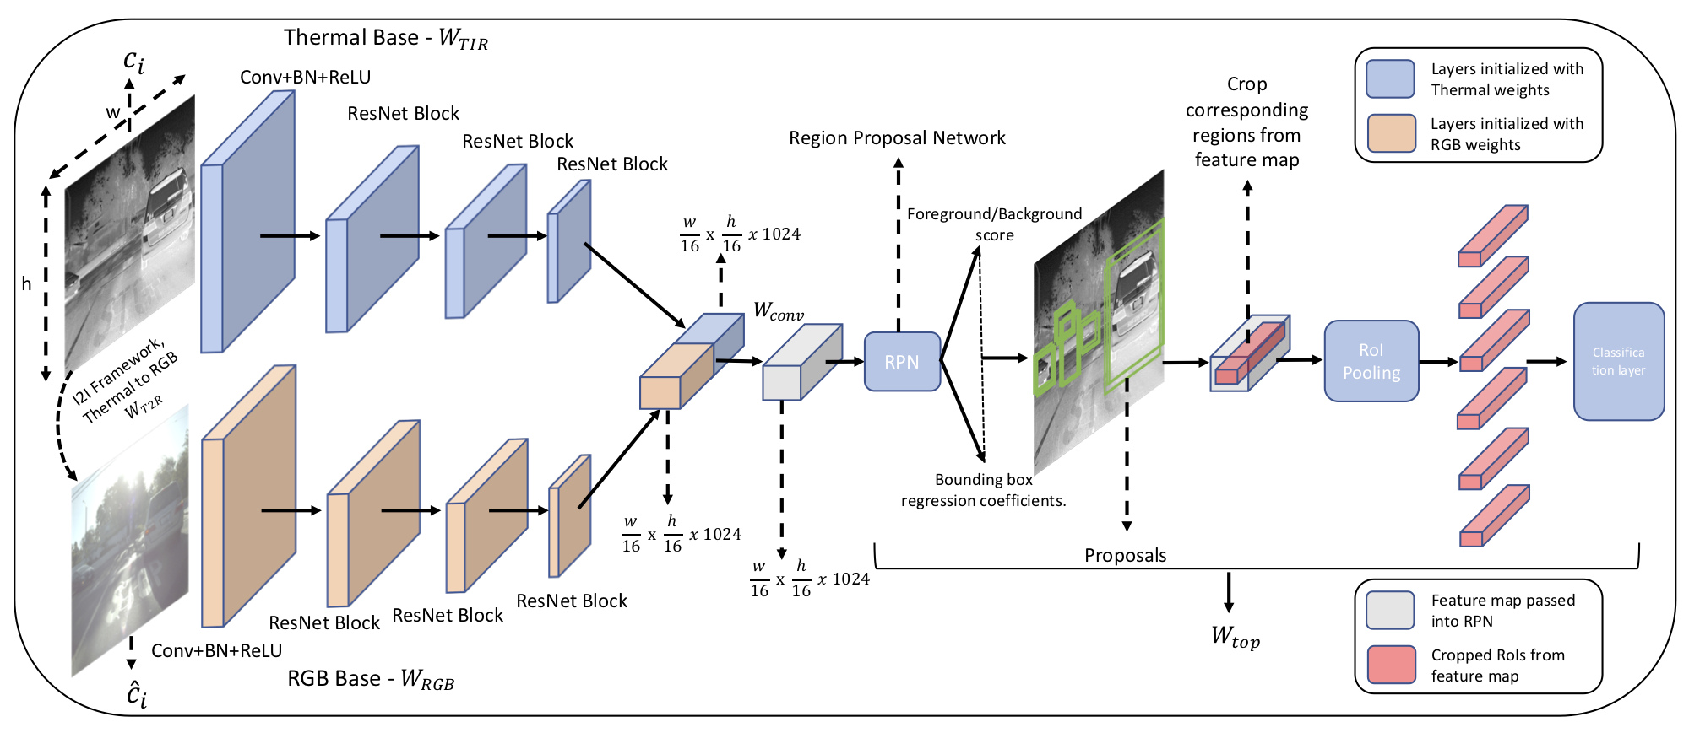
Proposed MMTOD Framework
Devaguptapu et al, Borrow from Anywhere, CVPRW PBVS 2019

Slide 4
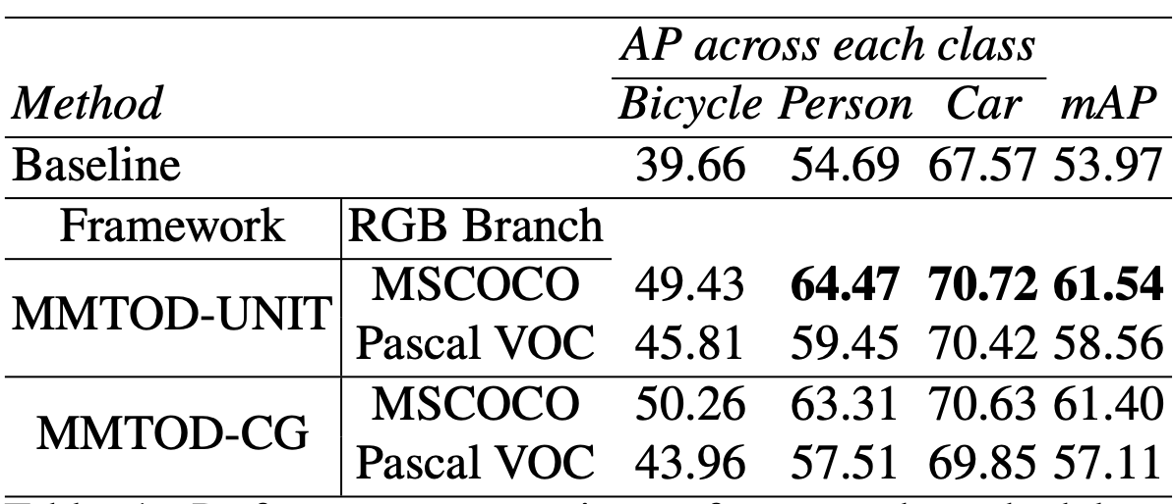
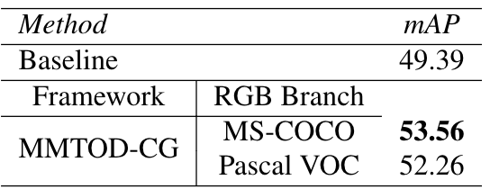
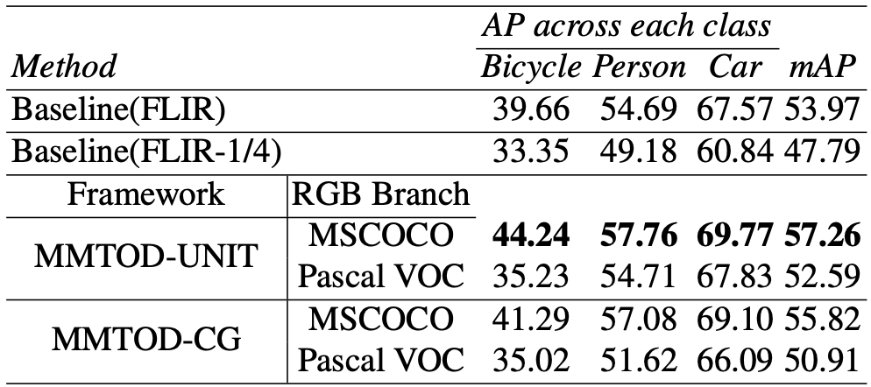
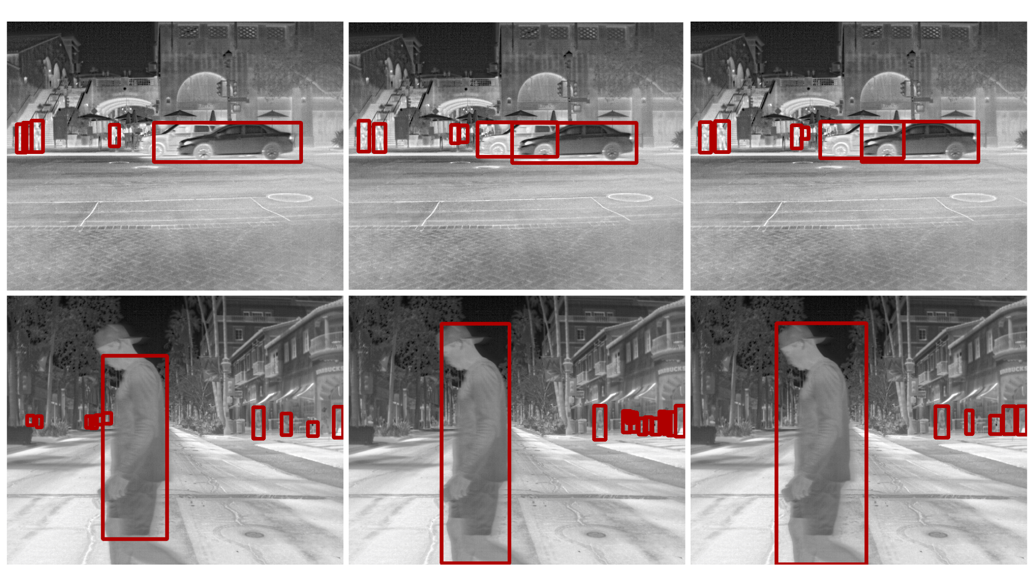
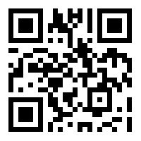
Results
Questions? Visit our poster, or
email us at
chaitanyadevaguptapu@iith.ac.in
or
vineethnb@iith.ac.in
Paper Link:
Results on KAIST dataset
Results on FLIR ADAS dataset
Single mode
MMTOD
GroundTruth
Results on using ¼ FLIR ADAS training set
arXiv id: 1905.08789
Devaguptapu et al, Borrow from Anywhere, CVPRW PBVS 2019

