Slide 1
Generative Adversarial Networks for Spectral Super-resolution and Bidirectional RGB-to-multispectral Mapping
Kin Gwn Lore¹, Kishore Reddy¹, Michael Giering¹, Edgar A. Bernal²
¹{lorek, reddykk, gierinmj}@utrc.utc.com
²edgar.bernal@rochester.edu
¹ United Technologies Research Center
411 Silver Lane, East Hartford CT 06018
² University of Rochester
260 E. Main St., Rochester NY 14604
PBVS 2019 Workshop – CVPR 2019 – Long Beach
June 16, 2019

Slide 2
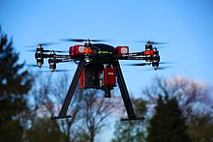
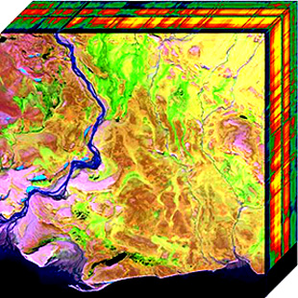
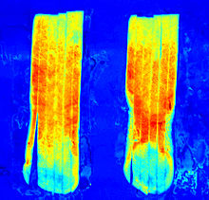
Introduction
RGB/Low-Res MSI to Hi-Res MSI
Problem: Full multispectral data cube may be expensive to obtain. Can we construct a “virtual sensor” to map RGB images to spectral information?
Solution: Multispectral image estimation from RGB image frames / low-res MSI
Benefits: Cost savings, less restrictive storage requirements
Hi-Res MSI to RGB
Problem: How to effectively fuse MSI images and represent RGB with good perceived visuals & RGB information?
Solution: Learn to fuse MSI into RGB with GANs
Benefits: Good visuals, good information content in each RGB channel for analysis tasks
Hyperspectral camera embedded on OnyxStar HYDRA-12 UAV from AltiGator.
Courtesy of Cargyrak, Creative commons license.
Aerial Hyperspectral Imaging
Courtesy of Dr. Nicholas M. Short, Sr. - NASA http://rst.gsfc.nasa.gov/ (Public domain)
Spectral imagining of potato strips showing invisible defects
Courtesy of SortingExpert. Creative Commons license.

Slide 3
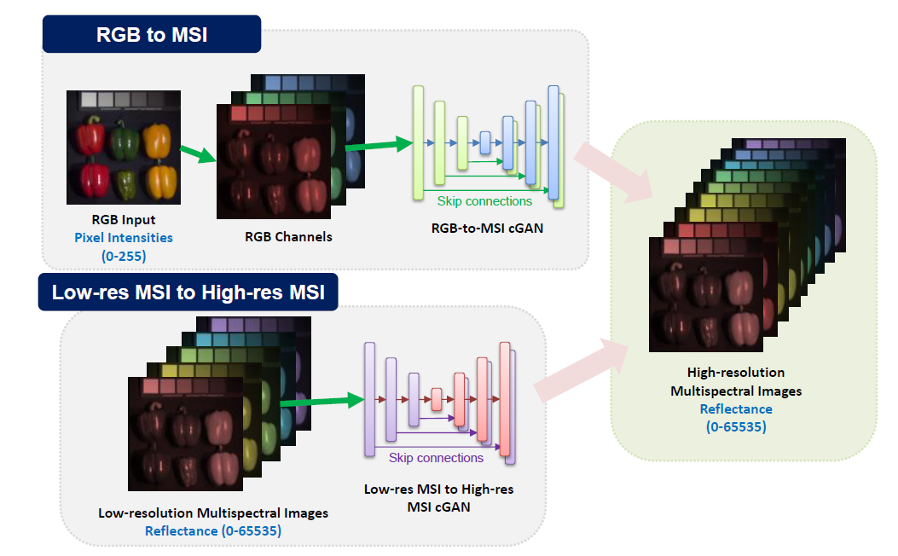
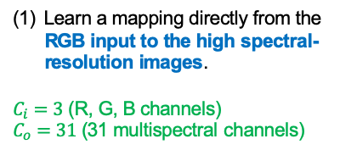
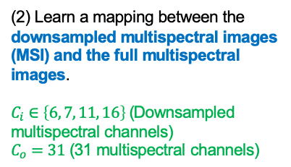
Problem Formulation
Source Domain: Pixel Intensity (0-255)
Learn a mapping directly from the RGB input to the high spectral-resolution images.
$C_{i}=3$ (R, G, B channels)
$C_{o}=31$ (31 multispectral channels)
(2) Learn a mapping between the downsampled multispectral images (MSI) and the full multispectral images.
$C_{i}∈\left\{6, 7, 11, 16\right\}$ (Downsampled multispectral channels)
$C_{o}=31$ (31 multispectral channels)
Source Domain: Reflectance (0-65536)

Slide 4
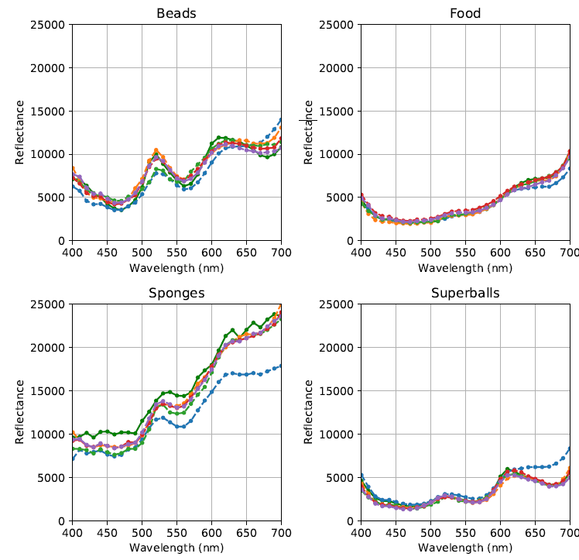
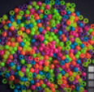
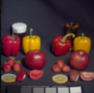
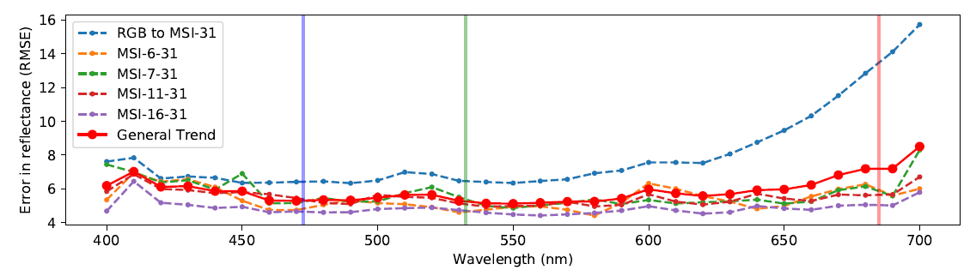
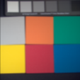
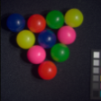
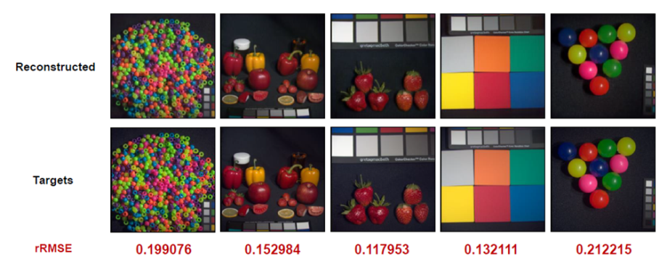


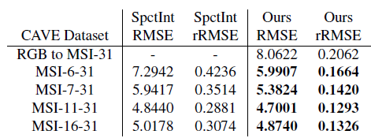
Results
From MSI/RGB to MSI
For more information, please visit our poster.
We’ll share more results & insights!
Domain gap
RMSE between reconstructed and ground truth images
From MSI to RGB
Within 2% error

