Slide 1
SurReal: Frechet Mean and Distance Transform for Complex-Valued Deep Learning
Rudrasis Chakraborty, Jiayun Wang, and Stella X. Yu

Slide 2
Introduction
We develop a novel deep learning architecture for naturally complex-valued data, which is often subject to complex scaling ambiguity.
With the polar form of a complex-valued number, the general group (G) that acts in this space is the product of planar rotation and non-zero scaling.
This allows us to develop
a) a convolution using weighted Fréchet mean (wFM) on a Riemannian manifold (equivariant to G).
b) a fully connected operator using the distance to the wFM (invariant to G).
4. On MSTAR data, our model achieves 98% target classification accuracy with only 9% of the parameters of the baseline model.

Slide 3
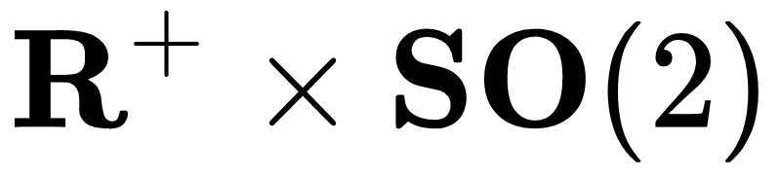


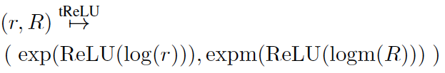
Key Components of our model
Represent complex numbers as
Define convolution as
Where,
3. Define tReLU as

Slide 4
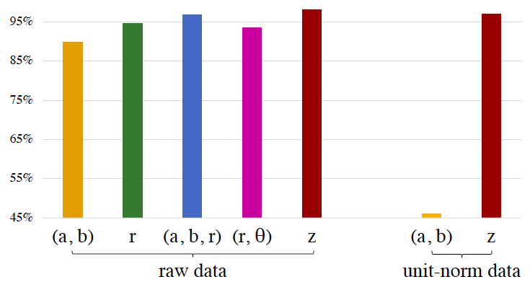
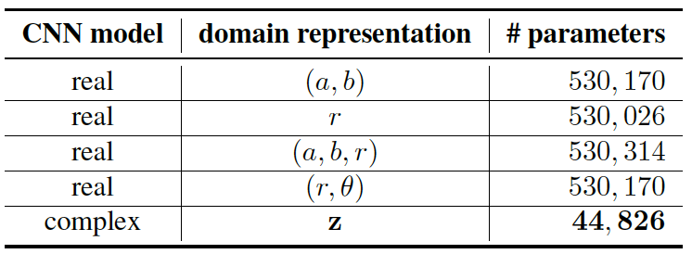
Experimental Results

Slide 5


